Slide 1
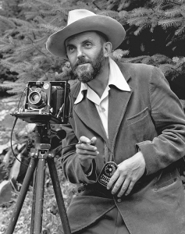
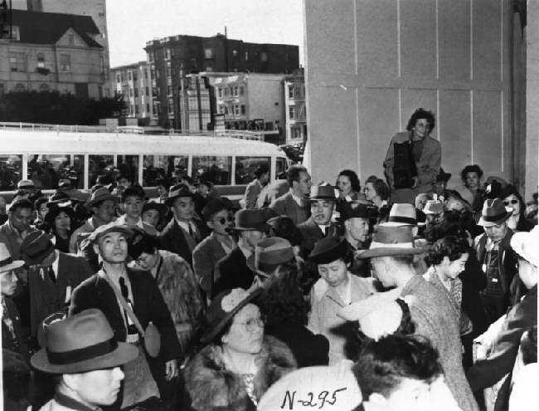
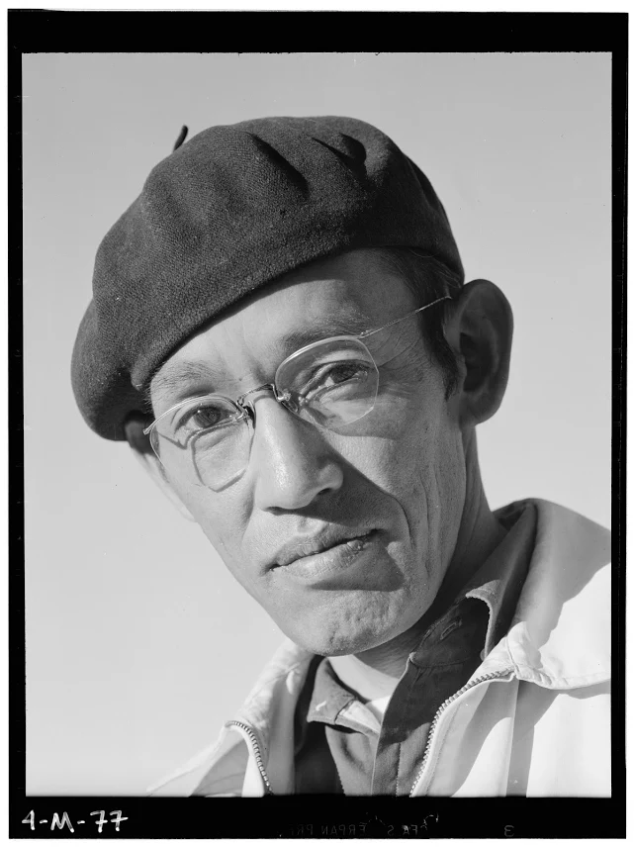
QFT+TPS Mashup = Student Driven Inquiry A Tale of 3 Lenses: Revealing the Stories of Primary Sources Through Questioning
Adams
Lange
Miyatake
Sarah Westbrook, Right Question Institute
Dr. Ann Canning, TPS Eastern Region
Melissa Lawson, Folsom Middle School
TPS ER Virtual Conference, June 16, 2020
Notes:
1:15-1:16 Barb introduces session
1:16-1:18 Sarah and Ann do Intros and Housekeeping
Ann: welcome, thank you for being here, we’re so excited, the journey began 2 sentence intro of the team, it all started in Basics, what we’ve learned from Melissa’s students has just blown us away, when you give students the right to ask their own questions, it is just so much more meaningful

Slide 2
Today’s Objectives
Experiment with a new inquiry model, the QFT+TPS Mashup in Zoom breakout rooms with a facilitator
Observe photographs taken by Toyo Miyatake, Ansel Adams, and Dorothea Lange to tell the same story
Ask questions about primary sources, lenses, and storytelling
Explore a real life classroom example
Share reflections about the Japanese American Internment and the QFT+TPS Mashup process
Notes:
1:16-1:18 Housekeeping
Facilitators: Thank you to Gay, Jenn, Josh from TPS Eastern Region and Katy, Andrew, Connie from The Right Question Institute who will be facilitating our breakout sessions

Slide 3
“There can be no thinking without questioning—no purposeful study of the past, nor any serious planning for the future.”
– David Hackett Fischer
University Professor Emeritus of History, Brandeis University
Notes:
1:18-1:25 framing

Slide 4
“Libraries allow children to ask questions about the world and find the answers. And the wonderful thing is that once a child learns to use a library, the doors to learning are always open.”
– Laura Bush
Educator & Former First Lady of the United States
Notes:
1:18-1:25 framing

Slide 5
And yet, not all students ask questions
Notes:
Questioning skill and frequency affected by:
Age
Setting
Socio-economic status and family income
Gender
Academic achievement
Young children ask more questions than older children (and adults)
Children as more questions at home than they do at school
Children from households in higher income brackets ask more questions than those in lower income brackets
High-scoring students ask more questions than low-scoring students
In some settings, boys ask more questions than girls
Teachers ask more questions than students
Tizard, B., Hughes, M., Carmichael, H., & Pinkerton, G. (1983). Children’s questions and adults’ answers. Journal of Child Psychology and Psychiatry, 24, 269-281.
Girls (mean age 3 years 11 months) from working class and middle class families asked 24 and 29 questions per hour at home, respectively. At school, these same girls asked on average 1.4 and 3.7 questions per hour (working and middle class, respectively)
Dillon, 1988, p. 199
Differences in question asking by income:
Tizard, B., Hughes, M., Carmichael, H., & Pinkerton, G. (1983). Children’s questions and
adults’ answers. Journal of Child Psychology and Psychiatry, 24, 269-281.
Sully, 1896
Harris, 2012

Slide 6
Deliberate work on teaching and practicing the skill of questioning can change those dynamics
Notes:
1:18-1:25

Slide 7
The QFT, on one slide…
Ask as many questions as you can
Do not stop to discuss, judge or answer
Record exactly as stated
Change statements into questions
Question Focus
Produce Your Questions
Follow the rules
Number your questions
Improve Your Questions
Categorize questions as Closed or Open-ended
Change questions from one type to another
Strategize
Prioritize your questions
Action plan or discuss next steps
Share
Reflect
Closed-Ended:
Answered with “yes,” “no” or one word
Open-Ended: Require longer explanation
Source: The Right Question Institute rightquestion.org
Notes:
1:18-1:25

Slide 8
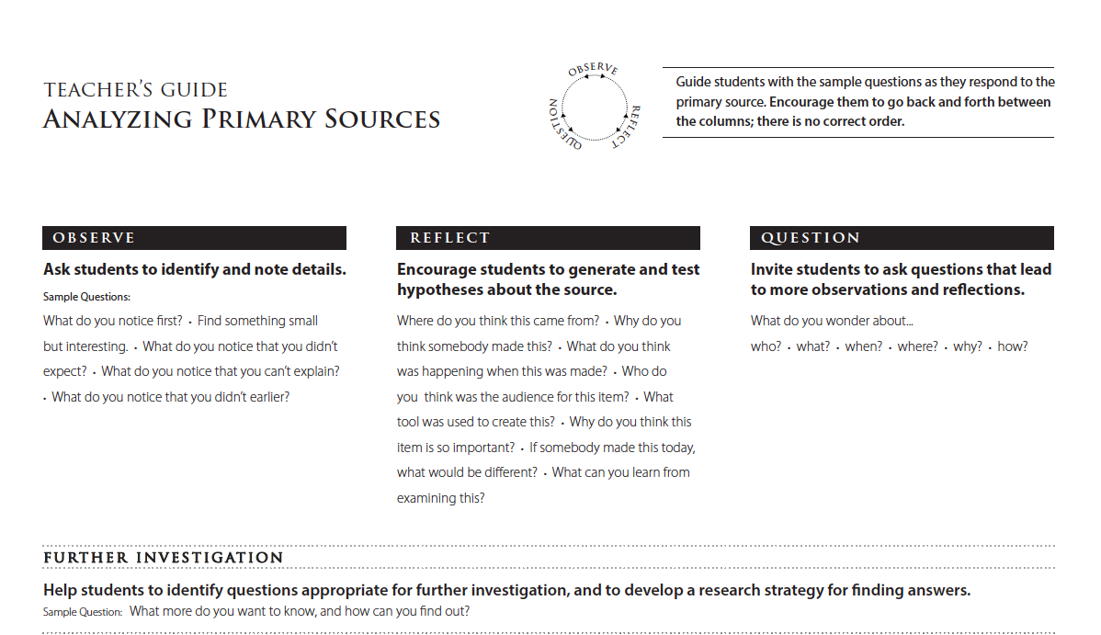
Notes:
1:18-1:25 Ann and Sarah provide framing for the session. On this slide point out the sentence at the top right about no correct order.

Slide 9
”If it ain’t broke…” why mash it up?
Every child asks questions (and practices an essential skill for learning and for life)
Student questions drive the full primary source analysis and further investigations
“What comes next? What now?” By combining processes, we can better move into next steps, further investigation, and initial research.
Each process cements the other
We get to learn from and strengthen each other
Notes:
1:18-1:25

Slide 10
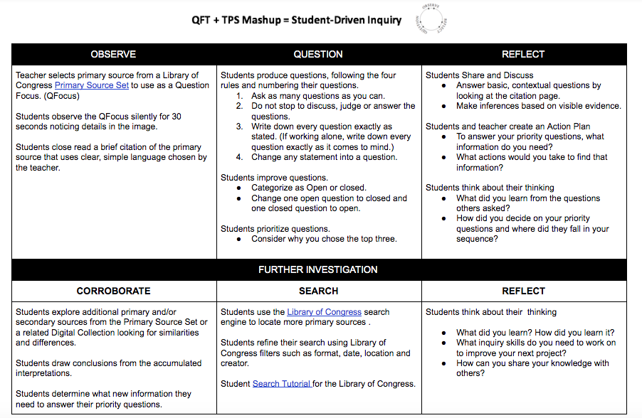
Notes:
1:18-1:25 (Slides 2-3-4-5) Ann and Sarah provide framing for the session.

Slide 11
Directions for Breakout Rooms
Zoom breakout rooms will automatically start and end; you will be moved automatically and do not need to click anything
Your facilitator will guide the process; you’ll do the active, collaborative work and intellectual heavy-lifting!
You will be able to participate via Zoom (chat & audio)and Padlet
Participate as yourself; no need to pretend to be a student
We’ll have about 25 minutes before breakout rooms close and we come back to the main room to debrief. It will be a quick taste of the process.
Notes:
1:25-26 Directions and set up
1:26-1:53 ish (ok if we run 1-2 min over Break Out Rooms
6 Small groups with a facilitator will test out the Mashup model with one primary source

Slide 12
Large Group Sharing
Break-out Room Report Back to Main Room
Could one person from each breakout room type in the chat box:
What caption, sentence or key question best summarizes the story or lens your group investigated today?
Notes:
1:53-2:03 Back to Main Room
Reflect and discuss as a whole group
Ann and Sarah share all of the primary sources (on previous slide) that different groups looked at and a couple tid-bits about each photographer.
Each break-out group shares a caption/summary.
Ask people to reflect in chat box.

Slide 13
The Student Question that Started the Deep Dive: “Why didn’t they resist?”
Notes:
1:53-2:03

Slide 14
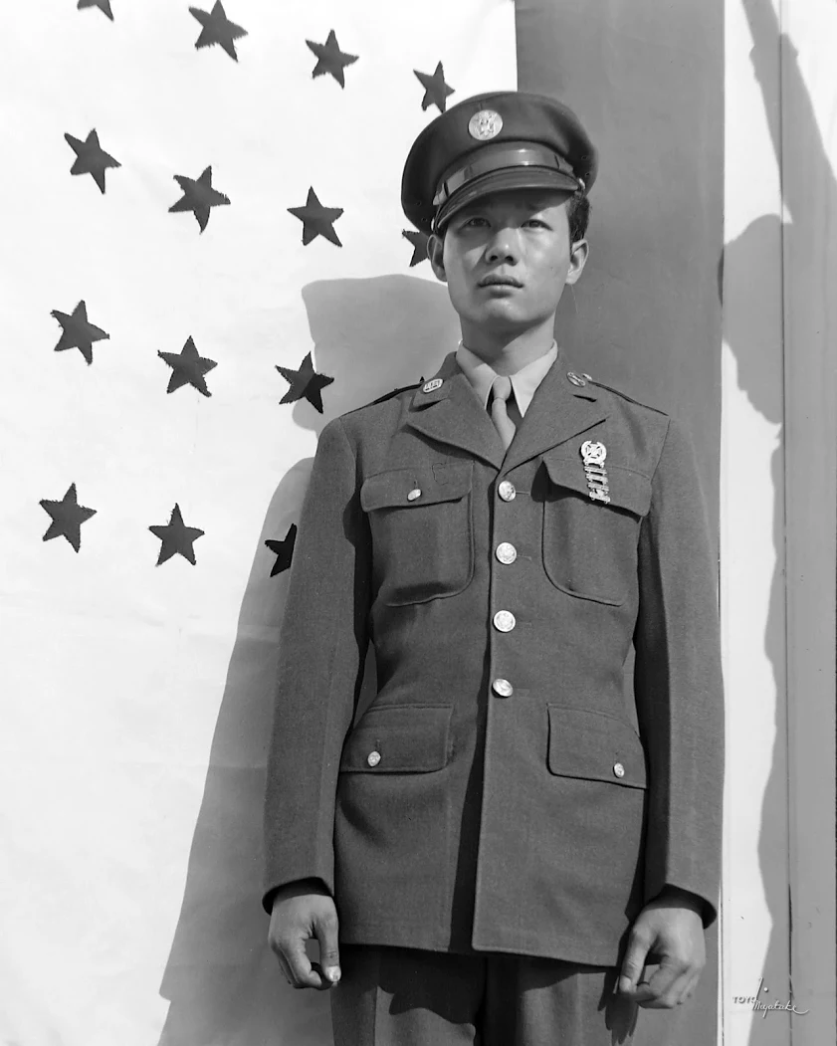
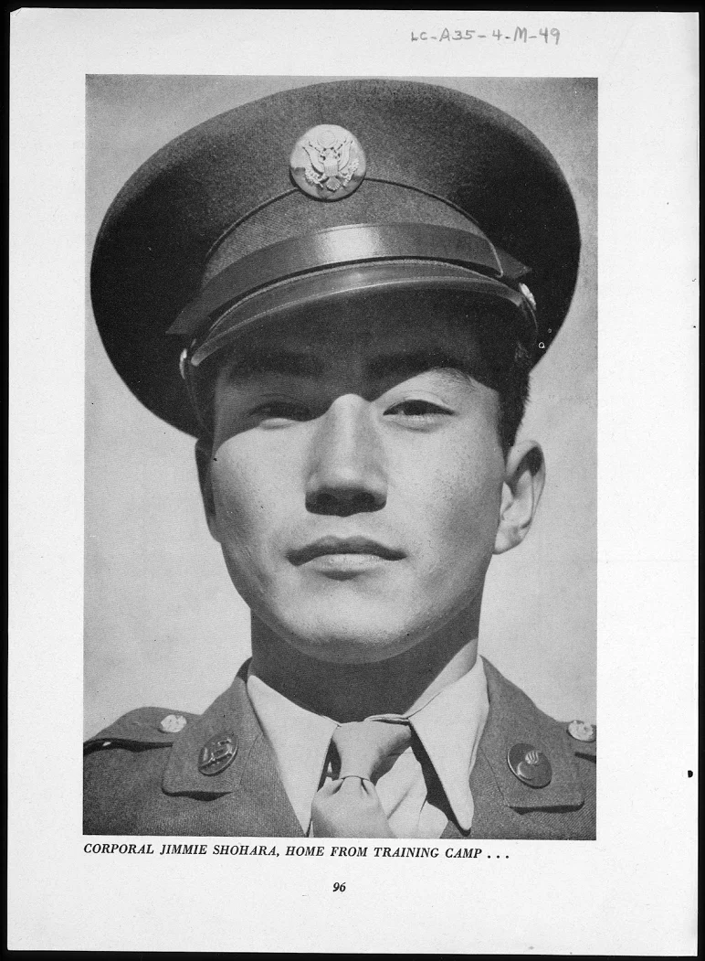
Breakout Room Mashups
Toyo Miyatake, 1943.
Copyright Toyo Miyatake Studios, reproduced with permission
Ansel Adams, 1943.
http://lcweb2.loc.gov/cgi-bin/ampage?collId=gdc3&fileName=scd0001_20020123001bfpage.db&recNum=82
Notes:
1:53-2:03 ish show the primary sources that each group was looking at and read out the captions from the chat box

Slide 15
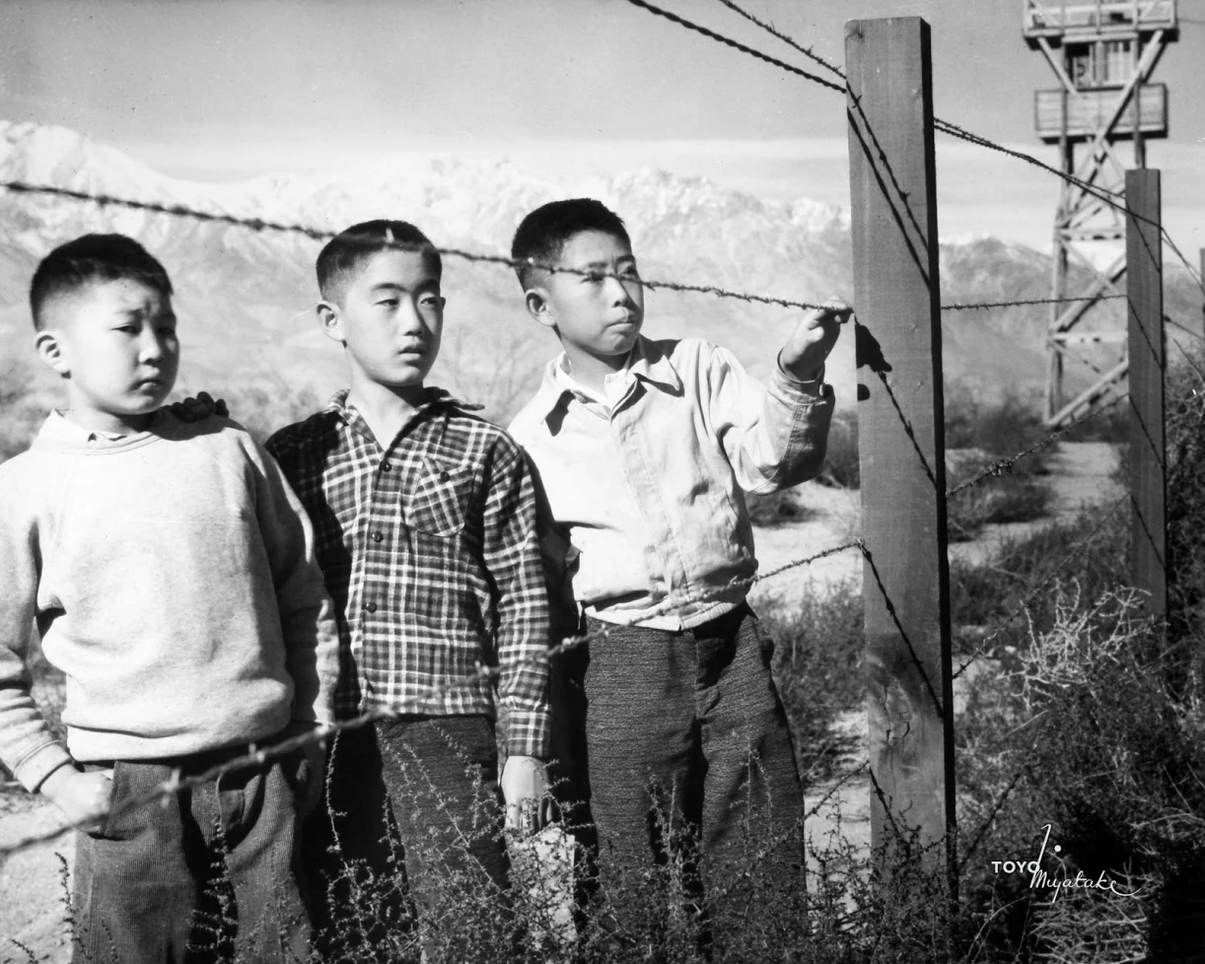
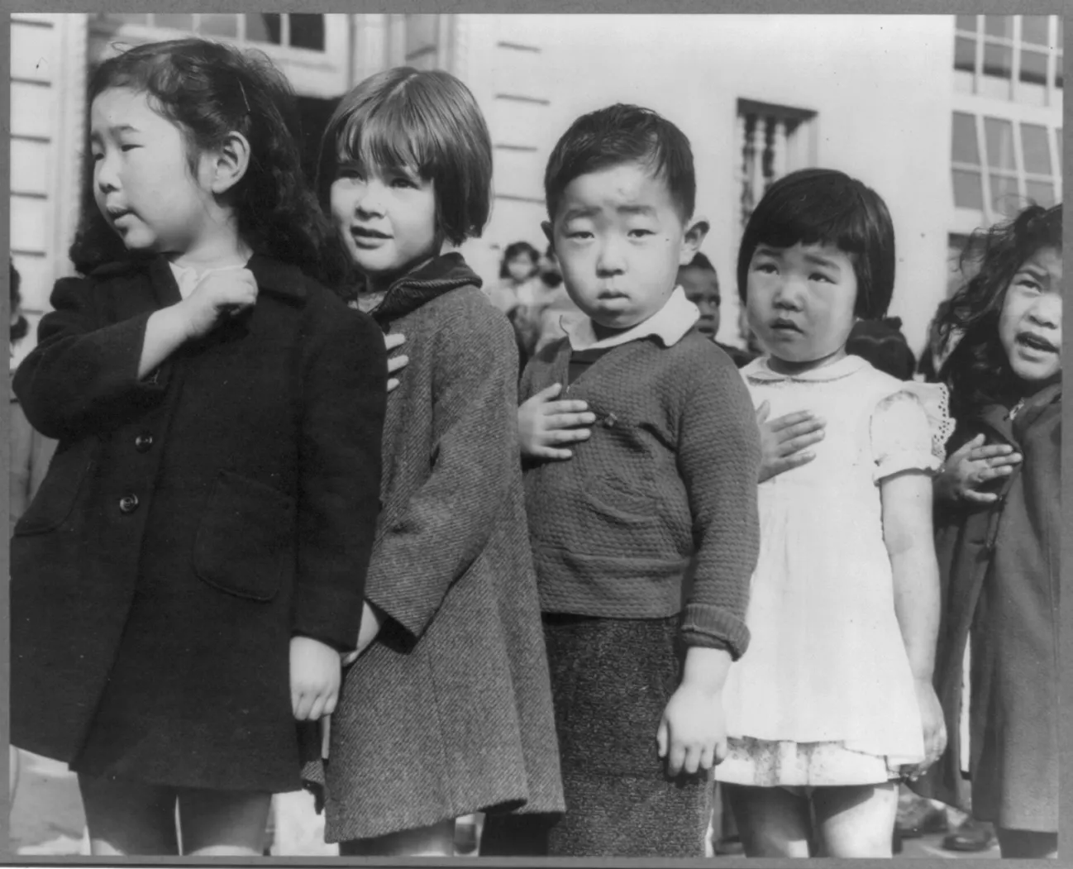
Toyo Miyatake, 1943. Manzanar War Relocation Center.
Copyright Toyo Miyatake Studios, reprinted with permission.
Dorothea Lange, April1942, San Francisco.
Retrieved from the National Archives: https://catalog.archives.gov/id/536439
Notes:
1:53-2:03

Slide 16
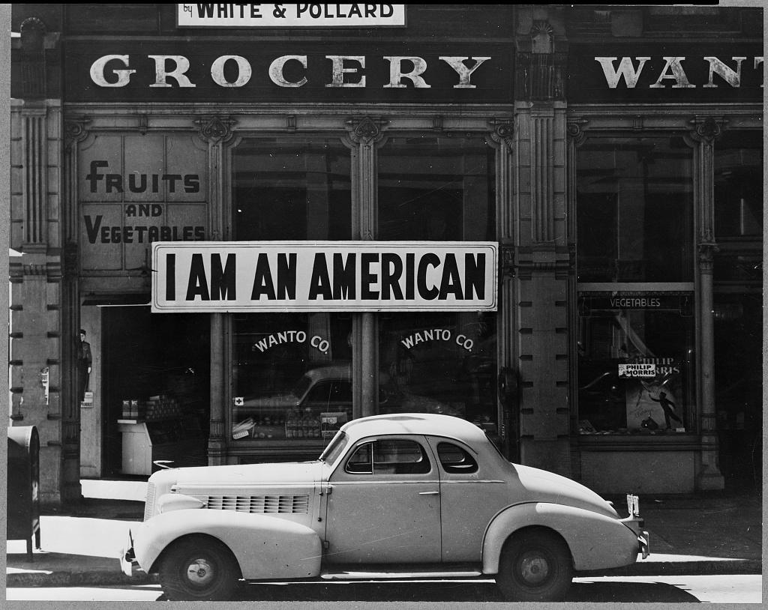
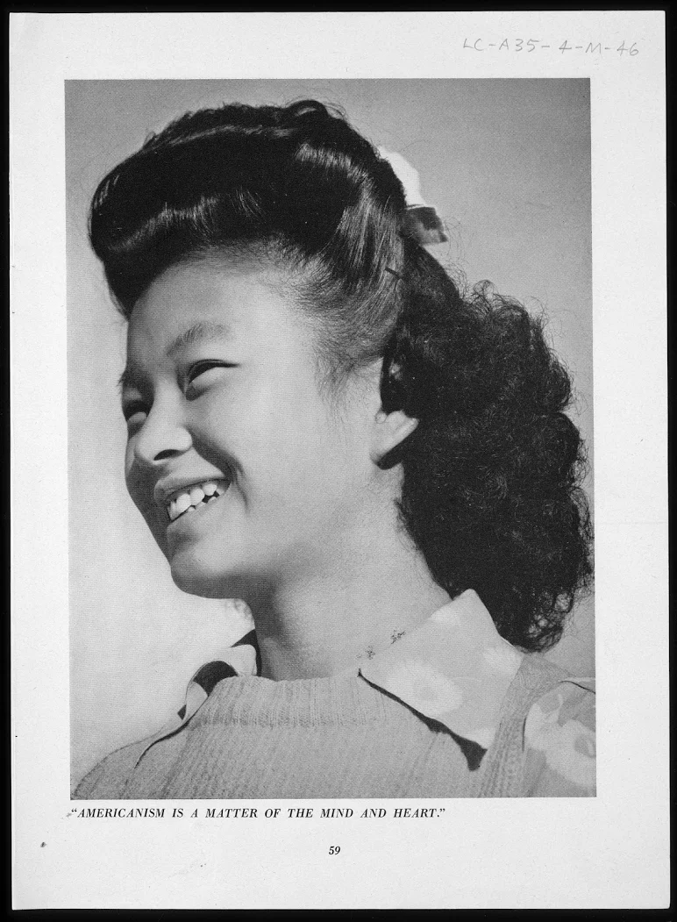
Dorothea Lange, 1942, Oakland, CA.
Retrieved from: the Library of Congress https://www.loc.gov/pictures/resource/cph.3a24566/
Ansel Adams, 1943, Manzanar War Relocation Center. Caption: “Americanism is a matter of the mind and heart.”
Retrieved from the Library of Congress: http://lcweb2.loc.gov/cgi-bin/ampage?collId=gdc3&fileName=scd0001_20020123001bfpage.db&recNum=50
Notes:
1:53-2:03

Slide 17
A Look Inside the Mashup Model
Notes:
2:03-2:05

Slide 18
Notes:
2:03-2:05 Put the slide of the model back up. Review the work we did going through the top 3 columns and Corroborate in the bottom 3 columns and segue into Melissa’s student work discussing the lower tier for Further Investigation when you have 6 class periods or 3 hours instead of 1.
Ann talks about this

Slide 19
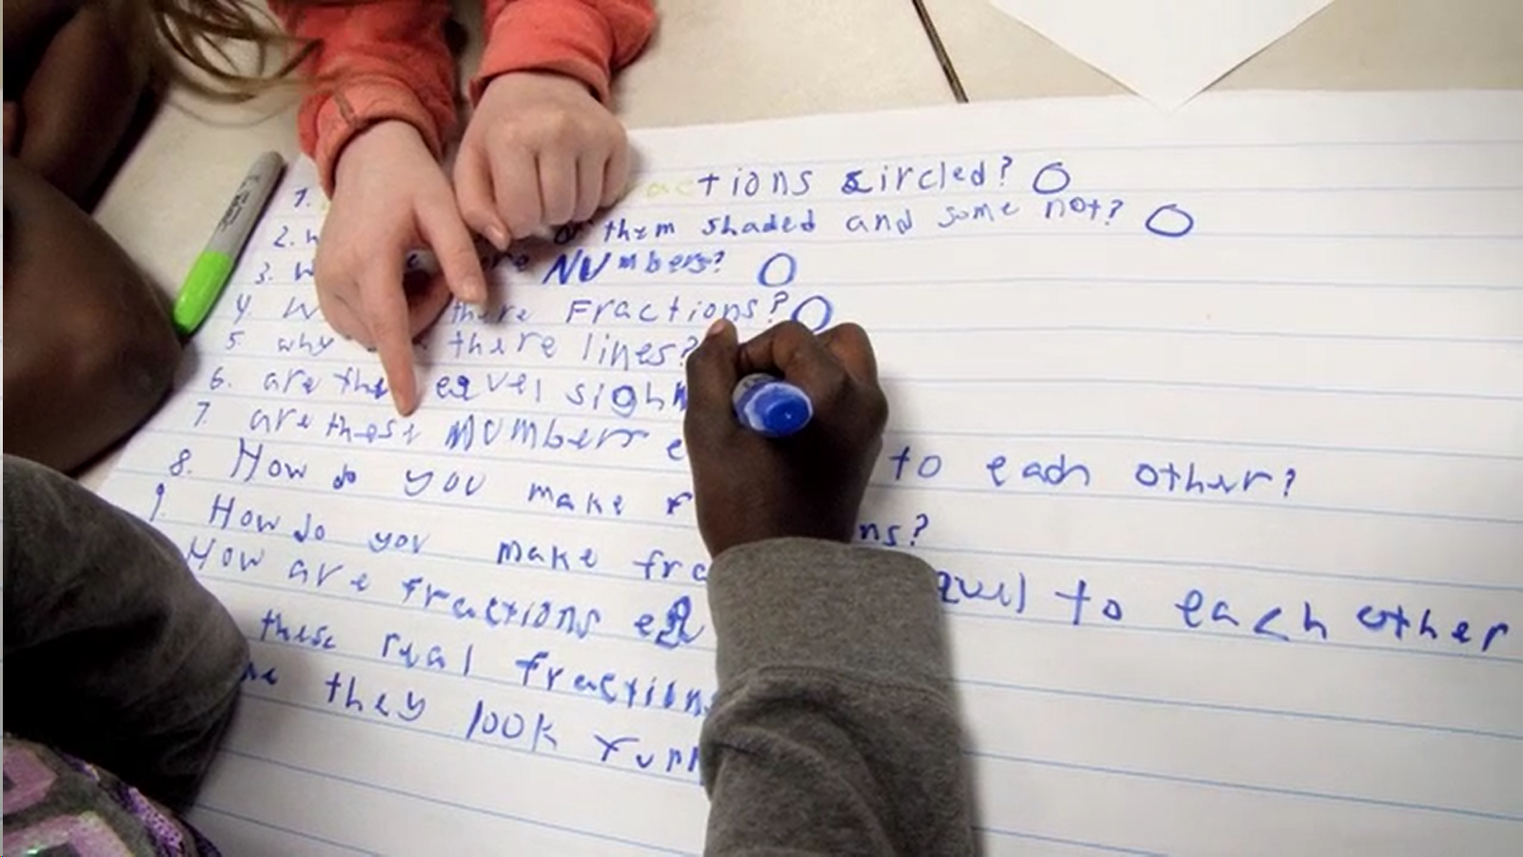
What does it look like in a (virtual) classroom?

Slide 20
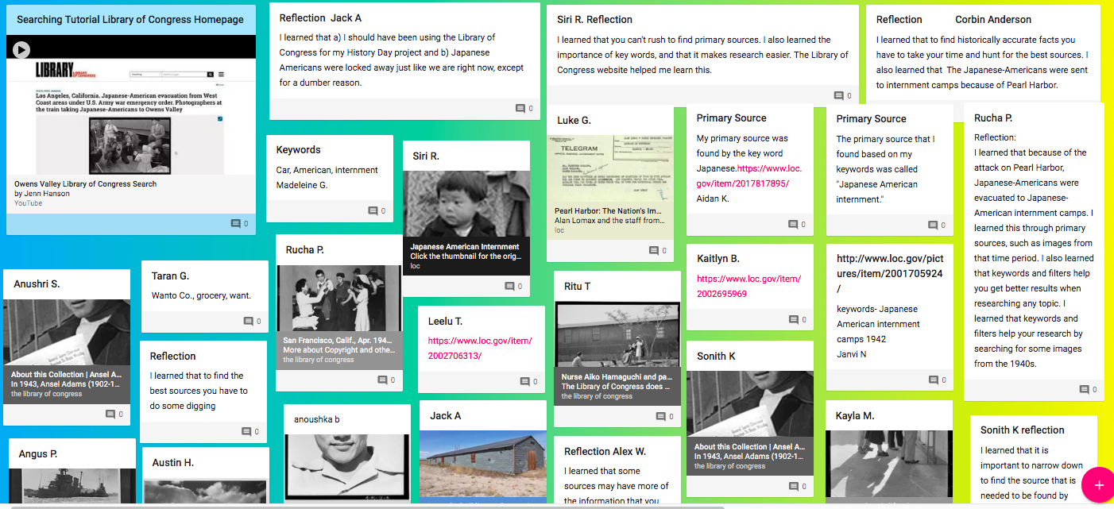
Padlet #3 Searching for Answers to Priority Questions at LOC.gov
Melissa Lawson’s 7th Grade Folsom Middle School
Notes:
2:05-2:10 Ann introduces Melissa and interviews her about her use of the MASHUP.
Interview Questions:
When and why did you use the QFT+TPS Mashup with your students?
Had your students worked with QFT or TPS before this project?
What student questions about the Manzanar primary sources and reflections about the QFT+TPS process stood out for you?

Slide 21
Final Reflection
What do you understand differently now about the story of Japanese American Internment specifically or about ‘who tells your story’ more generally?
What questions do you have now about lenses, primary sources, and storytelling?
What about these primary sources resonates with you today?
Emails Welcomed!
sarah.westbrook@rightquestion.org Sarah Westbrook
acanning@waynesburg.edu Ann Canning
MLawson@fcusd.org Melissa Lawson
Notes:
2:10-2:14 Ask participants to silently reflect on these 3 questions and then share in the chat box or by using their mike. Remind participants that this slide show and the Mashup Model will be in the Conference folder for this session.Ann will start the discussion.

Slide 22
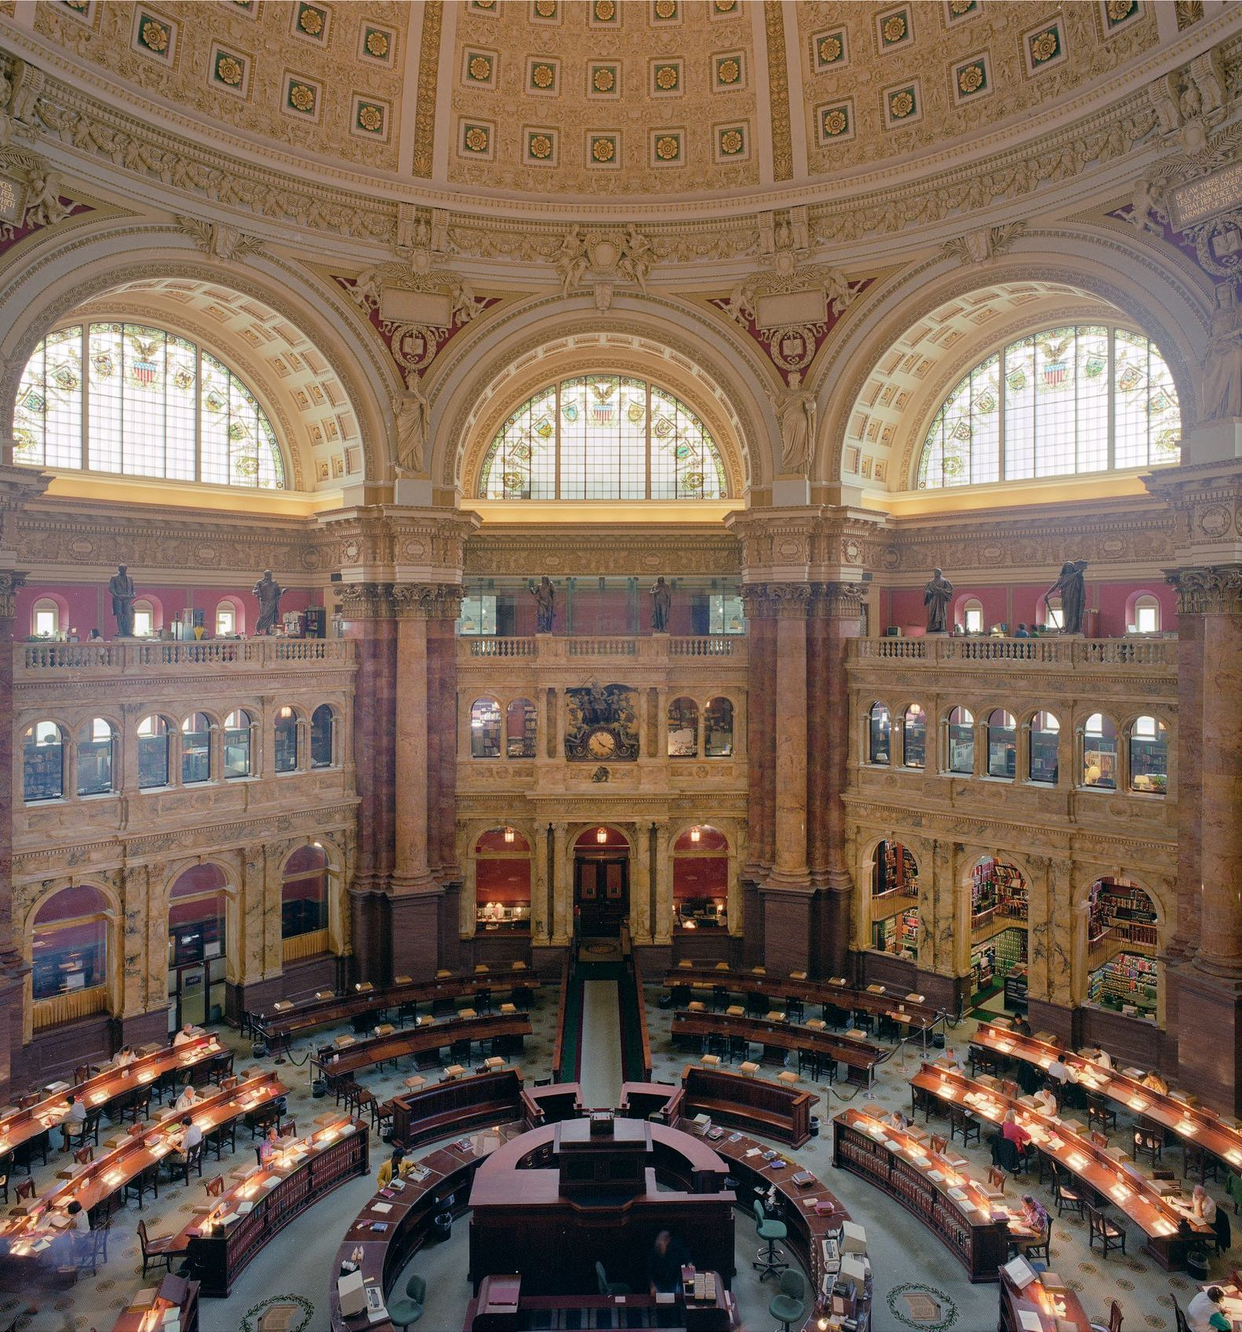
Thank you!
(hope to see you in THIS room soon!)
[Photograph] Retrieved from the Library of Congress, https://www.loc.gov/item/2011635726/.

Slide 23
Make Your Own Padlet
Access the QFT Padlet Template Here:
https://padlet.com/sarahwestbrook1/QFT2
Access a quick guide to using Padlet:
https://rightquestion.org/remote-learning-resources/

Slide 24
Use and Share QFT Resources
The Right Question Institute offers materials through a Creative Commons License. You are welcome to use, adapt, and share our materials for noncommercial use, as long as you include the following reference:
“Source: The Right Question Institute (RQI). The Question Formulation Technique (QFT) was created by RQI. Visit rightquestion.org for more information and free resources.”
Access today’s materials (and more!): http://rightquestion.org/events/

