Slide 1
Asking More (and Better) Questions: Introduction to the Question Formulation Technique (QFT)
Sarah Westbrook
Director of Professional Learning
The Right Question Institute
Cambridge, MA
CCSSO FAST Group Summer Meeting
Thursday, June 18, 2020

Slide 2
There are 2 icons you will see in this session:
This means that you should be thinking or working on the task assigned
This means get ready to use your chat box to share some of your work

Slide 3
Who is in the room?

Slide 4
Today’s Agenda
Why Spend Time on Teaching the Skill of Question Formulation?
Collaborative Learning with the Question Formulation Technique (QFT)
Explore Real Classroom Examples & Applications
Why is Question Formulation Important Now?
Discuss Applications to Your Ongoing Work with Formative Assessment and Equity Goals
Q&A

Slide 5
We’re Tweeting…
@RightQuestion
@SarahRQI
#QFT

Slide 6
Access Today’s Materials and All of Our Free Resources
https://rightquestion.org/events/
Classroom Examples
Instructional Videos
Planning Tools & Templates

Slide 7
Use and Share These Resources
The Right Question Institute offers materials through a Creative Commons License. You are welcome to use, adapt, and share our materials for noncommercial use, as long as you include the following reference:
“Source: The Right Question Institute (RQI). The Question Formulation Technique (QFT) was created by RQI. Visit rightquestion.org for more information and free resources.”

Slide 8
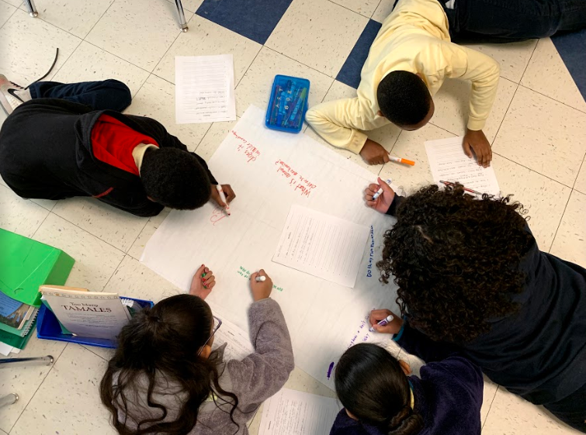
Why spend time teaching the skill of question formulation?

Slide 9
Honoring the Original Source: Parents in Lawrence, Massachusetts, 1990
“We don’t go to the school because we don’t even know what to ask.”

Slide 10
"There is no learning without having to pose a question."
- Richard Feynman
Nobel Laureate, Physics, 1965

Slide 11
“We must teach students how to think in questions, how to manage ignorance.”
– Stuart Firestein
Former chair, Department of Biology,
Columbia University

Slide 12
College Presidents on What College Students Should Learn
“The primary skills should be analytical skills of interpretation and inquiry. In other words, know how to frame a question.”
- Leon Botstein, President of Bard College
“…the best we can do for students is have them ask the right questions.”
- Nancy Cantor, Former Chancellor of University of Illinois
The New York Times, August 4, 2002

Slide 13
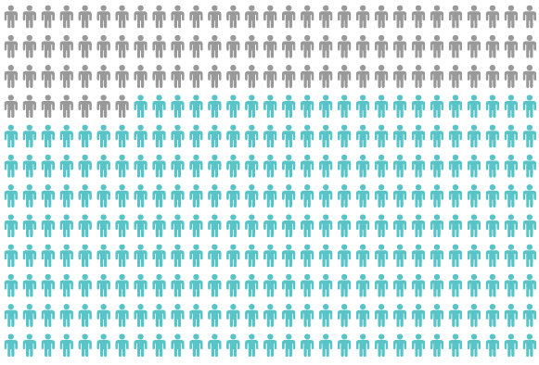
Yet, Only 27% of Graduates Believe College Taught Them How to Ask Their Own Questions
Alison Head, Project Information Literacy at University of Washington, 2016

Slide 14
But, the problem begins long before college…

Slide 15
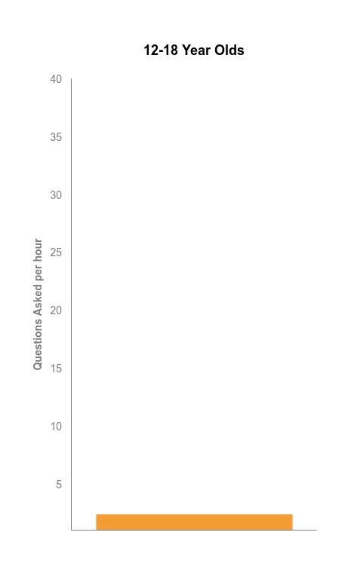
Question Asking Declines with Age
Tizard, B., Hughes, M., Carmichael, H., & Pinkerton, G. (1983).
Dillon, J. T. (1988).
Notes:
First Graph:
Tizard, B., Hughes, M., Carmichael, H., & Pinkerton, G. (1983). Children’s questions and adults’ answers. Journal of Child Psychology and Psychiatry, 24, 269-281.
Girls (mean age 3 years 11 months) from working class and middle class families asked 24 and 29 questions per hour at home, respectively. At school, these same girls asked on average 1.4 and 3.7 questions per hour (working and middle class, respectively)
Need to look into the article to see what age at school.
Second
Differences in question asking by income:
Tizard, B., Hughes, M., Carmichael, H., & Pinkerton, G. (1983). Children’s questions and
adults’ answers. Journal of Child Psychology and Psychiatry, 24, 269-281.
This research study examines two groups of children, one from middle class families and one from working class families, to explore socioeconomic status differences in question-asking behavior at home and at school.

Slide 16
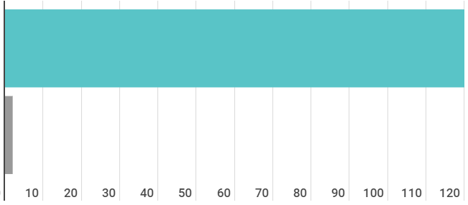
Question Asking in School
Who’s asking questions over the course of an hour?
Educators
Students
Dillon, 1988, p. 199

Slide 17
We can work together on changing these dynamics

Slide 18
We Are Not Alone
More than 1 million classrooms worldwide

Slide 19
What happens when students do learn to ask their own questions?

Slide 20
Research Confirms the Importance of Questioning
Self-questioning (metacognitive strategy):
Student formulation of their own questions is one of the most effective metacognitive strategies
Engaging in pre-lesson self-questioning improved students rate of learning by nearly 50% (Hattie, p.193)
John Hattie
Visible Learning: A Synthesis of Over 800
meta-Analyses Relating to Achievement, 2008
Notes:
UC Davis Research Linking Curiosity to Memory (UC Davis) 2014
The Fullerton Longitudinal Study (FLS), a 30-plus year study of the development of giftedness across various points in time conducted by Adele and Allen Gottfried of California State University ”This finding has strong implications for the development of STEM considering that curiosity is a fundamental predictor of the aspiration to become a scientist.”
S. von Stumm, B. Hell, T. Chamorro-Premuzic. The Hungry Mind: Intellectual Curiosity Is the Third Pillar of Academic Performance. Perspectives on Psychological Science, 2011 meta-analysis shows They found that curiosity did, indeed, influence academic performance. In fact, it had quite a large effect, about the same as conscientiousness. When put together, conscientiousness and curiosity had as big an effect on performance as intelligence.

Slide 21
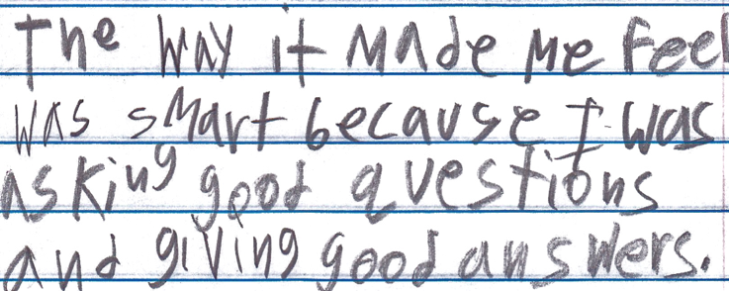
Student Reflection
“The way it made me feel was smart because I was asking good questions and giving good answers.”
-Boston 9th grade summer school student

Slide 22
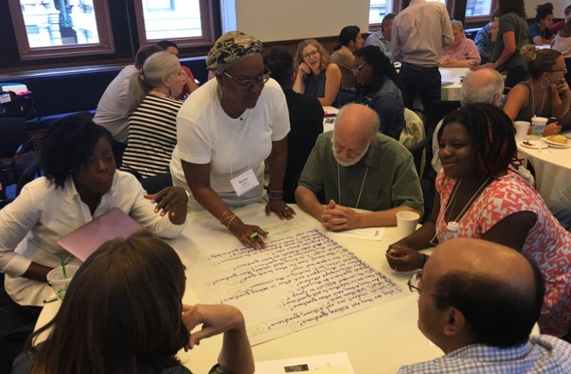
Collaborative Learning with the Question Formulation Technique (QFT)
Notes:
Now we’re going to work together on the problem of students not asking questions, by using the Question Formulation Technique.
The next 20 minutes or so will be highly participatory and of course we’re going to be putting you to work. You may want to get some paper or pull up a blank document on your computer screen now. And remember, watch out for the chat box icon. I will tell you when you need to type into it.
The timing may be a little quick, so don’t worry if you haven’t completed every step; we’re more giving you a taste of the whole process. The rest of this course will go far more in depth on each piece.” we will be moving you quickly through an experience to demonstrate how we go through the process, but will be rushing to make sure there is time for your questions at the end." This is giving you a taste

Slide 23
The Question Formulation Technique (QFT)
Individuals learn to:
Produce their own questions
Improve their questions
Strategize on how to use their questions
Reflect on what they have learned and how they learned it

Slide 24
Rules for Producing Questions
1. Ask as many questions as you can
2. Do not stop to answer, judge, or discuss
3. Write down every question exactly as stated
4. Change any statements into questions
Notes:
NOTE THAT THEY ARE Working ALONE rather than in a group: Say something about not judging YOURSELF or changing your wording as it comes out
Think about what will be difficult to follow for you. Pause.
DO NOT ASK THEM TO SHARE!!!
Usually, people say that it is difficult not to stop to answer and judge.

Slide 25
Produce Questions
Ask Questions
Follow the Rules
Ask as many questions as you can.
Do not stop to answer, judge, or discuss.
Write down every question exactly as it was stated.
Change any statements into questions.
Number the Questions

Slide 26
Question Focus
Some students are not asking questions.
→Now, ask questions. Number the questions. Follow the rules.
Notes:
Take a minute to just observe
give directions and pause/time. 3 Min. Give HALFWAY WARNING.
MAKE SURE TO WRITE THEM DOWN BECAUSE YOU NEED THEM FOR ALL THE NEXT STEPS.
Put the 4 rules in the chat box.

Slide 27
Categorize Questions: Closed/Open
Definitions:
Closed-ended questions can be answered with a “yes” or “no” or with a one-word answer.
Open-ended questions require
more explanation.
Directions: Identify your questions as closed-ended or open-ended by marking them with a “C” or an “O.”
Notes:
Read slide. Pause/time. 11/2 Minutes. DO NOT ASK THEM TO SHARE.

Slide 28
Discuss
Closed-ended Questions
Advantages
Disadvantages

Slide 29
Discuss
Open-ended Questions
Advantages
Disadvantages
Notes:
The point here is that the closed ended questions are equally useful as open-ended!!!

Slide 30
Improve Questions
Take one closed-ended question and change it into an open-ended question.
Take one open-ended question and change it into a closed-ended question.
Closed
Open
Open
Closed
Notes:
Read Slide. 1 ½ Minutes. Pause & Time. DO NOT ASK THEM TO SHARE.

Slide 31
Prioritize Questions
Review your list of questions
Choose three questions that you are most curious to discuss and think about further.
While prioritizing, think about your Question Focus.
Then, think about why you chose those questions.
After prioritizing, use the chat box to share a priority question or two.
Notes:
Read the slide. Pause and Time. 1 ½ min.
“Share just ONE of your priority questions.”
You should type in the chat box now.

Slide 32
Add and Refine
Add and Refine
After reading the questions that others posed, think: what new questions do you have? Is there one you would steal, build upon, or ask in a slightly different way?
Ask at least one new question and add it to the bottom of your list as a new question.
Then, share it in the chat box.

Slide 33
Action Plan
Moving from priority questions into action steps.
In order to answer your priority questions:
What do you need to know? Information
What do you need to do? Tasks
Write down a couple ideas you have.
Notes:
Read the slide. Pause & Time. 2 minutes to write a couple notes. DO NOT ASK TO SHARE
Tasks can include investigations.
Remember to confine yourself to what we could reasonably do with the materials in our classroom.

Slide 34
Share
Using the Chat Box, please share:
One idea you had from your action plan
- and -
The numbers of your three priority questions in your original sequence (For ex: “2, 4, 7 out of 8 total”)

Slide 35
Reflect
What did you learn?
How did you learn it?
After reflecting, use the chat box to share your response to ONE of the questions above.

Slide 36
A Look Inside the Process

Slide 37
The QFT, on one slide…
Ask as many questions as you can
Do not stop to discuss, judge or answer
Record exactly as stated
Change statements into questions
Question Focus
Produce Your Questions
Follow the rules
Number your questions
Improve Your Questions
Categorize questions as Closed or Open-ended
Change questions from one type to another
Strategize
Prioritize your questions
Action plan or discuss next steps
Share
Reflect
Closed-Ended:
Answered with “yes,” “no” or one word
Open-Ended: Require longer explanation
Source: The Right Question Institute rightquestion.org
Notes:
Note the changes we made to PRIORITIZATION – could have done “the 3 questions that lend themselves to research” or “3 questions that would help us learn more about topic x”
It is NOT just a question brainstorming process
Say something about the LARGER POINT of the PROCESS—it is about changing the way that school is played

Slide 38
Three thinking abilities
with one process

Slide 39
Thinking in many different directions
Divergent
Thinking

Slide 40
Narrowing Down, Focusing
Convergent
Thinking

Slide 41
Thinking about Thinking
Metacognition
Notes:
Self-directed learners

Slide 42
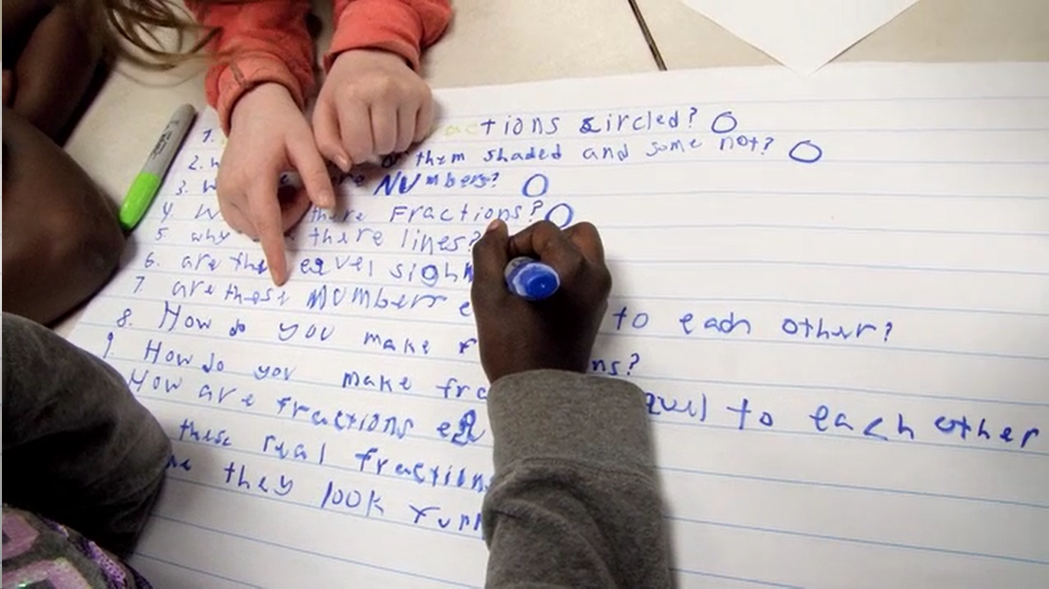
Exploring Classroom Examples

Slide 43
Classroom Example: 4th Grade
Teacher: Deirdre Brotherson, Hooksett, NH
Topic: Math unit on variables
Purpose: To engage students at the start of a unit on variables and assess their prior knowledge

Slide 44
Question Focus
24 = ☺ + ☺ + ☺

Slide 45
Student Questions
Why is the 24 first?
What do the smiley faces mean?
Why are there 3 smiley faces?
How am I suppose to figure this out?
Is the answer 12?
Can I put any number for a smiley face?
Do three faces mean something?
Do the numbers have to be the same because the smiley faces are the same?
What numbers will work here?
Does it mean 24 is a really happy number?
Can we replace each smiley face with an 8?
Do any other numbers work?
Can we do this for any number?
Does it always have to be smiley faces?
Do we always have to use three things?

Slide 46
Next Steps with Student Questions
Questions were posted on classroom walls.
Students crossed off the questions they answered during subsequent lessons.
Teacher returned to student questions at the end of the unit to discuss with students what they learned and what they still want to know.

Slide 47
Classroom Example: 7th Grade Life Science
Teacher: Angela Miklavcic Brandon, Chicago, IL
Topic: Introduction to Animal and Plant Cells
Purpose: To find out what the students already know and generate questions to investigate during the unit.

Slide 48
Question Focus
"The living cell is the most complex system of its size known to mankind."

Slide 49
Student Questions [One group’s questions]
How big is the cell? (O) → Are cells big? (C)
How long have we known cells?
What is a cell? (C) → What does it do? (O)
How many cells are in the body?
Does the cells change in a woman and man?
Are cells intelligent?
What do cells do?
Do cells help us survive?
Are there different types of cells?
How many different types of cells are there?
Do cells have different characteristics?
Can you see cells?
Where are cells located?
Are cells only in humans?
Do other things (besides animals + humans) have cells?
What conditions can cells live in?
Are cells only on earth?
Are cells in hair, in ears, feet, eyes?
What makes cells survive?
What makes a cell a cell?
What color is a cell?
Do cells have families?
Do cells die?
Do cells thrive in dying organisms? (C) → How do cells die if they do?

Slide 50
Next Steps with Students’ Questions
The teacher printed out their questions and every couple days throughout the unit students returned to them and crossed out ones that had been answered.
By the end most had crossed off all questions.
On the last day of class when students were finishing up projects at their own pace they could choose a question that was left and research it on their own.

Slide 51
Student Reflections
“I liked the question activity because it helped us generate questions that I don't think I ever would have really thought [of] asking.”
“I liked hearing other people’s questions because it was a good opportunity for me to make more questions in my head and then get even more curious about this cell.”

Slide 52
Virtual Classroom Example: 4th Grade Social Studies
Teacher: Alyssa Park, Gardnerville, NV
Topic: The Hoover Dam
Purpose: To analyze a primary source and launch a mini-inquiry – using Google Forms!

Slide 53
Question Focus
Library of Congress: https://www.loc.gov/resource/cph.3b07810/
Notes:
She told them: draw on what you know of these two texts

Slide 54
Question Focus…using Prezi!
Library of Congress: https://www.loc.gov/resource/cph.3b07810/
Notes:
She told them: draw on what you know of these two texts

Slide 55
Student Questions
1.Where is this?
2.Why is there a river?
3. Is it a desert?
4. Is it near the grand canyon?
5.When was this picture taken?
6.How did they take the picture?
7.Was it in the 1900's?
8.Where does the road lead to?
9.What is the road called?
10. Is the sculpture (or whatever it is) in the middle of the road a rock?
11.Where is the building located?
12.Do people live in that building?
13. Is it a work place?
14.Is there water at the bottom of the building?
15.Is the road from the last picture lead to the building?
16.How did they build that building?
17.How do people get to the top to the bottom?
18.Is the water falling from the rocks a waterfall?
19.Can people visit the building?
20.How does the water get there?

Slide 56
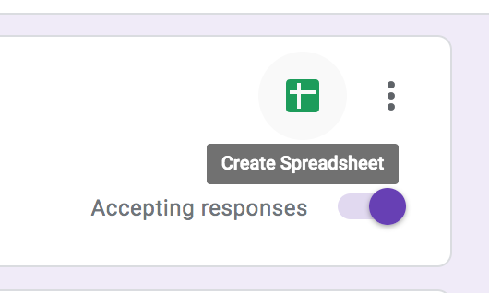
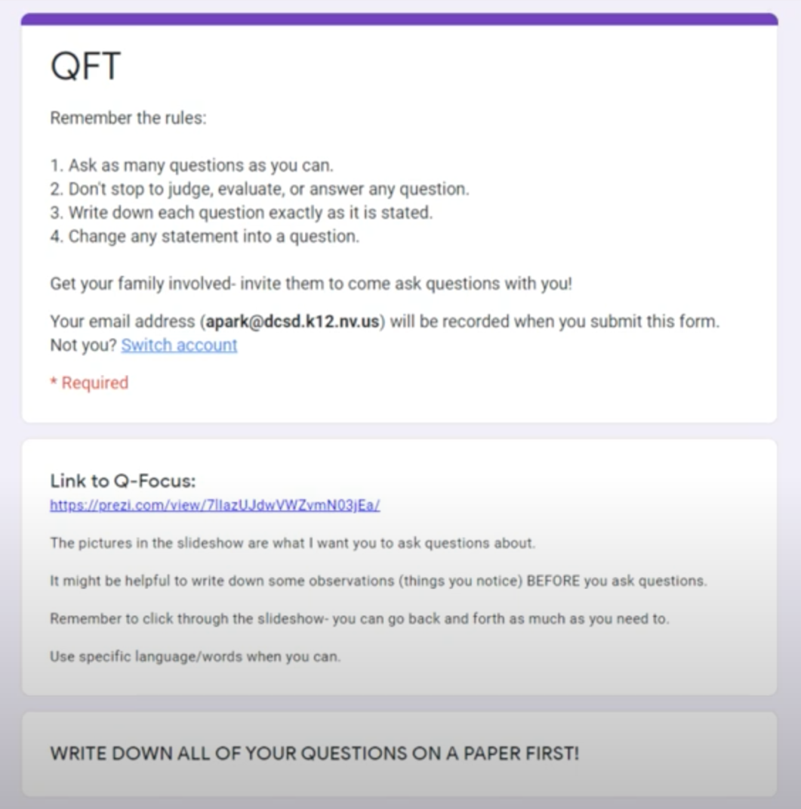
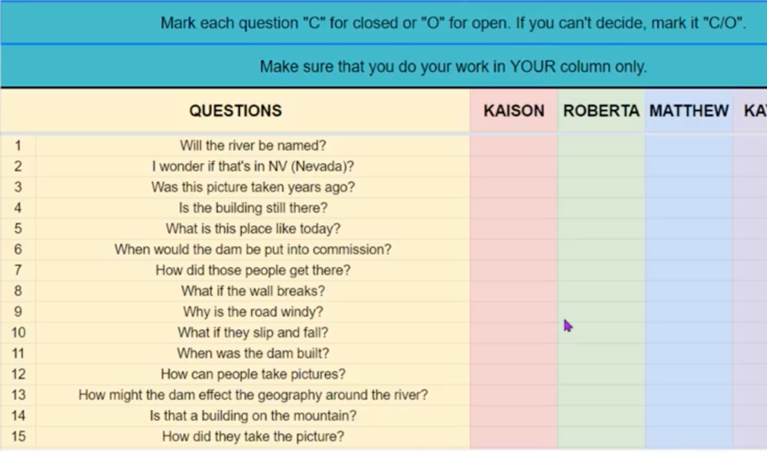
Student Questions…using Google Forms!
Students entered their questions in a google form, which populated a google sheet they could use to categorize their questions as open and closed.
Notes:
She made hers fancy and collaborative, but you don’t have to necessarily do that

Slide 57
Next Steps
Days 1-3 | Using google forms and google sheets
Ask & Improve Questions
Day 4
Gather Basic Information
Students picked 3 closed-ended questions to answer
Read from a collection of 4th grade, Hoover Dam books on Epic!
Shared answers in a collaborative google slide deck
Day 5
Prioritize Questions (Again!)
Pick from the whole class list: 3 questions you would need to answer to write a historical fiction story on the Hoover Dam.
Days 6 & 7
Further Research
They will spend time looking through a “playlist” of resources categorized by the major themes – how dams work, life during the great depression, etc. and answer their second set of priority questions.

Slide 58
Virtual Classroom Example: 7th Grade
Teacher: Melissa Lawson, Folsom, CA
Topic: Japanese American Internment during World War II
Purpose: To help students engage with primary sources to begin a research process. Students practiced analyzing a primary source and performing searches in the Library of Congress collections.

Slide 59
Question Focus
Lange, Dorothea. (1942) Oakland, CA, Mar. 1942.
A large sign reading "I am an American" placed in the window of a store on December 8, the day after Pearl Harbor. The store was closed following orders to persons of Japanese descent to evacuate from certain West Coast areas.
[Photograph] Retrieved from the Library of Congress, https://www.loc.gov/pictures/resource/cph.3a24566/.

Slide 60
Selected Questions
Why is the car there?
Who was the owner of the car?
Is that a BMW or something?
Where is this?
Who took the photograph?
Why is there a sign that says, I am an American?
Who is “I”?
What does "Wanto Co.," mean?
Who wrote the "I Am an American" sign?
Was the 'I am American' because the owner was of Japanese heritage and defending him/herself from prosecution? (after Pearl Harbor)
When the picture was taken, was the store open or closed?
Why was this picture taken?
What year is this from?
Who decided to close the store?
What happened to the store after this?
Did that store do well?
What happened to the Japanese Americans?
Did they ever get full fledged justice?

Slide 61
Asking and Answering via Padlet

Slide 62
Student Reflections
“I learned that we cannot draw conclusions just by looking at a picture once. You can look at it and ask questions to learn more. I am wondering if we can use this technique on other things.”
“Not only did I learn about the picture we were analyzing, but I learned that asking questions makes me want to think more and it makes me curious. Once I started asking questions and reading other peoples responses, I was very interested and curious about the questions that were posted.”
“I learned that Japanese Americans were locked away, just like we are now, just for a much stupider reason.”
“I learned that I should have been using this for my History Day paper.”

Slide 63
Make Your Own Padlet
Access the QFT Padlet Template Here:
https://padlet.com/sarahwestbrook1/QFT2
Access all of RQI’s Virtual Learning Resources:
https://rightquestion.org/remote-learning-resources/

Slide 64
Virtual Professional Learning Examples
Topic: Plans for the 2020-2021 School Year
Purpose: Engaging school and district staff in contingency planning around COVID-19 and the start of the school year via ZOOM and GoogleDocs

Slide 65
Question Focus
The 2020-2021 school year will begin with a blended learning environment.

Slide 66
Selected Participant Questions
What are our options?
What are the advantages of having students alternating days with eLearning on the other days?
Would we do a staggered start?
What role would eLearning play?
How will the model we choose impact our community if parents are also going back to work?
How much time do we need to allow for cleaning?
How could we utilize our buildings differently?
How do we work with parents who do not want to send their student to school?
How can we continue to support parents?
What if the Health Dept. makes decisions around closing our district?
How do we need to adjust our supply lists to account for students learning at home/school?
How can we minimize costs to families?
How do we ensure every family has the technology they need for their child to e-learn?
How do we consider courses we can offer?
How do we look at vertical alignment to account for incomplete learning?
How do we continue to integrate the strengths we have discovered in eLearning?
How do we maximize face to face time?
How do we shift eLearning time to fit this blended approach?
Do we need to continue an eLearning plan for possible future closure?
What would it look like if we continued our team lesson planning and shared teaching responsibilities to help with sharing the load?

Slide 67
Next Steps with Questions
Participants suggested action steps as they were able and began to populate a shared google doc with questions, action steps, and information gathering
Several small groups formed to focus on different areas and report back
The principal reported: “It changed how I am approaching the problem. It doesn’t put all the pressure on one person. People aren’t worried about answers rather than just getting questions out there. Questions also create more questions which makes for a better decision making outcome.”

Slide 68
Why is the skill of question formulation so important now?

Slide 69
In the Age of Google
“How should you respond when you get powerful new tools for finding answers?
Think of harder questions.”
– Clive Thompson
Journalist and Technology Blogger

Slide 70
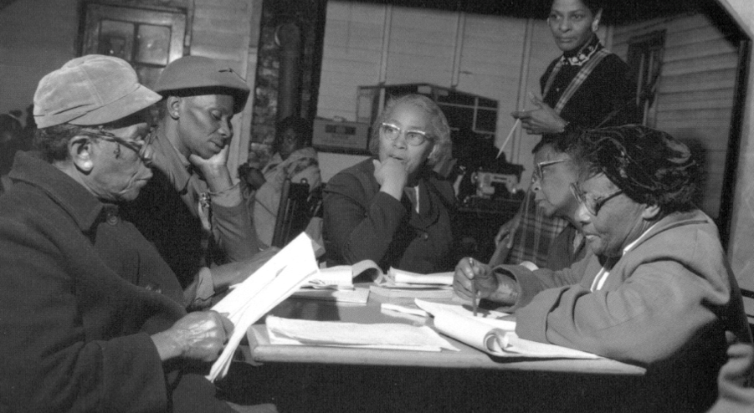
Questions and Democracy
“We need to be taught to study rather than to believe, to inquire rather than to affirm.”
– Septima Clark
Chapter 6 on Septima Clark in Freedom Road: Adult Education of African Americans (Peterson, 1996)

Slide 71
How do you see this connecting to your ongoing work with formative assessment and equity goals?
Notes:
4:45

Slide 72
What are your questions?
Notes:
4:45

Slide 73
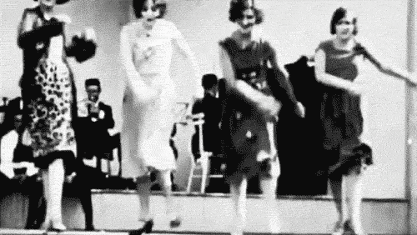
Thank you! Enjoy!

Slide 74
Using & Sharing RQI’s Resources
The Right Question Institute offers materials through a Creative Commons License. You are welcome to use, adapt, and share our materials for noncommercial use, as long as you include the following reference:
“Source: The Right Question Institute (RQI). The Question Formulation Technique (QFT) was created by RQI. Visit rightquestion.org for more information and free resources.”
Access today’s materials (and more!): http://rightquestion.org/events/

Slide 75
To Learn Even More
https://www.gse.harvard.edu/ppe/program/teaching-students-ask-their-own-questions-best-practices-question-formulation-technique
Check out our 3-week online course hosted by the Harvard Graduate School of Education, starting July 6, 2020.

Slide 76
Classroom Example: 5th Grade
Teacher: Deirdre Brotherson, Hooksett, NH
Topic: Common Core Word Problem
Purpose: To develop critical thinking skills in preparation for problem-solving and state testing

Slide 77
Question Focus
A Common Core Word Problem

Slide 78
Student Questions
Initial Questions
What are we supposed to do?
Why are all the answers the same?
What does “down” mean?
Why do some have -30?
What do the ( ) and [ ] mean?
Do we -30 or +30?
7. What is a discount?
8. What is ½ of a balance?
9. What is a balance?

Slide 79
Student Questions
Questions Post-Vocabulary Discussion
Do we look at the problems with only -30?
Do we cross out +30 problems?
Do we do 110 + 30 first?
If we do 110 + 30 that is the amount he put down and the discount, right?
So that means we take that away from the total $350, right?
So the ( ) mean we do that first but how do we subtract that from 350 then divide by half?
Is that what the [ ] means?

Slide 80
Classroom Example: 9th Grade Algebra I
Teacher: Claire Yablong, Phoenix, AZ
Topic: Methods for solving quadratic functions
Purpose:
To reveal what students did not know or understand about the topic after students overall performed poorly on a quiz
For students to think critically about the best approach to solving different quadratic functions

Slide 81
Before the Question Focus
Part 1:
Students tried solving an equation, individually:
3x²-5x=12
Part 2:
Students solved the same equation with a partner, using a method not used by them or their partner on part 1.

Slide 82
Question Focus
(Now in groups of 4):
Solving 3x²-5x=12

Slide 83
Students’ Questions
How would one know what is the best method to use on a question by question basis?
How do you know if the equations is solvable?
Do certain formulas work better for certain problems?
Is it safe to use mental math?
Is using the calculator smart for this problem?
What if there is no y intercept? What if it’s just 3x^2 for example?
What are the types of equations in which it will cross the y axis?
What step do you start with?
How do you factor with two X’s?
What is completing the square?
Do you have to move the 12 over before you start every time?
How do you know when to stop?
Why do we set the equation to zero?
Why are there two answers?
In what way can this be simplified?
Which way has the smallest margin of error?
What does axis of symmetry have to do with this lesson?

Slide 84
Next Steps with Student Questions
Students copied their 3 priority questions into Padlet, and made a comment to questions they could answer as a team
Before the test, they reviewed as a class the answers to the questions no one could answer
Students made a noticeable improvement in their scores from when they took the quiz
The teacher noted: “I think our QFT day forced some of them to stop saying ‘I don't get this’ and instead get specific about what they didn't understand.”

