Slide 1
The “Why Vote?” Tool:
Reaching more voters in low-income communities
Luz Santana, Co-Director
Naomi Campbell, Legal Program Director
Yeja Dunn, Program Coordinator
July 22nd, 2020

Slide 2
In this webinar we will explore:
A new model for engaging voters
A nonpartisan, simple, and powerful tool to help people make the connection between the services that are important to them and voting
How people on the front lines of services in low-income communities can play a role in getting more people to vote
How voter engagement efforts can integrate the tool into their work
Notes:
We are working to engage people from low income communities who DON’t vote.
Our agenda for today:
This is an interactive webinar – meaning that we will try to engage you to complete a series of easy to do activities you will be sharing with each other.
Housekeeping –
I will give you a brief overview of the Right Question Strategy and its origins
We will do an exercise on the Voter engagement tool
We will look at why the process works
We will think about situations in which we can use it
Will have some closing words and assignments
And, lastly there will be an opportunity for asking questions of us

Slide 3
Agenda
Logistics
About the work of the Right Question Institute
Exploring the Right Question Voter Engagement Strategy
Components of the strategy and why it works
Applying the strategy
Q & A
Evaluation
Notes:
Our agenda for today:
This is an interactive webinar – meaning that we will try to engage you to complete a series of easy to do activities you will be sharing with each other.
Housekeeping –
I will give you a brief overview of the Right Question Strategy and its origins
We will do an exercise on the Voter engagement tool
We will look at why the process works
We will think about situations in which we can use it
Will have some closing words and assignments
And, lastly there will be an opportunity for asking questions of us

Slide 4
What is different about the strategy?
A complementary strategy that can be integrated into existing efforts
Focuses on having people name the value of voting as opposed to being told what to do or think
Leverages hundreds of direct service agencies around the country

Slide 5
Free Resources
The Right Question Institute offers many of our resources and methodology through a Creative Commons License and we encourage you to make use of and/or share the resources presented today. Please reference the Right Question Institute as the source when using our resources or methods.
Source: www.rightquestion.org

Slide 6
An Interactive Webinar
Notes:
In this webinar, you will have many opportunities to think and work actively, as well as participate.
You will notice these two icons on some of the slides. The pencil means that it is time for you to work on your own, and the computer means that it is time to share your thoughts in the chat box.
If you have questions, you are welcome to write them in the chat box during the Q&A section in the end.
You will also see this timer on some of the slides. It will helps us stay on time.

Slide 7
An Interactive Webinar
@RightQuestion
@LuzSantana20
#whyvotetool

Slide 8
Let’s see who’s here!
Please share in the chat box:
Your name
State or country
Make sure you are sending the message to everyone! Click “All panelists and attendees”

Slide 9
After the Webinar
？
Fill out evaluation
Download free resources at www.rightquestion.org
Get support from RQI
Look out for emails and stay in touch!

Slide 10
The lower the income level of potential voters, the less likely they are to vote.
In 2016, fewer than half of eligible voters living below the poverty line voted, compared to 76 percent of eligible voters earning $75,000 or more.

Slide 11
This webinar introduces you to a resource that you can use to engage people in low-income communities.
Notes:
OUR single focus is on offering a non partisan strategy to social and direct services workers. That being said –it is strategy anyone can use in their work with potential voters.

Slide 12
Honoring the original source: Parents in Lawrence, Massachusetts, 1990
“We don’t go to the school because we don’t even know what to ask.”

Slide 13
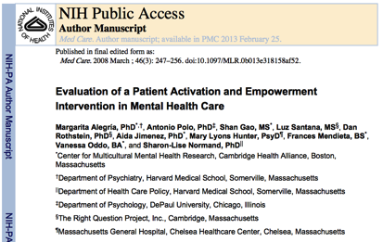

Slide 14
What is the Right Question Voter Engagement Strategy?

Slide 15
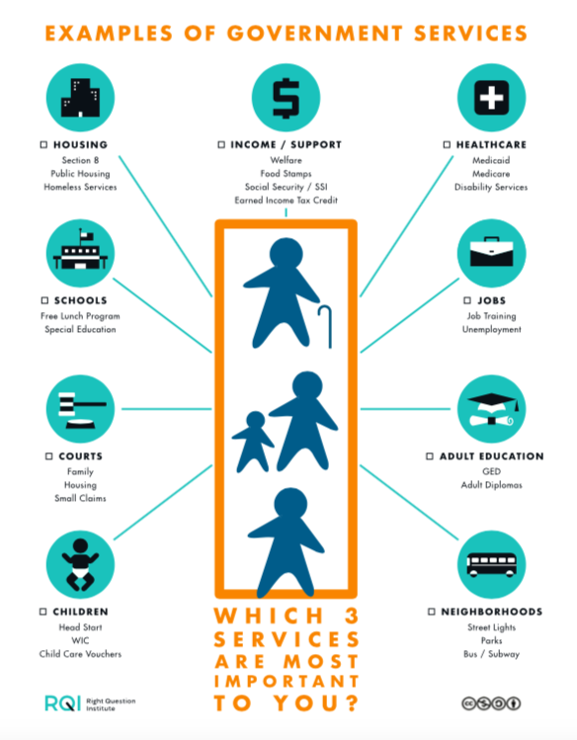
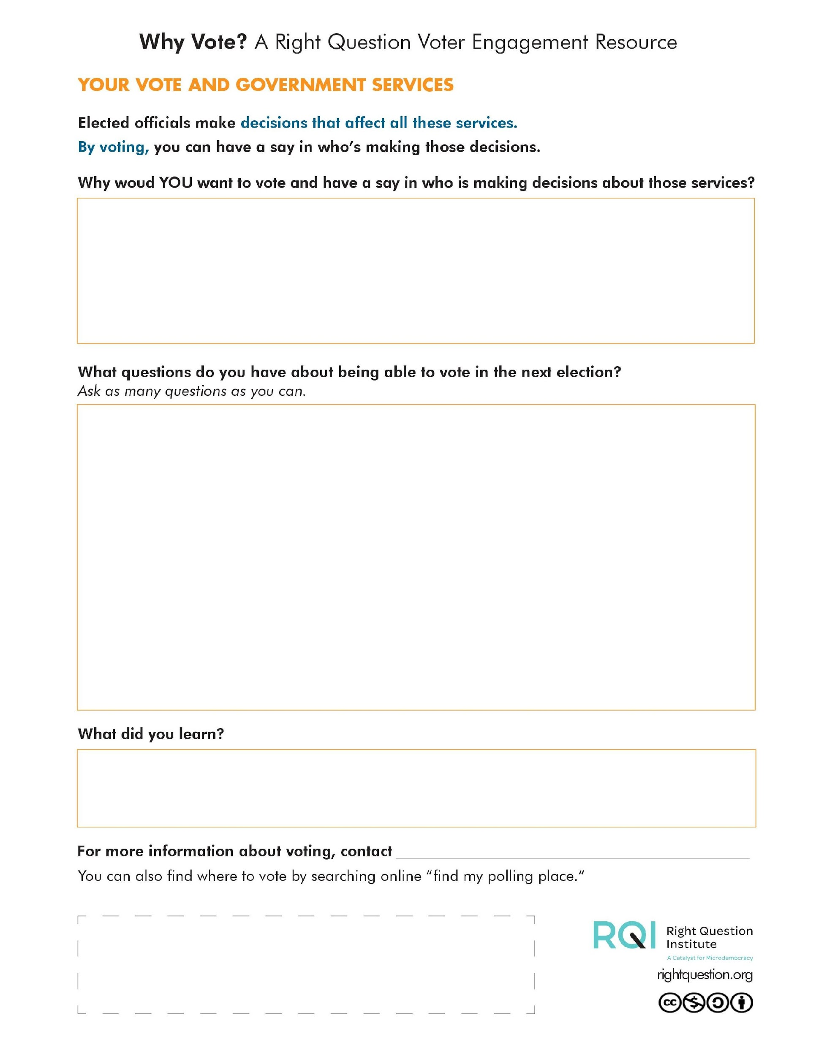
Exploring the “Why Vote?” Tool

Slide 16
Which three services are most important to people you work with or who live in your community? Add a service if you don’t see it on the list.
EXAMPLES OF GOVERNMENT SERVICES
HOUSING Section 8 Public Housing Homeless Services | INCOME / SUPPORT Welfare Food Stamps Social Security / SSI Earned Income Tax Credit | HEALTHCARE Medicaid Medicare Disability Services
SCHOOLS Free Lunch Program Special Education | JOBS Job Training Unemployment | COURTS Family Housing Small Claims
CHILDREN Head Start WIC Child Care Vouchers | ADULT EDUCATION GED Adult Diploma | NEIGHBORHOODS Street Lights Parks Bus / Subway
Notes:
Which 3 services are most important to your clients?

Slide 17
The Role of Elected Officials
Elected officials make decisions that affect these services
By voting, people you work with or in your community can have a say in who is making these decisions

Slide 18
Making the Connection
Why would it be important for people to see for themselves the connection between services they receive and decisions elected officials make?

Slide 19
Questions About Voting
?
What questions do you think they might have about actually voting?
Ask as many questions as you can.

Slide 20
Reflecting on the Experience
You:
Thought about government services that affect people’s lives,
Reflected on the connection between services and decisions elected officials make, and
Asked questions people might have about voting.
What did you learn, or what thoughts do you have?

Slide 21
Unpacking the “Why Vote?” Tool

Slide 22
The “Why Vote?” Tool
A simple, 5-step process that allows people to name for themselves the value of voting
It helps develop a sense of urgency to participate and vote
It is a non-partisan strategy that encourages all people to vote, but it does not encourage people to vote for a specific candidate

Slide 23
The “Why Vote?” Tool
It gives space for people to ask questions and identify obstacles to voting

Slide 24
Notes:
Remove black line

Slide 25
The “Why Vote?” Tool
Design informed by pilot work in different states around the country
Notes:
Naomi

Slide 26
Unpacking the Tool
Page 1:
Reviewing the range of services
Prioritizing the services that are most important to them

Slide 27
Unpacking the Tool
Page 2
Notes:
Can you give me each of the components separate?

Slide 28
Unpacking the Resource
Become aware of decisions elected officials make

Slide 29
Unpacking the Resource
Think about reasons for voting

Slide 30
Unpacking the Resource
Ask questions about being able to vote

Slide 31
Unpacking the Resource
Questions we have heard:
Can I bring my kids with me?
What if I don’t know what to do?
Can I get help?
What if I make a mistake?
Will I get punished?

Slide 32
Unpacking the Resource
Reflect

Slide 33
Unpacking the Resource
Connect to additional voting resources

Slide 34
Reflection
What are your thoughts on the “Why Vote?” Tool?

Slide 35
Three changes as outcomes
KNOW
FEEL
DO

Slide 36
Cognitive changes
Notes:
Naomi
Simplify the summary: make cognitive, affective, behavioral changes.
Cognitive changes: knowing the connection between services and decisions elected officials make
Affective changes: naming what they feel is most important
Behavioral changes: thinking about the benefits of a certain action
Separate: let’s think about potential ways in which you can make it a part of your work.

Slide 37
Affective changes
“I have never vote. I feel really strong about voting now. It would make a different.”
“It made me feel that voting is very important so your voice can be heard.”
Notes:
Naomi
Simplify the summary: make cognitive, affective, behavioral changes.
Cognitive changes: knowing the connection between services and decisions elected officials make
Affective changes: naming what they feel is most important
Behavioral changes: thinking about the benefits of a certain action
Separate: let’s think about potential ways in which you can make it a part of your work.

Slide 38
Behavioral changes
“I think is really important do the right of vote, and I will vote for the next presidential election. “
Notes:
Naomi
Simplify the summary: make cognitive, affective, behavioral changes.
Cognitive changes: knowing the connection between services and decisions elected officials make
Affective changes: naming what they feel is most important
Behavioral changes: thinking about the benefits of a certain action
Separate: let’s think about potential ways in which you can make it a part of your work.

Slide 39
Integration opportunities
Let’s think about potential ways you can make it part of your work.

Slide 40
Works with nonprofit organizations and social service agencies around the country to promote voter participation
Over 114 national and state partners, representing more than 65,210 nonprofits nationally
Offers free factsheets, guides, and webinars on nonpartisan voter engagement in their resource library: www.nonprofitvote.org/npv-resource-library/

Slide 41
Using the resource
Share it with the people with whom you work or people in your community
Use it as a script for your conversation
Share tools available at rightquestion.org/voter-engagement

Slide 42
Best practices in using the tool
If possible, we recommend that you lead people through the step-by-step process.
One cardinal rule: you are presenting this to them, you are not telling them what they should be thinking, doing, or asking.
If you are going to give information related to voting (polling place, registration, etc.), do it after guiding the participant through all the steps of the process.

Slide 43
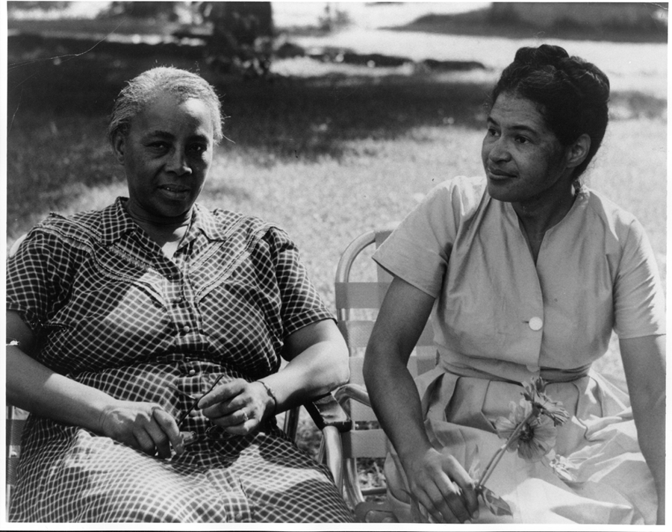
Individual Skills and Democracy
Image Courtesy of Highlander Research and Education Center

Slide 44
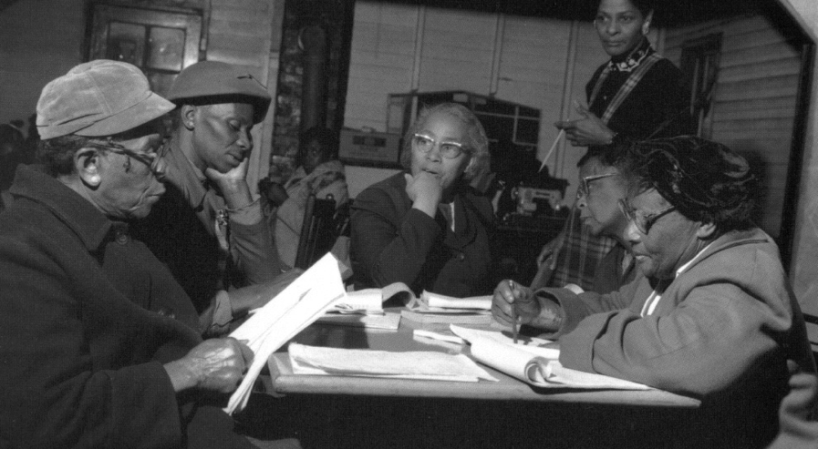
“We need to be taught to study rather than to believe, to inquire rather than to affirm.” - Septima Clark
See Chapter 6 on Septima Clark in Freedom Road: Adult Education of African Americans (Peterson, 1996).

Slide 45
Next Steps
Help us to reach new voters!
Put the resource into the hands of as many as people as possible.
On our website, you can find this resource as well as other resources for voter engagement:
rightquestion.org/voter-engagement/

Slide 46
Next Steps
Help us to reach new voters!
Share with others and invite 5 people to our next webinar
Become a partner and receive support in using the tool

Slide 47
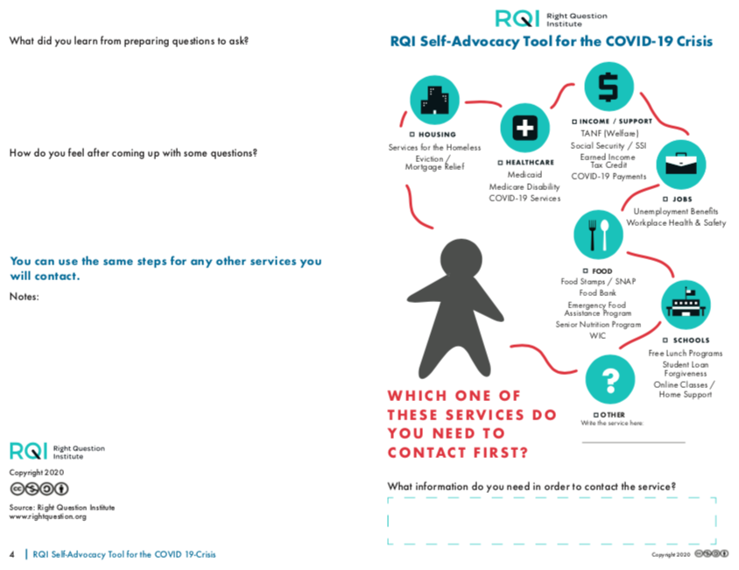

Slide 48
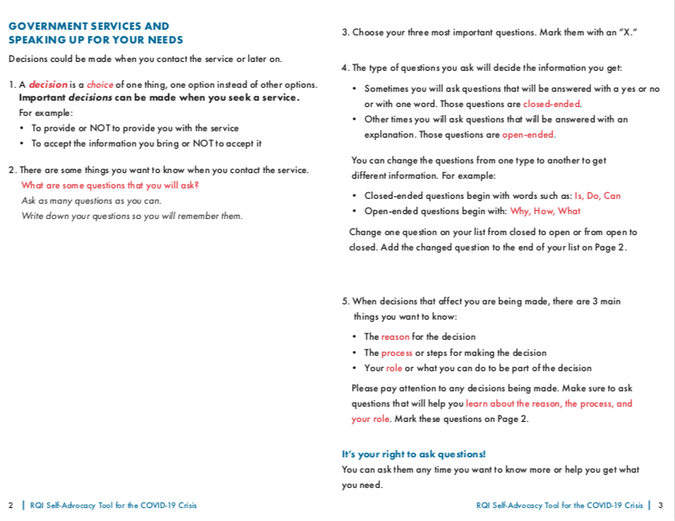

Slide 49
Resources for Voter Engagement https://rightquestion.org/resources/field/voter-engagement/
Resources> Voter Engagement
The “Why Vote?” Tool <English and Spanish>
The “Why Vote?” Tool for Youth
“Why Vote?” Toolkit
User Guide for the “Why Vote?” Tool

Slide 50
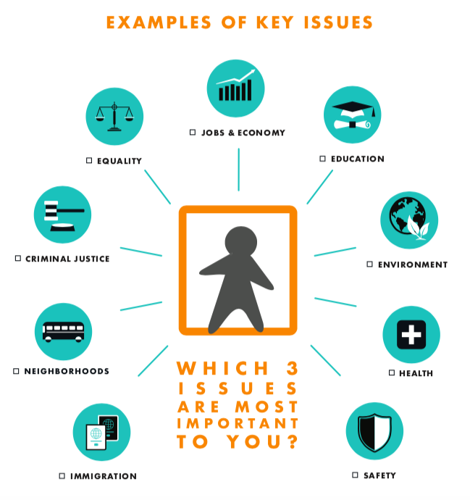
The “Why Vote?” Tool
for work with youth

Slide 51
Resources for Census https://rightquestion.org/resources/census-tool/
Resources> Microdemocracy

Slide 52
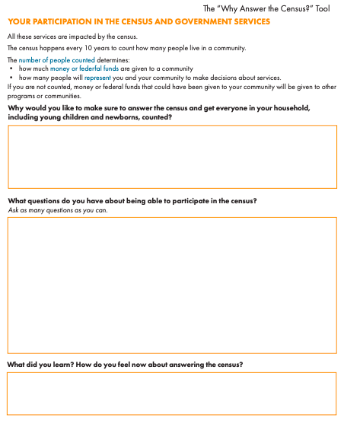
Census Tool:
“Why Answer the Census?”

Slide 53
Online versions

Slide 54
Next Steps
Complete evaluation:
tinyurl.com/rqiwebinar4
Look for an email with:
A recording of this webinar
Resources, including links to videos and resources in Spanish and English

Slide 55
Now, some time for your questions. Evaluation at tinyurl.com/rqiwebinar4 We are eager to connect with you and explore how we can support your work: naomi.campbell@rightquestion.org luz@rightquestion.org
yeja.dunn@rightquestion.org Register to access free resources at: www.rightquestion.org
Thank you!

