Slide 1
Working & Questioning Together to Explore Student Research
Andrew P. Minigan, Director of Strategy
Sarah Westbrook, Director of Professional Learning
The Right Question Institute
Visit & register to access resources from today’s experience:
rightquestion.org/events

Slide 2
Quick Housekeeping
Please:
Be ready to actively participate
Ensure your name is visible if it isn’t already

Slide 3
Acknowledgments
We are deeply grateful to The Library of Congress, The National Science Foundation, and The Hummingbird Fund for their generous support of the Right Question Institute’s work in education.
We would like to thank the RQI board of directors, and our colleagues Katy Connolly and Tomoko Ouchi for all they do to make possible our work in education.

Slide 4
Access Free Resources
Visit to access resources from today’s experience:
rightquestion.org/events
You can also find
Easy-to-use templates and downloadable resources
Classroom examples, articles, and blogs
Instructional videos

Slide 5
Share your thinking and learning from today
@AndrewRQI
@SarahRQI
@RightQuestion
#QFT

Slide 6
Overview
Questions as a portal to learning
An experience in the Question Formulation Technique (QFT)
Unpacking the QFT
Question formulation as a fundamental skill
Reflection & Q&A

Slide 7
Questions as a Portal to Learning

Slide 8
Honoring the Original Source: Parents in Lawrence, MA 1990
“We don’t go to the school because we don’t even know what to ask.”

Slide 9
“…it is always okay to dig deeper, to press harder, to question things that seem obvious. This insistent curiosity is at the heart of many deep problems...”
– Adina Roskies
Professor of Philosophy, Dartmouth College

Slide 10
“If you are a researcher you are trying to figure out what the question is as well as what the answer is.”
“You want to find the question that is sufficiently easy that you might be able to answer it, and sufficiently hard that the answer is interesting.”
– Edward Witten
Physicist, Institute of Advanced Study

Slide 11
A List of Things Stuart Firestein Learned in Graduate School
Questions are more important than facts.
Answers or facts are temporary; data, hypotheses (models) are provisional.
Failure happens… a lot.
Patience is a requirement; there is no substitute for time.
Occasionally you get lucky—hopefully you recognize it.
Things don’t happen in the linear or narrative way that you read about in papers or textbooks.
The smooth “Arc of Discovery” is a myth; science stumbles along.
If there is free food, get there early.
Notes:
Embrace the messiness. Embrace the unknown. It’s part of the process and creating the space for discovery and research. What Sarah is about to share is how to start with our questions and curiosity. It’s going to get a little bit messy, but we’re going to do this work together.

Slide 12
A Culture of Curiosity
“We are here to ask questions—questions about one another and about the world around us. We are at Yale to nurture a culture of curiosity.”
- Peter Salovey, President of Yale University
https://president.yale.edu/speeches-writings/speeches/culture-curiosity

Slide 13
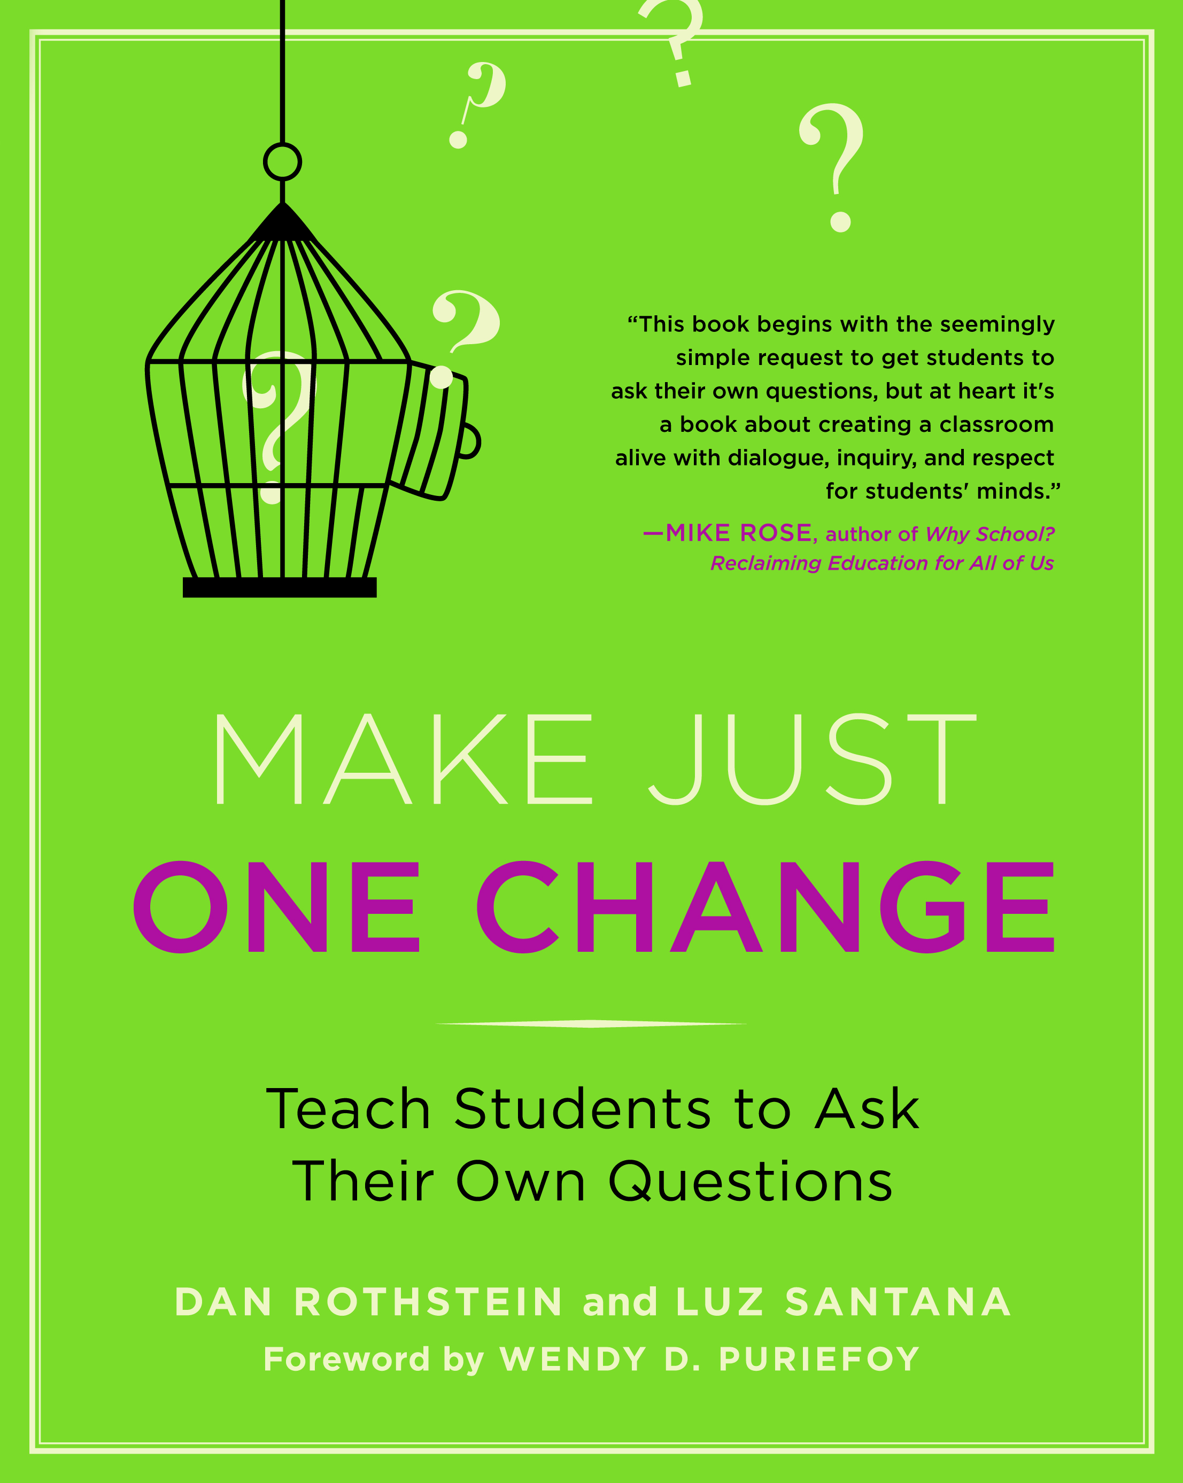

Slide 14
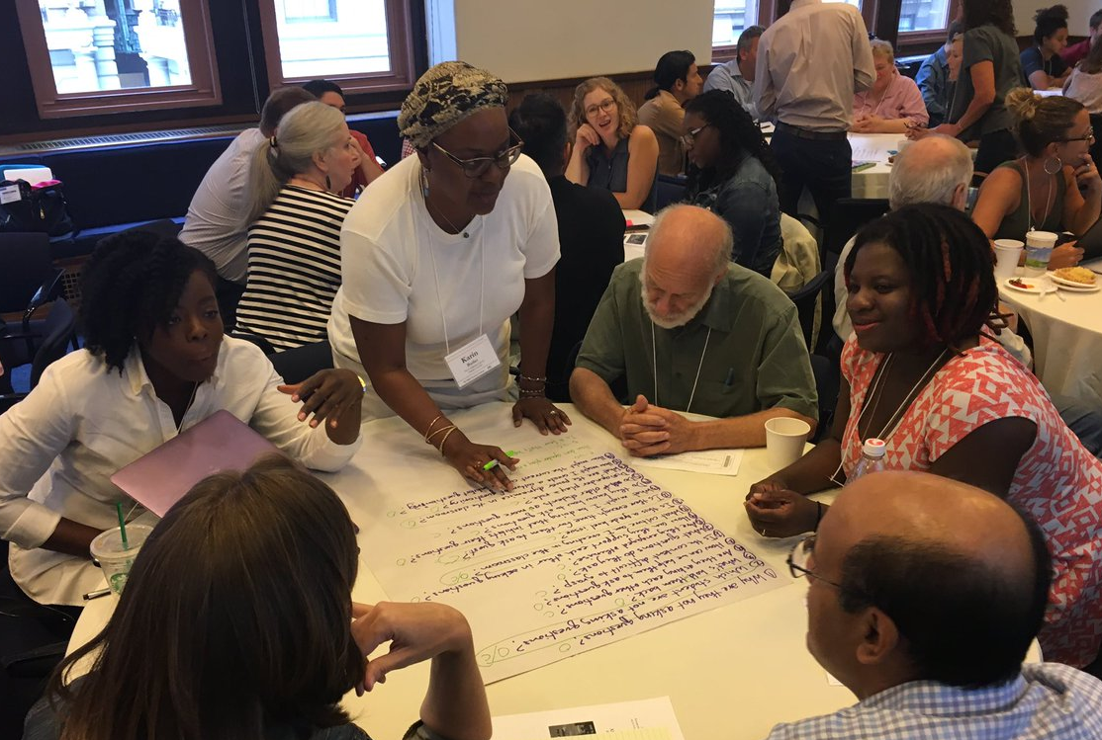
Collaborative Work with the Question Formulation Technique

Slide 15
There are two icons you will see in this section
This means that you should be thinking or working on the task assigned
This means get ready to use your chat box to share some of your work

Slide 16
The Question Formulation Technique
Individuals learn to:
Produce their own questions
Work with and improve their questions
Strategize on how to use their questions
Reflect on what they have learned and how they learned it

Slide 17
Rules for Producing Questions
1. Ask as many questions as you can
2. Do not stop to answer, judge, or discuss
3. Write down every question exactly as stated (or as it first comes to mind)
4. Change any statements into questions

Slide 18
Produce Questions
Ask questions
Follow the rules
Ask as many questions as you can
Do not stop to answer, judge, or discuss
Write down every question exactly as it was stated (or as it first comes to mind)
Change any statements into questions
Number the questions as you produce them

Slide 19
Question Focus
Some students struggle with original research.
Ask questions. Number the questions. Follow the rules:
Ask as many questions as you can; Do not stop to answer, judge, or discuss
Write down each question exactly as it was stated (or as it first comes to mind).
Change any statements into questions.

Slide 20
Categorize Questions: Closed/Open
Definitions:
Closed-ended questions can be answered with a “yes” or “no” or with a one-word answer.
Open-ended questions require an explanation and cannot be answered with a “yes,” “no,” or with one word.
Directions:
Label your closed-ended questions with a “C” and your open-ended questions with an “O.”

Slide 21
Discuss
Open-ended questions
Closed-ended questions
Advantages
Disadvantages
Advantages
Disadvantages

Slide 22
Discuss
Open-ended questions
Open-ended questions
Advantages
Disadvantages
Advantages
Disadvantages

Slide 23
Work with Closed and Open-ended Questions
Take one closed-ended question and change it into an open-ended question.
Take one open-ended question and change it into a closed-ended question.
Add your new questions to the bottom of your list of questions.
Closed
Open
Open
Closed
Notes:
Please be sure to number your new questions—they are new questions and so they should be the next two numbers in your list of questions.

Slide 24
Prioritize Questions
Review your list of questions:
Choose three questions that you would like to explore further with this group.
While prioritizing, think about your Question Focus: Some students struggle with original research.
After prioritizing, think about why you chose those questions.

Slide 25
Share & Build
After prioritizing, use the chat box to share one of your priority questions.
The numbers of your three priority questions in your original sequence. (E.G., 2, 4, 7 out of 8 total)
Read the questions others share in the chat.
Add at least one new question to your list that is sparked by a question someone else asked.

Slide 26
Action Plan
Moving from priority questions into action steps
Two choices to respond:
Try action planning on a shared Padlet:
https://padlet.com/sarahwestbrook1/actionplan
2) Continue to respond via chat box

Slide 27
Reflect
What did you learn?
How did you learn it?
After reflecting, use the chat box or “raise hand” to share your response to one of the prompts above.

Slide 28
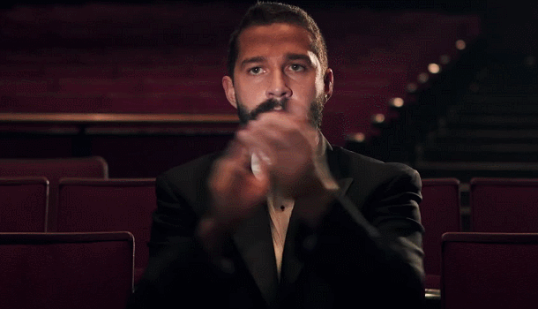
A Round of Applause

Slide 29
Unpacking the QFT

Slide 30
Three thinking abilities, one strategy.

Slide 31
The QFT, on one slide
Question Focus
Produce Your Questions
Follow the rules
Number your questions
Improve Your Questions
Categorize questions as closed or open-ended
Change questions from one type to another
Strategize
Prioritize your questions
Action plan or discuss next steps
Share
Reflect
Ask as many questions as you can
Do not stop to answer, judge, or discuss
Write down every question exactly as it was stated
Change any statements into questions
Closed-ended can be answered with a “yes,” “no,” or one-word
Open-ended requires a longer explanation, cannot be answered with “yes,” “no,” or one-word
Source: The Right Question Institute rightquestion.org
Notes:
It is NOT just a question brainstorming process
Say something about the LARGER POINT of the PROCESS—it is about changing the way that school is played

Slide 32
Thinking in many different directions
Divergent
Thinking

Slide 33
Narrowing down, focusing
Convergent
Thinking

Slide 34
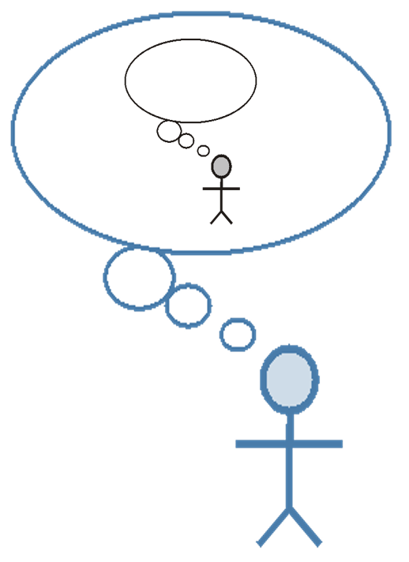
Thinking about thinking
Metacognition

Slide 35
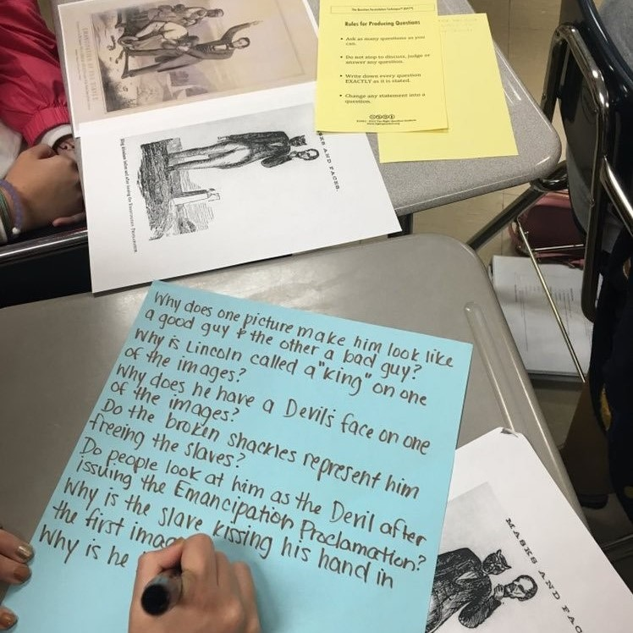
Question Formulation as a Fundamental Skill

Slide 36
In the Age of Google
“How should you respond when you get powerful new tools for finding answers?
Think of harder questions.”
– Clive Thompson
Journalist and Technology Blogger

Slide 37
The Skill of Question Formulation
For developing cognitive skills to leverage the new, powerful tools at our disposal
For reframing the perception of ignorance: not a weakness, but an opportunity
For arriving at better answers (and more questions)
For cultivating collaboration, inclusion, and tackling real-world problems
For a little more joy in learning and researching
And…

Slide 38
Democracy & Questions
Image Courtesy of Highlander Research and Education Center
Notes:
We have learned a lot from people with limited education, far from power, who were parents in a low-income Massachusetts city. They
were not participating in their children’s education because “they did not even know what questions to ask.” These parents were the
individuals who first named the problem and made the critical insight into the importance of questions for thinking, learning, and
participating. We have worked on this problem for nearly 30 years since.
Yet, we are not the first people to say question formulation is critical. We see our work connecting back to the work of someone who
you probably have never heard of but is one of the greatest educators of the 20th century.
Septima Clark was a civil rights activist and an African American educator who worked alongside Rosa Parks. After having her
teaching license revoked after decades or teaching service for her activism with a civil rights organization (NAACP), Clark, with her
cousin Bernice Robinson, established citizenship schools in South Carolina. Clark began working with low people with low literacy, first
to make sure they could vote and were not cheated out of wages, but as a part of a larger effort for people to become more effective
participants in democracy.
She said, “we need to be taught to study rather than to believe, to inquire rather than to affirm.” Clark saw inquiry and questioning as a
foundational part of learning, civic participation, and advocacy. By honing this fundamental skill one is able to advance research, think
and learn in new ways, and also to integrate this skill democratic habit of mind into their daily life.
Septima Clark, seated center, and her cousin Bernice Robinson standing to the right.
21

Slide 39
Democracy & Questions
“We need to be taught to study rather than to believe, to inquire rather than to affirm.”
- Septima Clark
See Chapter 6 on Septima Clark in Freedom Road: Adult Education of African Americans (Peterson, 1996).
Notes:
We have learned a lot from people with limited education, far from power, who were parents in a low-income Massachusetts city. They
were not participating in their children’s education because “they did not even know what questions to ask.” These parents were the
individuals who first named the problem and made the critical insight into the importance of questions for thinking, learning, and
participating. We have worked on this problem for nearly 30 years since.
Yet, we are not the first people to say question formulation is critical. We see our work connecting back to the work of someone who
you probably have never heard of but is one of the greatest educators of the 20th century.
Septima Clark was a civil rights activist and an African American educator who worked alongside Rosa Parks. After having her
teaching license revoked after decades or teaching service for her activism with a civil rights organization (NAACP), Clark, with her
cousin Bernice Robinson, established citizenship schools in South Carolina. Clark began working with low people with low literacy, first
to make sure they could vote and were not cheated out of wages, but as a part of a larger effort for people to become more effective
participants in democracy.
She said, “we need to be taught to study rather than to believe, to inquire rather than to affirm.” Clark saw inquiry and questioning as a
foundational part of learning, civic participation, and advocacy. By honing this fundamental skill one is able to advance research, think
and learn in new ways, and also to integrate this skill democratic habit of mind into their daily life.
Septima Clark, seated center, and her cousin Bernice Robinson standing to the right.
21

Slide 40
Closing Reflections
How can you use what you learned?
An “a-ha moment” or a meaningful take away from your experience today.
Notes:
To use during discussion usually

Slide 41
Access Free Resources
Visit to find resources from today’s experience:
rightquestion.org/events
You can also find
Easy-to-use templates and downloadable resources
Classroom examples, articles, and blogs
Instructional videos
We offer materials through a Creative Commons License and we encourage you to make use of and/or share all resources.
Please reference the Right Question Institute and rightquestion.org as the source on any materials you use/share.

Slide 42
Thank you! Now, some time for your questions. We are eager to connect with you and explore how we can support your work: Andrew.Minigan@rightquestion.org Sarah.Westbrook@rightquestion.org Register to access free resources over at: www.rightquestion.org

