Slide 1
Introduction to the
Question Formulation Technique (QFT)
Andrew P. Minigan, Director of Strategy, Education Program
The Right Question Institute
Visit & register to access resources from today’s experience:
rightquestion.org/events

Slide 2
Community Building
We shall not cease from exploration
And the end of all our exploring
Will be to arrive where we started
And know the place
For the first time.
– T.S. Eliot

Slide 3
Who is in the room?

Slide 4
Acknowledgments
We are deeply grateful to The National Science Foundation, The Library of Congress, and The Hummingbird Fund for their generous support of the Right Question Institute’s work in education.
I would like to thank the RQI board of directors, and my colleagues Katy Connolly, Tomoko Ouchi, and Sarah Westbrook for all they do to make possible our work in education.
And, I would like to thank Theresa Sanchez & Teresa Diaz for all of their work in making today’s experience possible.

Slide 5
Access Free Resources
Visit to access resources from today’s experience:
rightquestion.org/events
You can also find
Easy-to-use templates and downloadable resources
Classroom examples, articles, and blogs
Instructional videos

Slide 6
We Tweet
Share your thinking and learning from today:
@AndrewRQI
@RightQuestion
#QFT

Slide 7
Overview
Questions & learning
An experience in the Question Formulation Technique (QFT)
Unpacking the QFT
Examples of the QFT in the classroom
Question formulation in the 21st century
Reflection & Q&A

Slide 8
Questions & Learning

Slide 9

Honoring the Original Source:
Parents in Lawrence, MA 1990
“We don’t go to the school because we don’t even know what to ask.”

Slide 10
















The Right Question Institute

Slide 11
“There is no learning without having to pose a question.”
– Richard Feynman
Nobel Laureate, Physicist

Slide 12
“The study of biology is about asking good questions about life and figuring out clever ways to find the answers.”
– Amy Gladfelter
Associate Professor, University of North Carolina

Slide 13
“There can be no thinking without questioning—no purposeful study of the past, nor any serious planning
for the future.”
– David Hackett Fischer
University Professor Emeritus of History, Brandeis University

Slide 14

“We must teach students how to think in questions, how to manage ignorance.”
– Stuart Firestein
Professor, Department of Biology, Columbia University

Slide 15
19th Century Public Intellectuals on
College Students’ Skills
Someone with a college education, “is able to converse…is able to listen…can ask a question pertinently.”
Aoun, 2017

Slide 16
College Presidents on
What College Students Should Learn
“The primary skills should be analytical skills of interpretation and inquiry. In other words, know how to frame a question.”
- Leon Botstein, President of Bard College
“…the best we can do for students is have them ask the right questions.”
- Nancy Cantor, Chancellor of University of Illinois
The New York Times, August 4, 2002

Slide 17
A Culture of Curiosity
“We are here to ask questions—questions about one another and about the world around us. We are at Yale to nurture a culture of curiosity.”
- Peter Salovey, President of Yale University
https://president.yale.edu/speeches-writings/speeches/culture-curiosity

Slide 18
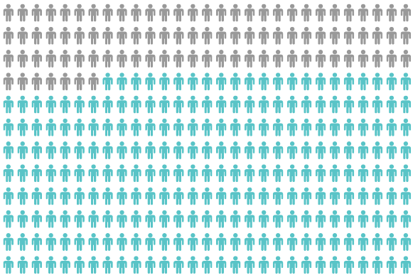
Yet, Only 27% of Graduates Believe College Taught Them How to Ask Their Own Questions
Head, 2016

Slide 19
But, the problem begins long before college...
But, the problem begins long before college…

Slide 20
Age Four: “The true age of inquisitiveness”
James Sully dubbed age four, “the true age of inquisitiveness when question after question is fired off with wondrous rapidity and pertinacity.”
Young children ask 10,000 questions per year before they begin formal schooling.
Sully, 1896
Harris, 2012

Slide 21
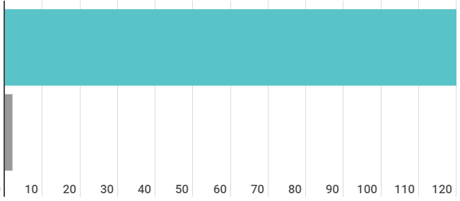
Question Formulation by Adolescence
Who’s asking questions over the course of an hour?
Educators
Students
Dillon, 1988, p. 199

Slide 22
Educators Recognize the Problem
Teachers report that getting students to ask questions feels like, “pulling teeth.”
Students ask less than 1/5th the questions educators estimated would be elicited and deemed desirable.
Susskind, 1979

Slide 23
First Year Students’ Engagement
Students engage in behaviors consistent with their high school behaviors.
Students who reported frequently asking questions in high school also reported doing the same in their first year of college.
Students who tended to not ask questions in high school tended to not do so during their first year at college.
National Survey of Student Engagement, 2008

Slide 24
How can teaching students to ask questions go from a feeling of “pulling teeth” to a feeling of excitement for both teachers and learners?

Slide 25
Moving from the exception…
In a 1912 study Romiett Stevens observed: “an unusual lesson because twenty-five of the thirty-four questions were asked by the pupils… The result was that the lesson developed an impetus born of real interest. I mention it because this lesson was unique in the series of one hundred.”
The question as a measure of efficiency in instruction: A critical study of classroom practice. Columbia University Contributions to Education, No. 48

Slide 26



Slide 27
But, the problem begins long before college...
What happens when students learn how to ask their own questions?

Slide 28
Question Formulation &
Metacognitive Learning
Student question formulation is one of the most effective metacognitive strategies
Engaging in pre-lesson self-questioning improved students rate of learning by nearly 50% (p.193)
Hattie, 2008

Slide 29
Student Reflections
Why do you think we ask questions?
“So we can be curious about what we are learning
and want to know more.”
- 1st Grader, Novi, MI

Slide 30
Student Reflections
“Asking questions may not always lead to answers, but it leads to curiosity… Question asking helps us guide our own adventure and helps us find new interests. Everything starts with a question, even if you don't realize it.”
- 9th Grader, Fitchburg, MA

Slide 31
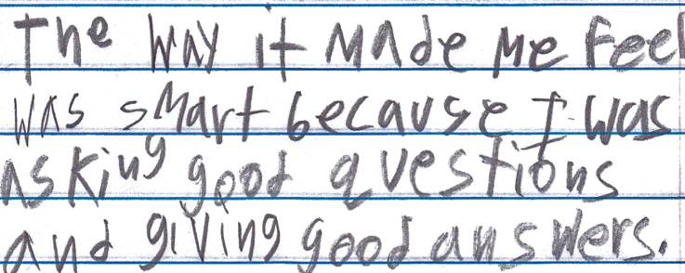
Student Reflections
“The way it made me feel was smart because I was asking good questions and giving good answers.”
- 9th Grader, Boston, MA

Slide 32
Student Reflections
“I learned that by doing the question exploration it can help you not be stuck when you do not understand the material.”
- Student, Mt. San Antonio College

Slide 33
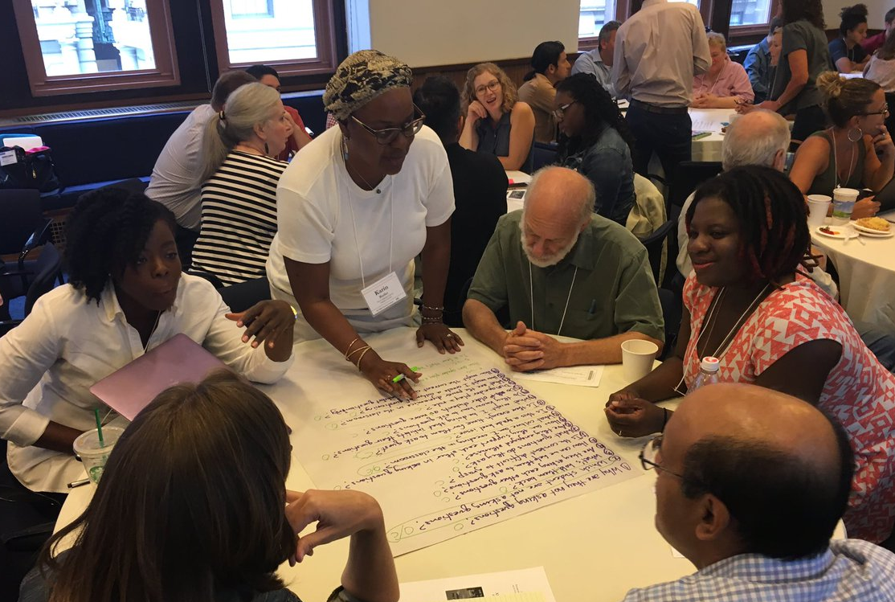
An Experience in the Question Formulation Technique

Slide 34
The Question Formulation Technique (QFT)
A strategy educators can use to teach students how to:
  formulate their own questions
  work with and improve their questions
  prioritize questions
  strategize on how to use questions
  reflect on their questions and the process
  use their questions to drive learning

Slide 35
Rules for Producing Questions
1. Ask as many questions as you can
2. Do not stop to answer, judge, or discuss
3. Write down every question exactly as stated
4. Change any statements into questions

Slide 36
Produce Questions
Ask questions
Follow the rules
  Ask as many questions as you can
  Do not stop to answer, judge, or discuss
  Write down every question exactly as it was stated
  Change any statements into questions
Number the questions as you produce them
You may want to write the Question Focus at the top of your paper.

Slide 37
Question Focus
Some students are not asking questions.
Please remember to follow the rules and to number your questions.

Slide 38
Categorize Questions: Closed/Open
Definitions:
  Closed-ended questions can be answered with a “yes” or “no” or with a one-word answer.
  Open-ended questions require an explanation and cannot be answered with a “yes,” “no,” or with one word.
Directions:
Label your closed-ended questions with a “C” and your open-ended questions with an “O.”

Slide 39
Discuss Advantages & Disadvantages
Closed-ended questions
Advantages
Disadvantages

Slide 40
Discuss Advantages & Disadvantages
Open-ended questions
Advantages
Disadvantages

Slide 41
Work with Closed and Open-ended Questions
Take one closed-ended question and change it into an open-ended question.
Take one open-ended question and change it into a closed-ended question.
Add your new questions to the bottom of your list of questions.
Closed
Open
Open
Closed
Notes:
Please be sure to number your new questions—they are new questions and so they should be the next two numbers in your list of questions.

Slide 42
Prioritize Questions
Review your list of questions:
  Choose your three most important questions.
  While prioritizing, keep in mind the Question Focus: Some students are not asking questions.
After prioritizing consider:
  Why did you choose those three questions?
  Where are your priority questions in the sequence of your entire list of questions?

Slide 43
Create an Action Plan
In order to answer your priority questions:
What do you need to know? Information
What do you need to do? Tasks
Information | Tasks

Slide 44
Share
Questions you changed from open/closed
Your three priority questions and their numbers in your original sequence
Rationale for choosing priority questions
Next steps

Slide 45
Reflect
What did you learn?
How did you learn it?

Slide 46
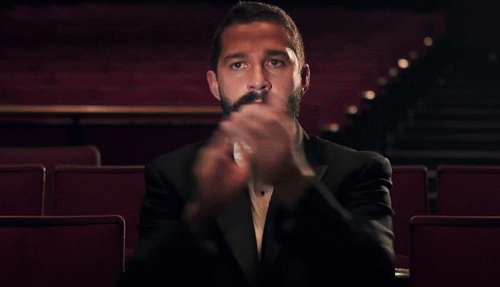
A Round of Applause

Slide 47

Unpacking the QFT

Slide 48
The Question Formulation Technique (QFT)
A strategy educators can use to teach students how to:
  formulate their own questions
  work with and improve their questions
  prioritize questions
  strategize on how to use questions
  reflect on their questions and the process
  use their questions to drive learning

Slide 49
Three thinking abilities, one strategy.

Slide 50
Thinking in many different directions
Divergent
Thinking

Slide 51
Narrowing down, focusing
Convergent
Thinking

Slide 52
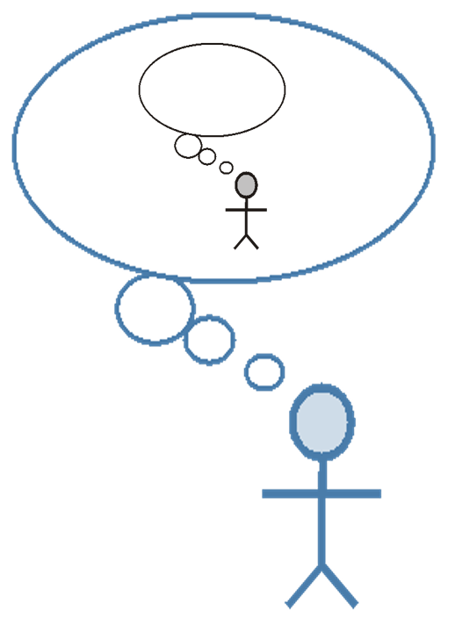
Thinking about thinking
Metacognition

Slide 53
Consistent Outcomes
Greater knowledge
Greater ownership
Greater intellectual rigor
Greater curiosity

Slide 54
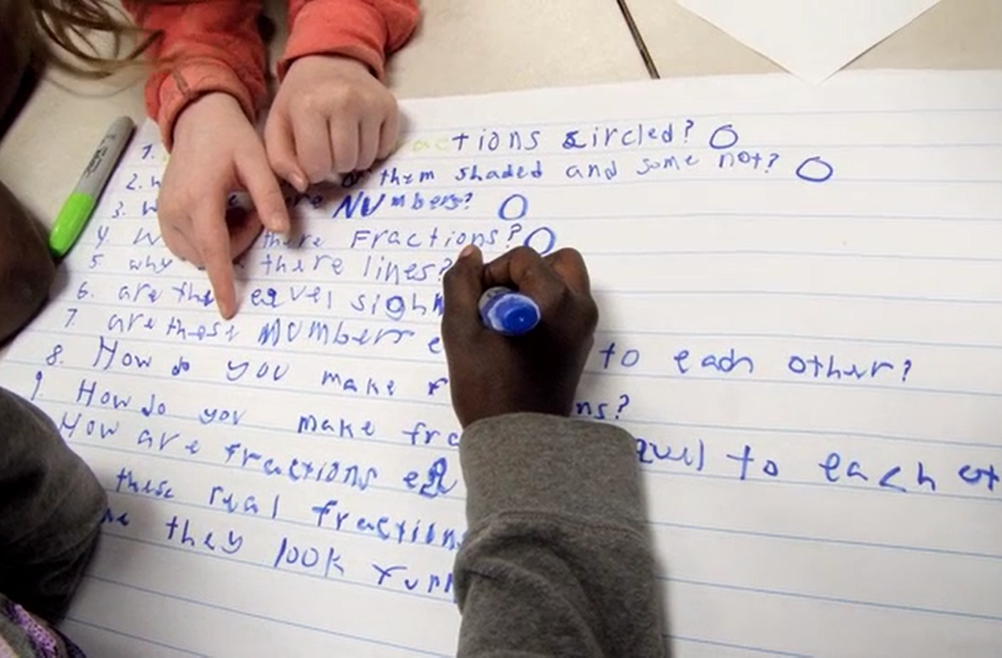
Examples of the QFT in the Classroom
Notes:
What does it look like when students learn to ask their own questions?

Slide 55
Classroom Example: Kindergarten
Jennifer Shaffer, Walkersville, MD
Topic: Nonfiction literacy
Purpose: To engage students prior to reading a nonfiction text about alligators

Slide 56

Question Focus

Slide 57
Students’ Questions
Is the alligator camouflaged?
Why do the babies have stripes?
Are those baby crocodiles?
Is it a mom or dad crocodile?
What is the green stuff?
Why are they in the water so low?
Where are they going?
Why are the baby alligator’s eyes white and the mom’s black?
Why are baby alligators on top of the momma alligator?
Why does momma or daddy have bumps on them?

Slide 58
Classroom Example: Elementary Math
Deirdre Brotherson, Hooksett, NH
Topic: Math unit on variables
Purpose: To engage students at the start of a unit on variables

Slide 59
Question Focus
24 = ☺ + ☺ + ☺

Slide 60
Students’ Questions
Why is the 24 first?
What do the smiley faces mean?
Why are there 3 smiley faces?
How am I suppose to figure this out?
Is the answer 12?
Can I put any number for a smiley face?
Do three faces mean something?
Do the numbers have to be the same because the smiley faces are the same?
What numbers will work here?
Does it mean 24 is a really happy number?
Can we replace each smiley face with an 8?
Do any other numbers work?
Can we do this for any number?
Does it always have to be smiley faces?
Do we always have to use three things?

Slide 61
Next Steps
Questions posted on classroom walls.
Students cross off the questions they answer during subsequent lessons.
Teacher returns to student questions at the end of the unit to discuss with students what they learned and what they still want to know.

Slide 62
Classroom Example: Middle School Social Studies
James Brewster, Austin, TX
Topic: Current events and social justice
Purpose: Engage students in difficult conversations on current events through analyzing contemporary political cartoons

Slide 63
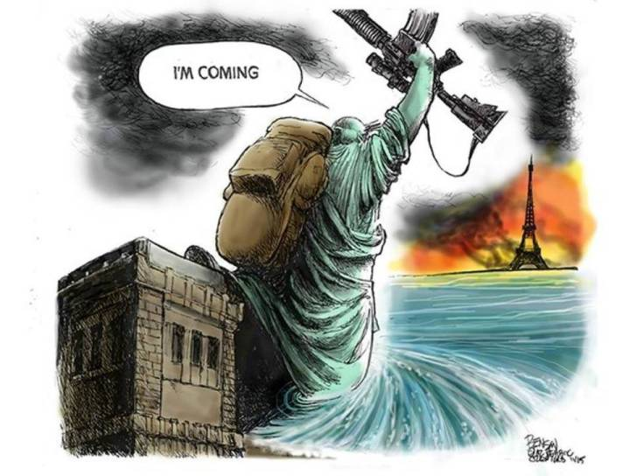
Question Focus

Slide 64
Students’ Questions
Why is the Eifel Tower burning?
Is New York supporting Paris?
Why Paris and not any other city?
How many people died or got hurt?
Will Obama help Paris?
Why did the Statue of Liberty say, “I’m coming?”
Why did ISIS attack?
Why doesn’t France do anything?
Who is ISIS?
Who are they going to attack next?
Does ISIS hate France as well as America?
Who is the founder of ISIS?
Is this propaganda?
Is that related to the recent bombings?

Slide 65

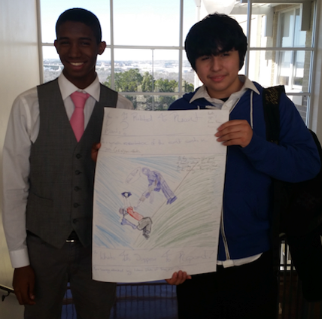
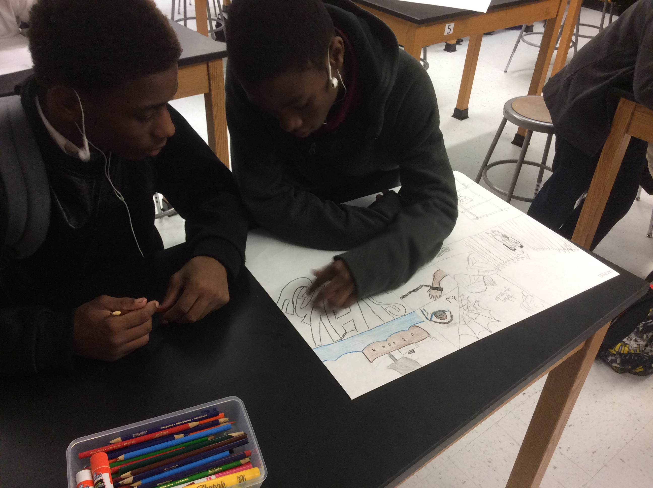
Next Steps
Students researched their questions
Students engaged in conversation on the current event
Students created posters to educate their peers on the tragedy
Organically led to a conversation on immigration

Slide 66
Student Reflections
“It helps me by getting me to think about questions on my own. Also, it gets my mind in motion to think about the questions other people make.”
- 8th Grader, Austin, TX
“I like creating as many questions as you can in a time limit without being judged because it lets my mind flow.”
- 8th Grader, Austin, TX

Slide 67
Classroom Example: High School Social Studies
Kelly Grotrian, East Brunswick, NJ
Topic: The end of World War II
Purpose: Leads into a discussion about whether the United States was justified in dropping the atomic bomb. Students’ questions were also used for a homework assignment on Google classroom.
Notes:
11th Grade U.S. History II

Slide 68
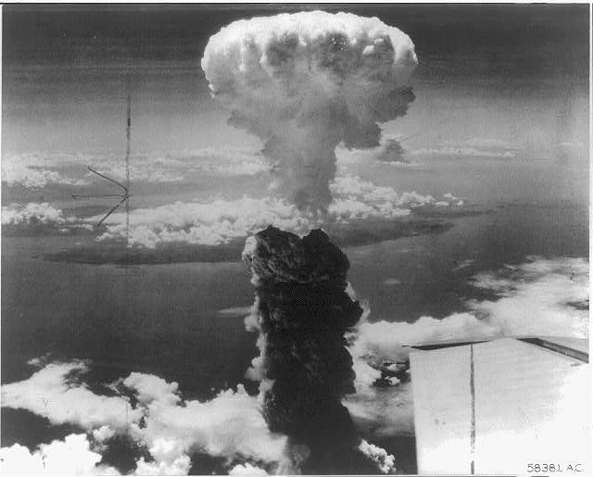
Question Focus
http://www.loc.gov/pictures/item/98506956/

Slide 69
Students’ Questions
What is this?
Who did this?
How did this affect people?
What were the environmental & economic implications of dropping the bomb?
How many people were hurt?
Is that a plane wing in the bottom right?
Did the people in that plane drop the bomb?
Did the people dropping the bomb know what they were doing?
Did they make the bomb?
Who was responsible for dropping the bomb?
What led to this event?
What happened as a result of dropping the bomb?
Where was the bomb dropped?
Had people been given warning?
How long did it take to notice effects of the bomb?
When did this happen (at what point in the war)?
How many lives were lost as a result?

Slide 70
Classroom Example: High School Science
Allison Gest, Park Ridge, IL
Topic: A unit on “Running Water”
Purpose: To give peer feedback and revise initial experiment designs

Slide 71
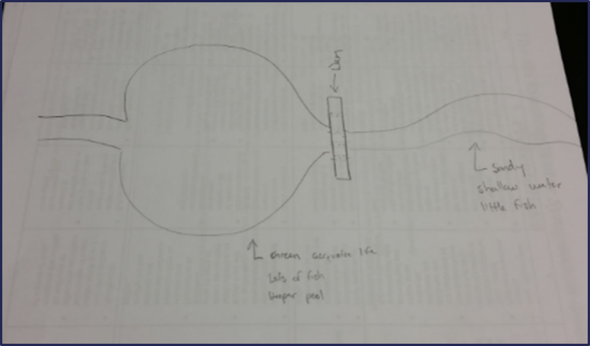
Before the Question Focus
Scientist’s claim:
“Adding a dam to a water system causes a decrease in aquatic life downstream.”
Student Design to test the claim:

Slide 72
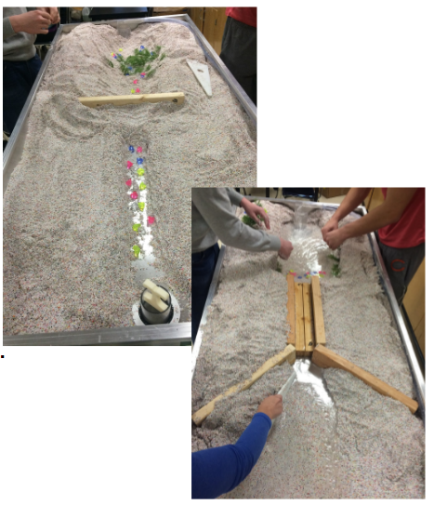
Question Focus

Slide 73
Classroom Example: Business Marketing
Kelly La Venture, Ed.D., Bemidji State University
Topic: Marketing Analytics
Purpose: To prepare for a guest speaker on a topic students identified as important for their learning and career interests

Slide 74
Question Focus
Marketing Analytics
Notes:
Before the QFocus: She asked: “What related to specific topics of interest. do you want to learn more about before you graduate and will help you to elevate your project?” and then adds lessons or brings in a guest speaker based on what they respond. They said, “analytics and Google analytics.”

Slide 75
Students’ Questions
What are marketing analytics?
How do you use them?
What are analytics?
Why are they important?
How can you use them?
What are their benefits?
What are their weaknesses?
Why should I use them?
Who should be using them?
When should you use them?
How can I use marketing analytics to benefit my company?
How often should a company use marketing analytics to their benefit?
What is the best way to use marketing analytics?
Is there a time and place to use marketing analytics?
How can I use social media and marketing analytics together?
With marketing analytics how can I analyze my competition?

Slide 76
Educator Reflections
“Not only were students highly engaged in the QFT process the whole 90 minute class period, but student after student, not just the same students, asked question after question of the guest speaker and didn’t move from their seats when class was over – they stayed about 15 more minutes to keep asking questions.”
“I had a ‘holy cow’ moment. We did the QFT last Tuesday, then on Thursday we had the guest speaker, and this week the students approached me unsolicited to share how much they liked the QFT and asked to do it again.”

Slide 77
Student Reflections
“The QFT can help us develop deeper questions.”
“Changing one word in the question can change the entire question.”
“We have more/better questions the longer we thought about it.”
“How to change closed questions to open.”

Slide 78
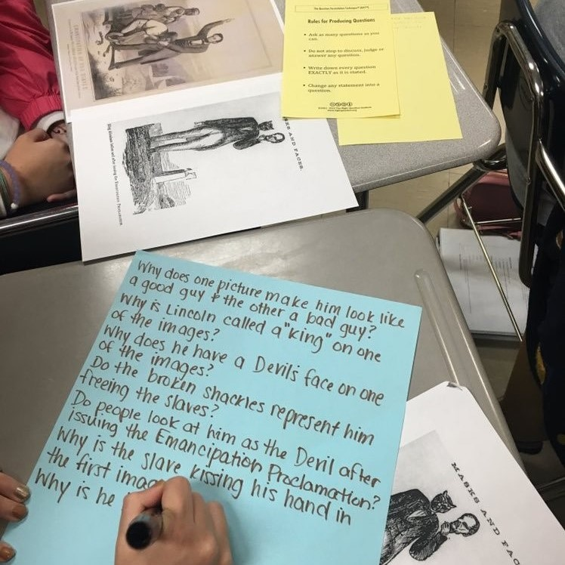
Question Formulation in the 21st Century

Slide 79

In the Age of Google
“How should you respond when you get powerful new tools for finding answers?
Think of harder questions.”
– Clive Thompson
Journalist and Technology Blogger

Slide 80
The Skill of Question Formulation
For reframing the perception of ignorance: not a weakness, but an opportunity
For arriving at better answers (and more questions)
For increasing engagement and ownership
For a little more joy in a very demanding profession
And…

Slide 81
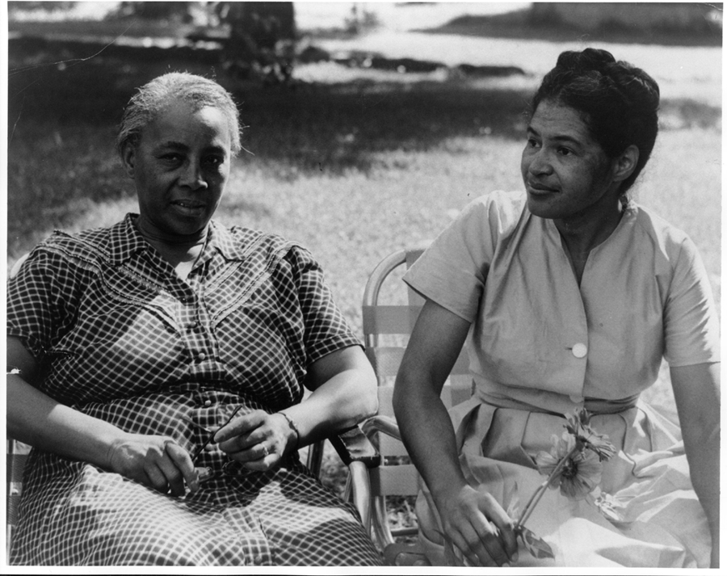
Democracy & Questions
Image Courtesy of Highlander Research and Education Center
Notes:
We have learned a lot from people with limited education, far from power, who were parents in a low-income Massachusetts city. They
were not participating in their children’s education because “they did not even know what questions to ask.” These parents were the
individuals who first named the problem and made the critical insight into the importance of questions for thinking, learning, and
participating. We have worked on this problem for nearly 30 years since.
Yet, we are not the first people to say question formulation is critical. We see our work connecting back to the work of someone who
you probably have never heard of but is one of the greatest educators of the 20th century.
Septima Clark was a civil rights activist and an African American educator who worked alongside Rosa Parks. After having her
teaching license revoked after decades or teaching service for her activism with a civil rights organization (NAACP), Clark, with her
cousin Bernice Robinson, established citizenship schools in South Carolina. Clark began working with low people with low literacy, first
to make sure they could vote and were not cheated out of wages, but as a part of a larger effort for people to become more effective
participants in democracy.
She said, “we need to be taught to study rather than to believe, to inquire rather than to affirm.” Clark saw inquiry and questioning as a
foundational part of learning, civic participation, and advocacy. By honing this fundamental skill one is able to advance research, think
and learn in new ways, and also to integrate this skill democratic habit of mind into their daily life.
Septima Clark, seated center, and her cousin Bernice Robinson standing to the right.
21

Slide 82
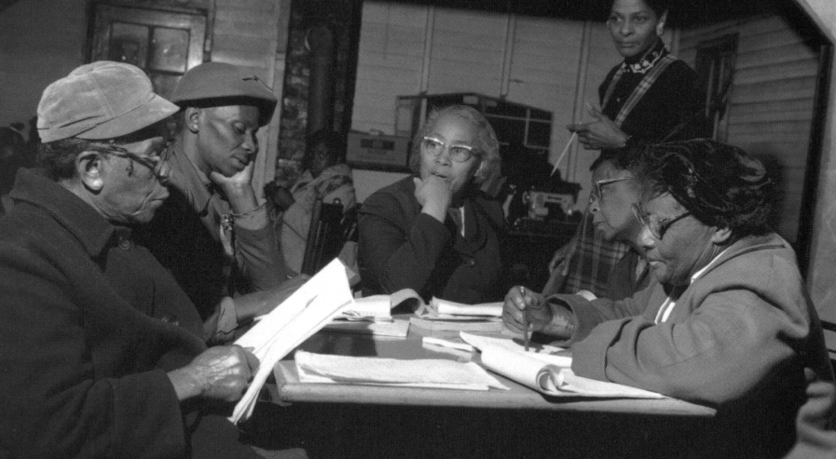
Democracy & Questions
“We need to be taught to study rather than to believe, to inquire rather than to affirm.”
- Septima Clark
See Chapter 6 on Septima Clark in Freedom Road: Adult Education of African Americans (Peterson, 1996).
Notes:
We have learned a lot from people with limited education, far from power, who were parents in a low-income Massachusetts city. They
were not participating in their children’s education because “they did not even know what questions to ask.” These parents were the
individuals who first named the problem and made the critical insight into the importance of questions for thinking, learning, and
participating. We have worked on this problem for nearly 30 years since.
Yet, we are not the first people to say question formulation is critical. We see our work connecting back to the work of someone who
you probably have never heard of but is one of the greatest educators of the 20th century.
Septima Clark was a civil rights activist and an African American educator who worked alongside Rosa Parks. After having her
teaching license revoked after decades or teaching service for her activism with a civil rights organization (NAACP), Clark, with her
cousin Bernice Robinson, established citizenship schools in South Carolina. Clark began working with low people with low literacy, first
to make sure they could vote and were not cheated out of wages, but as a part of a larger effort for people to become more effective
participants in democracy.
She said, “we need to be taught to study rather than to believe, to inquire rather than to affirm.” Clark saw inquiry and questioning as a
foundational part of learning, civic participation, and advocacy. By honing this fundamental skill one is able to advance research, think
and learn in new ways, and also to integrate this skill democratic habit of mind into their daily life.
Septima Clark, seated center, and her cousin Bernice Robinson standing to the right.
21

Slide 83
Overview
Questions & learning
An experience in the Question Formulation Technique
Unpacking the QFT
Examples of the QFT in the classroom
Question formulation in the 21st century
Lesson planning and exploring resources
Reflection & Q&A

Slide 84
Reflection & Q&A

Slide 85
Closing Reflections
What did you learn?
How can you use what you learned?
An “a-ha moment” or a meaningful take away from your experience today.
Notes:
To use during discussion usually

Slide 86
Closing Reflections
https://www.surveymonkey.com/r/QPY2PR2
Notes:
To use during discussion usually

Slide 87

Access Free Resources
Visit to find resources from today’s experience:
rightquestion.org/events
You can also find
Easy-to-use templates and downloadable resources
Classroom examples, articles, and blogs
Instructional videos
We offer materials through a Creative Commons License and we encourage you to make use of and/or share all resources.
Please reference the Right Question Institute and rightquestion.org as the source on any materials you use/share.

Slide 88
Thank you.
Now, some time for your questions.
We are eager to connect with you and explore how we can support your work:
Andrew.Minigan@rightquestion.org
Katy.Connolly@rightquestion.org
Register to access free resources over at: www.rightquestion.org

