Slide 2
Support the Shift to Inquiry-Based Classrooms with Inquiry-Based Professional Learning
Sarah Westbrook The Right Question Institute (MA)
Virnilisa Printup
Rockdale County Public Schools (GA)
Trudy Delhey
Cobb County School District (GA)
Ashley Melville
Cobb County School District (GA)
@RightQuestion

Slide 3
Who is in the room?

Slide 4
Today’s Agenda
Question Formulation: A lifelong skill for inquiry and for life
Collaborative learning with the Question Formulation Technique (QFT)
Supporting a Larger Shift to Inquiry: classroom examples & professional learning applications
Why is question formulation important now?
Final words, reflections, and questions

Slide 5
Access RQI’s Free QFT Resources
https://rightquestion.org/education/resources
Classroom Examples
Instructional Videos
Planning Tools & Templates

Slide 6
Use and Share These Resources
The Right Question Institute offers materials through a Creative Commons License. You are welcome to use, adapt, and share our materials for noncommercial use, as long as you include the following reference:
“Source: The Right Question Institute (RQI). The Question Formulation Technique (QFT) was created by RQI. Visit rightquestion.org for more information and free resources.”

Slide 7
We’re Tweeting…
@RightQuestion #QFT
@SarahRQI
@cobb_ss
@ashleyhmelville
@Trudy_Delhey
#NSSSA2020

Slide 8
Question Formulation: a foundational skill for inquiry, for learning, and for life

Slide 9
"There is no learning without having to pose a question."
- Richard Feynman
Nobel Laureate, Physics, 1965

Slide 10
Research Confirms the Importance of Questioning
Self-questioning (metacognitive strategy):
Student formulation of their own questions is one of the most effective metacognitive strategies
Engaging in pre-lesson self-questioning improved students rate of learning by nearly 50% (Hattie, p.193)
John Hattie
Visible Learning: A Synthesis of Over 800
meta-Analyses Relating to Achievement, 2008
Notes:
UC Davis Research Linking Curiosity to Memory (UC Davis) 2014
The Fullerton Longitudinal Study (FLS), a 30-plus year study of the development of giftedness across various points in time conducted by Adele and Allen Gottfried of California State University ”This finding has strong implications for the development of STEM considering that curiosity is a fundamental predictor of the aspiration to become a scientist.”
S. von Stumm, B. Hell, T. Chamorro-Premuzic. The Hungry Mind: Intellectual Curiosity Is the Third Pillar of Academic Performance. Perspectives on Psychological Science, 2011 meta-analysis shows They found that curiosity did, indeed, influence academic performance. In fact, it had quite a large effect, about the same as conscientiousness. When put together, conscientiousness and curiosity had as big an effect on performance as intelligence.

Slide 11
Standards Emphasize Questioning
“Central to a rich social studies experience is the capability for developing questions that can frame and advance an inquiry. ”
Notes:
National Council for the Social Studies, The College, Career, and Civic Life (C3) Framework for Social Studies State Standards: Guidance for Enhancing the Rigor of K-12 Civics, Economics, Geography, and History (Silver Spring, MD: National Council for the Social Studies, 2013).

Slide 12
Questions and Participation: Parents in Lawrence, Massachusetts, 1990
“We don’t go to the school because we don’t even know what to ask.”
Notes:
And parents named an obstacle to participation that many of us face in schools and educational organizations.

Slide 13
The Uneven Communication Problem
Leigh Thompson, Creative Conspiracy: The New Rules of Breakthrough Collaboration (2013)

Slide 14
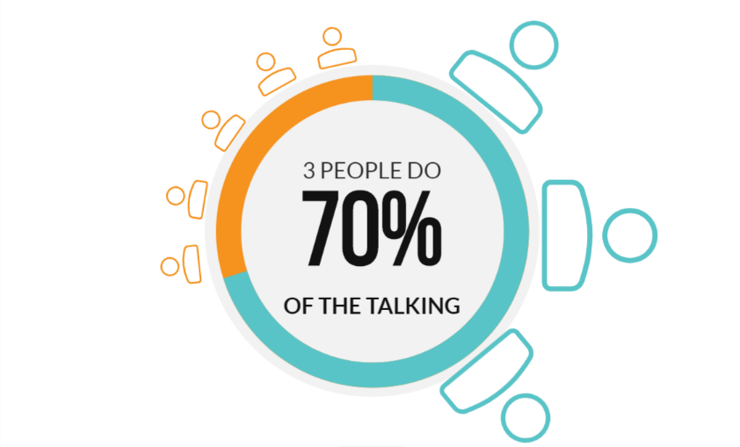
The Uneven Communication Problem
Leigh Thompson, Creative Conspiracy: The New Rules of Breakthrough Collaboration (2013)
Notes:
It isn’t just low income parents who felt unable to participate; many of us eventually end up in a room where there is a power differential and we’re one of the 5 instead of one of the 3.

Slide 15
Questions and Organizational Leadership
“Good leaders and managers share two key qualities: humility and curiosity. The missing ingredients in most organizations are curiosity and willingness to ask questions to which we do not already know the answer.”
- Edgar Schein
Professor Emeritus at the MIT Sloan School of Management
Humble Inquiry (2013)
Notes:
AND INVITE QUESTIONS FROM OTHERS
“Questions are taken for granted rather than given a starring role in the human drama. Yet all my teaching and consulting experience has taught me that what builds a relationship, what solves problems, what moves things forward is asking the right questions.”
There are dynamics at play that make voicing questions or voicing opinions difficult. Questions can be a powerful tool to insert yourself into a conversation in which you feel powerless. So questions are powerful ways to both lead and participate in organizations. If questions are so powerful, why aren’t we all asking them?

Slide 16
If questions are so powerful, why aren’t we all asking them?

Slide 17
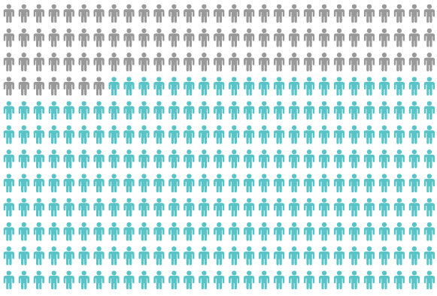
Only 27% of Graduates Believe College Taught Them How to Ask Their Own Questions
Alison Head, Project Information Literacy at University of Washington, 2016

Slide 18
But, the problem begins long before college…

Slide 19
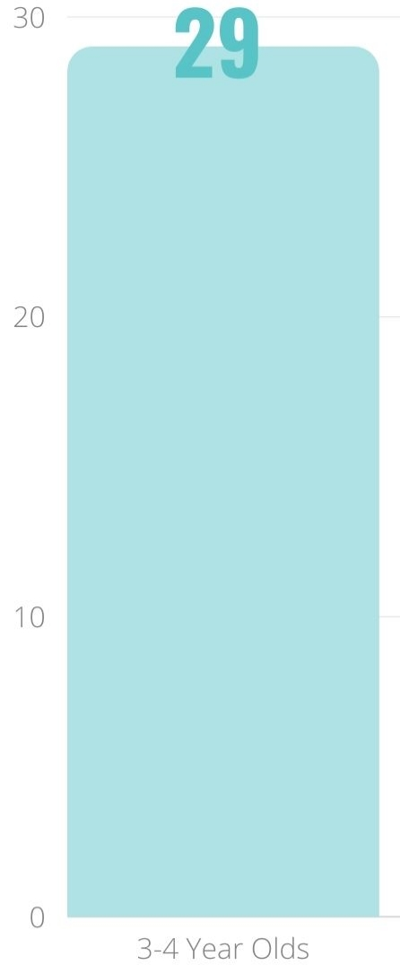
Question Asking Declines with Age
Tizard, B., Hughes, M., Carmichael, H., & Pinkerton, G. (1983).
Pearson, J.C. & West, R. (2009)
Notes:
Tizard, B., Hughes, M., Carmichael, H., & Pinkerton, G. (1983). Children’s questions and adults’ answers. Journal of Child Psychology and Psychiatry, 24, 269-281.
Girls (mean age 3 years 11 months) from working class and middle class families asked 24 and 29 questions per hour at home, respectively. At school, these same girls asked on average 1.4 and 3.7 questions per hour (working and middle class, respectively)

Slide 20
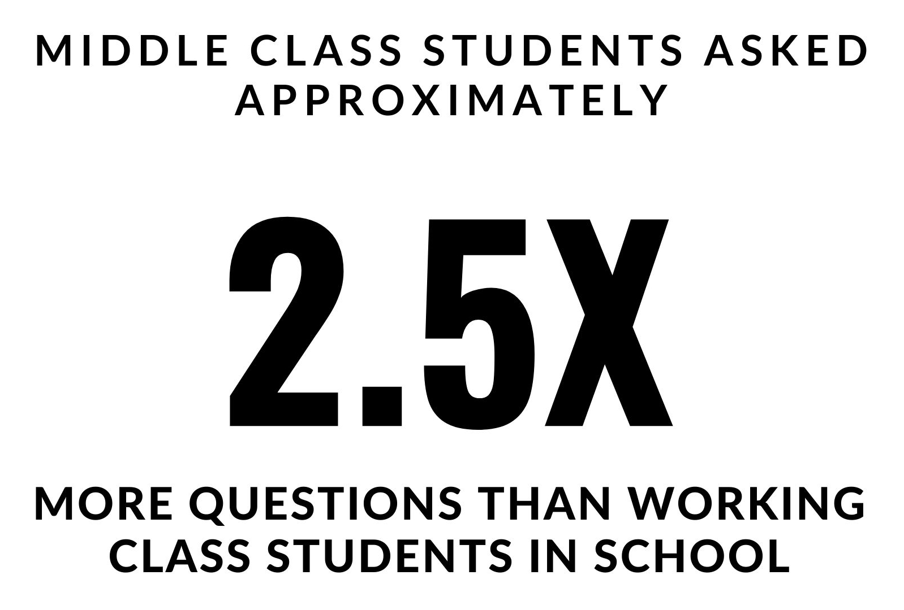
Which students ask questions?
Tizard, B., Hughes, M., Carmichael, H., & Pinkerton, G. (1983)
Carter, A., Croft, A., Lukas, D., Sandstrom, G. (2017).
Notes:
First: Tizard, B., Hughes, M., Carmichael, H., & Pinkerton, G. (1983). Children’s questions and adults’ answers. Journal of Child Psychology and Psychiatry, 24, 269-281.
Girls (mean age 3 years 11 months) from working class and middle class families asked 24 and 29 questions per hour at home, respectively. At school, these same girls asked on average 1.4 and 3.7 questions per hour (working and middle class, respectively)
Second:
Carter, A., Croft, A., Lukas, D., Sandstrom, G. (2017). Women’s visibility in academic seminars: Women ask fewer questions than men
Men are two and a half times more likely to ask a question in an academic seminar than women, according to a major study that offers further explanation of female underrepresentation in science.
Researchers who collected observational data from 247 departmental seminars at 35 institutions in 10 countries found that the two and a half times difference significantly misrepresented the gender ratio of the audience, which was, on average, equal.

Slide 21
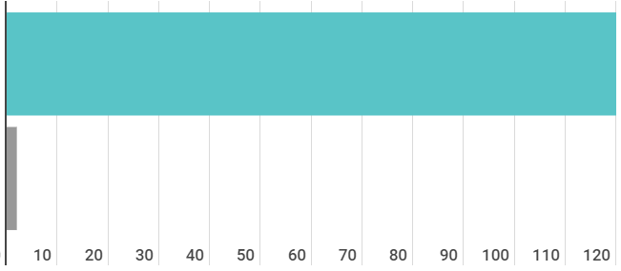
Question Asking in School
Who’s asking questions over the course of an hour?
Educators
Students
Dillon, 1988, p. 199

Slide 22
We can work together on creating more opportunities for all people to ask their own questions
Notes:
More deliberate, intentional work on teaching the skill of question formulation and fostering environments (for students AND for adults, teachers, parents) that invite questions from those who may not typically be expected to ask. It is a very subtle way to shift power dynamics and dialogue patterns in a room.

Slide 23
We Are Not Alone
More than 1 million classrooms worldwide
Notes:
Millions of classrooms and many other organizations—including voting, healthcare, social services, legal services, soup kitchens, halfway homes…many groups of disenfranchised adults AND highly educated, highly resourced folks can all benefit from honing this skill.

Slide 24
What happens when individuals do learn to ask their own questions?

Slide 25
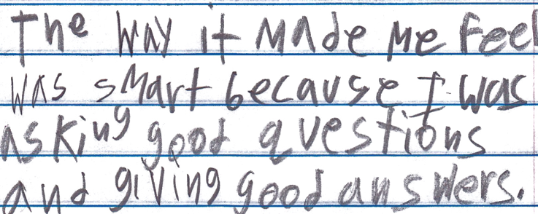
Student Reflection
“The way it made me feel was smart because I was asking good questions and giving good answers.”
-Boston 9th grade summer school student

Slide 26
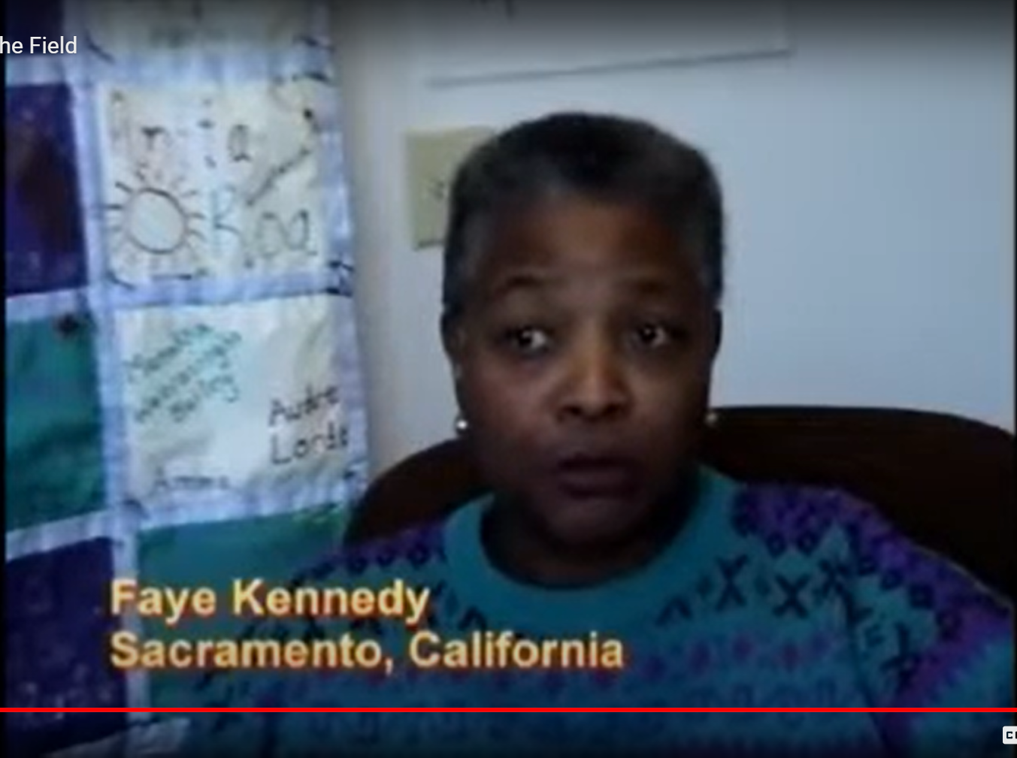
Parent Reflection
https://rightquestion.org/resources/video-voices-from-the-field/

Slide 27
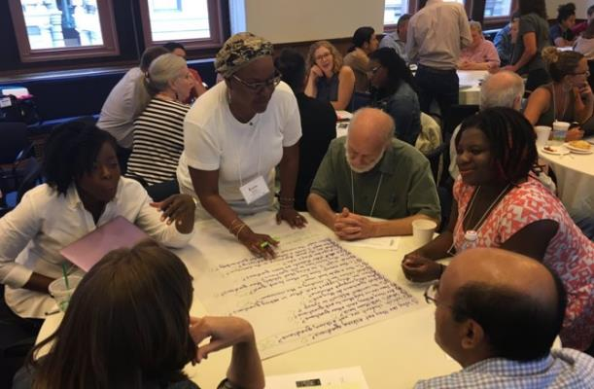
Collaborative Learning with the Question Formulation Technique (QFT)
Notes:
The next 30 minutes or so will be highly participatory and of course we’re going to be putting you to work. You may want to get some paper or pull up a blank document on your computer screen now. And remember, watch out for the chat box icon. I will tell you when you need to type into it.
The timing may be a little quick, so don’t worry if you haven’t completed every step; we’re more giving you a taste of the whole process. we will be moving you quickly through an experience to demonstrate how we go through the process, but will be rushing to make sure there is time for your questions at the end." This is giving you a taste

Slide 28
The Question Formulation Technique (QFT)
Individuals learn to:
Produce their own questions
Improve their questions
Strategize on how to use their questions
Reflect on what they have learned and how they learned it

Slide 29
There are 2 icons you will see in this experience:
This means please work on your own
This means use your chat box to share some of your work now
(We’ll invite you to share more via Twitter at the end)

Slide 30
Rules for Producing Questions
1. Ask as many questions as you can
2. Do not stop to answer, judge, or discuss
3. Write down every question exactly as stated
4. Change any statements into questions

Slide 31
Produce Questions
Ask Questions
Follow the Rules
Ask as many questions as you can.
Do not stop to answer, judge, or discuss.
Write down every question exactly as it was stated.
Change any statements into questions.
Number the Questions

Slide 32
Question Focus
Ask as many questions as you can.
Do not stop to answer, judge, or discuss.
Write down every question exactly as it was stated.
Change any statements into questions.
Number the questions.
Photograph of a store owned by a Japanese American family, taken by Dorothea Lange in Oakland, CA, March, 1942.
https://www.loc.gov/pictures/item/2004665381/

Slide 33
Share & Build
Share at least one question in the chat box (any question you want).
Read what others write in the chat box.
Add at least one new question to your own list, based on someone else’s question.

Slide 34
Categorize Questions: Closed/Open
Definitions:
Closed-ended questions can be answered with a “yes” or “no” or with a one-word answer.
Open-ended questions require
more explanation.
Directions: Identify your questions as closed-ended or open-ended by marking them with a “C” or an “O.”

Slide 35
Discuss
Closed-ended Questions
Advantages
Disadvantages

Slide 36
Discuss
Open-ended Questions
Advantages
Disadvantages
Notes:
The point here is that the closed ended questions are equally useful as open-ended!!!

Slide 37
Improve Questions
Take one closed-ended question and change it into an open-ended question.
Take one open-ended question and change it into a closed-ended question.
Write these as new questions at the bottom of your list.
Closed
Open
Open
Closed

Slide 38
Prioritize Questions
Review your list of questions
Choose the three questions you are most curious to discuss further.
While prioritizing, think about your Question Focus.
After prioritizing consider…
Why did you choose those three questions?
Where are your priority questions in the sequence of your entire list of questions?

Slide 39
Action Plan
Moving from priority questions into action steps.
In order to answer your priority questions:
What do you need to know? Information
What do you need to do? Tasks
Generate a few ideas of what you might do next to answer or explore your own priority questions.

Slide 40
Share
Please share in the chat box:
ONE of your priority questions
One idea from action plan
The numbers of your 3 priority questions out of the total number (Ex: 1,5,9 out of 12 total)
Think:
What do you notice, if anything, about the sequences?

Slide 41
Reflect
What did you learn?
How did you learn it?
What did you notice about how the process was facilitated?
How do you see applying this technique to your own work?
After reflecting, use the chat box to share your response to ONE of the questions above.

Slide 42
Share your list of questions
@RightQuestion
@cobb_ss
#QFT
#NSSSA2020

Slide 43
A Look Inside the Process

Slide 44
The QFT, on one slide…
Ask as many questions as you can
Do not stop to discuss, judge or answer
Record exactly as stated
Change statements into questions
Question Focus
Produce Your Questions
Follow the rules
Number your questions
Improve Your Questions
Categorize questions as Closed or Open-ended
Change questions from one type to another
Strategize
Prioritize your questions
Action plan or discuss next steps
Share
Reflect
Closed-Ended:
Answered with “yes,” “no” or one word
Open-Ended: Require longer explanation
Source: The Right Question Institute rightquestion.org
Notes:
It is NOT just a question brainstorming process
Say something about the LARGER POINT of the PROCESS—it is about changing the way that school is played

Slide 45
Three thinking abilities
with one process

Slide 46
Thinking in many different directions
Divergent
Thinking

Slide 47
Narrowing Down, Focusing
Convergent
Thinking

Slide 48
Thinking about Thinking
Metacognition

Slide 49
Widespread Adoption
Ashley Melville & Trudy Delhey | Cobb County School District | GA
Notes:
Sticky notes
Pens
Chart paper
Coaching article

Slide 50
Connect
How ideas presented CONNECTED to what you already knew?
Extend
What new ideas did you get that EXTENDED or pushed your thinking in new directions?
Challenge
What is still CHALLENGING or confusing for you to get your mind around? What questions, wonderings or puzzles do you now have?

Slide 51
National
State
District
School
Classroom
Our
Cobb
Experience

Slide 52
National
IDM (Inquiry Design Model)
C3 Framework Disciplinary Literacies

Slide 53
Inquiry Arc
Raising Questions & Planning Inquiries
Applying Disciplinary Tools & Thinking
Evaluating Sources & Using Evidence
Communicating Conclusions & Taking Action
1
2
dimensions
3
4
Notes:
[10] Trudy & Ashley talk about their experience, include disciplinary connections
What does the qft have to do with socials studies?
The QFT can be used in every dimension of the inquiry arc
D1 – they have to raise questions to inquire about in the first place, they have ask what is the best way to answer the question – what do I need to know and do in order to answer the inquiry question
D2 – what kinds of questions would a historian, economist, political scientists, or geographer ask to answer the inquiry question?
D3 – what sources should I analyze to answer my inquiry question? How would a historian, economist, political scientist, or geographer evaluate the source and use the evidence to answer the inquiry question?
D4 – what’s the best way to communicate my conclusions and answer the inquiry question? Analyze a social problem and determine the best line of action

Slide 54
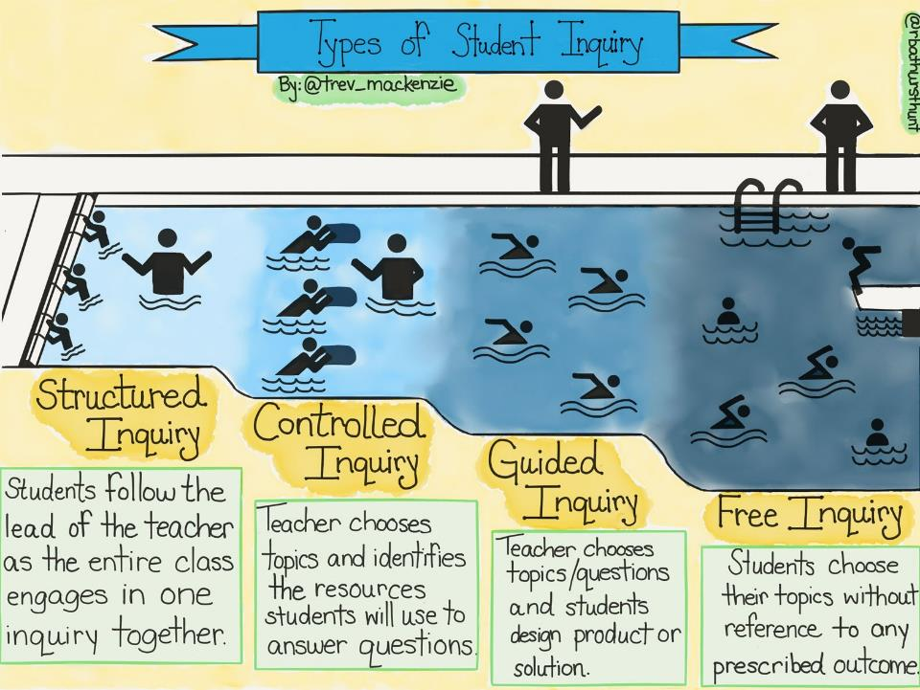
@Trev_MacKenzie

Slide 55
Raising Questions & Planning Inquiries
Applying Disciplinary Tools & Thinking
Evaluating Sources & Using Evidence
Communicating Conclusions & Taking Action
1
Disciplinary Literacies
Civic mindedness
Economic Decision making
Geospatial reasoning
Historical thinking
2
3
4
Notes:
Inquiry literacies are the tools and skills students need in order to navigate dimensions 1, 3, and 4 of the inquiry cycle. In dimension 1, raising questions and planning inquires, students must be able to . . . Read slide

Slide 56
Raising Questions & Planning Inquiries
Applying Disciplinary Tools & Thinking
Evaluating Sources & Using Evidence
Communicating Conclusions & Taking Action
Inquiry Literacies
Construct questions
Determine helpful sources
Select sources
1
2
Gather information form sources
Evaluate sources
Make claims
Use evidence
3
Construct, adapt, present, & critique arguments & explanations
Analyze social problems
Assess options for action
Take informed action
4
Notes:
Inquiry literacies are the tools and skills students need in order to navigate dimensions 1, 3, and 4 of the inquiry cycle. In dimension 1, raising questions and planning inquires, students must be able to . . . Read slide

Slide 57
State
GCSS
Metro Supervisors
Neighboring districts
GADOE inquiry video

Slide 58
District
Cobb New Teacher Academy
Cobb Teacher Leader Academy
District-wide PL Days & after school trainings
Humanities in Practice (HiP) Innovation Academy
Transdisciplinary
Inquiry Conference
Department Heads/Coordinators

Slide 59
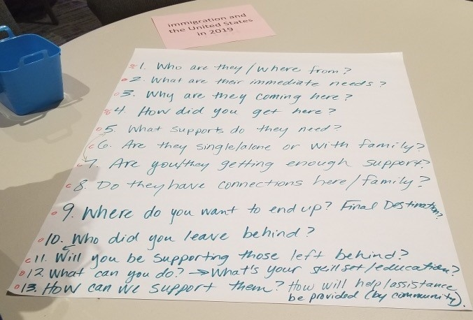
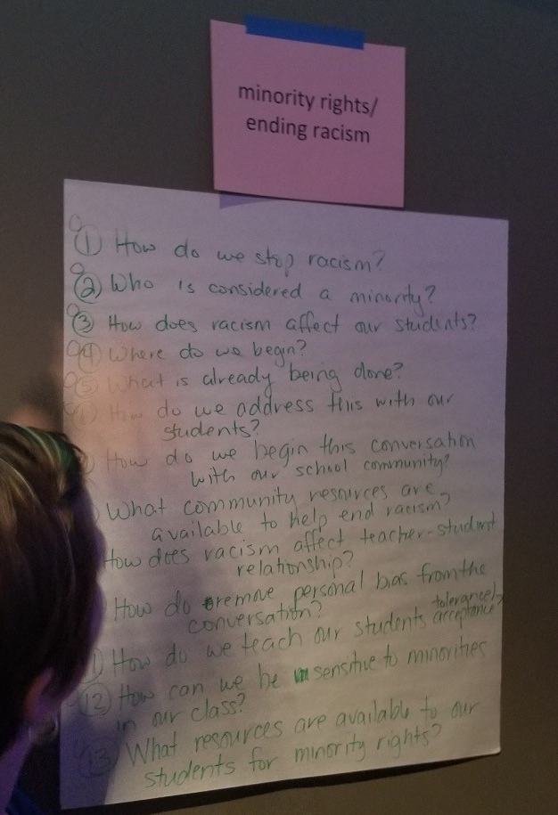
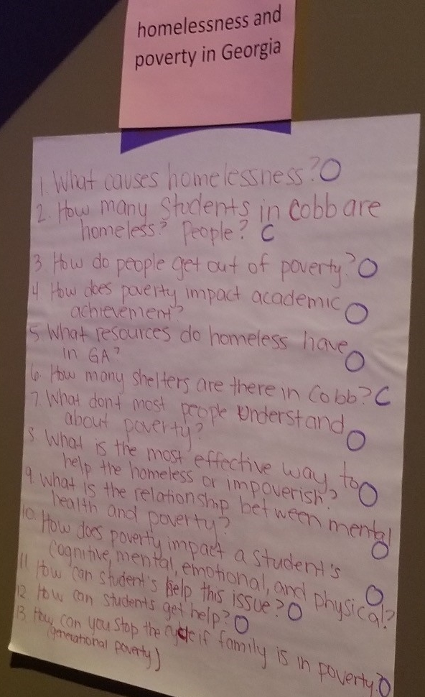
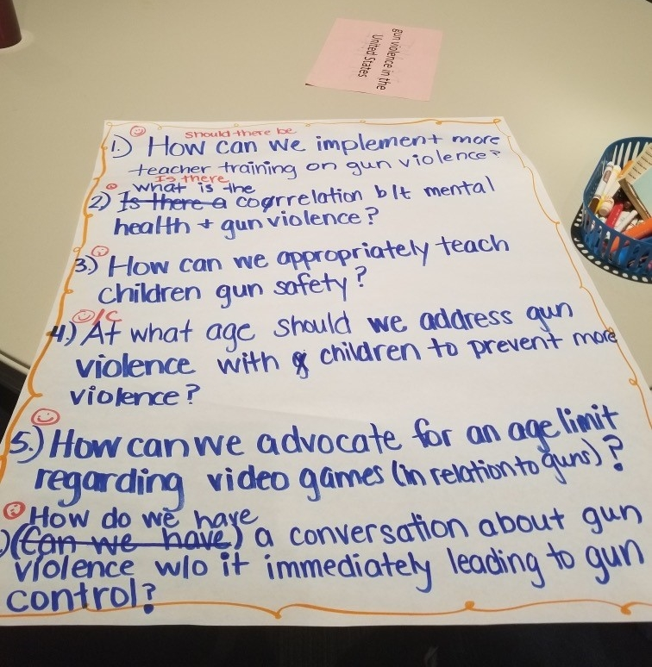
recycling and taking care of the planet
homelessness and poverty in Georgia
minority rights/ending racism
gender inequality in the 21st century
LGBT rights in the 21st century
gun violence in the United States
immigration and the United States in 2019
social media, too much technology, and teens
teen depression and mental health
bullying/anti-bullying
lack of youth voice in the public school setting
abolishing the death penalty

Slide 60
School
Local School Request
Inquiry PLC’s
IB
TKES

Slide 61
Classroom Example: Elementary School – 2nd grade
Teacher: Carol Morreale, Smyrna, GA
Topic: Geography
Purpose: To gauge students’ map and globe skills as well as their knowledge about Georgia’s geographic regions
Notes:
Ashley

Slide 62
Standard
SS2G1 Locate and compare major topographical features of Georgia and describe how these features define Georgia’s surface.
Locate and compare the geographic regions of Georgia: Blue Ridge, Piedmont, Coastal Plain, Ridge and Valley, and Appalachian Plateau.
Locate on a physical map the major rivers: Savannah, Flint, and Chattahoochee.
Notes:
Ashley

Slide 63
Notes:
Ashley

Slide 64
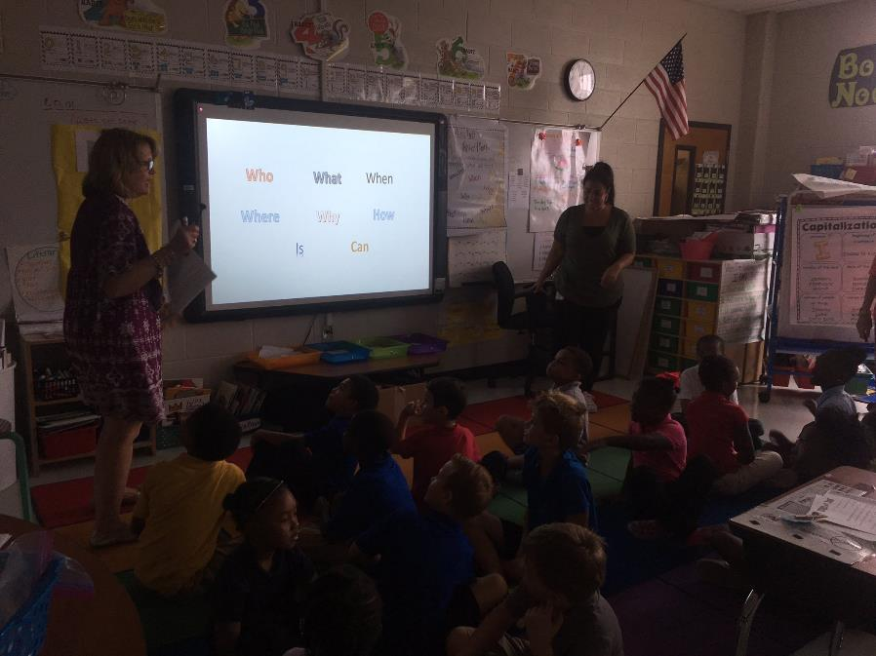
Notes:
Ashley
Students had been learning about “question” words in an earlier Language Arts lesson, so they briefly reviewed possible question starters.

Slide 65
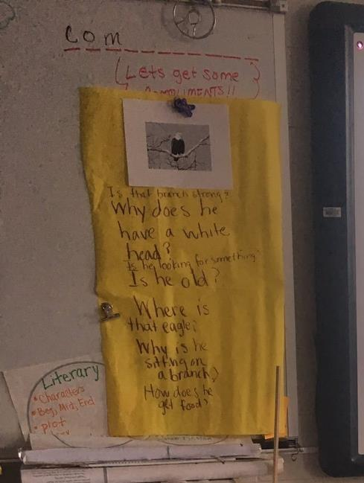
Notes:
Ashley
This was the first time students had done the QFT. We briefly modeled the QFT for students before we went over the rules. We used a different Qfocus than they were using later. We had them deduce the rules from our behavior. What did they notice us doing/not doing? We then introduced the rules on the board to confirm their observations. We had to explain what words like “discuss, judge, or answer” questions meant.

Slide 66
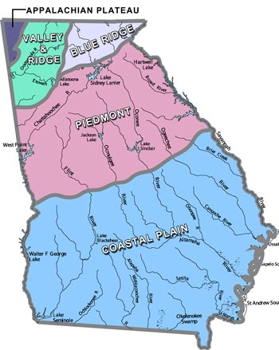
QFocus
Georgia’s Five Regions
Notes:
Ashley

Slide 67
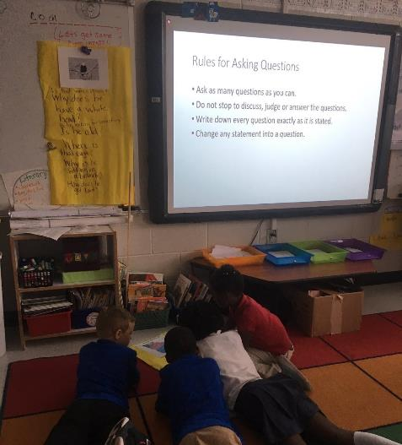
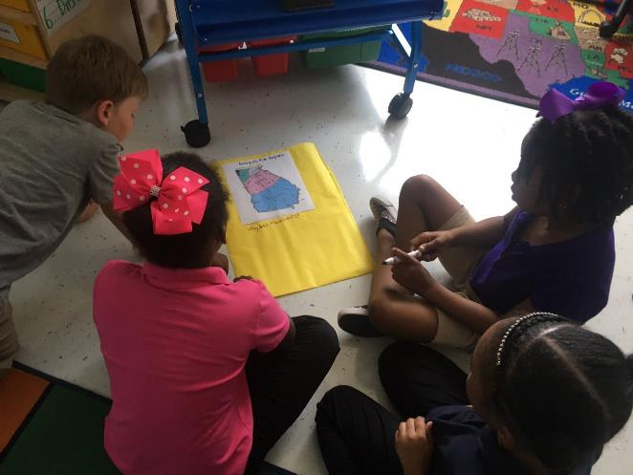
Students working on the QFT
Notes:
Ashley

Slide 68
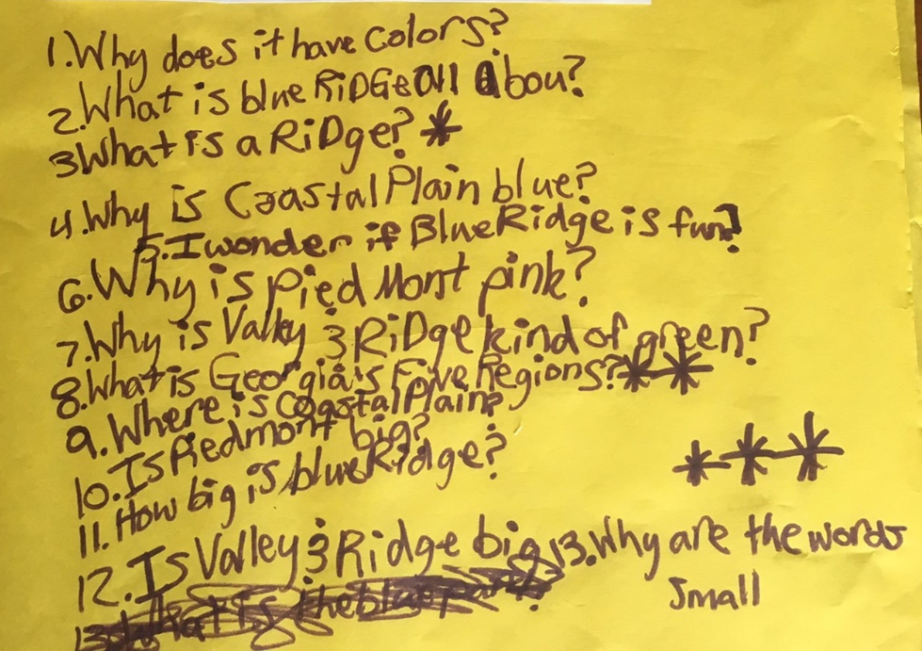
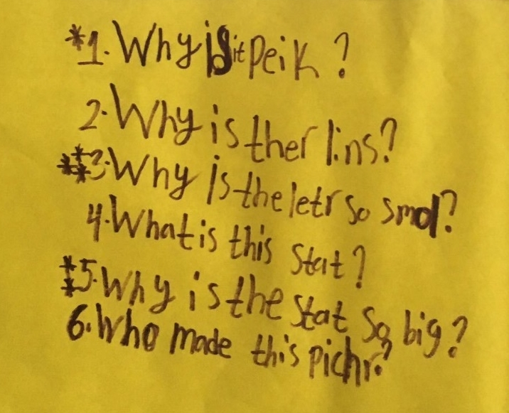
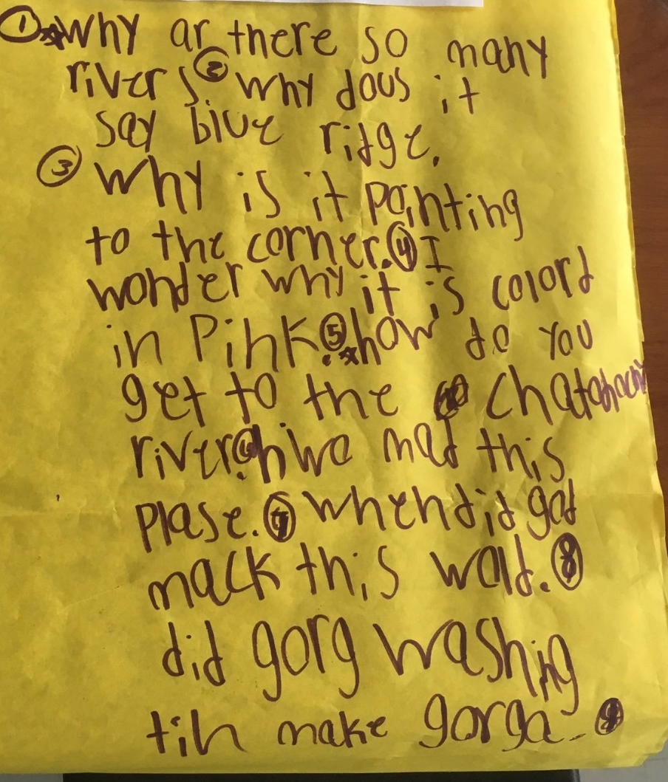
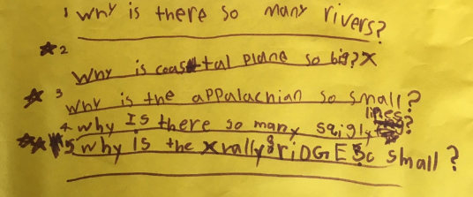
Student Questions
Notes:
Ashley
Group 1
Why is it peik?
Why is there lines?
Why is the letter so small?
What is this state?
Why is the state so big?
Who made this picture?
Group 2
Why are there so many rivers?
Why does it say blue ridge?
Why is it pointing to the corner?
I wonder why it is colored in pink
How do you get to the Chato…river
Who made this place?
When did god make this world?
???
Group 3
Why does it have colors?
What is blue Ridge about?
What is a ridge?
Why is Coastal Plain blue?
I wonder if Blue Ridge is fun?
Why is Piedmont pink?
Why is Valley & Ridge kind of green?
What is Georgia’s five regions?
Where is coastal plain?
Is Piedmount big?
How big is Blue Ridge?
Is Valley & Ridge big?
Why are the words small?
Group 4
Why is there so many rivers?
Why is coastal plain so big?
Why is the Appalachian so small?
Why is there so many s,,,, lines?
Why is the Valley & Ridge Small?

Slide 69
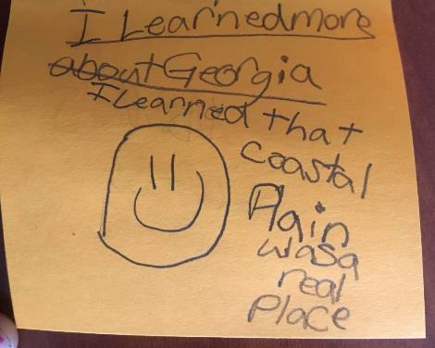
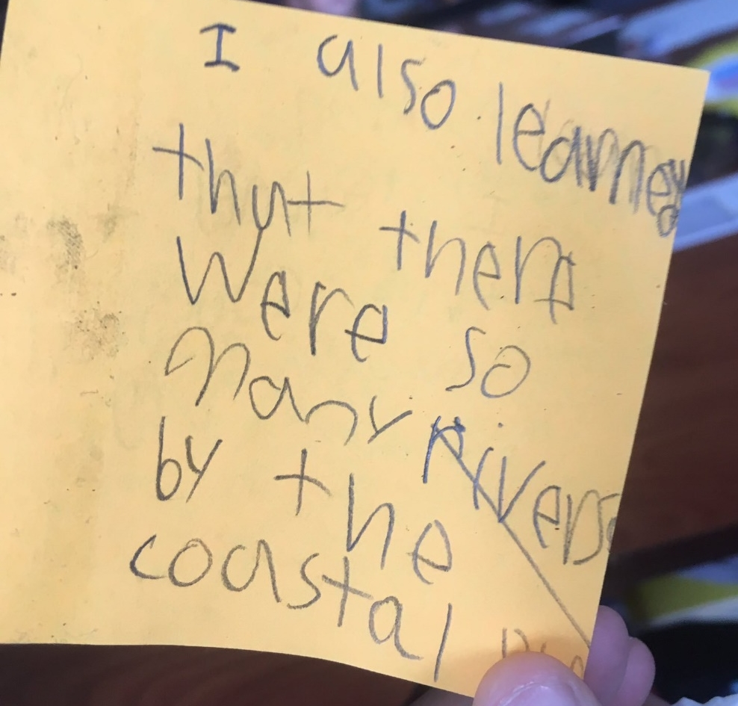
Student Reflection
Notes:
Ashley

Slide 70
Next Step
The teacher used the student questions to plan differentiated learning experiences for Georgia’s geographic regions and map/globe skills.
Notes:
Ashley

Slide 71
TKES 3. Instructional Strategies
The teacher . . .
Engages students in active learning and maintains interest.
Builds upon students’ existing knowledge and skills.
Uses a variety of research-based instructional strategies and resources.
Develops higher-order thinking through questioning and problem-solving activities.

Slide 72
TKES 6. Assessment Uses
The teacher . . .
Teaches students how to self-assess and to use metacognitive strategies in support of lifelong learning.

Slide 73
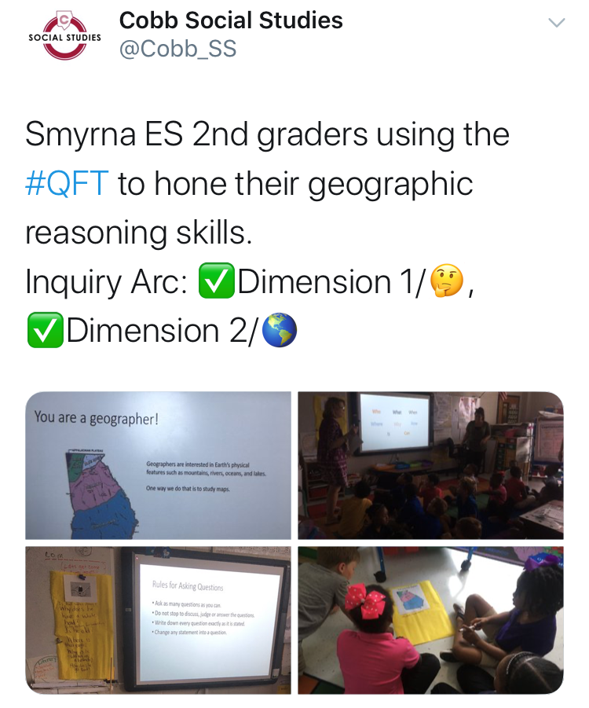
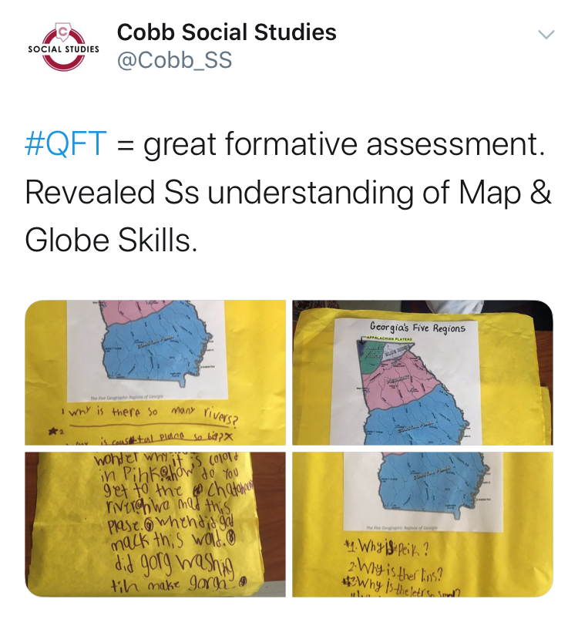
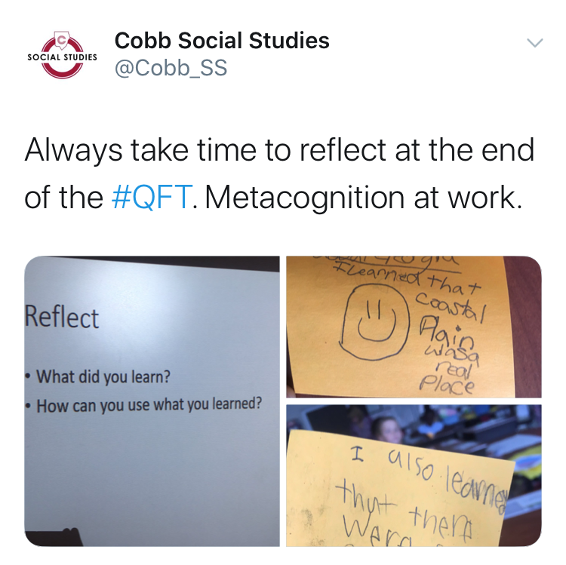
Tweet to Document, Share, Connect

Slide 74
Virnilisa Printup
Coordinator of Social Studies and Fine Arts Rockdale County Public Schools

Slide 75
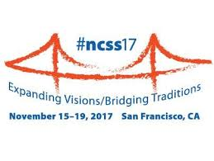
Our Journey
2017-2018
2018-2019
2019-2020
QFT for Leaders
Assistant Principals Principals
Instructional Support Team
Ongoing Teacher Training*
RCPS Professional Learning Institute
Independent Learning Days
On-Demand School-Based PD
Ongoing Teacher Training*
RCPS Professional Learning Institute
Independent Learning Days
On-Demand School-Based PD
Virtualizing the QFT
District Coaches, Coordinators, and
Digital Learning Specialists
Science Teacher Leader Cohort-Mathematics and Science Partnerships Grant
Student Academic Competition Support
Social Studies Fair Research Model
National History Day Research Model
Social Studies and Science Georgia Standards of Excellence Mini-Conference

Slide 76
Enhancing Professional Learning with the QFT
Question Focus (QFocus):
Some students are not asking questions.
Instructional Support Team reviews state testing disparities broken down by subgroup data.

Slide 77
Next Steps
Follow-up with returning leaders
Train new leaders
Train new teachers
Ongoing training for returning teachers
Refresher Course
I’ve Tried It: Now What?
Capacity Building for Teacher Leaders
RQI Course at Harvard Graduate School of Education

Slide 78
With WHOM and HOW would you like to share the QFT?
Notes:
Think about who and how would you like to share the QFT? Share in the chat

Slide 79
Why is the skill of question formulation so important now?

Slide 80
The Challenges and Rewards of Curiosity
“Curiosity is unruly. It doesn’t like rules, or, at least, it assumes that all rules are provisional, subject to the laceration of a smart question nobody has yet thought to ask. It disdains the approved pathways, preferring diversions, unplanned excursions, impulsive left turns. In short, curiosity is deviant.”
-Ian Leslie, Curious: The Desire to Know and Why Your future Depends on It
Notes:
This is why we fear asking questions—it is messy, it takes time, it doesn’t “follow the rules,” it challenges. But I love the idea that curiosity is deviant—isn’t innovation and deviance a fine line? Chaotic, unexpected…sounds a bit like COVID to me. The world is unruly and unplanned sometimes. Isn’t questioning one of the best ways to chart a path forward through unprecedented territory? We need mavericks.

Slide 81
Virtual Professional Learning Example
Topic: Plans for the 2020-2021 School Year
Purpose: Engaging school and district staff in contingency planning around COVID-19 and the start of the school year via ZOOM and GoogleDocs

Slide 82
Question Focus
The 2020-2021 school year will begin with a blended learning environment.

Slide 83
Selected Participant Questions
What are our options? Half days? Alternating?
What are the advantages of having students alternating days with eLearning on the other days?
Would we do a staggered start?
What role would eLearning play?
How will the model we choose impact our community if parents are also going back to work?
How much time do we need to allow for cleaning?
How could we utilize our buildings differently?
How do we work with parents who do not want to send their student to school?
How can we continue to support parents?
What if the Health Dept. makes decisions around closing our district?
How do we need to adjust our supply lists to account for students learning at home/school?
How can we minimize costs to families?
How do we ensure every family has the technology they need for their child to e-learn?
How do we consider courses we can offer?
How do we look at vertical alignment to account for incomplete learning?
How do we continue to integrate the strengths we have discovered in eLearning?
How do we maximize face to face time?
How do we shift eLearning time to fit this blended approach?
Do we need to continue an eLearning plan for possible future closure?
What would it look like if we continued our team lesson planning and shared teaching responsibilities to help with sharing the load?

Slide 84
Next Steps with Questions
Participants suggested action steps as they were able and began to populate a shared google doc with questions, action steps, and information gathering
Several small groups formed to focus on different areas and report back
The principal reported: “It changed how I am approaching the problem. It doesn’t put all the pressure on one person. People aren’t worried about answers rather than just getting questions out there. Questions also create more questions which makes for a better decision making outcome.”

Slide 85
RQI’s Virtual Learning Resources
Access all of RQI’s Virtual Learning Resources:
https://rightquestion.org/remote-learning-resources/

Slide 86
In the Age of Google
“How should you respond when you get powerful new tools for finding answers?
Think of harder questions.”
– Clive Thompson
Journalist and Technology Blogger

Slide 87
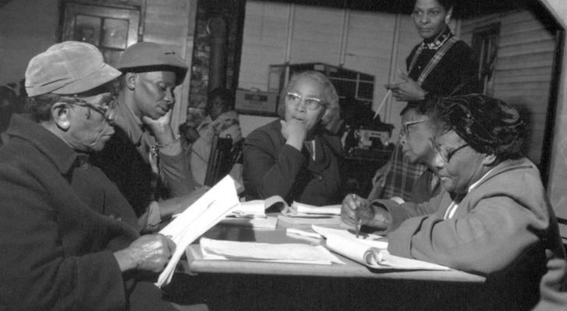
Questions and Democracy
“We need to be taught to study rather than to believe, to inquire rather than to affirm.”
– Septima Clark
Chapter 6 on Septima Clark in Freedom Road: Adult Education of African Americans (Peterson, 1996)

Slide 88
What are your questions?
Notes:
4:45

Slide 89
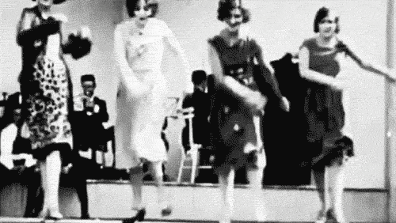
Thank you! Enjoy!

Slide 90
Using & Sharing RQI’s Resources
The Right Question Institute offers materials through a Creative Commons License. You are welcome to use, adapt, and share our materials for noncommercial use, as long as you include the following reference:
“Source: The Right Question Institute (RQI). The Question Formulation Technique (QFT) was created by RQI. Visit rightquestion.org for more information and free resources.”
Access the full library of resources: http://rightquestion.org/education/resources

