Slide 1
Cultivating a Lifelong Explorer Mindset through Student-Led Inquiry
Fay Gore
Mid-Atlantic Regional Director, Education
National Geographic Society
Sarah Westbrook Director of Professional Learning The Right Question Institute(RQI)

Slide 2
Who is in the room?
Please introduce yourself with your name and location in the Chat box

Slide 3
Today’s Agenda
Intros & housekeeping
What is an ‘explorer mindset’ and how do we help all students to develop one?
Collaborative learning with the Question Formulation Technique (QFT)
Resources and next steps
Final thoughts

Slide 4
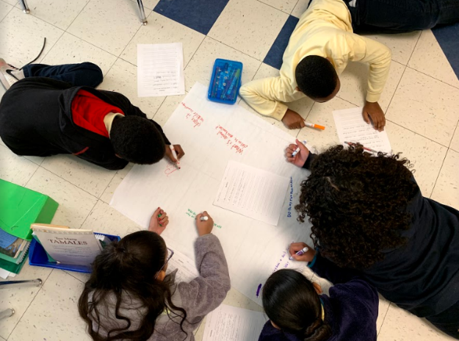
Our core, shared philosophy: Student curiosity drives learning

Slide 5
EXPLORER MINDSET
OUR LEARNING FRAMEWORK
ATTITUDES
SKILLS
KNOWLEDGE
-
NATGEOED.ORG
Notes:
But first, a little more background. The National Geographic Learning Framework is built around a set of learning outcomes that describe what it means to be an explorer—or what we call the “explorer mindset.” In other words, it aims to define the attitudes, skills, and knowledge areas students needed to think like explorers.

Slide 6
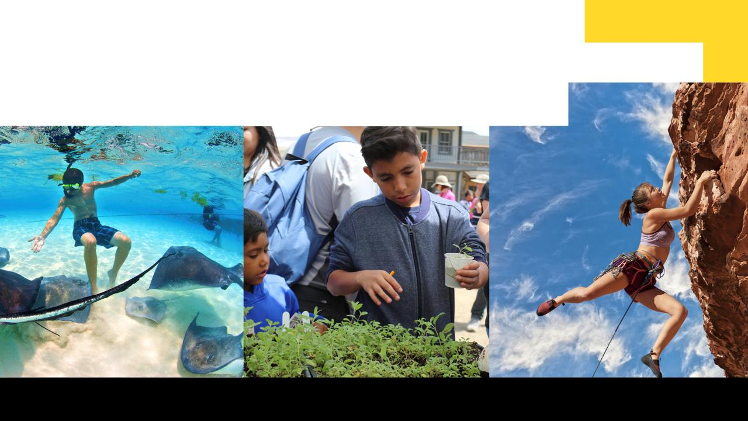
ATTITUDES
EXPLORERS ARE:
RESPONSIBLE
EMPOWERED
CURIOUS &
Adventurous
-
NATGEOED.ORG
Notes:
…CURIOUS and adventurous – curious about how the world works, seeking out new and challenging experiences throughout their lives.
Explorers feel EMPOWERED to make a difference. They act on curiosity, respect, responsibility, and adventurousness, and they persist in the face of challenges.

Slide 7
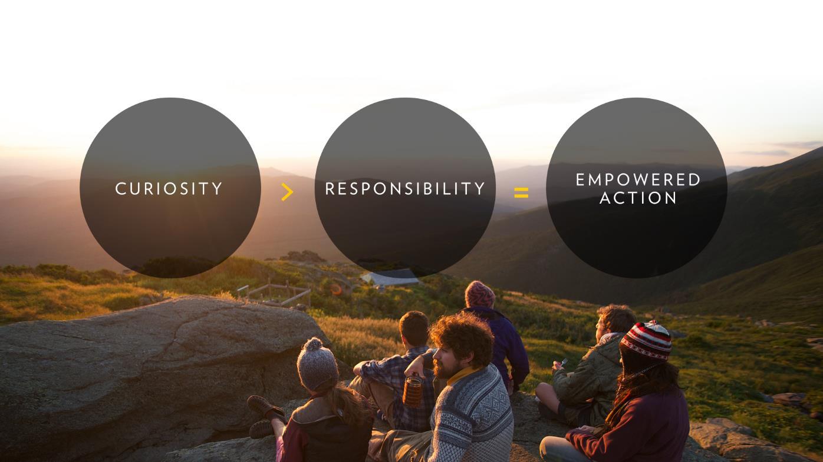
LEADING
TO EMPOWERED
ACTION
NATGEOED.ORG
Notes:
We see these three attitudes as existing on a continuum, where curiosity leads to responsibility, which culminates in empowered action.

Slide 8
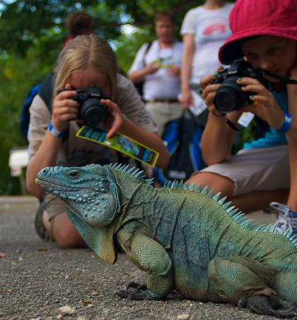
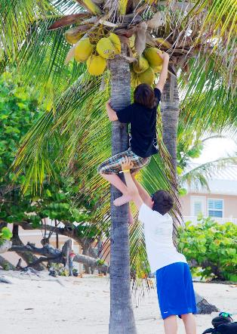
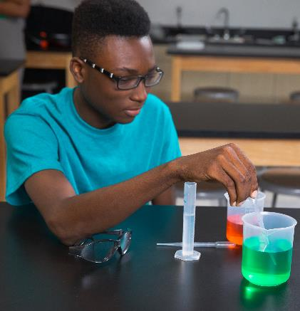
SKILLS
EXPLORERS CAN:
OBSERVE
COMMUNICATE
COLLABORATE
PROBLEM-SOLVE
-
NATGEOED.ORG
Notes:
And explorers are PROBLEM SOLVERS. They are able to generate, evaluate, and implement solutions to problems. They are capable decision makers—able to identify alternatives and weigh trade-offs to make well-reasoned decisions.

Slide 9
KNOWLEDGE
EXPLORERS UNDERSTAND:
WILDLIFE & WILD PLACES
OUR CHANGING PLANET
THE HUMAN JOURNEY
NATGEOED.ORG
Notes:
In addition to the skills and attitudes of an explorer, people need to understand how our ever-changing and interconnected world works in order to function effectively and act responsibly. Critical knowledge required of explorers can be expressed through the three National Geographic key focus areas.

Slide 10
Notes:
One of the ways that we support educators and young people with developing an Explorer Mindset is through inquiry where students can further develop their attitudes and use their skills to solve real world problems in their community. Students begin by asking questions through investigations and use real data to tell a compelling story and get others to act.

Slide 11
Research on the Importance of Questioning
Self-questioning (metacognitive strategy):
Student formulation of their own questions is one of the most effective metacognitive strategies
Engaging in pre-lesson self-questioning improved students rate of learning by nearly 50% (Hattie, p.193)
John Hattie
Visible Learning: A Synthesis of Over 800
meta-Analyses Relating to Achievement, 2008
Notes:
UC Davis Research Linking Curiosity to Memory (UC Davis) 2014
The Fullerton Longitudinal Study (FLS), a 30-plus year study of the development of giftedness across various points in time conducted by Adele and Allen Gottfried of California State University ”This finding has strong implications for the development of STEM considering that curiosity is a fundamental predictor of the aspiration to become a scientist.”
S. von Stumm, B. Hell, T. Chamorro-Premuzic. The Hungry Mind: Intellectual Curiosity Is the Third Pillar of Academic Performance. Perspectives on Psychological Science, 2011 meta-analysis shows They found that curiosity did, indeed, influence academic performance. In fact, it had quite a large effect, about the same as conscientiousness. When put together, conscientiousness and curiosity had as big an effect on performance as intelligence.

Slide 12
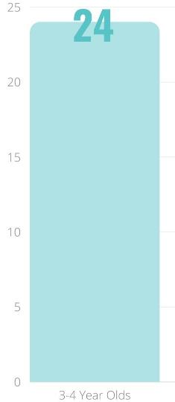
Question Asking Declines with Age
Tizard, B., Hughes, M., Carmichael, H., & Pinkerton, G. (1983).
Pearson, J.C. & West, R. (2009)
Notes:
First Graph:
Tizard, B., Hughes, M., Carmichael, H., & Pinkerton, G. (1983). Children’s questions and adults’ answers. Journal of Child Psychology and Psychiatry, 24, 269-281.
Tizard, B., Hughes, M., Carmichael, H., & Pinkerton, G. (1983). Children’s questions and
adults’ answers. Journal of Child Psychology and Psychiatry, 24, 269-281.
This research study examines two groups of children, one from middle class families and one from working class families, to explore socioeconomic status differences in question-asking behavior at home and at school.

Slide 13
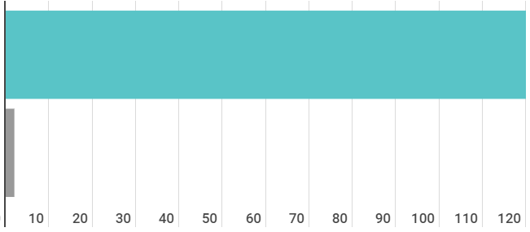
Question Asking by Adolescence
Who’s asking questions over the course of an hour?
Educators
Students
Dillon, 1988, p. 199

Slide 14
We can work together on creating more opportunities for all students to ask their own questions and develop an explorer mindset (for geographic study and for LIFE!)

Slide 15
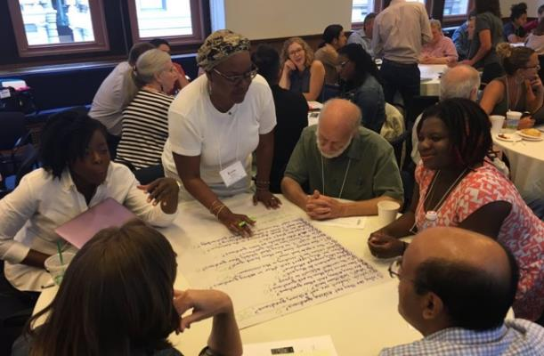
Collaborative Experience with the Question Formulation Technique (QFT)

Slide 16
There are 2 icons you will see in this experience:
This means that you should be thinking or working on the task assigned
This means get ready to use your chat box to share some of your work

Slide 17
The Question Formulation Technique (QFT)
Individuals learn to:
Produce their own questions
Improve their questions
Strategize on how to use their questions
Reflect on what they have learned and how they learned it

Slide 18
Rules for Producing Questions
1. Ask as many questions as you can
2. Do not stop to answer, judge, or discuss
3. Write down every question exactly as stated
4. Change any statements into questions

Slide 19
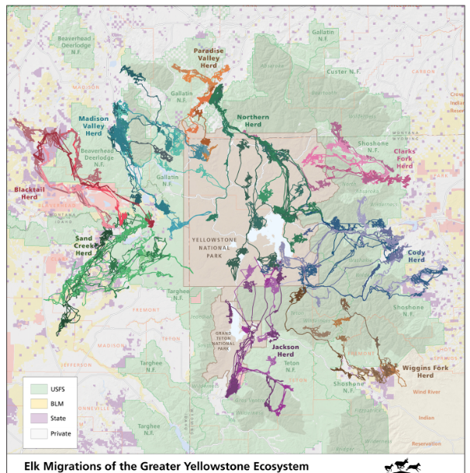
Question Focus
Ask as many questions as you can.
Don’t stop to answer, judge, or discuss.
Record each question exactly as it was stated (or first came to mind).
Change any statements into questions.
Number your questions.

Slide 20
Categorize Questions: Closed/Open
Definitions:
Closed-ended questions can be answered with a “yes” or “no” or with a one-word answer.
Open-ended questions require
more explanation.
Directions: Identify your questions as closed-ended or open-ended by marking them with a “C” or an “O.”

Slide 21
Discuss
Closed-ended Questions
Advantages
Disadvantages

Slide 22
Discuss
Open-ended Questions
Advantages
Disadvantages

Slide 23
Improve Questions
Take one closed-ended question and change it into an open-ended question.
Take one open-ended question and change it into a closed-ended question.
Number and add new questions to the bottom of your list
Closed
Open
Open
Closed
Notes:
.

Slide 24
Prioritize Questions
Review your list of questions
Choose three questions that you feel best reveal the story that this graph is telling.
Then, think about why you chose those questions.
After prioritizing, use the chat box to share ONE of your priority questions.

Slide 25
Action Plan
Moving from priority questions into action steps.
In order to answer your priority questions:
What do you need to know? Information
What do you need to do? Tasks

Slide 26
Share
Using the Chat Box, please share:
One idea for what you might do next (to go about answering priority questions)
- and -
The numbers of your three priority questions in your original sequence (For ex: “2, 4, 7 out of 8 total”)

Slide 27
Reflect
What did you learn?
How do you see using this?
After reflecting, use the chat box to share your response to ONE of the questions above.

Slide 28
Check out the Real-Life Explorer Inspiration
Why are more Elk calves dying? Are wolves responsible?
What is Elk migration really like?
https://media.nationalgeographic.org/assets/file/Case_Study_Arthur_Middleton_SECURE.pdf
Conclusions:
“The movement in and out of Yellowstone is like the pulse of the ecosystem. Man made lines on a map do not represent the real-life territory animals needs to survive.”

Slide 29
A Look Inside the Process

Slide 30
The QFT, on one slide…
Ask as many questions as you can
Do not stop to discuss, judge or answer
Record exactly as stated
Change statements into questions
Question Focus
Produce Your Questions
Follow the rules
Number your questions
Improve Your Questions
Categorize questions as Closed or Open-ended
Change questions from one type to another
Strategize
Prioritize your questions
Action plan or discuss next steps
Share
Reflect
Closed-Ended:
Answered with “yes,” “no” or one word
Open-Ended: Require longer explanation
Source: The Right Question Institute rightquestion.org
Notes:
It is NOT just a question brainstorming process
Say something about the LARGER POINT of the PROCESS—it is about changing the way that school is played

Slide 31
Three thinking abilities
with one process

Slide 32
Thinking in many different directions
Divergent
Thinking

Slide 33
Narrowing Down, Focusing
Convergent
Thinking

Slide 34
Thinking about Thinking
Metacognition

Slide 35
Today’s Agenda
Intros & housekeeping
What is an ‘explorer mindset’ and how do we help all students to develop one?
Collaborative learning with the Question Formulation Technique (QFT)
Resources and next steps
Final thoughts

Slide 36
Resources and Next Steps
https://bit.ly/3qxPim2

Slide 37
Access RQI’s Free QFT Resources
https://rightquestion.org/education/resources
Classroom Examples
Instructional Videos
Planning Tools & Templates

Slide 38
Use and Share These Resources
The Right Question Institute offers materials through a Creative Commons License. You are welcome to use, adapt, and share our materials for noncommercial use, as long as you include the following reference:
“Source: The Right Question Institute (RQI). The Question Formulation Technique (QFT) was created by RQI. Visit rightquestion.org for more information and free resources.”

Slide 39
Why is cultivating the mindset of an explorer so important now?

Slide 40
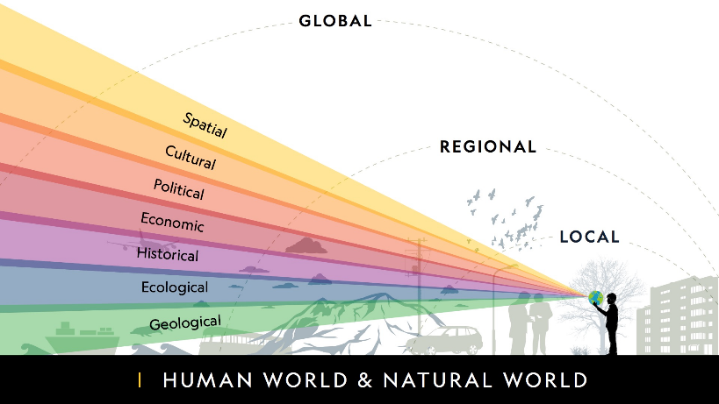
Geographic Thinking as a Life Skill
"A geographically proficient thinker answers geographic questions by using a range of tools and perspectives to acquire data, organize it (often times using maps and other spatial representations), observe, and seek meaning in the patterns...that occur in specific places, at a range of geographic and time scales."
(Bednarz, S.W., Heffron, S., & Huynh, N.T. (Eds.). 2013)
COMMUNICATE
COLLABORATE
PROBLEM-SOLVE

Slide 41
In the Age of Google
“How should you respond when you get powerful new tools for finding answers?
Think of harder questions.”
– Clive Thompson
Journalist and Technology Blogger

Slide 42
Questions and Self-Advocacy
Origin of The Right Question Institute: Parents in Lawrence, MA, 1990
“We don’t go to the school because we don’t even know what to ask.”

Slide 43
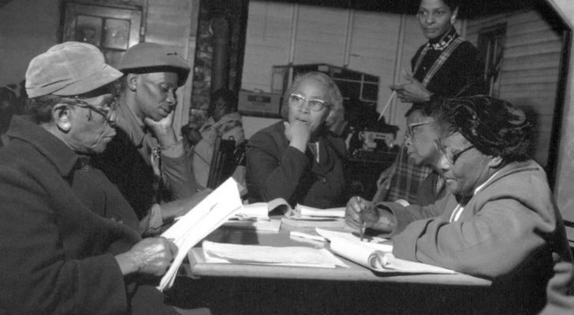
Questions and Democracy
“We need to be taught to study rather than to believe, to inquire rather than to affirm.”
– Septima Clark
Chapter 6 on Septima Clark in Freedom Road: Adult Education of African Americans (Peterson, 1996)

Slide 44
Thank you so much!

