Slide 1
Blending the QFT & the TPS Analysis Tool
A reminder: This meeting is being recorded

Slide 2
Welcome!
Please share in the chat box:
Your name
Where you are joining us from
What you teach (subject, grade level)
One question you have asked someone or that someone has asked you in the last 24 hours

Slide 3
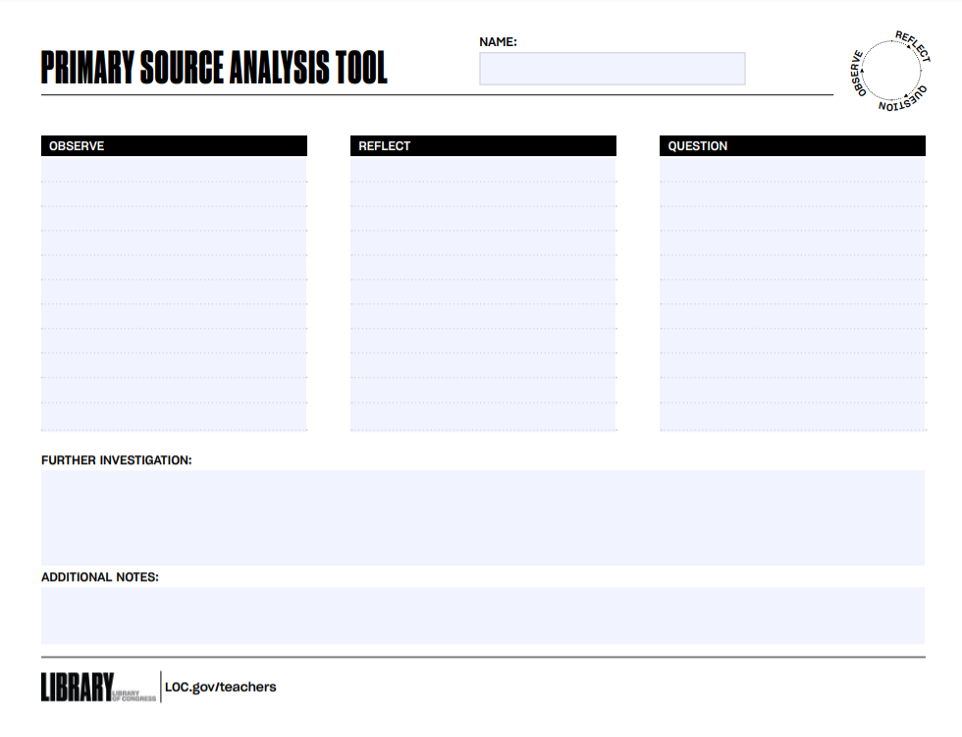
Mini QFT-Primary Source Experience
Question Formulation Technique (QFT)
Primary Source Analysis Tool
UNDER
CONSTRUCTION
https://www.loc.gov/item/2017744592/
https://www.loc.gov/item/2005677799/

Slide 4
Rules for Producing Questions
1. Ask as many questions as you can
2. Do not stop to answer, judge, or discuss
3. Write down every question exactly as stated
4. Change any statements into questions

Slide 5
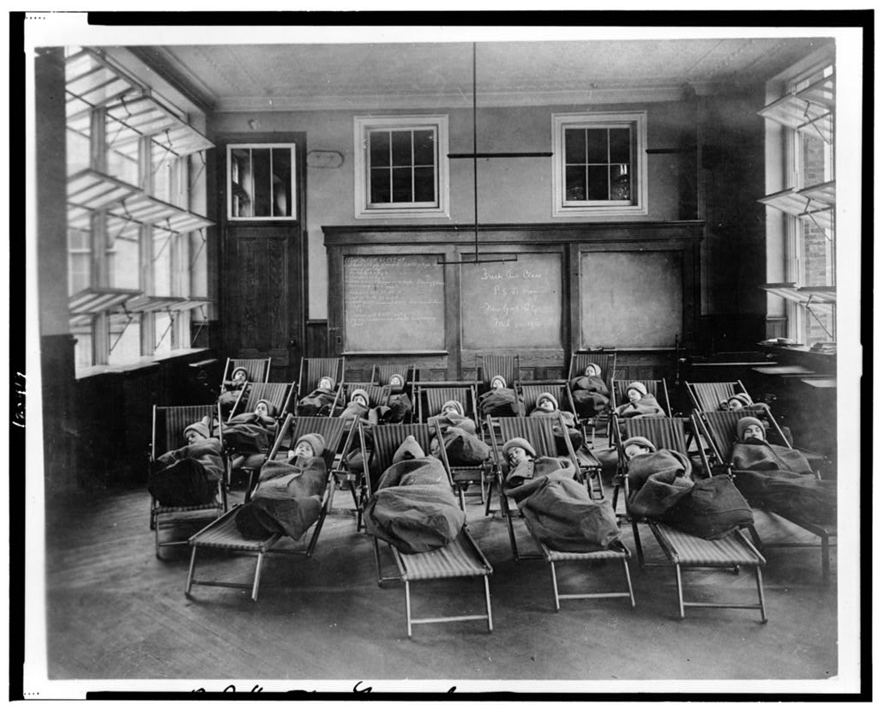
Question Focus
https://www.loc.gov/resource/cph.3c20419/
Don’t Forget To Follow the 4 Rules!
1. Ask as many questions as you can
2. Do not stop to answer, judge, or discuss
3. Write down every question exactly as stated
4. Change any statements into questions
Open air class--Public School #51--Manhattan, N.Y. City--Rest hour

Slide 6
https://www.loc.gov/resource/cph.3c20419/
Open air class--Public School #51--Manhattan, N.Y. City--Rest hour

Slide 7
https://www.loc.gov/resource/cph.3c20419/
Open-air schools were common in some cities as a response to an outbreak of tuberculosis in 1904-1905.
Open air class--Public School #51--Manhattan, N.Y. City--Rest hour

Slide 8
Improve Questions
Now, review your list of questions.
Add at least one new question:
A question inspired by someone else’s
An adaptation or wording change of an existing question to create a new question. (for ex: change an open-ended question to closed-ended or a closed to an open)
Notes:
1 min

Slide 9
Prioritize Questions
Choose the three questions that you are curious to discuss.
Then, think about why you chose those questions.
Notes:
1 min

Slide 10
Observe & Infer
What observations are you making about this image that could help you answer any of your questions?
What can you infer from this image that might help answer a question?
Notes:
1 min

Slide 11
Strategize
Select 2-3 questions that relate to the larger idea of education in some way. You may choose from the existing questions on our list or write a new question (or two) that has emerged for you.
Then, think: What would you like to do with that priority question? Would you set about answering it—how?

Slide 12
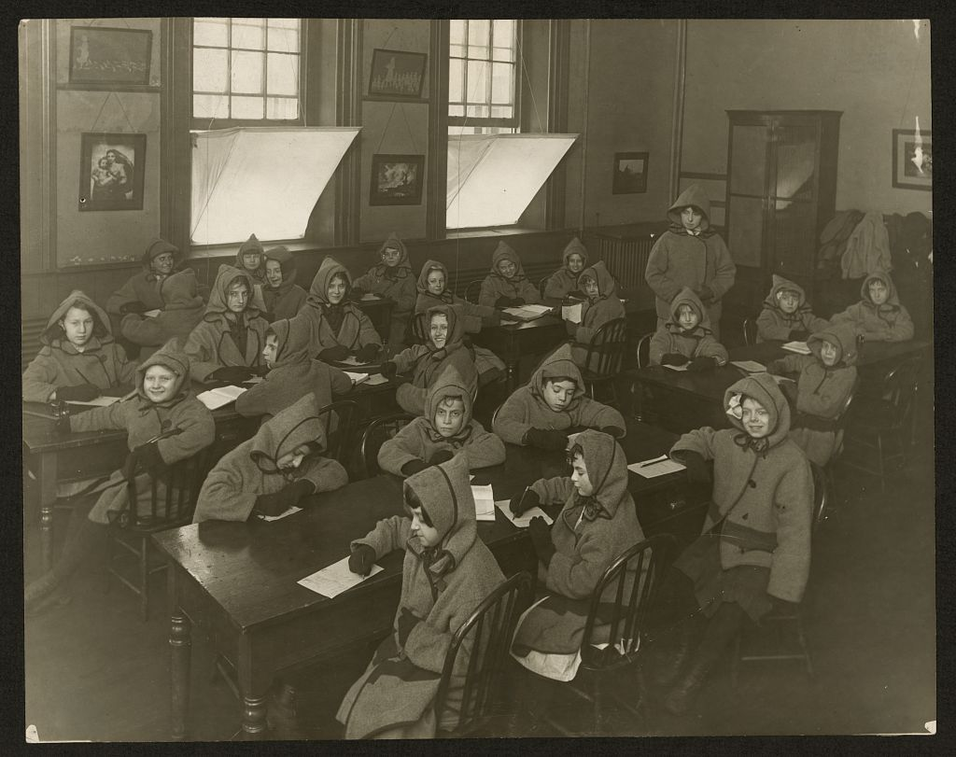
Related Sources
https://www.loc.gov/item/2008675531/
Graham School [or Mosely School], Chicago. Interior - children seated at desks [between 1900 and 1915]

Slide 13
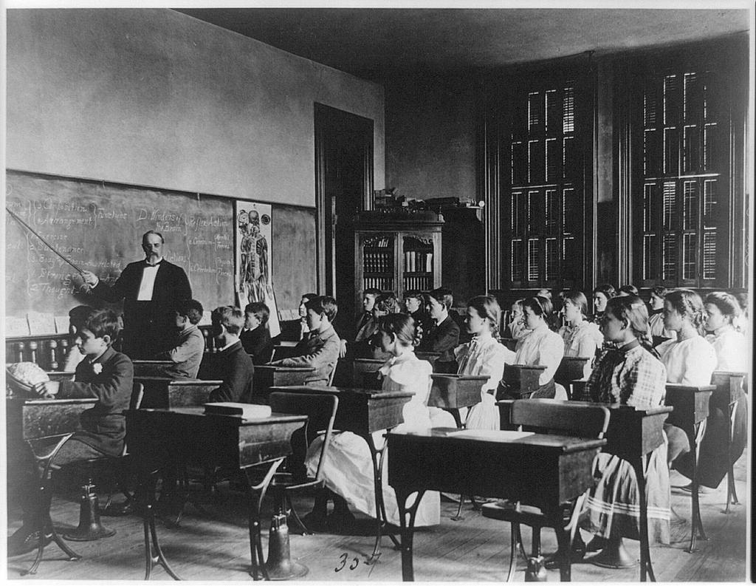
Related Sources
https://www.loc.gov/resource/cph.3a17792/
[School children studying anatomy or health, Washington, D.C.] [1899?]

Slide 14
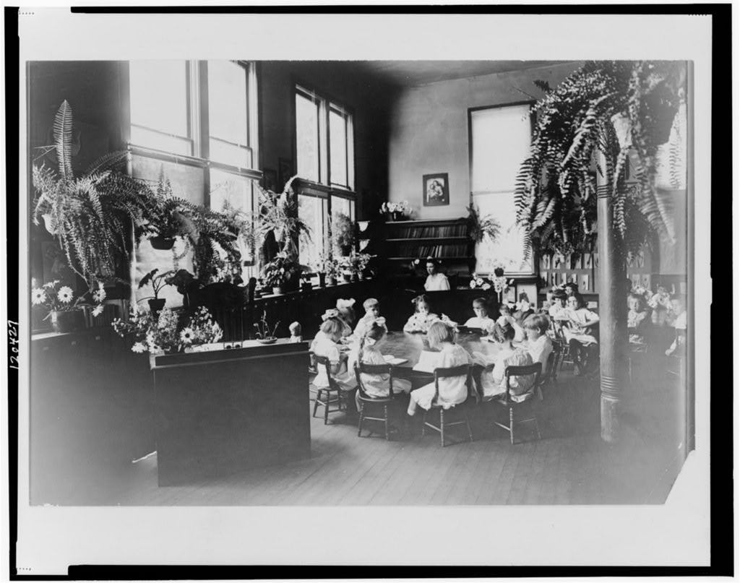
Related Sources
https://www.loc.gov/resource/cph.3c20427/
[Children seated in classroom at a circular table, Sacramento, California] [between 1900 and 1920]

Slide 15
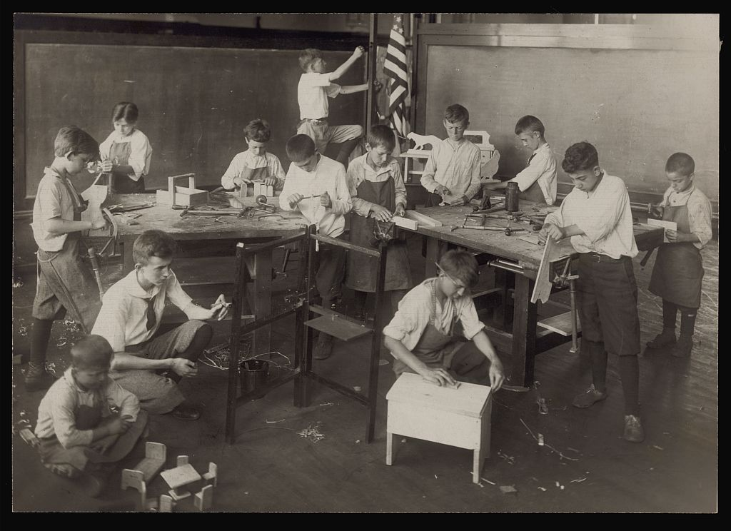
Related Sources
https://www.loc.gov/resource/ppmsca.11778/
Franklin (Chicago) summer open air school, 1917, manual training class / Burke & Atwell, Chgo.

Slide 16
Related Sources
https://loc.gov/pictures/resource/ds.03647/?
[Mathematics class at Tuskegee Institute, 1906]

Slide 17
Reflect
What did you learn?
How are you now thinking differently about the initial primary source?
How do you connect this to your work in education more broadly?

Slide 18
Mini QFT-Primary Source Experience
Question Formulation Technique (QFT)
Primary Source Analysis Tool

Slide 19
The QFT, on one slide…
Ask as many questions as you can
Do not stop to discuss, judge or answer
Record exactly as stated
Change statements into questions
Question Focus
Produce Your Questions
Follow the rules
Number your questions
Improve Your Questions
Categorize questions as Closed or Open-ended
Change questions from one type to another
Strategize
Prioritize your questions
Action plan or discuss next steps
Share
Reflect
Closed-Ended:
Answered with “yes,” “no” or one word
Open-Ended: Require longer explanation
Source: The Right Question Institute rightquestion.org

Slide 20
The TPS Analysis Tool
https://www.loc.gov/programs/teachers/getting-started-with-primary-sources/guides/

Slide 21
What we did today
Observe the QFocus
Produce Questions
Follow the 4 rules
Layer in a Caption
Produce Questions (part 2)
Improve & Add Questions
Prioritize Questions
Observe & Infer
Strategize
Discuss next steps
Observe related primary sources
Produce new questions
Reflect
Ask as many questions as you can
Do not stop to discuss, judge or answer
Record exactly as stated
Change statements into questions
Continue to add &/or Refine Questions

Slide 22
Questions, comments, and feedback

