Slide 1
QFT + TPS Mash-Up: Off the Charts Student-driven Research
NCSS 2021 Virtual Conference
Sarah Westbrook The Right Question Institute
Cambridge, MA
Dr. Ann Canning TPS Eastern Region Waynesburg University Waynesburg, PA
Katy Connolly The Right Question Institute
Cambridge, MA

Slide 2
Who is in the room?
Please share in the chat box:
Your name
Where you are joining us from
What you teach (subject, grade level)

Slide 3
There are 2 icons you will see in this session:
This means that you should be thinking or working on the task assigned
This means get ready to use your chat box to share some of your work

Slide 4
Today’s Agenda
Question Formulation Technique (QFT) + Teaching with Primary Sources (TPS) Overview
Mini QFT+TPS Mashup Experience
Explore Classroom Examples
Take-Away Resources
Q&A

Slide 5
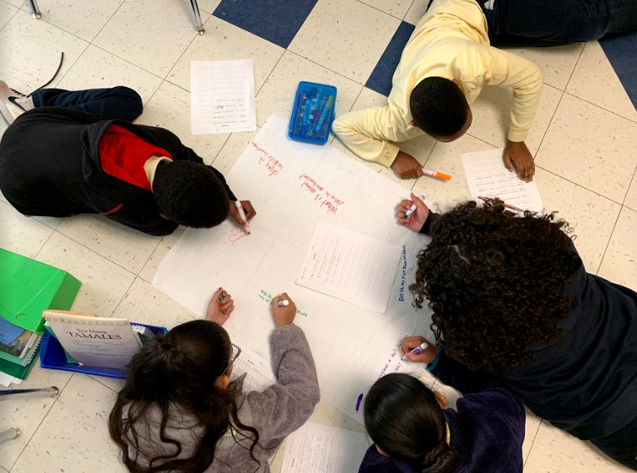
Question Formulation Technique (QFT) and Teaching with Primary Sources (TPS)

Slide 6
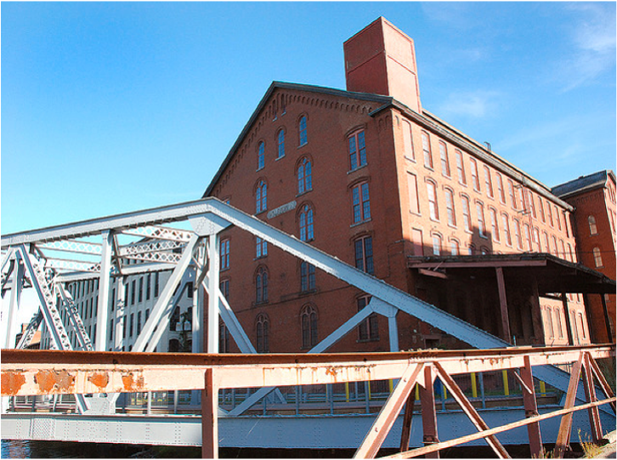
Honoring the Original Source: Parents in Lawrence, Massachusetts, 1990
“We don’t go to the school because we don’t even know what to ask.”

Slide 7
The QFT, on one slide…
Ask as many questions as you can
Do not stop to discuss, judge or answer
Record exactly as stated
Change statements into questions
Question Focus
Produce Your Questions
Follow the rules
Number your questions
Improve Your Questions
Categorize questions as Closed or Open-ended
Change questions from one type to another
Strategize
Prioritize your questions
Action plan or discuss next steps
Share
Reflect
Closed-Ended:
Answered with “yes,” “no” or one word
Open-Ended: Require longer explanation
Source: The Right Question Institute rightquestion.org

Slide 8
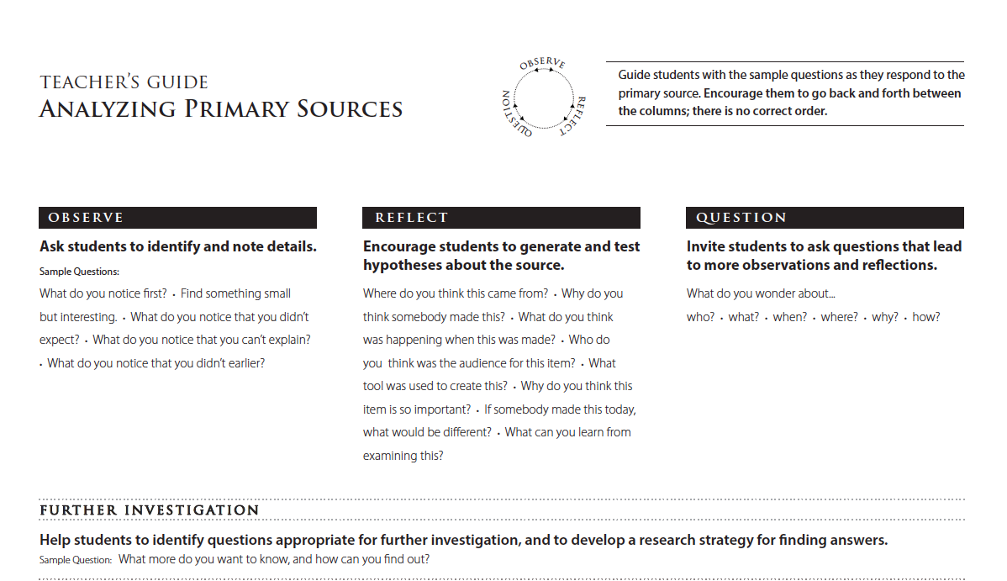

Slide 9
Primary Sources and Inquiry
“Working with primary sources - the raw materials of history
allows students to evaluate information and begin to ask good questions.
Working with primary sources is not necessarily about getting
to the answer but about the questions they inspire and the connections they allow students to make.”
Lee Ann Potter, Director
Library of Congress
Professional Learning and Outreach Initiatives Office
https://www.youtube.com/watch?v=SGq_TSp0UeQ

Slide 10
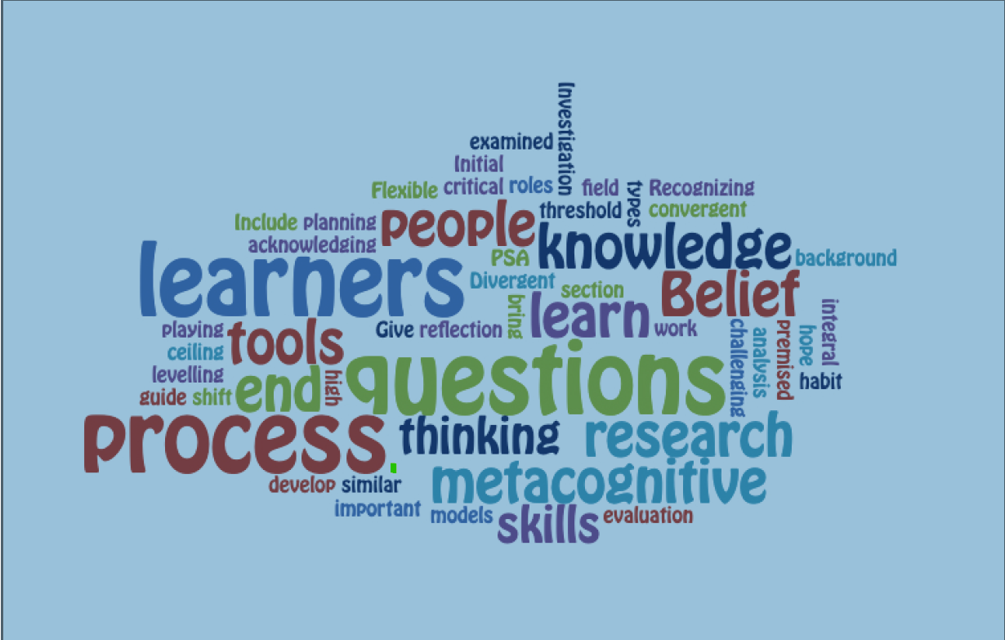
QFT + TPS Similarities

Slide 11
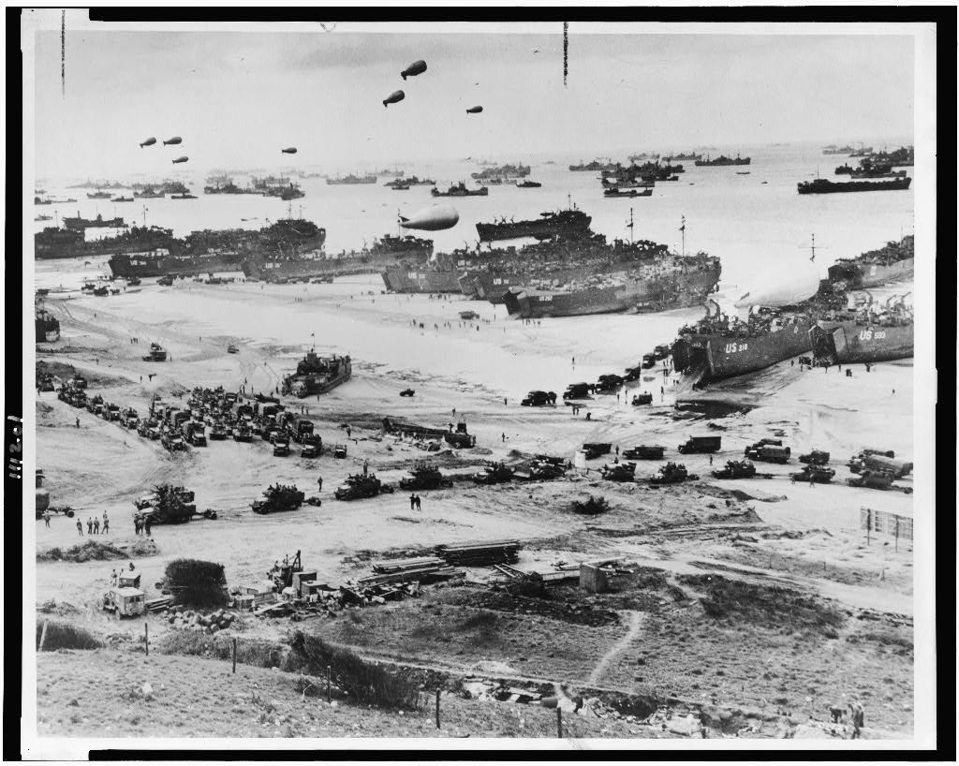
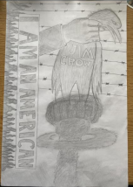
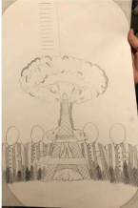
Using a Primary Source with the QFT
“It wasn’t something I had ever done before. Normally we are reading an article and answering questions that don’t make us think. With primary source pictures, you really had to look at all the details to try and understand what was going on which just made my brain work in a way that it never had before.”
--Piper, 12th Grade Student at Gardiner Area High School, Maine
Debra Butterfield’s Padlet for Advanced Placement Research

Slide 12
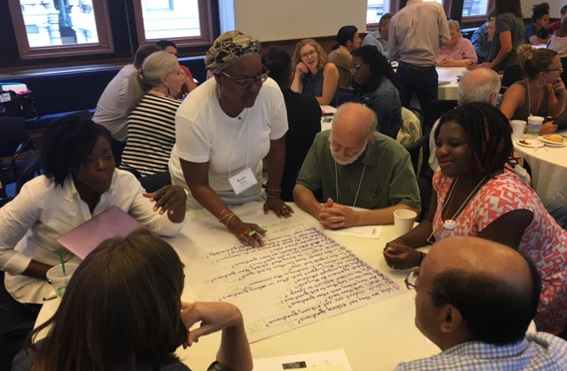
Mini QFT+TPS Mashup Experience

Slide 13
Rules for Producing Questions
1. Ask as many questions as you can
2. Do not stop to answer, judge, or discuss
3. Write down every question exactly as stated
4. Change any statements into questions

Slide 14
Observe & Produce Questions
Observe the Question Focus
Ask Questions
Follow the Rules
Ask as many questions as you can.
Do not stop to answer, judge, or discuss.
Write down every question exactly as it was stated.
Change any statements into questions.
Number the Questions

Slide 15
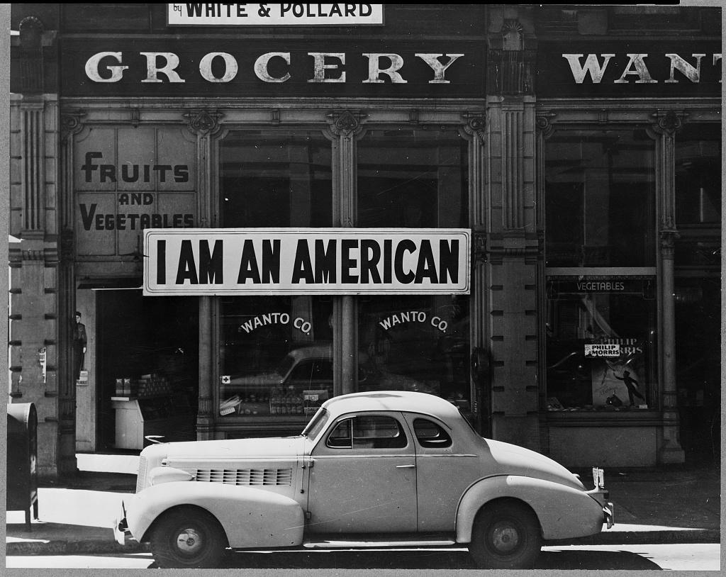
https://www.loc.gov/item/2004665381/

Slide 16
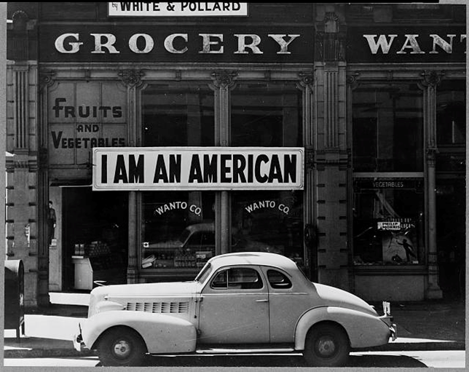
A Japanese-American business owner hung this sign in his store window after the bombing of Pearl Harbor.
https://www.loc.gov/item/2004665381/

Slide 17
Prioritize Questions
Choose the three questions you are most curious about.
Think about why you chose those questions and where they fell in your original sequence of questions (EX: #1, 4, 6 out of 10).
Then share one of your priority questions in the chat box.

Slide 18
Photograph taken by: Dorothea Lange, Oakland, California, Mar. 1942.
https://www.loc.gov/item/2004665381/

Slide 19
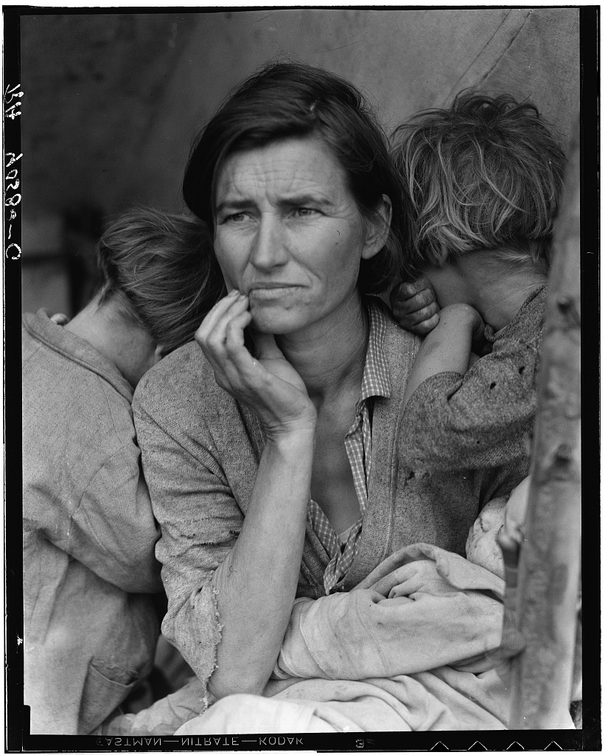
Photograph taken by: Dorothea Lange, Nipomo, California, Mar. 1936.
https://www.loc.gov/item/2004665381/

Slide 20
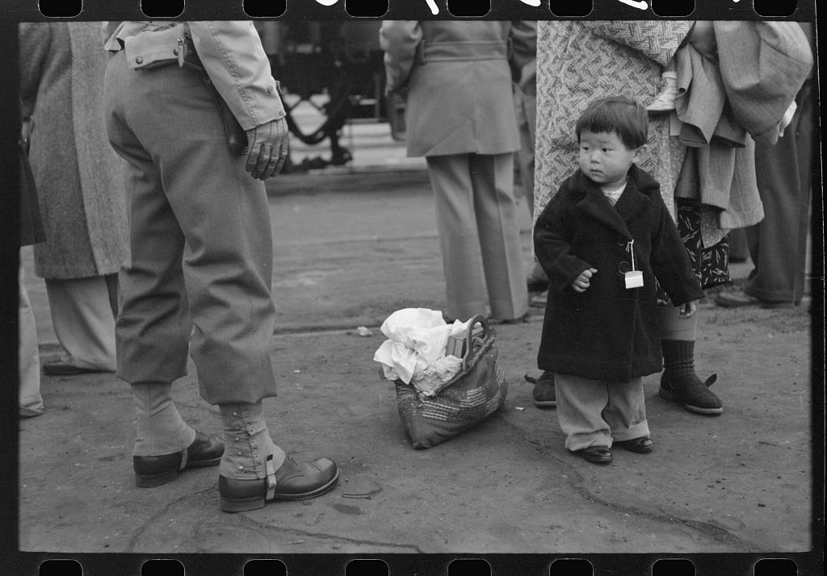
Los Angeles, California. Japanese-American evacuation from West Coast areas under U.S. Army war emergency order. Japanese-American child who will go with his parents to Owens Valley. Russell Lee, 1942. https://www.loc.gov/item/2017744887/

Slide 21
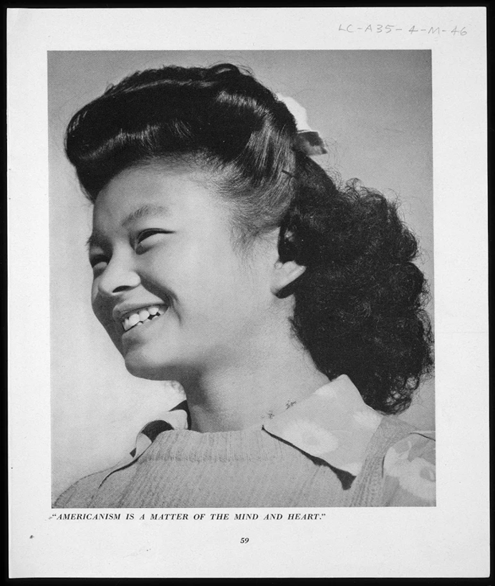
Photograph taken by Ansel Adams at the Manzanar War Relocation Center, 1943. Caption: “Americanism is a matter of the mind and heart.” https://www.loc.gov/resource/gdclccn.45002975/?sp=60

Slide 22
Add & Improve Questions
Now, review your list of questions.
Add at least one new question to your list:
Something that was inspired by another person’s question.
An adaptation or wording change of an existing question to create a new question. (for ex: change an open-ended question to closed-ended or a closed to an open)
Something that was sparked by seeing additional primary sources or building some context

Slide 23
Further Investigation
What inferences can you make about the evidence you have noticed through these primary sources?
Which question(s) do you want to explore deeper?
How could you explore those questions?

Slide 24
Reflect (metacognition)
What did you learn?
How did you learn it?

Slide 25
A Look Inside the Process

Slide 26
What we did today
Ask as many questions as you can
Do not stop to discuss, judge or answer
Record exactly as stated
Change statements into questions
Observe the Question Focus
Produce Your Questions
Follow the rules
Layer in a caption
Produce additional questions
Prioritize Your Questions
Contextualize
Observe related primary sources
Add more questions
Improve Your Questions
Add and/or improve questions (i.e. changing from open to closed and vice versa)
Discuss Further Investigation
Make inferences
Prioritize questions and brainstorm next steps
Reflect (Metacognition)
Closed-Ended:
Answered with “yes,” “no” or one word
Open-Ended: Require longer explanation
tps.waynesburg.edu rightquestion.org

Slide 27
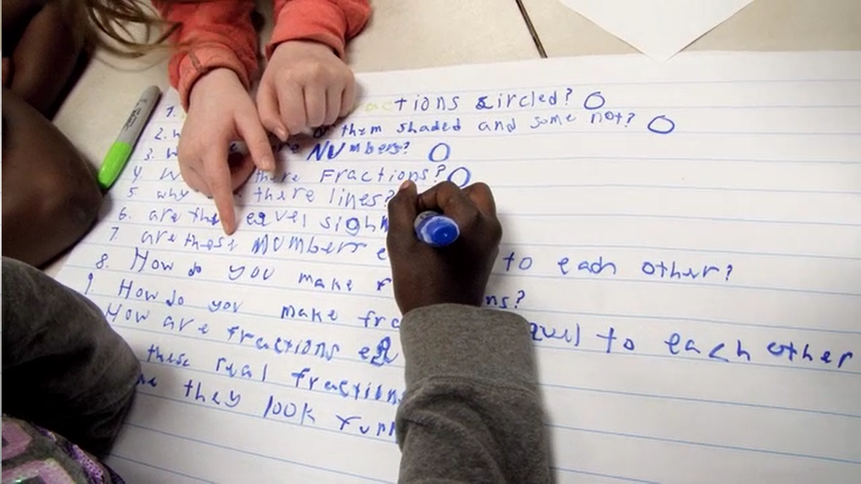
Exploring Classroom Examples

Slide 28
Virtual Classroom Example: 7th Grade English
Teacher: Melissa Lawson, Folsom, California
Topic: Japanese-American Internment
Purpose: To learn how to search the Library of Congress using keywords generated by using the QFT and TPS strategies

Slide 29
Question Focus
Citation
Lange, Dorothea, photographer. Oakland, Calif., Mar. A large sign reading "I am an American" placed in the window of a store, at 401 - 403 Eighth and Franklin streets. Photograph. Retrieved from the Library of Congress, www.loc.gov/item/2004665381/

Slide 30
7th Grade English Class Student Questions
Why were the Americans so harsh?
Did the Asian community ever get full-fledged justice?
I am interested in why the owner specifically put up an I am an American sign. Did others follow this move?
Why did people think the Japanese American citizens were dangerous?
What does the sign mean to Japanese Americans?
What does this have to do with being American?
What is the meaning of this sign?
Who put the sign there?
Were White and Pollard significant people or everyday people?
Why are there so many vegetable signs?
Does this sign symbolize something?

Slide 31
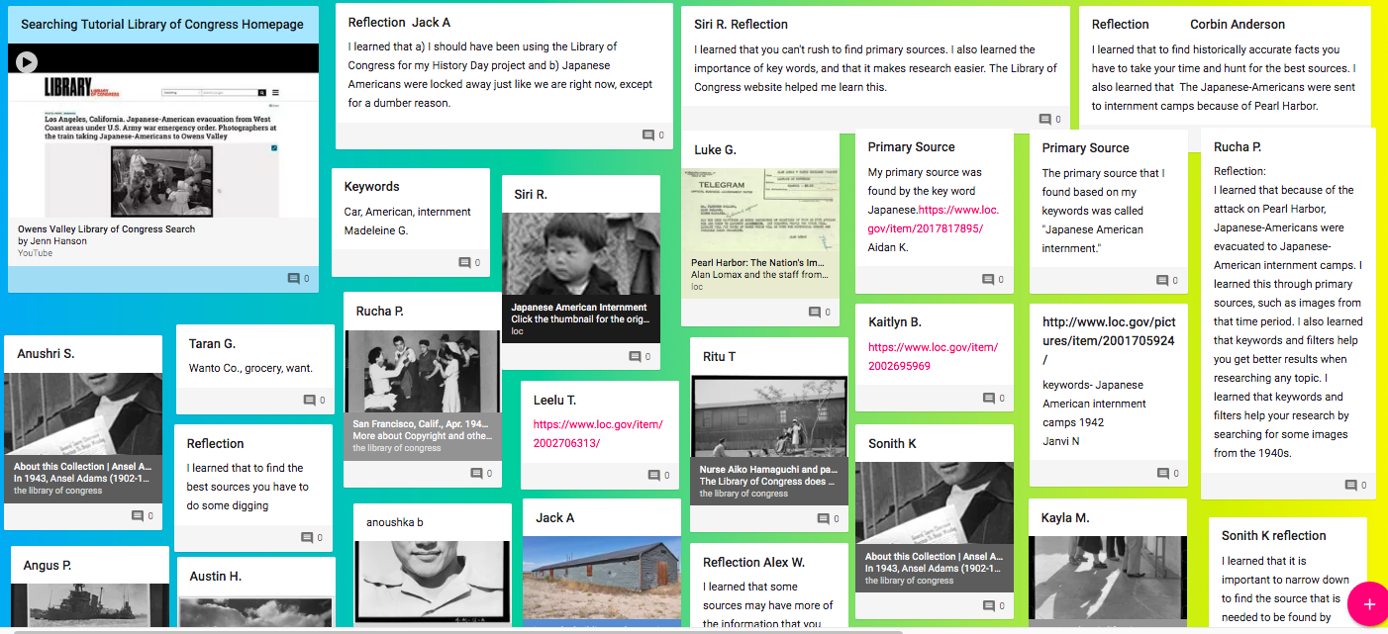
Next Steps with Student Questions
Melissa Lawson’s Padlet

Slide 32
Classroom Example: 11-12th Grade Women’s and Gender Studies
Teacher: Caroline Berz, Cambridge, MA
Topic: Intersectionality & the women’s suffrage movement
Purpose: Prompt student research and discussion on the role of BIPOC women activists in fighting for the right to vote in the early 1900s.

Slide 33
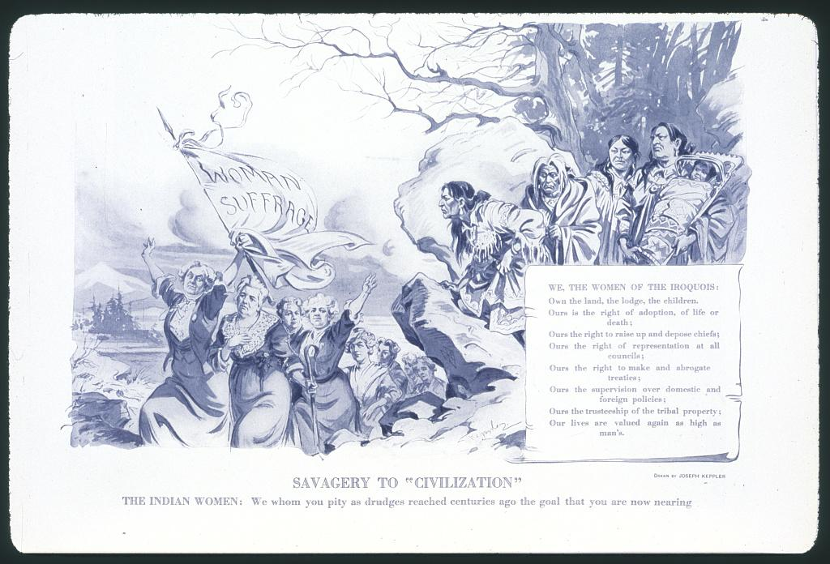
Question Focus
https://www.loc.gov/resource/cph.3b49089/
Text at the bottom reads: THE INDIAN WOMEN: We whom you pity as drudges reached centuries ago the goal that you are now nearing

Slide 34
Student Questions
Why are the indigenous women shown with children but the white women are not?
Is it a coincidence that the women in front styled their hair like the founding fathers?
What is the meaning of “savagery” in this image?
Are the indigenous women supposed to be the “savage” while the other group of women is the “civilized”? Would that explain why the indigenous women are hiding?
Why does the text about the Native women show them in a more positive light, but the drawing shows them in a more negative light?
Is this image related to how white women didn’t include women of color in their feminist movement?
I understand the line about adoption, but in what context do Iroqouis women have jurisdiction over life and death? Crime/punishment? Reproductive rights?
Why are the indigenous women separated from the other women marching?
Does the fact that the indigenous women are standing at a higher elevation watching the other women have any significance?

Slide 35
Next Steps with Student Questions
Students searched for answers to their questions in the LoC collections Shall Not Be Denied: Women Fight for the Vote and More to the Movement.
Students gathered research and shared their findings during class discussion.

Slide 36
Today’s Agenda
Question Formulation Technique (QFT) + Teaching with Primary Sources (TPS) Overview
Mini QFT+TPS Mashup Experience
Explore Classroom Examples
Take-Away Resources
Q&A

Slide 37
Take-Away Resources from TPS
TPS Eastern Region Professional Development Events
Library of Congress Classroom materials
Teaching with the Library of Congress Blog
TPS Teachers Network: Community conversations focused on using primary sources to improve student learning.
TPS Eastern Region: Activities, Lesson Plans and PD Plans
Access all the Library of Congress Educational Resources: https://www.loc.gov/education/

Slide 38
Take-Away Resources from RQI
Learning the QFT
What is the QFT?
QFT Educational Resources
rightquestion.org
Putting QFT + TPS Together
4 Week Online Course
Lesson Snapshots & Planning Workbook
Video playlist
The QFT for Primary Source Learning in a Los Angeles Classroom
TPS Teachers Network Group
Access all of the Right Question Institute’s Free Resources:
https://rightquestion.org/register/

Slide 39
Use and Share These Resources
The Right Question Institute offers materials through a Creative Commons License. You are welcome to use, adapt, and share our materials for noncommercial use, as long as you include the following reference:
“Source: The Right Question Institute (RQI). The Question Formulation Technique (QFT) was created by RQI. Visit rightquestion.org for more information and free resources.”

Slide 40
What are your questions for us?

Slide 41
Thank you! Enjoy!

Slide 42
Additional Examples
Notes:
4:45

Slide 43
Classroom Example: 11-12th Grade ESL 4
Teacher: Charlotte Dumont, Cambridge, MA
Topic: Food sustainability
Purpose: To launch the unit and prepare to read the anchor text The Omnivore’s Dilemma by Michael Pollan

Slide 44
Question Focus 1
“If it came from a plant, eat it;
if it was made in a plant, don’t.”
--Michael Pollan

Slide 45
Student Questions
How many people agree with the author?
What is the difference between organic food and non organic?
I wonder why we don’t (the people) eliminate made in plant food?
Why made the author think that anything come from factory should not be eaten?
Does the food made by nature takes more time to properly grow than the food that are scientifically reproduced?
Is it the workers that are bad or the factory itself?
Did more people change their diets after this quote?
If people know that the food is made in a factory do they still go market and still buy that?
Are all the plants healthy?
How is food made in a plant is different come from a plant?

Slide 46
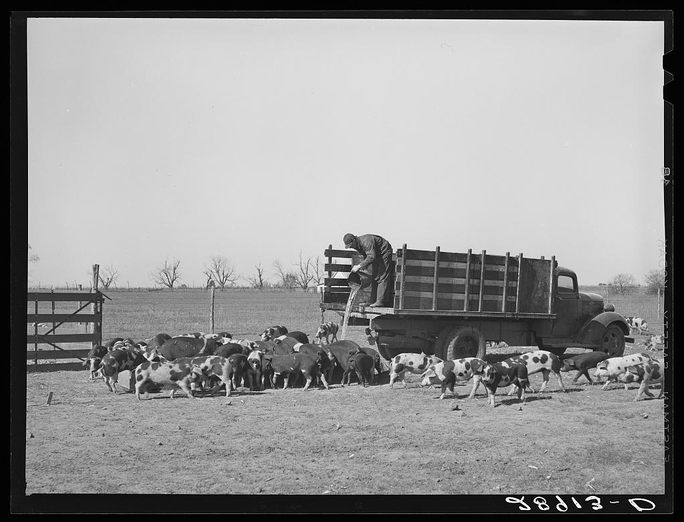
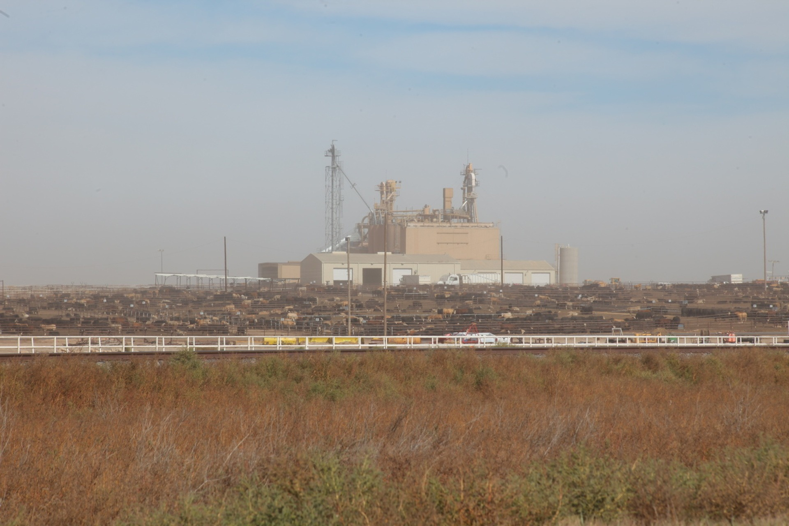
Question Focus 2
https://www.loc.gov/resource/fsa.8b18996/
https://foodprint.org/wp-content/uploads/2018/10/agriculture-pollution.jpg

Slide 47
Priority Student Questions - QFocus 2
Is that enough space for all the cows in photo 2?
If the industrial farming is paid more money is unfair for the small farmers like in the photo 1 to be paid less money?
Photo 2: Did the bosses of the industrial farm think that it is okay to close all those cows in a small place and feeding them corn instead of grass?
There is no other way to grow the cows in the industrial farms so it can be better for the cows?
Do cows stay in the same place all the time?
How the cows feel when they are hundreds in a closed place like in photo 2?
I wonder how much money they can get in both farming system?

Slide 48
Next Steps with Student Questions
The 1st QFT
After reading the anchor text, The Omnivore’s Dilemma, for a few weeks, initial priority questions were revisited. They discussed what they had learned and still had questions about. Finally, they built upon their original questions and resumed reading the text
The 2nd QFT
Students used priority questions to conduct research in the LoC resource Foodprint.org and other credible sources. They wrote short papers and presented their findings to the class.

