Slide 1
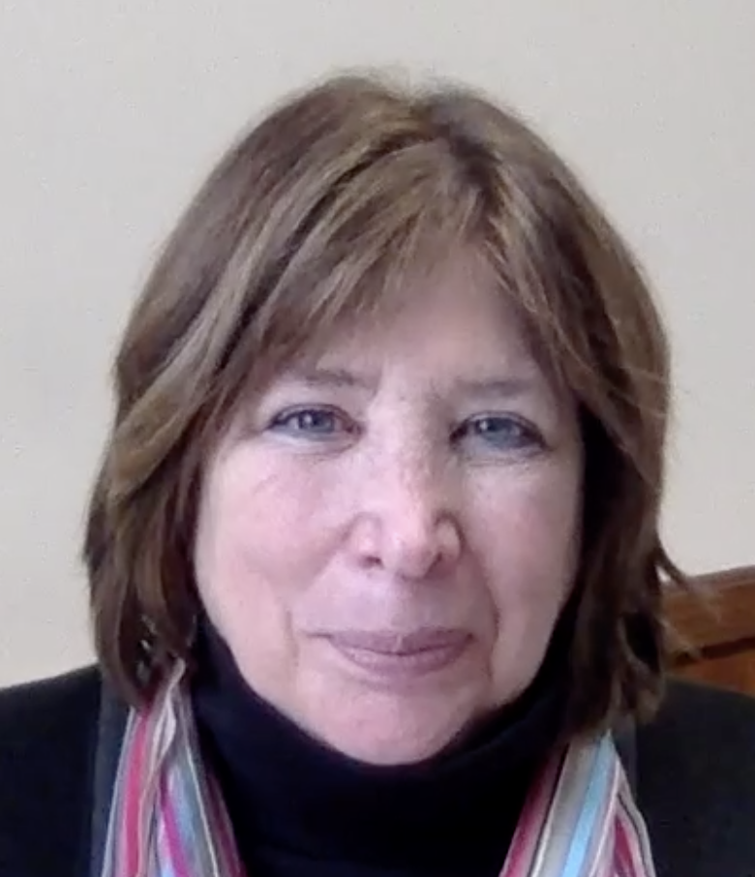
Teach Your Students to Ask Their Own Questions: Using the QFT to spark curiosity and promote research and media literacy
Katy Connolly
The Right Question Institute
Cambridge, MA
Nancy Florio
Kent School
Kent, CT
Notes:
Katy

Slide 2
Who is in the room?
Please share in the chat box:
Your name
Where you are joining us from
Notes:
Katy

Slide 3
To Access Today’s Materials:
https://libguides.kent-school.edu/AISL-2022
Notes:
Katy

Slide 4
Access RQI’s Free QFT Resources
https://rightquestion.org/education/resources
Classroom Examples
Instructional Videos
Planning Tools & Templates
Notes:
Katy

Slide 5
Use and Share These Resources
The Right Question Institute offers materials through a Creative Commons License. You are welcome to use, adapt, and share our materials for noncommercial use, as long as you include the following reference:
“Source: The Right Question Institute (RQI). The Question Formulation Technique (QFT) was created by RQI. Visit rightquestion.org for more information and free resources.”
Notes:
Katy

Slide 6
Today’s Agenda
Welcome
Why Spend Time on Teaching the Skill of Question Formulation?
Collaborative Learning with the Question Formulation Technique (QFT)
Explore Applications for Media Literacy & Research
Why is Question Formulation Important Now?
Q&A
Notes:
Katy
mention about saving questions for the Q&A at the end

Slide 7
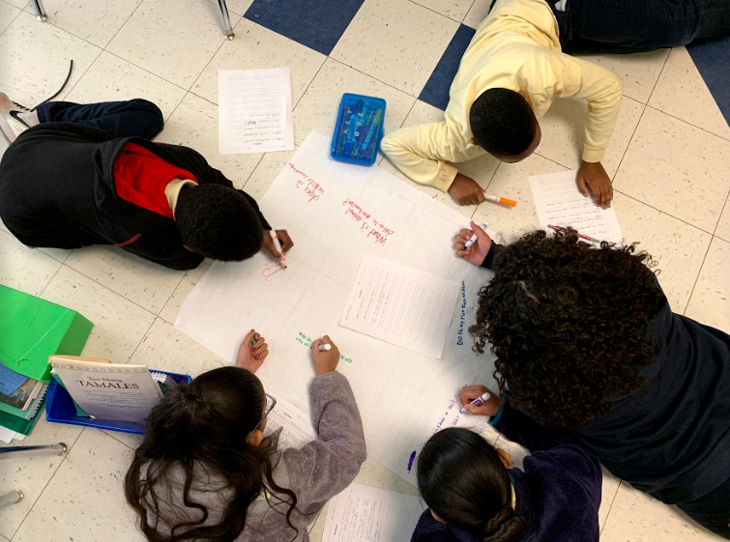
Why spend time teaching the skill of question formulation?
Notes:
Katy

Slide 8
Honoring the Original Source: Parents in Lawrence, Massachusetts, 1990
“We don’t go to the school because we don’t even know what to ask.”
Notes:
Katy
As you saw in the introductory video…

Slide 9
"There is no learning without having to pose a question."
- Richard Feynman
Nobel Laureate, Physics, 1965
Notes:
Katy

Slide 10
“We must teach students how to think in questions, how to manage ignorance.”
– Stuart Firestein
Former chair, Department of Biology,
Columbia University
Notes:
Katy

Slide 11
College Presidents on What College Students Should Learn
“The primary skills should be analytical skills of interpretation and inquiry. In other words, know how to frame a question.”
- Leon Botstein, President of Bard College
“…the best we can do for students is have them ask the right questions.”
- Nancy Cantor, Former Chancellor of University of Illinois
The New York Times, August 4, 2002
Notes:
Katy

Slide 12
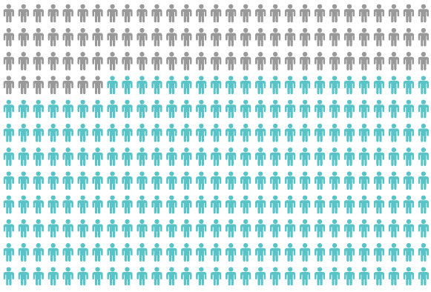
Yet, Only 27% of Graduates Believe College Taught Them How to Ask Their Own Questions
Alison Head, Project Information Literacy at University of Washington, 2016
Notes:
Katy

Slide 13
But, the problem begins long before college…
Notes:
Katy

Slide 14
Question Asking Declines with Age
Tizard, B., Hughes, M., Carmichael, H., & Pinkerton, G. (1983).
Pearson, J.C. & West, R. (2009)
Notes:
Katy
Tizard, B., Hughes, M., Carmichael, H., & Pinkerton, G. (1983). Children’s questions and adults’ answers. Journal of Child Psychology and Psychiatry, 24, 269-281.
Girls (mean age 3 years 11 months) from working class and middle class families asked 24 and 29 questions per hour at home, respectively. At school, these same girls asked on average 1.4 and 3.7 questions per hour (working and middle class, respectively)

Slide 15
We can work together on creating more opportunities for students to ask their own questions
Notes:
Katy

Slide 16
We Are Not Alone
More than 1 million classrooms worldwide
Notes:
Katy

Slide 17
What happens when students do learn to ask their own questions?
Notes:
Katy

Slide 18
Research Confirms the Importance of Questioning
Self-questioning (metacognitive strategy):
Student formulation of their own questions is one of the most effective metacognitive strategies
Engaging in pre-lesson self-questioning improved students rate of learning by nearly 50% (Hattie, p.193)
John Hattie
Visible Learning: A Synthesis of Over 800
meta-Analyses Relating to Achievement, 2008
Notes:
Katy
UC Davis Research Linking Curiosity to Memory (UC Davis) 2014
The Fullerton Longitudinal Study (FLS), a 30-plus year study of the development of giftedness across various points in time conducted by Adele and Allen Gottfried of California State University ”This finding has strong implications for the development of STEM considering that curiosity is a fundamental predictor of the aspiration to become a scientist.”
S. von Stumm, B. Hell, T. Chamorro-Premuzic. The Hungry Mind: Intellectual Curiosity Is the Third Pillar of Academic Performance. Perspectives on Psychological Science, 2011 meta-analysis shows They found that curiosity did, indeed, influence academic performance. In fact, it had quite a large effect, about the same as conscientiousness. When put together, conscientiousness and curiosity had as big an effect on performance as intelligence.

Slide 19
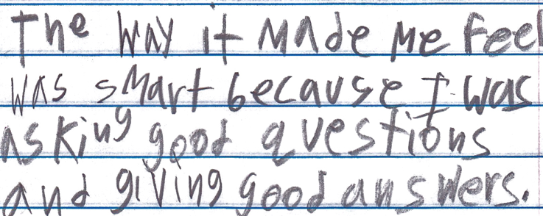
Student Reflection
“The way it made me feel was smart because I was asking good questions and giving good answers.”
-Boston 9th grade summer school student
Notes:
Katy

Slide 20
Today’s Agenda
Welcome & Community Building
Why Spend Time on Teaching the Skill of Question Formulation?
Collaborative Learning with the Question Formulation Technique (QFT)
Explore Real Classroom Examples & Applications
Why is Question Formulation Important Now?
Q&A
Notes:
Nancy

Slide 21
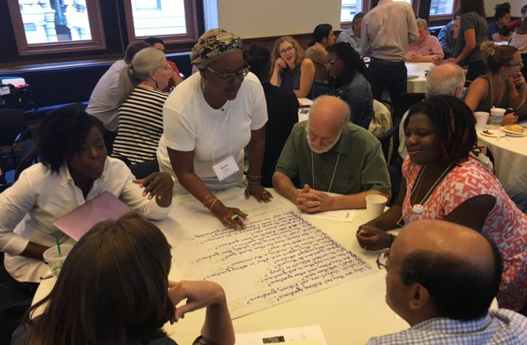
Collaborative Learning with the Question Formulation Technique (QFT)
Notes:
Nancy
Think of the development in children from the unoccupied play of babies to parallel play with the goal being movement toward and engagement in cooperative play.
Closeness through shared experiences
Come to know and understand each other which we all realize is a critical skill in today’s charged climate.
Cornell University Center for Teaching Innovation is a good place to learn more on active and collaborative learning

Slide 22
The Question Formulation Technique (QFT)
Individuals learn to:
Produce their own questions
Improve their questions
Strategize on how to use their questions
Reflect on what they have learned and how they learned it
Notes:
Nancy
In addition to individuals learning, group norms and ground rules allow meaningful work to happen

Slide 23
Rules for Producing Questions
1. Ask as many questions as you can
2. Do not stop to answer, judge, or discuss
3. Write down every question exactly as stated
4. Change any statements into questions
Notes:
Nancy
If you are working alone, rule #3 becomes: “write down every question as it first comes to mind.” Don’t judge yourself!

Slide 24
Produce Questions
Ask Questions
Follow the Rules
Ask as many questions as you can.
Do not stop to answer, judge, or discuss.
Write down every question exactly as it was stated.
Change any statements into questions.
Number the Questions
Notes:
Nancy
feel free to skip these slides if you want and go straight to the breakout rooms/explain verbally the instructions

Slide 25
Question Focus
Some students are not asking questions.
Notes:
Nancy

Slide 26
Categorize Questions: Closed/Open
Definitions:
Closed-ended questions can be answered with a “yes” or “no” or with a one-word answer.
Open-ended questions require
more explanation.
Directions: Identify your questions as closed-ended or open-ended by marking them with a “C” or an “O.”
Notes:
Katy

Slide 27
Discuss
Closed-ended Questions
Advantages
Disadvantages
Notes:
Katy

Slide 28
Discuss
Open-ended Questions
Advantages
Disadvantages
Notes:
Katy
The point here is that the closed-ended questions are equally useful as open-ended!

Slide 29
Improve Questions
Take one closed-ended question and change it into an open-ended question.
Take one open-ended question and change it into a closed-ended question.
Add these as new questions to your list
Closed
Open
Open
Closed
Notes:
Katy

Slide 30
Prioritize Questions
Review your list of questions
Choose three questions that you feel are most important.
While prioritizing, think about your Question Focus, Some students are not asking questions.
Then, think about why you chose those questions.
Notes:
Nancy
Groups will be given 4 minutes to discuss and prioritize questions. Drag your card to the Top Three column and add your Group name and color code it if not more than 6 groups.
Share out about priority questions (2-3 groups share)
Each group share your priority questions and why you chose them
Where did they fall in the number sequence
Any patterns you’re seeing?

Slide 31
Action Plan
Moving from priority questions into action steps.
In order to answer your priority questions:
What do you need to know? Information
What do you need to do? Tasks
Write down a couple ideas you have.
Notes:
Nancy
What do we do now?
This step supports metacognition - how we think about how we think.
Many of our students are familiar with KWL charts
Supports next steps when students

Slide 32
Reflect
What did you learn?
How did you learn it?
How could you use it in your work?
Notes:
Nancy

Slide 33
A Look Inside the Process
Notes:
Katy

Slide 34
The QFT, on one slide…
Ask as many questions as you can
Do not stop to discuss, judge or answer
Record exactly as stated
Change statements into questions
Question Focus
Produce Your Questions
Follow the rules
Number your questions
Improve Your Questions
Categorize questions as Closed or Open-ended
Change questions from one type to another
Strategize
Prioritize your questions
Action plan or discuss next steps
Share
Reflect
Closed-Ended:
Answered with “yes,” “no” or one word
Open-Ended: Require longer explanation
Source: The Right Question Institute rightquestion.org
Notes:
Katy

Slide 35
Three thinking abilities
with one process
Notes:
Katy

Slide 36
Thinking in many different directions
Divergent
Thinking
Notes:
Katy

Slide 37
Narrowing Down, Focusing
Convergent
Thinking
Notes:
Katy

Slide 38
Thinking about Thinking
Metacognition
Notes:
Katy

Slide 39
Today’s Agenda
Welcome & Community Building
Why Spend Time on Teaching the Skill of Question Formulation?
Collaborative Learning with the Question Formulation Technique (QFT)
Explore Applications for Media Literacy & Research
Why is Question Formulation Important Now?
Q&A
Notes:
Katy

Slide 40
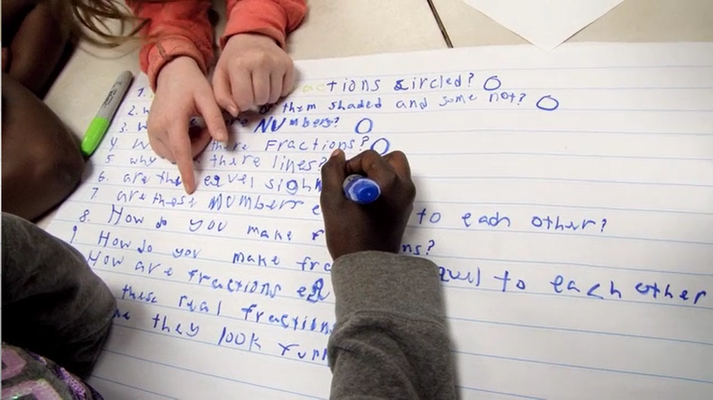
Exploring Applications for Media Literacy & Research
Notes:
Nancy

Slide 41
Example: Media Literacy
Teacher: Nancy Florio, Kent, CT
Topic: Creator Bias & Primary Sources
Purpose: To explore iconic primary source photographs by examining the lens of the photographer
Notes:
Nancy

Slide 42
Question Focus
"A photograph is shaped more by the person behind the camera than by what's in front of it.”
Notes:
Nancy

Slide 43
Student Questions
How do you measure the “shaping”?
Does the age of the photographer or subject play a role?
How did the time period the photo was taken play a role in the shoot?
Did the development of the film and the printing play a role?
Do politics/religion play a role?
How does the subject affect the photo?
Did the old cameras have a part in this?
Do men shape their photos more than women?
How does light play a role in this?
Can you show me some examples?
Notes:
Nancy

Slide 44
Next Steps with Student Questions
Following the QFT, students explored a set of iconic primary source photographs
Students chose three primary source images that appealed to them and added an observation, reflection, and additional questions to each of their three chosen pictures.
Using their priority questions as a lens, as well as additional collections and databases, students created an Adobe Spark webpage on a topic of choice.
Notes:
Nancy

Slide 45
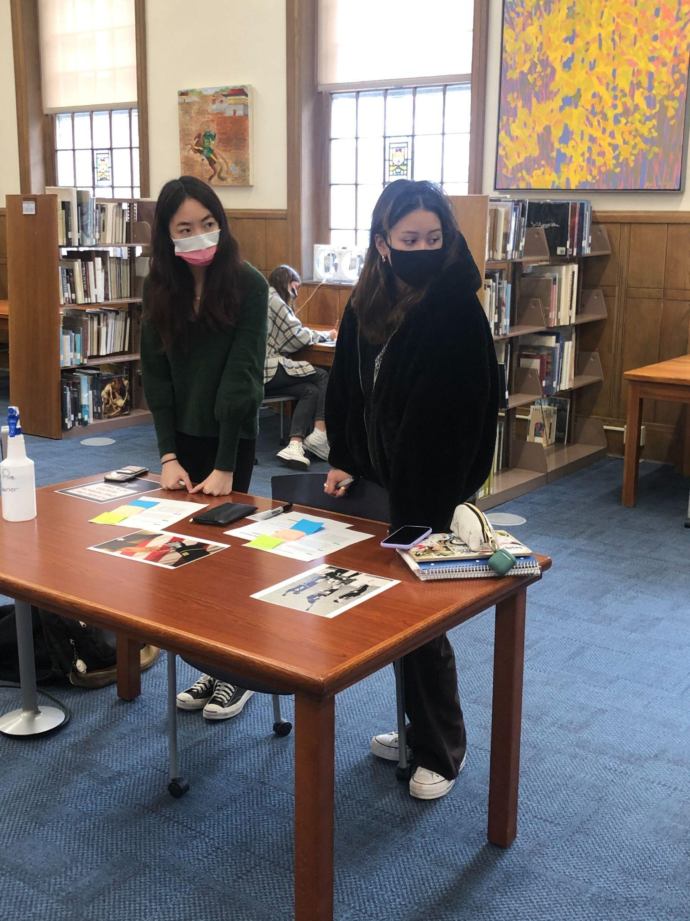
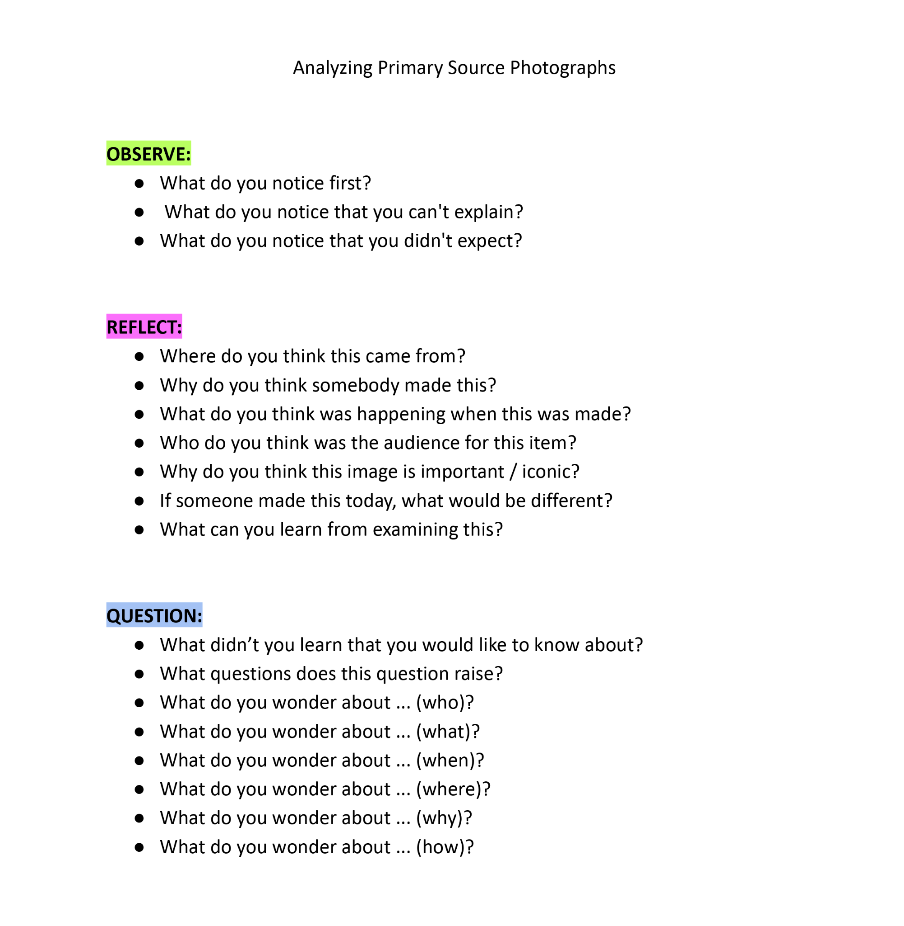
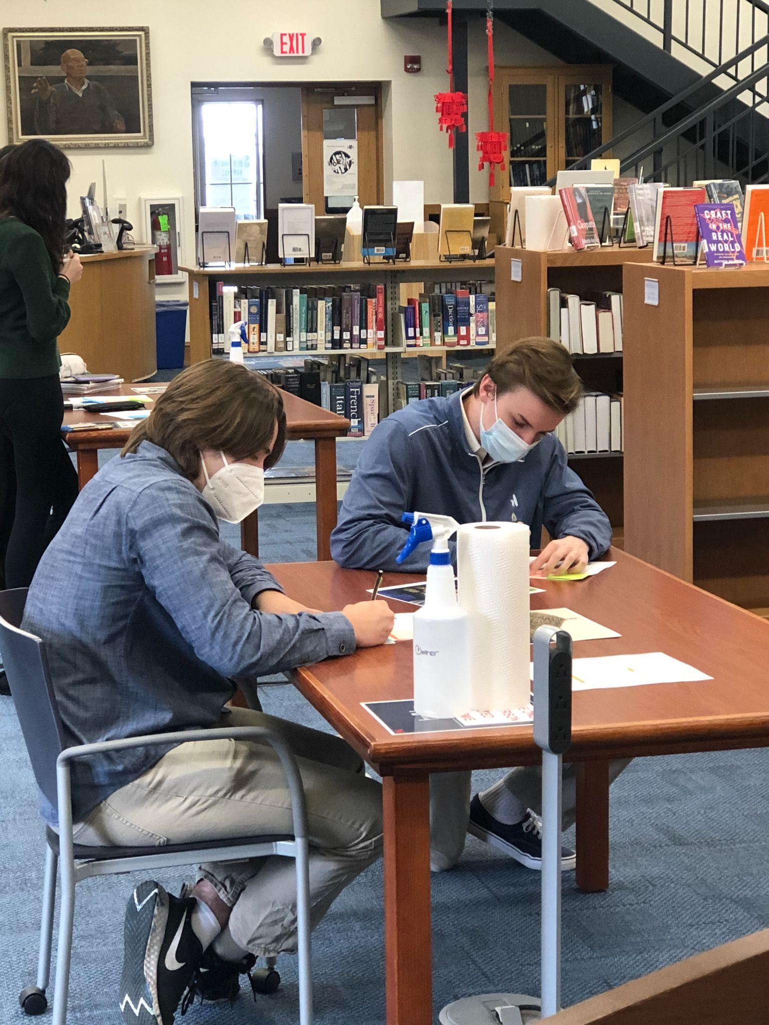
Exploring Iconic Primary Source Photographs
Notes:
Nancy

Slide 46
Example: Research
Teacher: Nancy Florio, Kent, CT
Topic: Civil War & Reconstruction
Purpose: In preparation for a primary source set project creating an Adobe Spark Video
Notes:
Nancy

Slide 47
Question Focus
Questions we should ask of the Civil War and Reconstruction
Notes:
Nancy

Slide 48
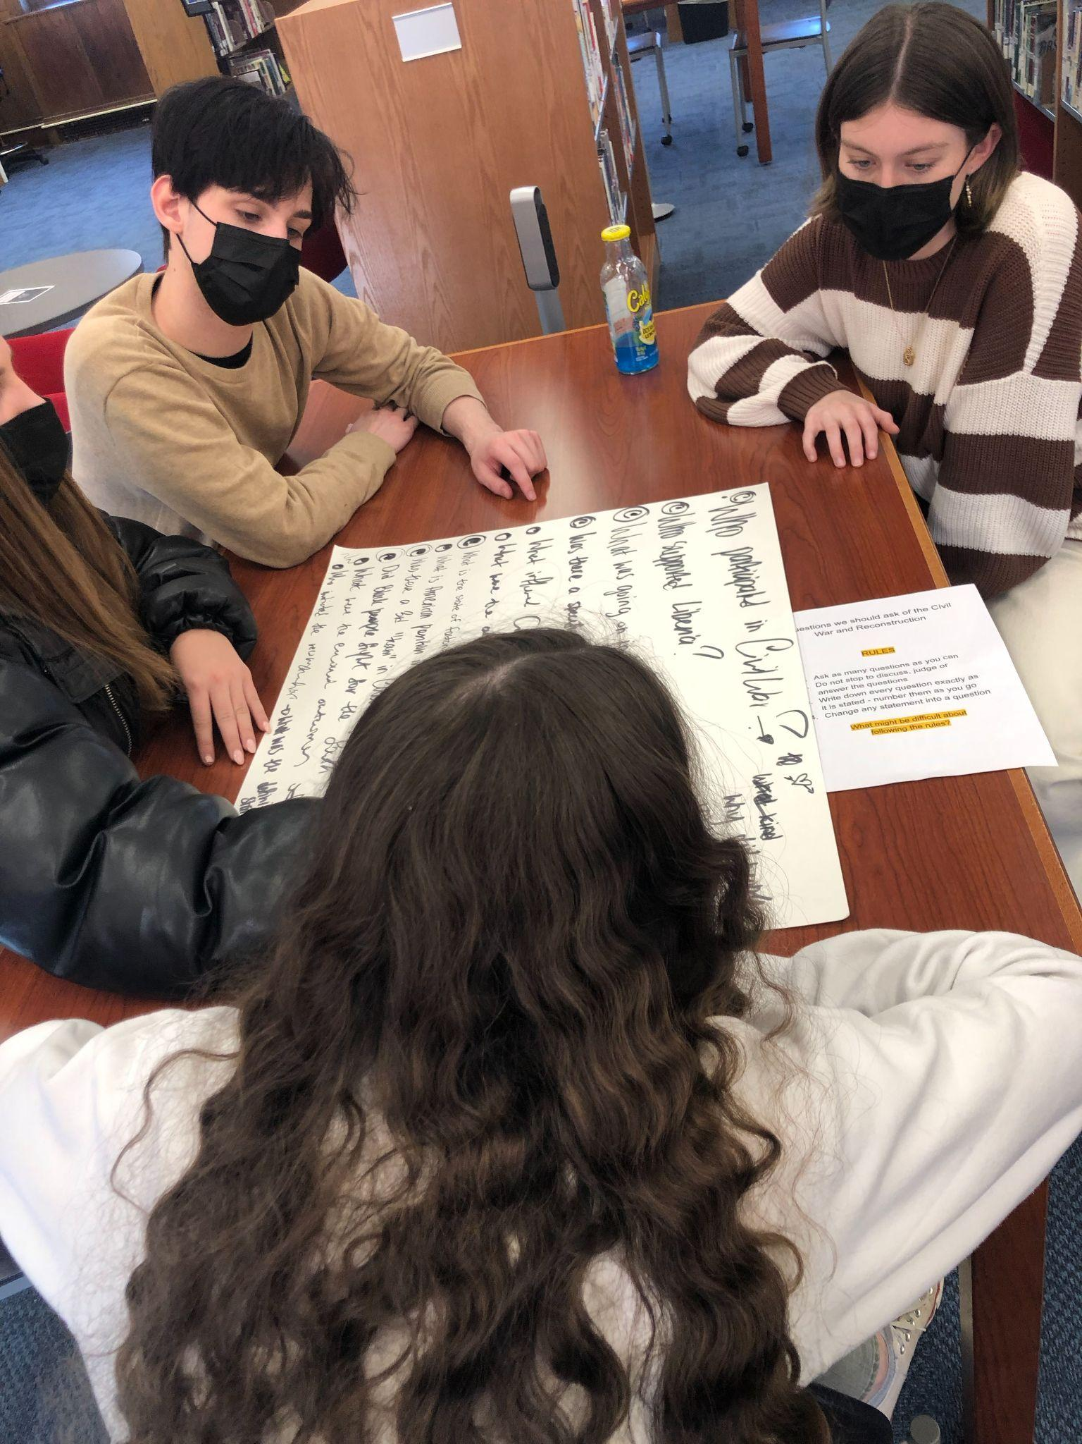
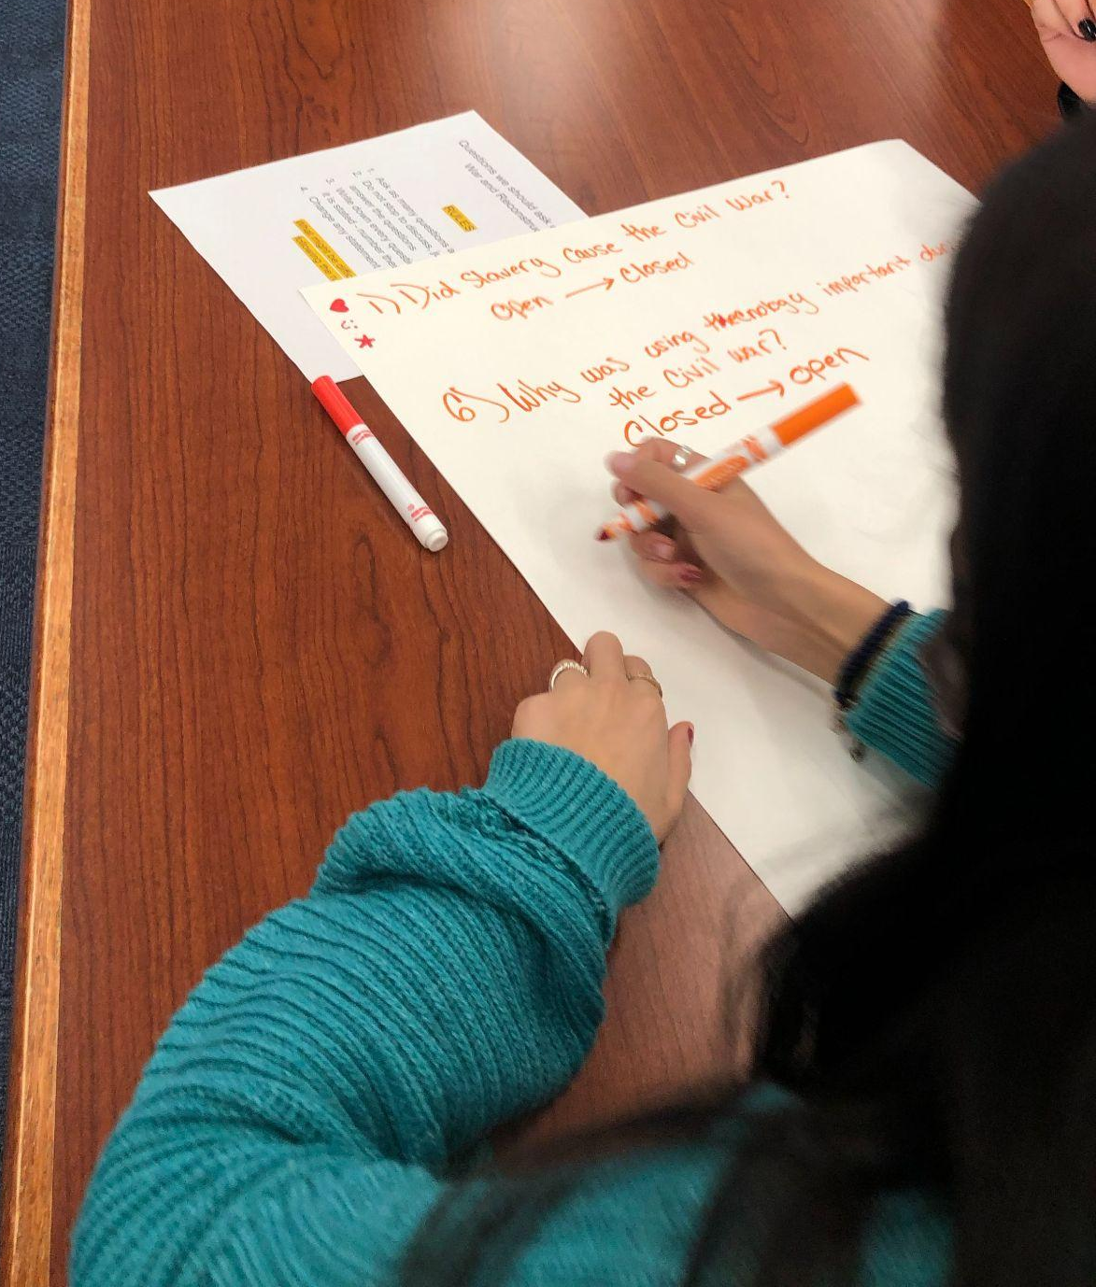
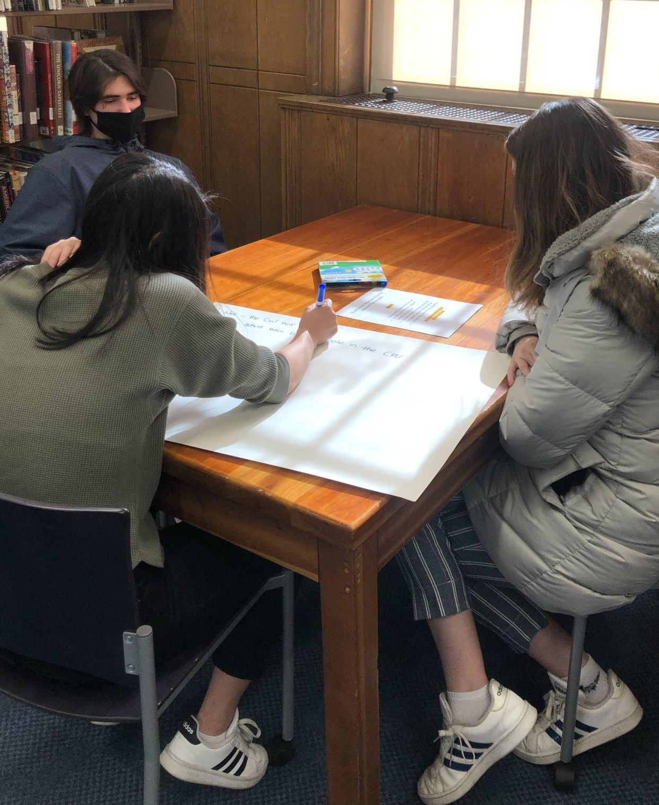
The QFT in Action
Notes:
Nancy

Slide 49
Student Questions (parking lot)
What is the Civil War?
What is the reconstruction era?
Who was involved?
What technology was used?
Why did it stop?
How did it end?
What haven’t historians learned yet?
What took so long?
Why hasn’t it happened again?
When did succession first become a possibility?
Where was it most impactful?
Who has it been most impactful to?
Whose story was saved?
Were there foreign powers included?
How much was the public involved?
What info was shared with the public?
Did the public want a war?
How closely were Black people involved?
What percentage of people were opposed to it?
What kind of atmosphere was in Congress after southern states came back?
Notes:
Nancy

Slide 50
The End Product - Spark Videos
Notes:
Nancy

Slide 51
A Few Thoughts
Coming up with a Q Focus is challenging - provocative statement vs. focused image
Collaborating and preparing faculty is critical
Their Questions are Helpful in Research Conferences
It’s Hard to Watch Students Struggle
It’s Hard for Teachers to Watch Their Students Struggle
Save Those Posters!
Notes:
Nancy

Slide 52
Today’s Agenda
Welcome & Community Building
Why Spend Time on Teaching the Skill of Question Formulation?
Collaborative Learning with the Question Formulation Technique (QFT)
Explore Applications for Media Literacy & Research
Why is Question Formulation Important Now?
Q&A
Notes:
Katy

Slide 53
Why is the skill of question formulation so important now?
Notes:
Katy

Slide 54
In the Age of Google
“How should you respond when you get powerful new tools for finding answers?
Think of harder questions.”
– Clive Thompson
Journalist and Technology Blogger
Notes:
Katy

Slide 55
The Role of Libraries in the Age of Google
“In the nonstop tsunami of global information, librarians provide us with floaties and teach us to swim.”
–Linton Weeks, Washington Post reporter & NPR contributor
https://www.loc.gov/resource/cph.3c31518/
Notes:
Katy

Slide 56
Thank you!
What are your questions?
Notes:
Katy

Slide 57
Using & Sharing RQI’s Resources
The Right Question Institute offers materials through a Creative Commons License. You are welcome to use, adapt, and share our materials for noncommercial use, as long as you include the following reference:
“Source: The Right Question Institute (RQI). The Question Formulation Technique (QFT) was created by RQI. Visit rightquestion.org for more information and free resources.”
Access the full library of resources: http://rightquestion.org/education/resources
Notes:
No one– the rest of these slides are just there for reference after the presentation

Slide 58
Media Literacy Example: 4th& 5th Grade Gifted Education
Teacher: Ashley Barefoot, Hattiesburg, MS
Topic: Typhoid Mary
Purpose: To engage students at the start of a new unit on the history of past pandemics

Slide 59
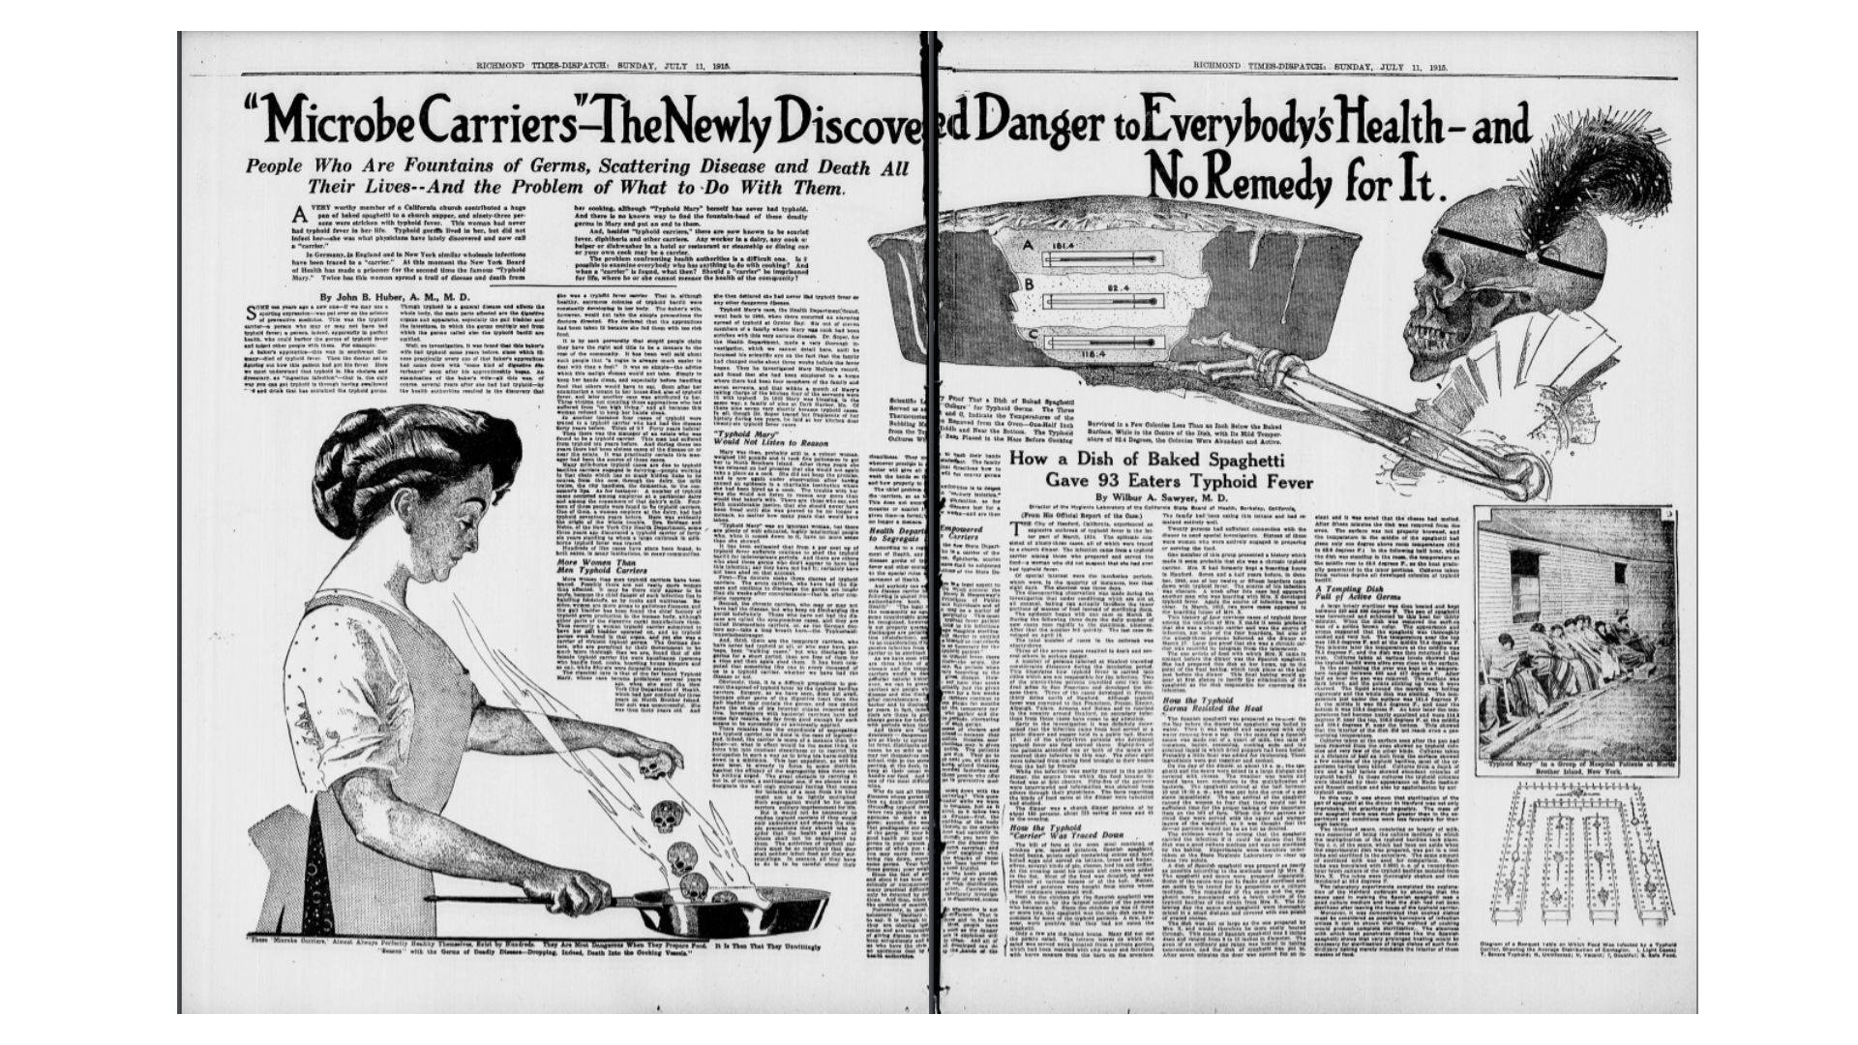
Original Source for the QFocus
https://chroniclingamerica.loc.gov/lccn/sn83045389/1915-07-11/ed-1/seq-43/

Slide 60
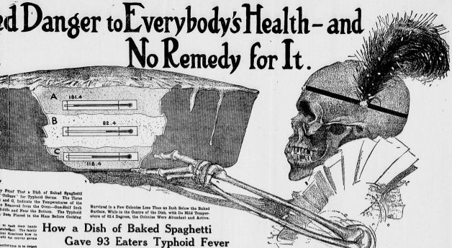
Question Focus
https://chroniclingamerica.loc.gov/lccn/sn83045389/1915-07-11/ed-1/seq-43/

Slide 61
Student Questions
Why is she cooking skull heads? O
Why does it say “How a Dish of Baked Spaghetti Gave 93 Eaters Typhoid Fever?” O
Is that baked spaghetti in the pan that the skeleton is holding? C
Do the skulls represent the fever? C 🡪 How do the skulls represent the fever? O
Is it from BC or AD? C
Why does it say on the top “People Who Are Fountains of Germs, Scattering Disease and Death All Their Lives -- And the Problem of What to Do With Them?” O
Is there poison in the pasta that’s giving people death and diseases? C
Is that for Halloween? C
Was this in the 1800s? C
Are they making something? C
Is that a pie that the skeleton is holding? C
Why is the lady making pizza in a pan? O
Why does the skeleton have a feather on his head? O
Why does it say “‘Microbe Carriers’ - The Newly Discovered Danger to Everybody’s Health - and No Remedy for It?” O
Is this a magazine? C
Was this newspaper a hoax? C
What do the skulls represent? O

Slide 62
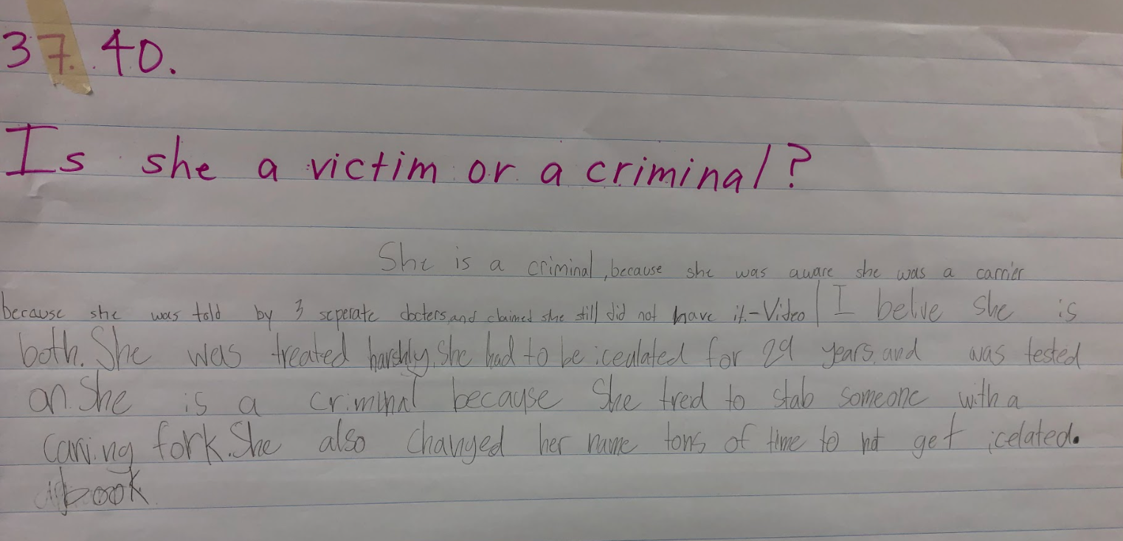
Next Steps
Students grouped and re-wrote priority questions
In small groups, they searched for answers using a collection of related primary and secondary sources

Slide 63
Research Example: 12th Grade Global Studies
Teacher: Rachel Otty, Cambridge, MA
Topic: Human Rights & Migration
Purpose: To develop a research question for a culminating project

Slide 64
Question Focus
Human Rights and Migration

Slide 65
Student Questions
Does every country who indirectly contributes to the displacement of peoples have a moral obligation to help those refugees?
Who legislates what is a human rights violation when it comes to immigrants/asylum seekers?
To what extent does political structure affect human rights?
How can people respect political diversity while pushing for human rights?
Can diverse peoples live in close proximity without suppressing cultures or having one culture dominate in an environment?
What is the best approach to mental health help for migrants or refugees?
How can we define human rights so they apply to every human?
Why does our country limit how many people can migrate from certain countries into the US?
Who decides which families are worthy of a home in another country?
Does migration have to stop?
How do you decide what a human rights violation actually is? How do you decide which ones are worthy of intervention?

Slide 66
Next Steps
Students shared their 1-2 priority questions with the class
Conducted background research to determine one they were most interested in
Refined each other’s questions to be arguable, clear, and focused
Created a list of “Need to Know” questions and keywords/search terms.
Presented their research and analysis in the form of a paper, podcast, website, or short story.

