Slide 1
Unlearning “Good” Questions to Create Space for Students to Ask Great Ones
Sarah Westbrook
The Right Question Institute
Cambridge, MA
Sarah.westbrook@rightquestion.org

Slide 2
To Access Today’s Materials:
https://bit.ly/Questions2022

Slide 3
Access RQI’s Free QFT Resources
https://rightquestion.org/education/resources
Classroom Examples
Instructional Videos
Planning Tools & Templates

Slide 4
Use and Share These Resources
The Right Question Institute offers materials through a Creative Commons License. You are welcome to use, adapt, and share our materials for noncommercial use, as long as you include the following reference:
“Source: The Right Question Institute (rightquestion.org).”

Slide 5
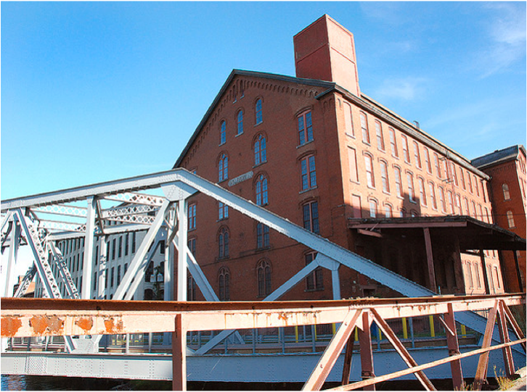
The Origin of The Right Question Institute: Parents in Lawrence, Massachusetts, 1990
“We don’t go to the school because we don’t even know what to ask.”

Slide 6
30+ Years 1 deceptively simple skill: asking your own questions

Slide 7
The QFT, on one slide…
Ask as many questions as you can
Do not stop to discuss, judge or answer
Record exactly as stated
Change statements into questions
Question Focus
Produce Your Questions
Follow the rules
Number your questions
Improve Your Questions
Categorize questions as Closed or Open-ended
Change questions from one type to another
Strategize
Prioritize your questions
Action plan or discuss next steps
Share
Reflect
Closed-Ended:
Answered with “yes,” “no” or one word
Open-Ended: Require longer explanation
Source: The Right Question Institute rightquestion.org
Notes:
I

Slide 8
4 Week Free Online Course: Find out more at rightquestion.org
Notes:
https://rightquestion.org/primary-sources-course-information/

Slide 9
The Myth and Mythology of ‘Good Questions’

Slide 10
Quick Write
Write your own definition of a “good question.”
You might consider:
“good questions” in your content area vs. another
If you can name specific, concrete criteria
What is not a “good question”?

Slide 11
To what extent is Huck an individual? To what extent are his values and decisions influenced by social, familial, and cultural forces?

Slide 12
“How old is Huck Finn?”
Notes:
Lessons learned: 1) I hadn’t done a good job on what I meant by “good discussion questions” 2) Even if I had, my students proved me wrong! They expanded my understanding of what a “good discussion question” was. Knowing the answers already/my content knowledge made it hard for me to put myself in the shoes of the student who had asked.

Slide 13
“Good” questions don’t exist in a vacuum

Slide 14
“Sometimes when I ask my questions I’m always like, oh wait, was that a smart question? Is that a stupid question?”
- 12th Grader, Boston, MA
Notes:
Where do students learn about “bad” questions or “dumb questions”? What are the implicit and explicit ways that message is communicated to them?

Slide 15
“We must teach students how to think in questions, how to manage ignorance.”
– Stuart Firestein
Former chair, Department of Biology,
Columbia University

Slide 16
Could the idea that there are “good questions” (and therefore bad questions) hold us back from asking any question at all?

Slide 17
3 Sources on the Mythology of Good Questions
Our Own Questions with the Question Formulation Technique (QFT)
Questioning “in the Wild”
Student Questions: Primary Source Classroom Examples

Slide 18
Explore Our Own Questions with the Question Formulation Technique (QFT)

Slide 19
Rules for Producing Questions
1. Ask as many questions as you can
2. Do not stop to answer, judge, or discuss
3. Write down every question exactly as stated
4. Change any statements into questions
Notes:
If you are working alone, rule #3 becomes: “write down every question as it first comes to mind.” Don’t judge yourself!

Slide 20
Question Focus
→Now, ask questions. Number the questions. Follow the rules:
Ask as many questions as you can.
Don’t stop to answer, judge, or discuss.
Record each question exactly as it was stated (or first came to mind).
Change any statements into questions.
Lange, Dorothea. (1942) Oakland, CA, March 1942.
Notes:
[Photograph] Retrieved from the Library of Congress, https://www.loc.gov/pictures/resource/cph.3a24566/.

Slide 21
Categorize Questions: Closed/Open
Definitions:
Closed-ended questions can be answered with a “yes” or “no” or with a one-word answer.
Open-ended questions require
more explanation.
Directions: Identify your questions as closed-ended or open-ended by marking them with a “C” or an “O.”

Slide 22
Discuss
Closed-ended Questions
Advantages
Disadvantages

Slide 23
Discuss
Open-ended Questions
Advantages
Disadvantages
Notes:
The point here is that the closed-ended questions are equally useful as open-ended!

Slide 24
Improve Questions
Take one closed-ended question and change it into an open-ended question.
Take one open-ended question and change it into a closed-ended question.
Add these as new questions to your list
Closed
Open
Open
Closed

Slide 25
Prioritize Questions
Review your list of questions
Choose three questions that you feel are most important.
While prioritizing, think about your Question Focus.
Then, think about why you chose those questions.
When you’re ready, please share 1-2 of your priority questions in the chat box.

Slide 26
The QFT, on one slide…
Ask as many questions as you can
Do not stop to discuss, judge or answer
Record exactly as stated
Change statements into questions
Question Focus
Produce Your Questions
Follow the rules
Number your questions
Improve Your Questions
Categorize questions as Closed or Open-ended
Change questions from one type to another
Strategize
Prioritize your questions
Action plan or discuss next steps
Share
Reflect
Closed-Ended:
Answered with “yes,” “no” or one word
Open-Ended: Require longer explanation
Source: The Right Question Institute rightquestion.org
Notes:
https://rightquestion.org/what-is-the-qft/

Slide 27
3 Sources on the Mythology of Good Questions
Our Own Questions with the Question Formulation Technique (QFT)
Questioning “in the Wild”
Student Questions: Primary Source Classroom Examples

Slide 28
Exploring Questions “in the Wild”
https://www.loc.gov/item/98518597/
Notes:
https://www.loc.gov/item/98518597/

Slide 29
Exploring Questions “in the Wild”
Please think about and use the chat box to report out on:
Track anything that surprises you or new insights about how questions function “in the wild”
Track which questions are closed and which are open
What confirms or challenges your understanding of “good” questions?
Notes:
Look at language, not at content

Slide 30
Asking Geo-Inquiry Questions
“Sala wanted to know: Is there any healthy ocean left? The Pristine Seas project would seek to answer this question.
This initial question led to more: What is a healthy ocean? Where are the last wild places in the ocean? What does a complete, undamaged marine ecosystem look like? What are the key threats to these areas, and how can they be addressed? Who controls these pristine waters, and how can those leaders be convinced that the waters are worth protecting?”
Excerpt from “In Search of a Healthy Ecosystem” a profile of marine ecologist Enric Sala for National Geographic education.
Notes:
https://media.nationalgeographic.org/assets/file/Case_Study_Enric_V6.pdf
Photo credit: https://www.usgs.gov/media/images/coast-guam, https://www.loc.gov/everyday-mysteries/item/why-is-the-ocean-blue/

Slide 31
https://www.philosophyofquestions.com/common-questions
Notes:
https://www.philosophyofquestions.com/common-questions
https://trends.google.com/trends/yis/2020/US/?utm_source=vanity&utm_medium=referral&utm_campaign=US

Slide 32
Notes:
A screenshot of a screening form I filled out at my doctor’s office yesterday!

Slide 33
Notes:
https://www2.census.gov/library/publications/decennial/2020/operations/planned-questions-2020-acs.pdf

Slide 34
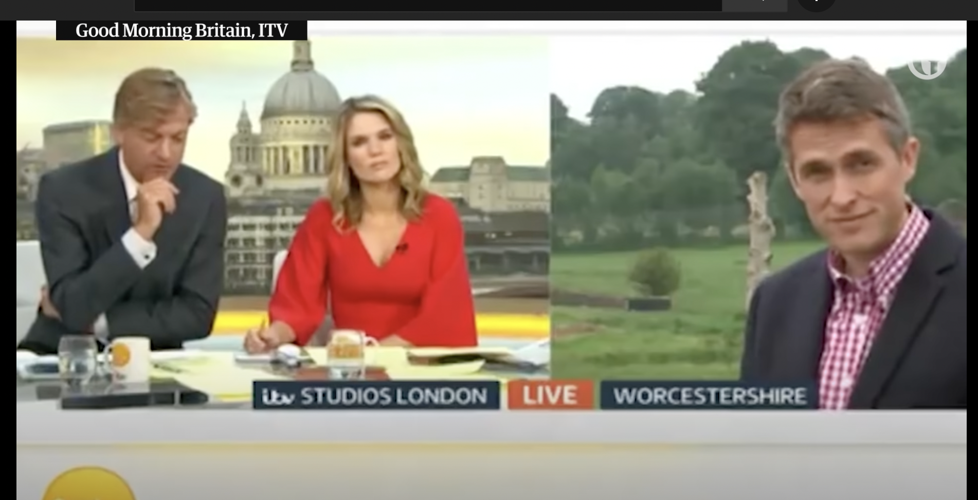
Journalist Interviewing a Politician
https://www.youtube.com/watch?v=nd9YmdenPLg
Notes:
https://www.youtube.com/watch?v=nd9YmdenPLg

Slide 35
3 Sources on the Mythology of Good Questions
Our Own Questions with the Question Formulation Technique (QFT)
Questioning “in the Wild”
Student Questions: Primary Source Classroom Examples

Slide 36
Exploring Student Questions

Slide 37
Classroom Example: 11th Grade English
Teacher: Rebecca King, Pikeville, KY
Topic: The Crucible by Arthur Miller
Purpose: To help students place the work within the context of history and guide students’ reading and interpretation of the play

Slide 38
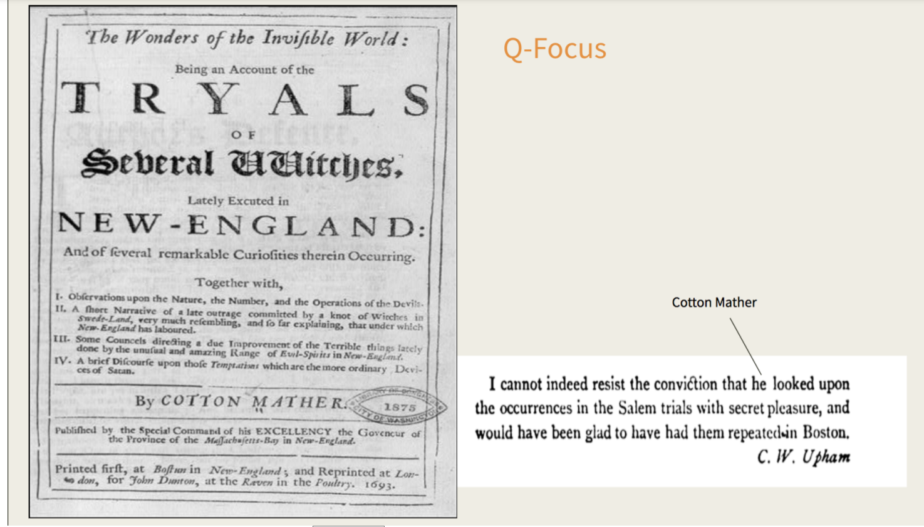
Question Focus
https://www.loc.gov/resource/cph.3b22753/

Slide 39
Student Questions
Who or what are several witches?
How does he want to punish them?
Are they actually witches?
Why was the article posted?
What is the significance of witches in Cotton’s area at the time he wrote that?
What did a witch do to make them execute them?
What happened during the Salem trials?
Who is Cotton Mather?
Why is some in cursive and some in print?
Why did they react in such an extreme way?
How many trials were there?
How do you know they are actually witches?
What does he mean by “the more ordinary devils of Salem”?
Were the witches actually affecting other people?
What is the invisible world?
Why was Mather secretly pleasured about the trials?
Why does he use different fonts throughout the intro?
What is the significance of the witches?
What did the witches do?
Why was it only women that were killed?

Slide 40
Virtual Classroom Example: 7th Grade
Teacher: Melissa Lawson, Folsom, CA
Topic: Japanese American Internment during World War II
Purpose: To help students engage with primary sources to begin a research process.

Slide 41
Question Focus
Lange, Dorothea. (1942) Oakland, CA, Mar. 1942.
A large sign reading "I am an American" placed in the window of a store on December 8, the day after Pearl Harbor. The store was closed following orders to persons of Japanese descent to evacuate from certain West Coast areas.
[Photograph] Retrieved from the Library of Congress, https://www.loc.gov/pictures/resource/cph.3a24566/.

Slide 42
Selected Questions
Why is the car there?
Who was the owner of the car?
Is that a BMW or something?
Where is this?
Who took the photograph?
Why is there a sign that says, I am an American?
Who is “I”?
What does "Wanto Co.," mean?
Who wrote the "I Am an American" sign?
Was the 'I am American' because the owner was of Japanese heritage and defending him/herself from prosecution? (after Pearl Harbor)
When the picture was taken, was the store open or closed?
Why was this picture taken?
What year is this from?
Who decided to close the store?
What happened to the store after this?
What happened to the Japanese Americans?
Did they ever get full fledged justice?

Slide 43
Asking and Answering via Padlet
Notes:
Access all of RQI’s Virtual Learning Resources:
https://rightquestion.org/remote-learning-resources/
Access the QFT Padlet Template Here:
https://padlet.com/sarahwestbrook1/QFT2

Slide 44
Student Reflections
“I learned that we cannot draw conclusions just by looking at a picture once. You can look at it and ask questions to learn more. I am wondering if we can use this technique on other things.”
“Not only did I learn about the picture we were analyzing, but I learned that asking questions makes me want to think more and it makes me curious. Once I started asking questions and reading other peoples responses, I was very interested and curious about the questions that were posted.”

Slide 45
Classroom Example: 11th & 12th Grade Physical Science
Teacher: Anthony Brown, Minden, NV
Topic: Early scientific models of the universe
Purpose: To begin a discussion about the need for skepticism in to advance science by questioning existing models

Slide 46
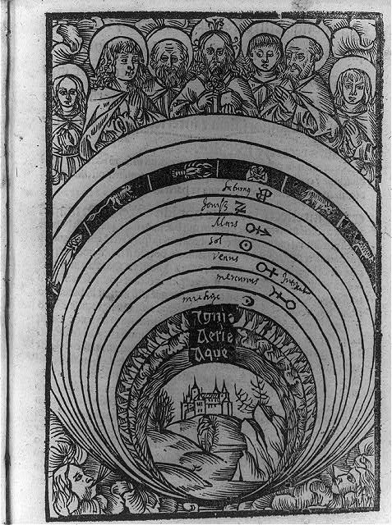
Question Focus
Ptolemaic concept of the universe
https://www.loc.gov/item/2007681147/
Notes:
https://www.loc.gov/item/2007681147/

Slide 47
Student Questions
Why are God and his disciples on top?
Is that God and his disciples?
Are they angels?
Was it made around the renaissance era?
Is it a calendar?
Is it in a church?
What does the words around the wheel say?
What language is this?
What culture is this?
What does the picture at the bottom mean?
Why is it connected to their mouths?
Why are all the zodiac signs on the perimeter?
Did it come from a book?
Is it an example of the solar system?
What do the symbols mean?
Why are there animals?
What are the circles behind their head?
Are they praying?

Slide 48
3 Sources on the Mythology of Good Questions
Our Own Questions with the Question Formulation Technique (QFT)
Questioning “in the Wild”
Student Questions: Primary Source Classroom Examples

Slide 49
Debrief
Are there new advantages/disadvantages or uses of open/closed questions that occur to you? Anything that you might revise?
How are you thinking differently now about “good” questions?
Notes:
Record the debrief conversation
Takeaways:
Close-ended questions are far more useful than we realize and just as valuable as open-ended questions.
You don’t need one perfect question, but many different ones. One question often leads to more.
Human language is unpredictable; people won’t always give you the answer you’re looking for, so you need follow up questions.
It isn’t about labeling “o” versus “c;” but rather, the practice of being flexible in your thinking and intentional with your language.
The “right” question is whatever question you need for the situation you are in

Slide 50
Expanding our Questioning Vocabulary
Complex
Sophisticated
Effective, strategic, and useful for a particular function, use, context
Good
Thoughtful

Slide 51
Why is the skill of question formulation so important now?

Slide 52
In the Age of Google
“How should you respond when you get powerful new tools for finding answers?
Think of harder questions.”
– Clive Thompson
Journalist and Technology Blogger

Slide 53
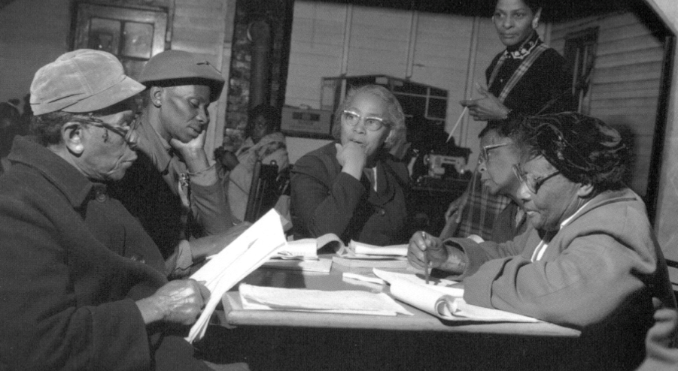
Questions and Democracy
“We need to be taught to study rather than to believe, to inquire rather than to affirm.”
– Septima Clark
Chapter 6 on Septima Clark in Freedom Road: Adult Education of African Americans (Peterson, 1996)

Slide 54
Final Reflection
From the past several days of, what are the questions you’re walking away with?

