Slide 1
An Experience in the Question Formulation Technique (QFT)
Sarah Westbrook
Director of Professional Learning
The Right Question Institute
Cambridge, MA
Sarah.westbrook@rightquestion.org

Slide 2
Who is in the room?

Slide 3
To Access Today’s Materials:
bit.ly/3uyfykC

Slide 4
Access RQI’s Free QFT Resources
https://rightquestion.org/education/resources
Classroom Examples
Instructional Videos
Planning Tools & Templates

Slide 5
Use and Share These Resources
The Right Question Institute offers materials through a Creative Commons License. You are welcome to use, adapt, and share our materials for noncommercial use, as long as you include the following reference:
“Source: The Right Question Institute (RQI). The Question Formulation Technique (QFT) was created by RQI. Visit rightquestion.org for more information and free resources.”

Slide 6
Today’s Agenda
Welcome
Why Spend Time on Teaching the Skill of Question Formulation?
Collaborative Learning with the Question Formulation Technique (QFT)
Explore Real Classroom Examples & Applications
Why is Question Formulation Important Now?
Q&A

Slide 7
Why spend time teaching the skill of question formulation?

Slide 8
Honoring the Original Source: Parents in Lawrence, Massachusetts, 1990
“We don’t go to the school because we don’t even know what to ask.”
Notes:
As you saw in the introductory video…

Slide 9
"There is no learning without having to pose a question."
- Richard Feynman
Nobel Laureate, Physics, 1965

Slide 10
“We must teach students how to think in questions, how to manage ignorance.”
– Stuart Firestein
Former chair, Department of Biology,
Columbia University

Slide 11
College Presidents on What College Students Should Learn
“The primary skills should be analytical skills of interpretation and inquiry. In other words, know how to frame a question.”
- Leon Botstein, President of Bard College
“…the best we can do for students is have them ask the right questions.”
- Nancy Cantor, Former Chancellor of University of Illinois
The New York Times, August 4, 2002

Slide 12
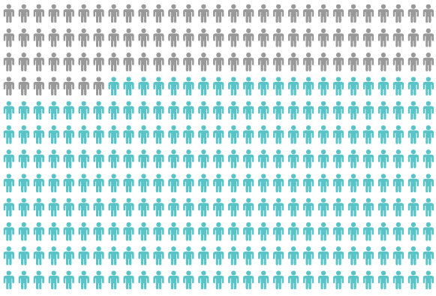
Yet, Only 27% of Graduates Believe College Taught Them How to Ask Their Own Questions
Alison Head, Project Information Literacy at University of Washington, 2016

Slide 13
But, the problem begins long before college…

Slide 14
Question Asking Declines with Age
Tizard, B., Hughes, M., Carmichael, H., & Pinkerton, G. (1983).
Pearson, J.C. & West, R. (2009)
Notes:
Tizard, B., Hughes, M., Carmichael, H., & Pinkerton, G. (1983). Children’s questions and adults’ answers. Journal of Child Psychology and Psychiatry, 24, 269-281.
Girls (mean age 3 years 11 months) from working class and middle class families asked 24 and 29 questions per hour at home, respectively. At school, these same girls asked on average 1.4 and 3.7 questions per hour (working and middle class, respectively)

Slide 15
We can work together on creating more opportunities for students to ask their own questions

Slide 16
We Are Not Alone
More than 1 million classrooms worldwide

Slide 17
What happens when students do learn to ask their own questions?

Slide 18
Research Confirms the Importance of Questioning
Self-questioning (metacognitive strategy):
Student formulation of their own questions is one of the most effective metacognitive strategies
Engaging in pre-lesson self-questioning improved students rate of learning by nearly 50% (Hattie, p.193)
John Hattie
Visible Learning: A Synthesis of Over 800
meta-Analyses Relating to Achievement, 2008
Notes:
UC Davis Research Linking Curiosity to Memory (UC Davis) 2014
The Fullerton Longitudinal Study (FLS), a 30-plus year study of the development of giftedness across various points in time conducted by Adele and Allen Gottfried of California State University ”This finding has strong implications for the development of STEM considering that curiosity is a fundamental predictor of the aspiration to become a scientist.”
S. von Stumm, B. Hell, T. Chamorro-Premuzic. The Hungry Mind: Intellectual Curiosity Is the Third Pillar of Academic Performance. Perspectives on Psychological Science, 2011 meta-analysis shows They found that curiosity did, indeed, influence academic performance. In fact, it had quite a large effect, about the same as conscientiousness. When put together, conscientiousness and curiosity had as big an effect on performance as intelligence.

Slide 19
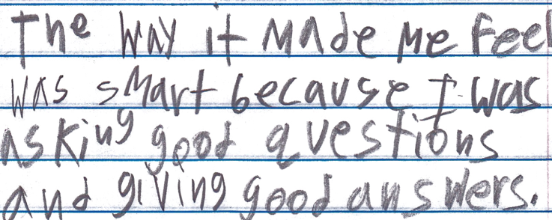
Student Reflection
“The way it made me feel was smart because I was asking good questions and giving good answers.”
-Boston 9th grade summer school student

Slide 20
Today’s Agenda
Welcome & Community Building
Why Spend Time on Teaching the Skill of Question Formulation?
Collaborative Learning with the Question Formulation Technique (QFT)
Explore Real Classroom Examples & Applications
Why is Question Formulation Important Now?
Q&A

Slide 21
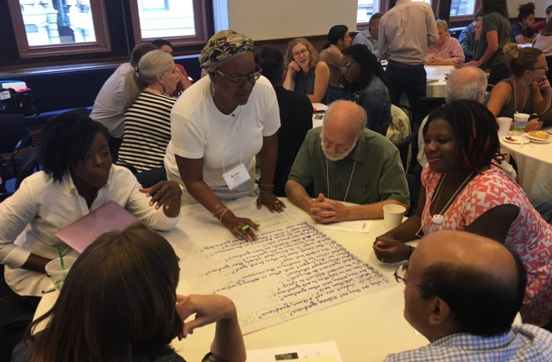
Collaborative Learning with the Question Formulation Technique (QFT)

Slide 22
The Question Formulation Technique (QFT)
Individuals learn to:
Produce their own questions
Improve their questions
Strategize on how to use their questions
Reflect on what they have learned and how they learned it

Slide 23
Rules for Producing Questions
1. Ask as many questions as you can
2. Do not stop to answer, judge, or discuss
3. Write down every question exactly as stated
4. Change any statements into questions
Notes:
If you are working alone, rule #3 becomes: “write down every question as it first comes to mind.” Don’t judge yourself!

Slide 24
Produce Questions
Ask Questions
Follow the Rules
Ask as many questions as you can.
Do not stop to answer, judge, or discuss.
Write down every question exactly as it was stated.
Change any statements into questions.
Number the Questions

Slide 25
Question Focus
Some students are not asking questions.
→Now, ask questions. Number the questions. Follow the rules:
Ask as many questions as you can.
Don’t stop to answer, judge, or discuss.
Record each question exactly as it was stated (or first came to mind).
Change any statements into questions.

Slide 26
Categorize Questions: Closed/Open
Definitions:
Closed-ended questions can be answered with a “yes” or “no” or with a one-word answer.
Open-ended questions require
more explanation.
Directions: Identify your questions as closed-ended or open-ended by marking them with a “C” or an “O.”

Slide 27
Discuss
Closed-ended Questions
Advantages
Disadvantages

Slide 28
Discuss
Open-ended Questions
Advantages
Disadvantages
Notes:
The point here is that the closed-ended questions are equally useful as open-ended!

Slide 29
Improve Questions
Take one closed-ended question and change it into an open-ended question.
Take one open-ended question and change it into a closed-ended question.
Add these as new questions to your list
Closed
Open
Open
Closed

Slide 30
Prioritize Questions
Review your list of questions
Choose three questions that you feel are most important.
While prioritizing, think about your Question Focus, Some students are not asking questions.
Then, think about why you chose those questions.

Slide 31
Action Plan
Moving from priority questions into action steps.
In order to answer your priority questions:
What do you need to know? Information
What do you need to do? Tasks
Write down a couple ideas you have.

Slide 32
Share
Your priority questions
Any highlights from your action plan
The numbers of your three priority questions in your original sequence (For ex: “2, 4, 7 out of 8 total”)

Slide 33
Reflect
What did you learn?
How did you learn it?
How could you use it in your work?

Slide 34
A Look Inside the Process

Slide 35
The QFT, on one slide…
Ask as many questions as you can
Do not stop to discuss, judge or answer
Record exactly as stated
Change statements into questions
Question Focus
Produce Your Questions
Follow the rules
Number your questions
Improve Your Questions
Categorize questions as Closed or Open-ended
Change questions from one type to another
Strategize
Prioritize your questions
Action plan or discuss next steps
Share
Reflect
Closed-Ended:
Answered with “yes,” “no” or one word
Open-Ended: Require longer explanation
Source: The Right Question Institute rightquestion.org
Notes:
I

Slide 36
Three thinking abilities
with one process

Slide 37
Thinking in many different directions
Divergent
Thinking

Slide 38
Narrowing Down, Focusing
Convergent
Thinking

Slide 39
Thinking about Thinking
Metacognition

Slide 40
Today’s Agenda
Welcome & Community Building
Why Spend Time on Teaching the Skill of Question Formulation?
Collaborative Learning with the Question Formulation Technique (QFT)
Explore Real Classroom Examples & Applications
Why is Question Formulation Important Now?
Q&A

Slide 41
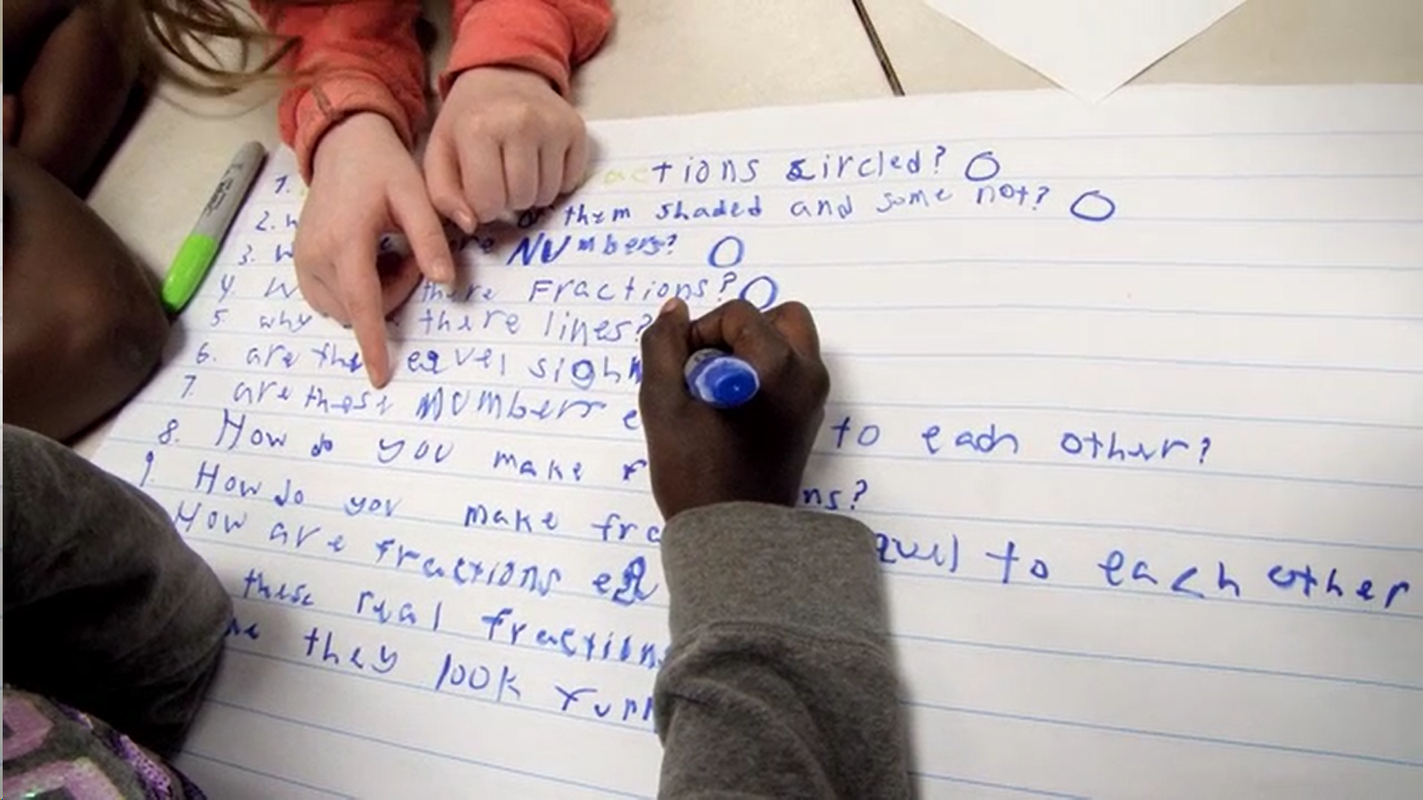
Exploring Classroom Examples

Slide 42
Classroom Example: Kindergarten
Teacher: Catherine Tommasello, Marietta, GA
Topic: How can we make our school playground more inviting for all?
Purpose: To launch kindergarten Project Based Learning (PBL) unit

Slide 43
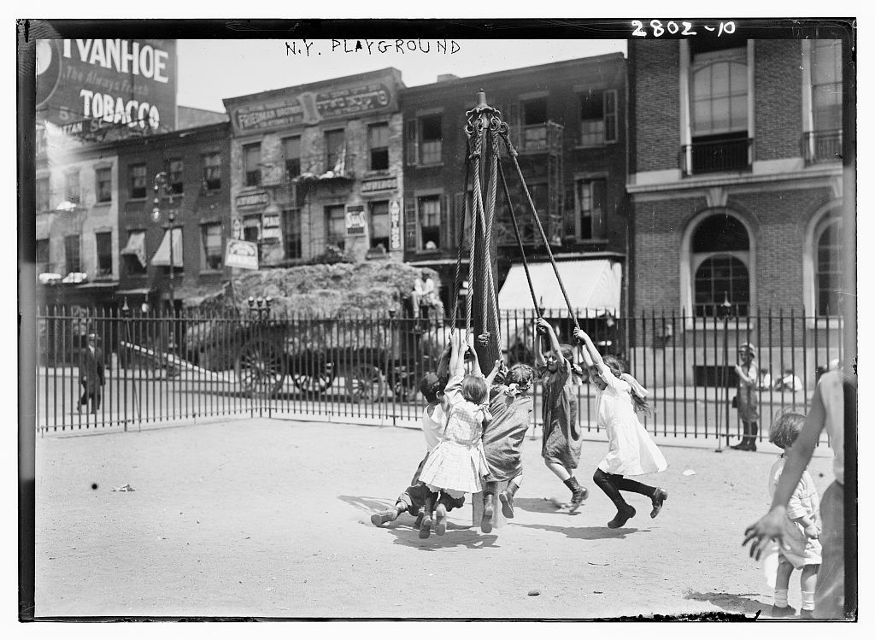
Question Focus
https://www.loc.gov/item/2014693976/

Slide 44
Student Questions
Is this a safe activity?
Where are the boys?
What are they swinging on?
Why are there buildings?
Where is the teacher?
Don’t they have any grass?
Is that fence safe? It has spikes on top
Why can’t that kid come inside?
Why do those kids have tights on?
Why is there a truck with hay on it?
Why do they have a fence?
Did anyone get hurt playing this game?
Do they have a PAWS promise?
Where is their mom and dad?
What does that sign say?
What happens after it rains?
Why don’t they invited that kid to play?

Slide 45
Next Steps with Student Questions
Students made a Venn Diagram to compare the playground from the past to their own playground. What is inviting about both? What is uninviting about the playground from the past? What is uninviting about our playground?
Students compiled their findings and shared them with other Kindergarten classes. This research helped them further investigate their driving question

Slide 46
Classroom Example: 4th Grade
Teacher: Deirdre Brotherson, Hooksett, NH
Topic: Math unit on variables
Purpose: To engage students at the start of a unit on variables and assess their current skill level

Slide 47
Question Focus
24 = ☺ + ☺ + ☺

Slide 48
Student Questions
Why is the 24 first?
What do the smiley faces mean?
Why are there 3 smiley faces?
How am I suppose to figure this out?
Is the answer 12?
Can I put any number for a smiley face?
Do three faces mean something?
Do the numbers have to be the same because the smiley faces are the same?
What numbers will work here?
Does it mean 24 is a really happy number?
Can we replace each smiley face with an 8?
Do any other numbers work?
Can we do this for any number?
Does it always have to be smiley faces?
Do we always have to use three things?

Slide 49
Next Steps
Posters of students’ questions were displayed on walls around the room
As students learned more about variables, they went up to the wall to cross off questions they had answered
At the end of the unit, students discussed what they had learned and what questions they now had

Slide 50
Classroom Example: 6th Grade
Teacher: Megan Harvell, Boston, MA
Topic: The Civil War
Purpose: Pre-reading activity to engage students

Slide 51
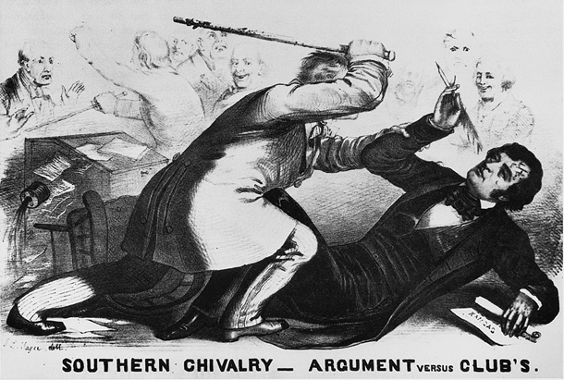
Question Focus

Slide 52
Student Questions
Why are they fighting?
Are they fighting?
Are they part of the government?
Where were they?
What started the fight?
Who are they?
Were they signing anything?
Who else was there?
Why are you hitting him?
Why didn’t they call 911?
Was this related to slavery?
Why are you taking a pen?
Were they in court?
Why are they in court?
Who hit who first?
Why is he hitting him with a bat?
Who died?
Why are they smiling?

Slide 53
Virtual Classroom Example: 7th Grade
Teacher: Melissa Lawson, Folsom, CA
Topic: Japanese American Internment during World War II
Purpose: To help students engage with primary sources to begin a research process.

Slide 54
Question Focus
Lange, Dorothea. (1942) Oakland, CA, Mar. 1942.
A large sign reading "I am an American" placed in the window of a store on December 8, the day after Pearl Harbor. The store was closed following orders to persons of Japanese descent to evacuate from certain West Coast areas.
[Photograph] Retrieved from the Library of Congress, https://www.loc.gov/pictures/resource/cph.3a24566/.

Slide 55
Selected Questions
Why is the car there?
Who was the owner of the car?
Is that a BMW or something?
Where is this?
Who took the photograph?
Why is there a sign that says, I am an American?
Who is “I”?
What does "Wanto Co.," mean?
Who wrote the "I Am an American" sign?
Was the 'I am American' because the owner was of Japanese heritage and defending him/herself from prosecution? (after Pearl Harbor)
When the picture was taken, was the store open or closed?
Why was this picture taken?
What year is this from?
Who decided to close the store?
What happened to the store after this?
What happened to the Japanese Americans?
Did they ever get full fledged justice?

Slide 56
Asking and Answering via Padlet

Slide 57
Student Reflections
“I learned that we cannot draw conclusions just by looking at a picture once. You can look at it and ask questions to learn more. I am wondering if we can use this technique on other things.”
“Not only did I learn about the picture we were analyzing, but I learned that asking questions makes me want to think more and it makes me curious. Once I started asking questions and reading other peoples responses, I was very interested and curious about the questions that were posted.”
“I learned that I should have been using this for my History Day paper.”

Slide 58
Make Your Own Padlet
Access the QFT Padlet Template Here:
https://padlet.com/sarahwestbrook1/QFT2
Access all of RQI’s Virtual Learning Resources:
https://rightquestion.org/remote-learning-resources/

Slide 59
Classroom Example: 11th Grade
Teacher: Isabel Morales, Los Angeles, CA
Topic: Social Justice
Purpose: Engage students in thinking about systemic injustice ahead of several fiction and nonfiction texts in the semester

Slide 60
Question Focus
“The disciplinary policies of our society perpetuate injustice.”

Slide 61
Students’ Questions
Why are student of color targeted the most?
How do disciplinary policies target specific racial groups?
Do teachers nationwide take notice of these stats?
How can teachers develop better & effective disciplinary policies?
Why do people see the stats & data as a coincidence?
What does a kid learn about the system once in jail?
What do people believe expulsion will teach the students?
Does going to juvie have a long-term effect on younger students about education?
When will it get better?
What are some ways to improve behavior?
What type of training will teachers go through that’ll bring justice to classrooms?
Shouldn’t school police officers be trained like teachers?
What is considered a criminal offense in school?
Isn’t it the teacher’s job to keep the students “in line”?
How should disruption in class be handled?
How come there aren’t any policies keeping students out of prison?

Slide 62
Next Steps with Student Questions
Students decided to research statistics and poll students and teachers.
Students met with the school administration to ask questions and address their concerns.
School principal founded a student advisory council, which many students joined, to give students a voice in new policies.

Slide 63
Classroom Example: High School
Teacher: Daniel Fouts, Des Plaines, IL
Topic: 12th Grade Government unit on the American presidency at moments of crisis
Purpose: To engage students at the start of the unit and to help students select a topic for an independent project

Slide 64
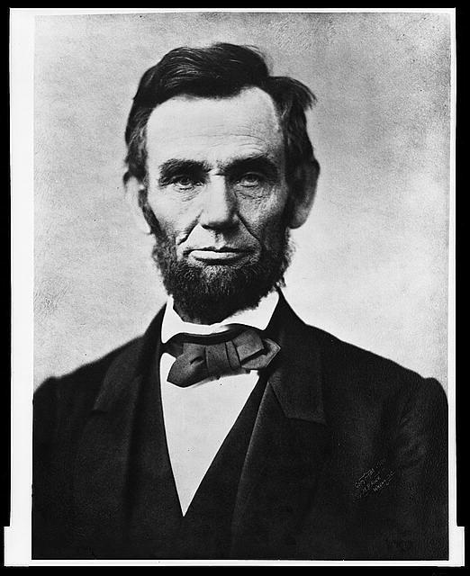
Question Focus
“Nearly all men can handle adversity; but if you really want to test a man’s character, give him power.”
https://www.loc.gov/pictures/item/96522529/

Slide 65
Student Questions
How does power challenge one’s morality?
Should everyone have some type of power?
Does power make people corrupt?
What if the person who is is qualified for power doesn’t attain it?
How is a man’s power tested?
What is considered power?
What defines good character?
How can we ensure that the good men get the power?
What kind of man can handle adversity?
What can power tell us about a man’s character?
How can power be obtained by adversity?
Why are some people affected by power differently?
If adversity supposedly makes you stronger, does that mean that power makes you weaker?

Slide 66
Next Steps
Each student selected l question from the class list to work on throughout the unit
Students answered their question using research and knowledge from the unit in a two-page reflection paper
Students shared their reflections in a class discussion on the final day of the unit

Slide 67
Today’s Agenda
Welcome & Community Building
Why Spend Time on Teaching the Skill of Question Formulation?
Collaborative Learning with the Question Formulation Technique (QFT)
Explore Real Classroom Examples & Applications
Why is Question Formulation Important Now?
Q&A

Slide 68
Why is the skill of question formulation so important now?

Slide 69
In the Age of Google
“How should you respond when you get powerful new tools for finding answers?
Think of harder questions.”
– Clive Thompson
Journalist and Technology Blogger

Slide 70
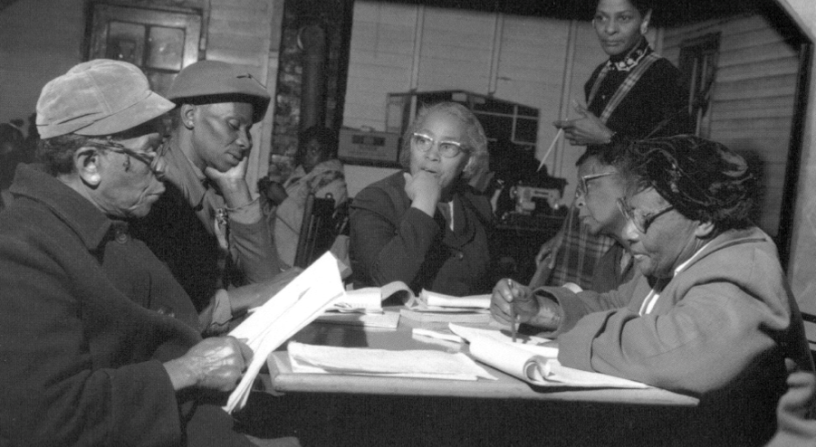
Questions and Democracy
“We need to be taught to study rather than to believe, to inquire rather than to affirm.”
– Septima Clark
Chapter 6 on Septima Clark in Freedom Road: Adult Education of African Americans (Peterson, 1996)

Slide 71
Thank you!
What are your questions?

Slide 72
The Basics of QFT Lesson Planning

Slide 73
Finding the Scale that Works for You
Start here!
Large scale, weeks- long civic action project or PBL unit
5 minute
“Do Now”
One-day class discussion
A multi-day research process
15 minute brainstorm before guest speaker arrives
Student- designed lab investigation
Students generate unit-long essential questions that are answered over course of unit

Slide 74
Various Teaching Purposes
Engagement
Research
Formative assessment
Summative assessment
Peer review
Skill development
Problem-solving
Is the QFT the right tool for your objective?
How will you make use of the questions students ask?

Slide 75
Next Steps?
Pop Quiz or Reading Check
Debate Prep
Paper topic
Lab work & Experiments
Exit ticket or ”Do Now”
Hang on walls,
Check Off as Answered
Research
Projects
Test Prep
Presentations
Homework
Class discussion prompts
And sometimes…
Nothing!
Student Choice Projects
Socratic Seminar Prompts
Interview an Expert
Make Your Own Final Test
Journal Prompt
Guest speakers
Close Reading Protocol
Year-long or Unit-long Essential Questions
Tailoring Instruction
Service Action Projects

Slide 76
Question Focus (QFocus): A stimulus or prompt for student questions
A phrase or quotation
An image or video
A primary source
A podcast or speech
A hands-on experience or experiment
An equation or data set
The QFocus is not a question!

Slide 77
Designing a Question Focus
An effective QFocus is:
Directly tied to lesson’s main idea or objective
Simple…but not too simple
Interesting or provocative to students…but not biased or leading

Slide 78
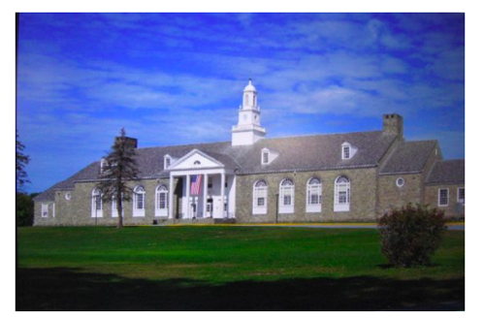
Initial Question Focus:
Student Questions: 1. Why does it look so old?
2. Why does the school have a Fallout Zone?
3. Why is there a flag hanging upside
down?
4. How old is the building?
5. Why are the classrooms numbered?
6. How many acres does it take up?
7. Why are there so many windows?
8. Why is there 4 big pillars at the
front?
9. What is the big tower at the top?
10. Why are we being fit into one
building?
11. When was the school made?
12. How much money did it cost to build it?
13. Why does it look like so many parts put together?
14. What is that white thing on top?
15. Why does it have 2 chimneys?
16. What is the point of lockers?
17. Who was the first principal?
18. Who is the boss of the superintendents?
Context: 6th Grade. The teacher designed this QFocus to elicit questions students might have related to their first few days of middle school. (the image is the exterior of their middle school building)

Slide 79
Initial Question Focus: “People, Animals, and Friends”
Do people exist?
Where do people live?
Why do animals live in the zoo?
Why do people go to the pool?
Why are friends fun?
Why do animals bite?
Why do people go to school?
Do people, animals, and friends play together?
Do animals make friends?
Why do I need friends?
Why do people want to be friends with animals?
Why are people making friends with animals?
Why do people, animal, and friends live in different countries?
Where did my dog and friend go?
Can my friend pet our new dog?
Why do I have eyes?
How do people smell?
Can animals speak?
Can people fly?
Where is my bunny? What happened?

Slide 80
Revising the Question Focus
“People, Animals, and Friends”
Your idea here!

Slide 81
Initial Question Focus

Slide 82
Revised Question Focus
“How you behave online is how you are in real life. That’s you. There’s no separation. You are a person who says those kind of things.”
– Mitch Gerads

Slide 83
Initial Question Focus
“There are books in every library that MUST be banned.”
Your idea here!

Slide 84
Using & Sharing RQI’s Resources
The Right Question Institute offers materials through a Creative Commons License. You are welcome to use, adapt, and share our materials for noncommercial use, as long as you include the following reference:
“Source: The Right Question Institute (RQI). The Question Formulation Technique (QFT) was created by RQI. Visit rightquestion.org for more information and free resources.”
Access the full library of resources: http://rightquestion.org/education/resources

