Slide 1
Question Formulation Technique (QFT) in Social Studies: A Collection of Classroom Examples

Slide 2
Table of Contents: [*To navigate to each of the examples, put the PowerPoint in presentation mode, and click the underlined item.]
A Few Key Ways to Use the QFT in the Social Studies Classroom
Classroom Examples
3rd grade, U.S. History, Mayflower Compact
Elementary School, Sub Separate classroom, child labor
Middle School, U.S. History, Civil War
Middle School, U.S. History, Paris Attacks
Middle School, Contemporary issues, Police-Civilian Relations
8th grade, American History, Imperialism
8th grade, World History, Holocaust
9th grade, Humanities, Bioethics
10th grade, World History, South Africa
10th grade, World History, Imperialism in India
10th grade, World History, Treaty of Versailles
11th grade, U.S. History, Atomic Weapon
12th grade, Government, Abraham Lincoln
12th grade, Civics, Voting
High School, Debate Team, Immigrant screening
High School, Contemporary issues, Social Justice

Slide 3
A Few Key Ways to Use the QFT in the Social Studies Classroom [*Navigate to an example corresponding with each bullet point: Put the PowerPoint in presentation mode, and click the underlined item.]
Unpacking political cartoons
Analyzing primary sources
Opening discussion on contentious current events
Formative assessment
Summative assessment
Debate preparation
Research
Taking informed action

Slide 4
Classroom Example: 3rd Grade History
Teacher: Maureen Bennett, Lexington, MA
Topic: Mayflower Compact
Purpose: Introduction to unit on Pilgrims

Slide 5
Question Focus
Notes:
The Mayflower Compact (students viewed the primary source on iPads)

Slide 6
Student Questions
What is a god amen?
What is an underhand?
Did the Indians sign it? (C-O) How many Indians signed it?
Did the pilgrims sign it?(C-O) Who signed it?
What does mutinality mean?
What does forseen mean?
Who is Lord James? (O-C) Was Lord James asking what is furtherance?
Notes:
What is a god amen?
What is a phone said?
What is an underhand?
What is undertaken?
Did the Indians sign it? (C-O) How many Indians signed it?
Did the pilgrims sign it?(C-O) Who signed it?
What does mutinality mean?
What does forseen mean?
I wonder who did the printing or the fancy writing?
Who is Lord James? (O-C) Was Lord James asking what is furtherance?

Slide 7
Teacher’s reflection
"I was so excited to see that even the quietest children were generating questions and participating in an activity that if it has been done as whole group discussion, they may not have participated at all. This was typical behavior in all of the groups.”
Notes:
Engagement,
Equity
Communication
Behavioral change
45, Isabel: float in questions:
1-3
5-6
8-10
13-15
17-18

Slide 8
Classroom Example:
Elementary School
Teacher: Esther Lee, New York, NY
Setting: Sub-separate small group classroom of students with a range of medium to severe learning disabilities
Topic: Child Labor
Purpose: To engage students at the beginning of the unit
Notes:
Setting - small group special education setting with students with a range medium to severe of LDs (sub-separate small group education setting) + grade level
9-12 year olds
https://rightquestion.org/resources/student-engagement-special-education-classroom/

Slide 9
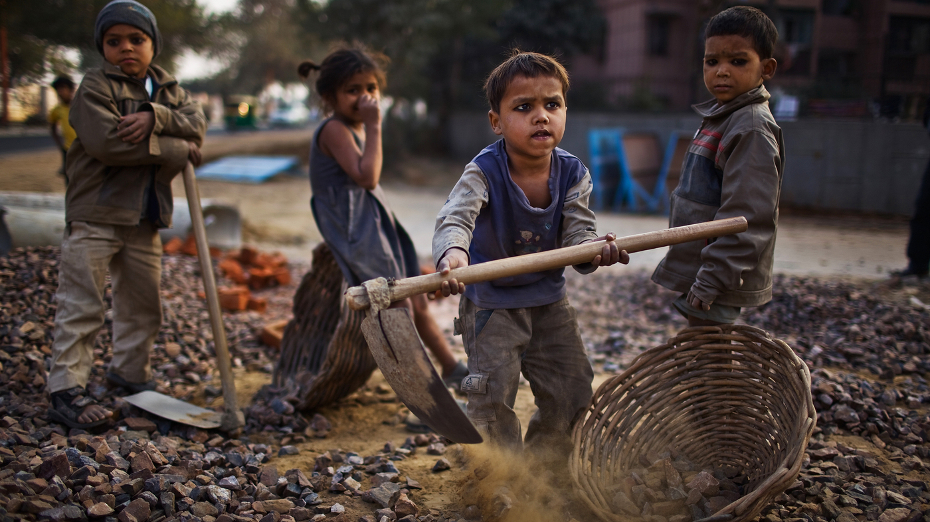
Question Focus
Daniel Berehulak/Getty Images
Notes:
Note - this is an image I found online.

Slide 10
Student Questions
Why are they so dirty?
Are they farming?
Where are their shoes?
Why are they sad?
Are they having fun?
Where are their parents?
Why are they farming?
Why are they holding that?
Are they in school?
Notes:
(Students who initially were described as struggling to maintain connections with their peers are empathizing with others)

Slide 11
Next Steps
Students complete the exam and essay for the New York State mandated ELA curriculum
Students write speeches, make t-shirts, and organize a protest on the streets of NYC
Notes:
http://rightquestion.org/blog/student-engagement-special-education-classroom/

Slide 12
Taking Action
Students making speeches about anti-child labor
Designing T-shirts to get other people engaged
Protesting against child labor in the streets of New York

Slide 13
To Read More, Visit:
http://rightquestion.org/blog/student-engagement-special-education-classroom/

Slide 14
Classroom Example: Middle School
Teacher: Megan Harvell, Boston, MA
Topic: American History –The Civil War
Purpose: Pre-reading activity to engage students in the unit and to build primary source reading & interpretation skills

Slide 15
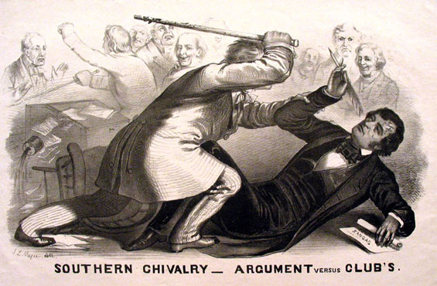
Question Focus
Image by John L. Magee, 1856

Slide 16
Student Questions
Why are you taking a pen?
Why are they in court?
Who hit who first?
Who died?
Why are they smiling?
Why are they fighting?
Are they fighting?
Are they part of the government?
Where were they?
Who are they?
Were they signing anything?
Who else was there?
Why are you hitting him?
Why didn’t they call 911?
Was this related to slavery?
Why is he hitting him with a bat?

Slide 17
Classroom Example: 8th Grade Social Studies
Teacher: James Brewster, Austin, TX
Topic: Current events and social justice
Purpose: Engage students in difficult conversations on current events through analyzing contemporary political cartoons

Slide 18
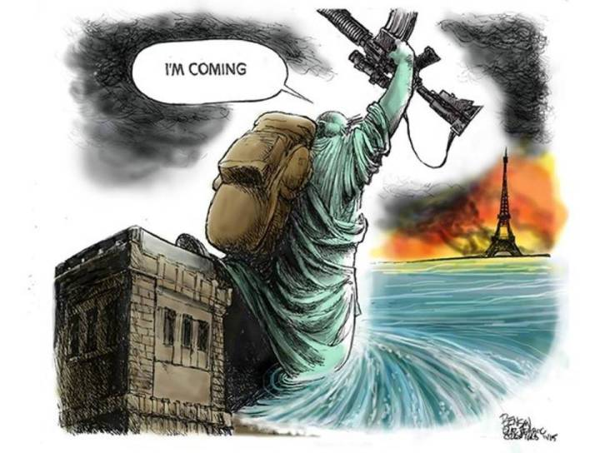
Question Focus

Slide 19
Student Questions
Why is the Eifel Tower burning?
Is New York supporting Paris?
Why Paris and not any other city?
How many people died or got hurt?
Will Obama help Paris?
Why did the Statue of Liberty say, “I’m coming?”
Why did ISIS attack?
Why doesn’t France do anything?
Who is ISIS?
Who are they going to attack next?
Does ISIS hate France as well as America?
Who is the founder of ISIS?
Is this propaganda?
Is that related to the recent bombings?

Slide 20
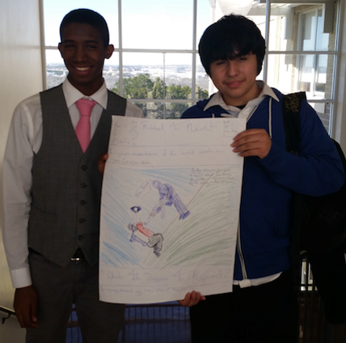
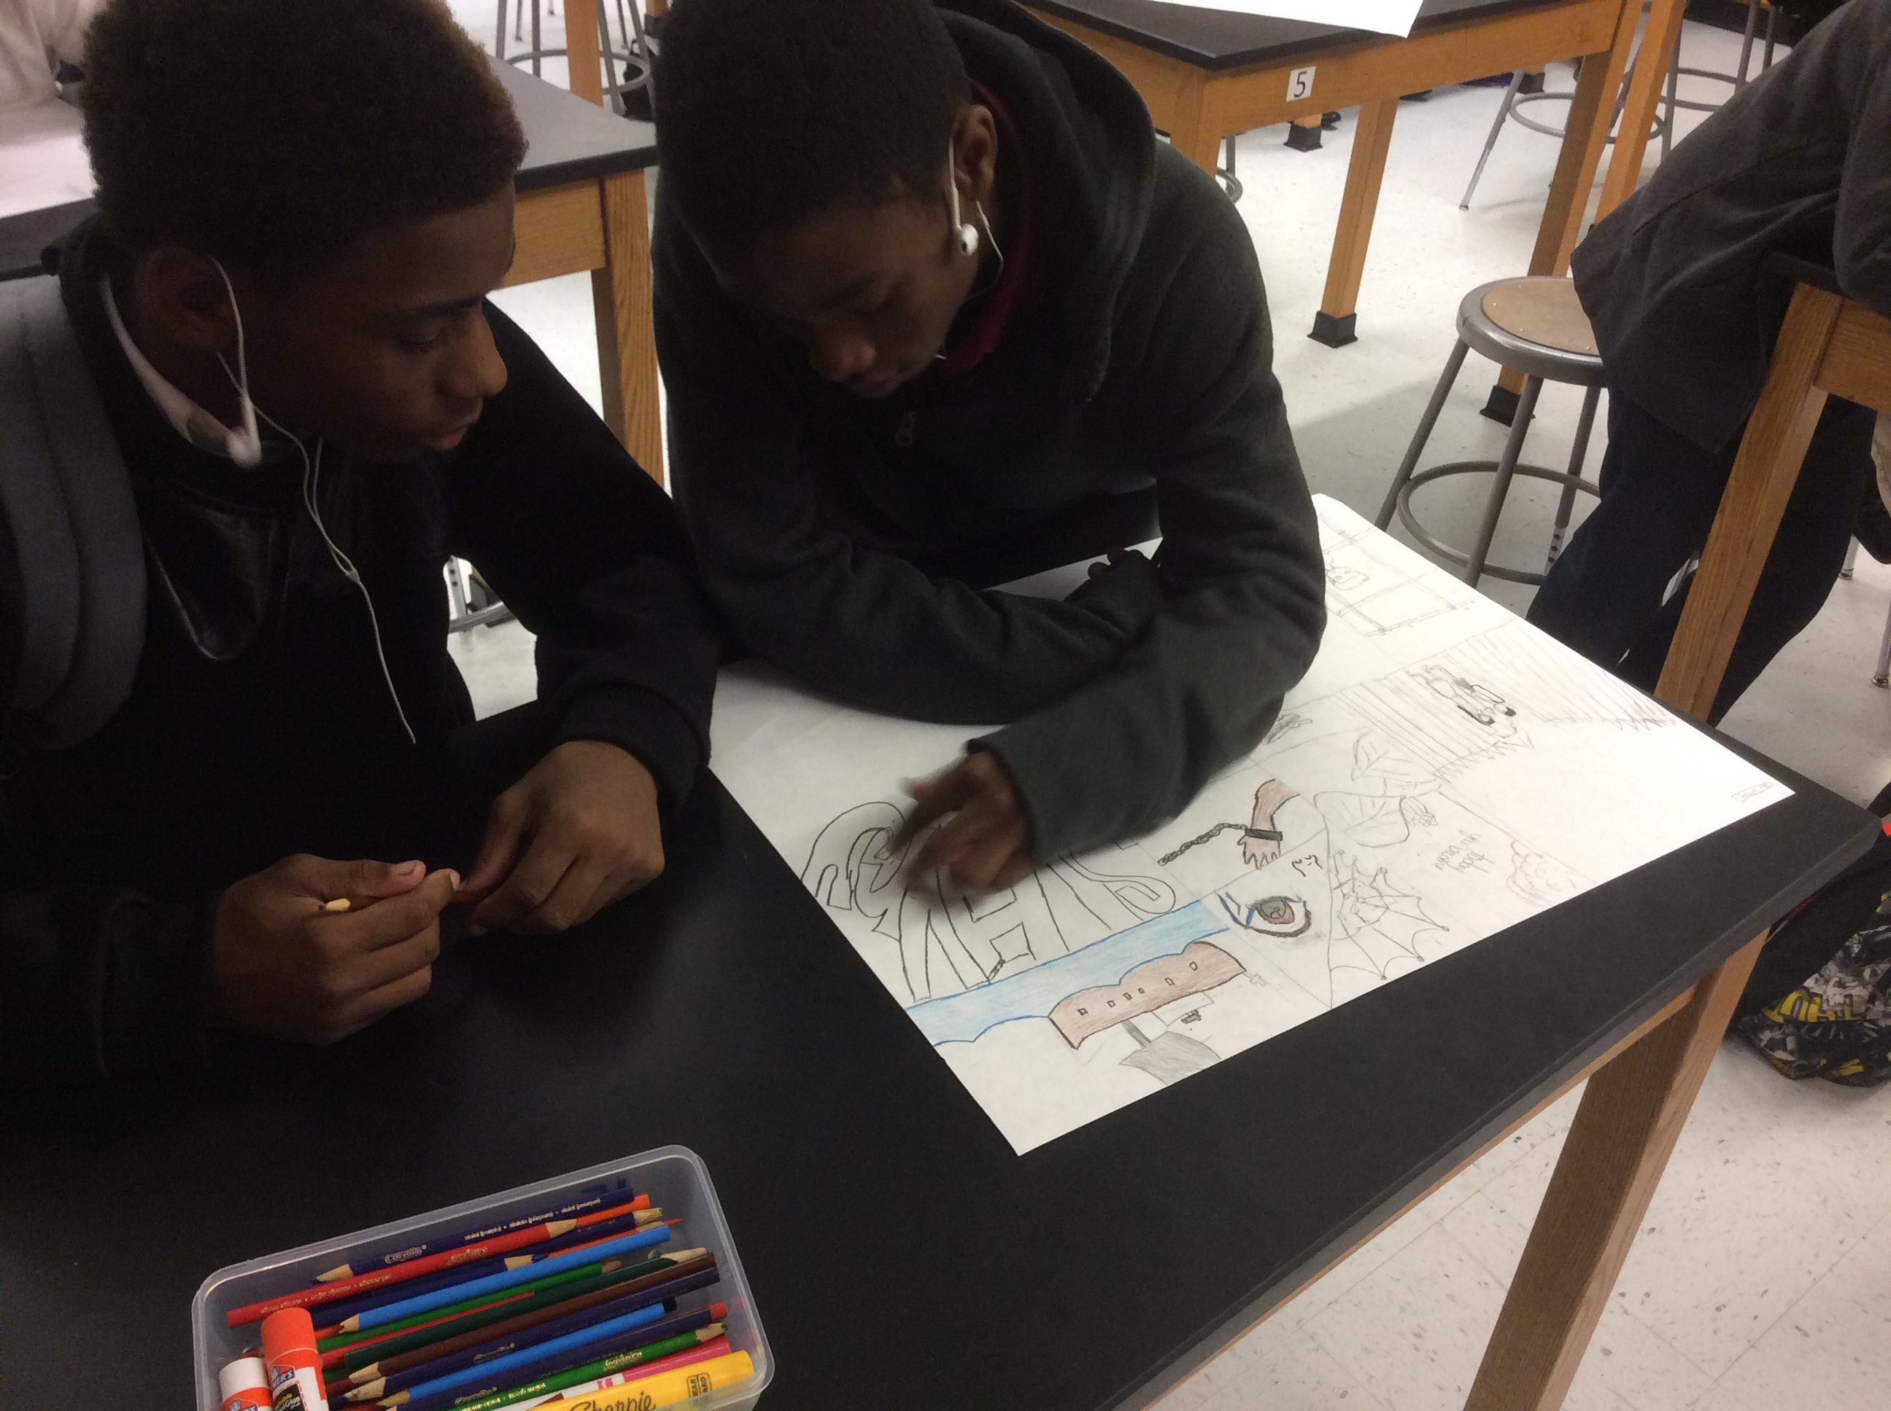
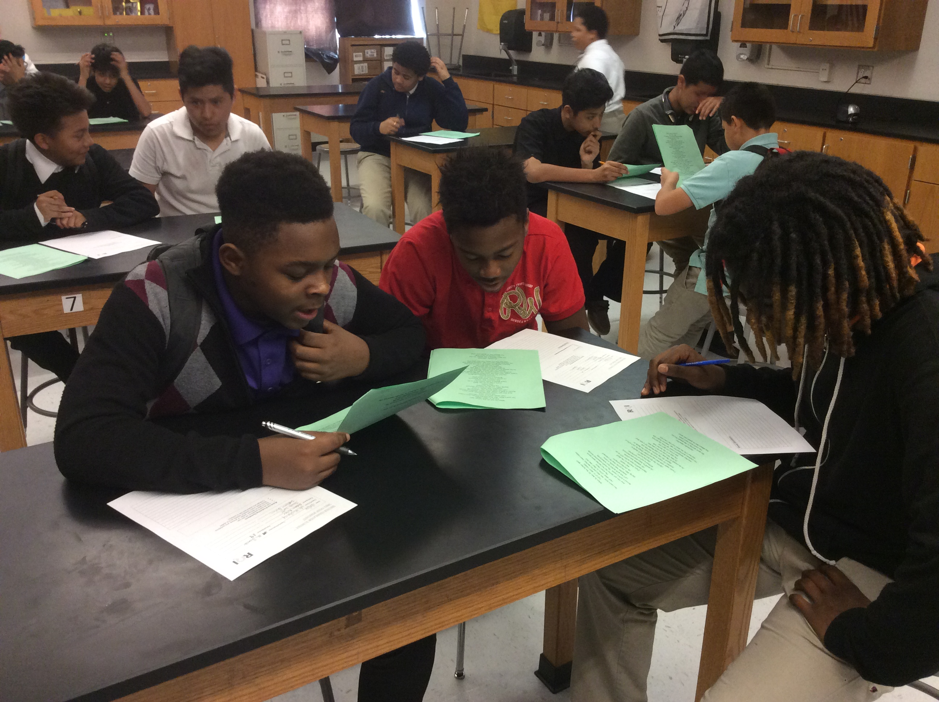
Next Steps
Students researched their questions
Students engaged in conversation on the current event
Students created posters to educate their peers on the tragedy
Organically led to a conversation on immigration

Slide 21
Student Reflections
“It helps me by getting me to think about questions on my own. Also, it gets my mind in motion to think about the questions other people make.”
- 8th Grader, Austin, TX
“I like creating as many questions as you can in a time limit without being judged because it lets my mind flow.”
- 8th Grader, Austin, TX

Slide 22
Classroom Example: Middle School
Teacher: Erica Ferguson, Chicago, IL
Topic: Police-civilian relations
Purpose: To gather information students want to know about a contemporary issue before taking informed action

Slide 23
Student Questions
Class #1 Selected Questions:
Class #2 Selected Questions:
What is the percent of officers get arrested?
Why do black people get arrested for crimes they didn’t commit?
Why do white people think it’s a joke?
Why are white people always killing black people?
Why do black people always have a better chance of dying?
Why does the judge always agree with the police?
Why do people die in the hands of law enforcement?
Why do people blame death on law enforcement?
Why aren’t officers found guilty when they commit a crime but citizens are found guilty when they commit a crime?
Why aren’t white officers found guilty when they commit a crime?
What makes officers want to kill innocent people? [o] → Do officers try to kill innocent people? [c]
Why do police officers walk in people’s house without a warrant?
Why do police officers get better treatment than American citizens?
Can officers go to jail?
Can citizens get away with a crime? [c] → How can a citizen get away with a crime? [o]
How many people die in the hands of law enforcement?

Slide 24
Student-Identified Next Steps
Information to Find | Steps to Take
How many times are police found guilty?
How many people do they accuse of murder they didn’t do?
If [police] are racist. They never arrest white people.
“I need to do research for the information.”
“I need to ask a security guard.”
“Look on the police website.”

Slide 25
Excerpts from Student Reflections:
“…After we got the basic questions down like how many are there or why they were in there we started to get into deeper questions like what happened to the inmates’ families or when was the last time they ate.”
“We had to actually truly think about what kind of message or story the picture wanted to tell. We had to think about what was going on around that time, what were people going through. The image made me personally think from a different perspective.”
“During the QFT I learned that my peers and I have very similar questions, as well as observations. I found out that a single image can generate more than 50 questions.”
“I found out from having questions you learn more.”

Slide 26
Classroom Example: 8th Grade
Teacher: Joshua Beer, Lempster, NH
Topic: American History, Imperialism unit
Purpose: To conclude unit and use student questions to create a summative assessment

Slide 27
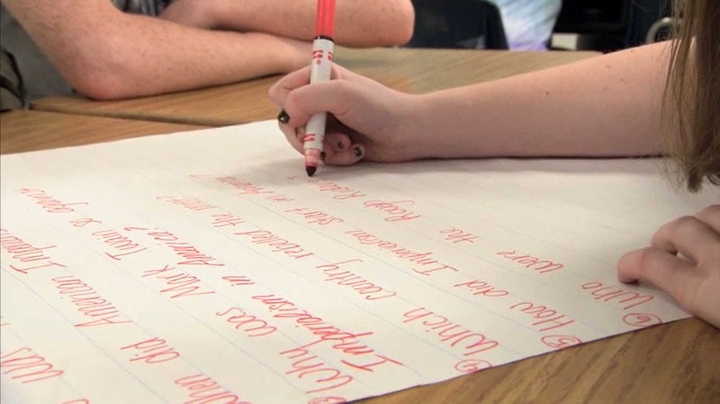
The Question Formulation Technique (QFT) in Action
https://www.youtube.com/watch?v=lfXEf0nG51I

Slide 28
Question Focus:
Questions that should be asked about American Imperialism at the turn of the 20th century

Slide 29
Selected Student Questions
1. Why did the United States want to annex Hawaii?
2. Why did the Hawaiian natives and queen Liloukalani not want the United States to annex Hawaii?
5. How was Alfred Thayer Mahan’s book influential towards imperialism?
6. What was Alfred Thayer Mahan’s stance on imperialism?
7. Why is it so important for America to have overseas bases?
8. What started the Spanish-American war?
9. Why was Spain mistreating Cubans & Phillipinos?
10. How did the Spanish-American war affect America?
6→12. Why did Alfred Thayer Mahan have the stance that he did on imperialism?
5→13. Did Alfred Thayer Mahan’s book influence imperialism?

Slide 30
Prioritization Instructions
Choose 3 questions you think are most important for understanding American Imperialism at the turn of the 20th century

Slide 31
Next Steps
Teacher collected questions and created the final unit test.
9 of the 10 questions on the test were student-generated.

Slide 32
Classroom Example: 8th Grade
Teacher: Joe Janovjak, Chicago, IL
Topic: The effects of the Holocaust on individuals
Purpose: To ask about and reflect on the experience of the concentration camps while reading Night by Elie Wiesel

Slide 33
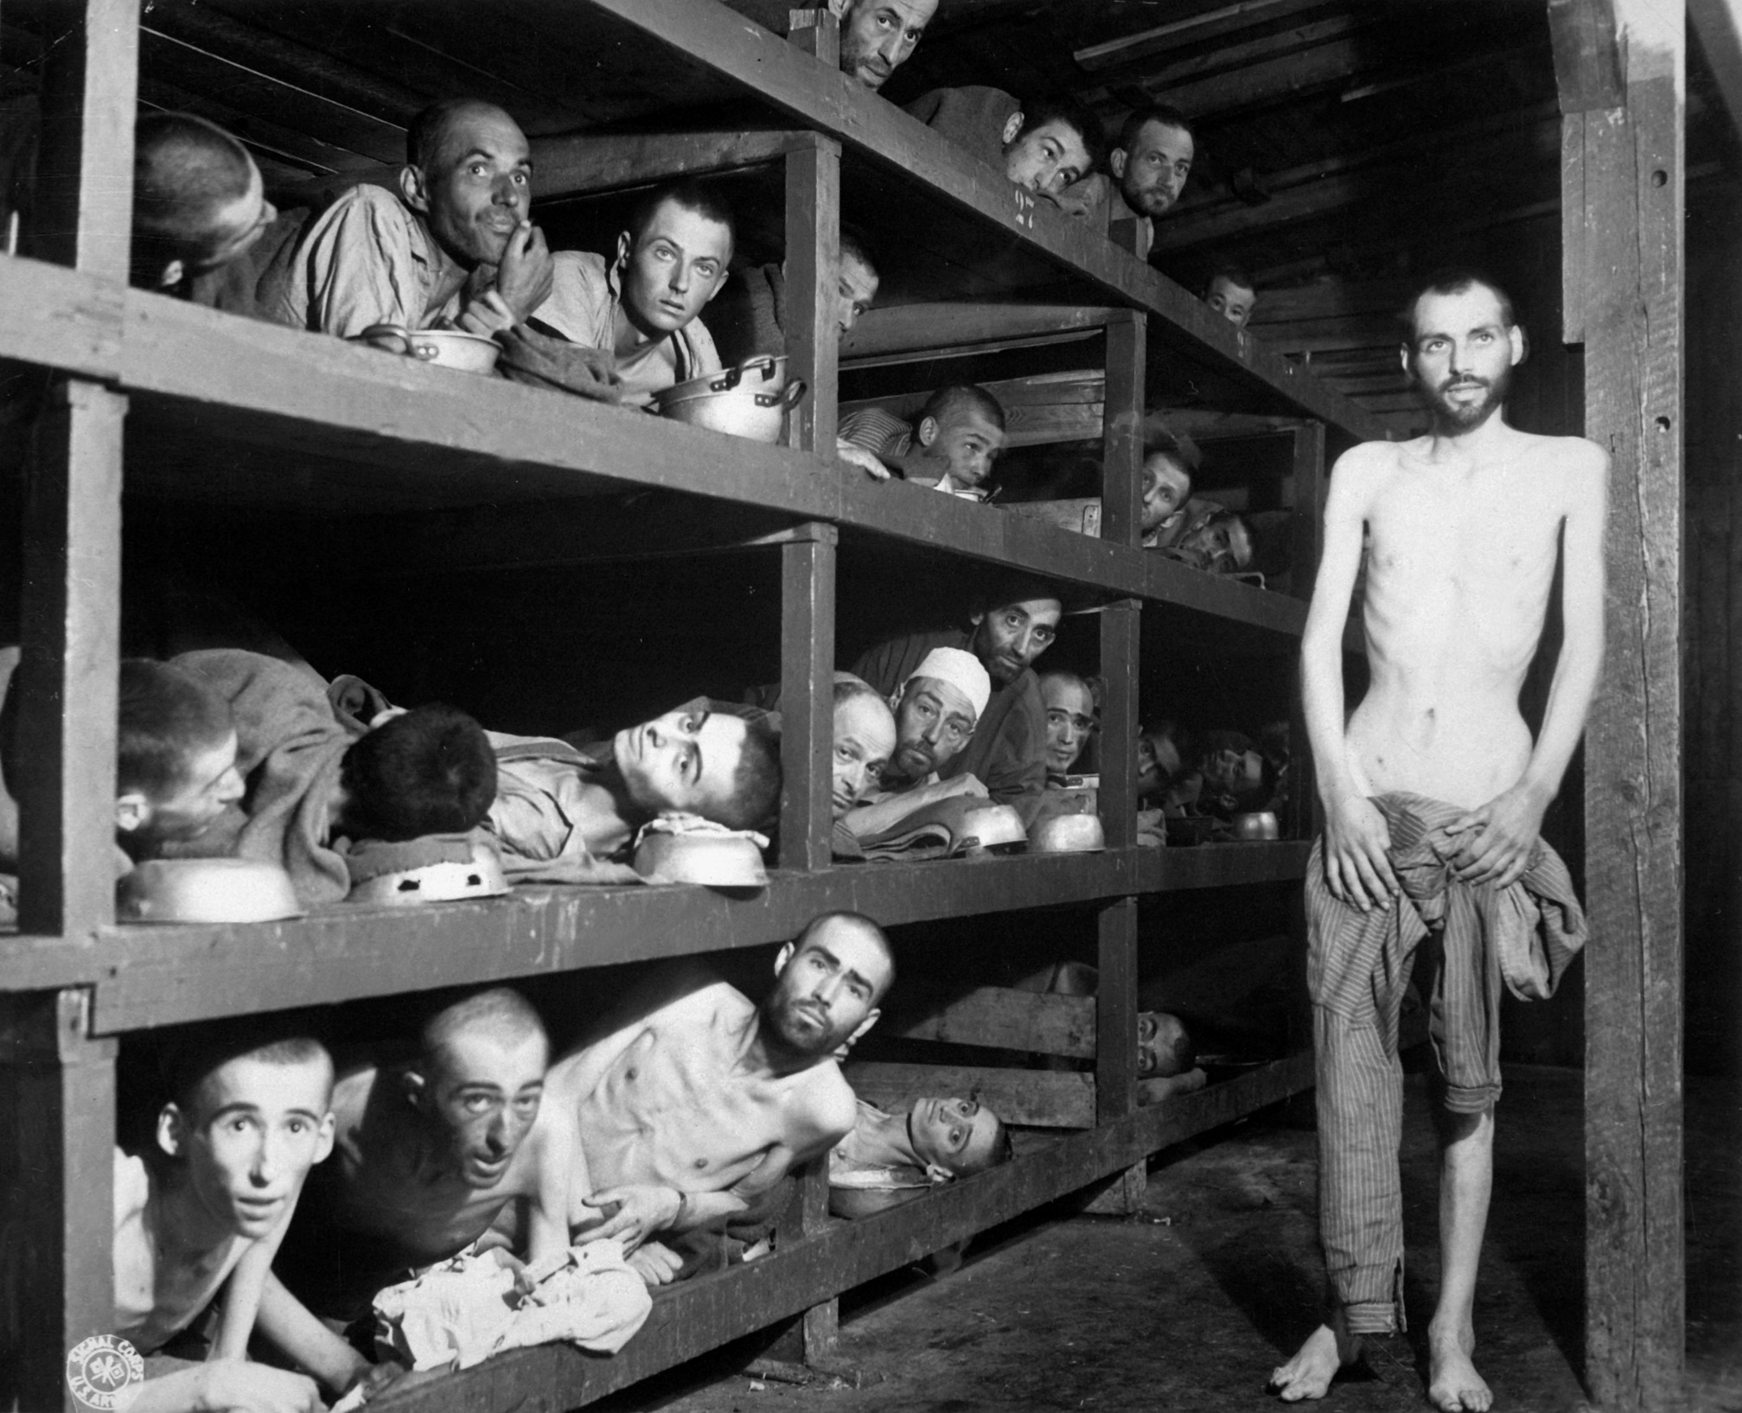
Question Focus

Slide 34
Student Questions
Class #1 Selected Questions:
Class #2 Selected Questions:
How many people are held in each barrack?
How do they sleep with bowls as a pillow?
Why are some of them naked?
Why are they so skinny/emaciated?
Are they cold?
Are they uncomfortable?
How can they sleep in small spaces? [o] → Can they sleep in small spaces? [c]
If there isn’t enough room, do they have to sleep standing up?
Do they get splinters from the bunks?
Are they separated by age? [c]→ How are they separated in their blocks/bunks? [o]
Were they forced to look at the camera?
Who was behind the camera?
What happened after the picture?
Were there any survivors?
How long were they there?
What did they have to do?
Are they resting?
Were they dying?
What was the purpose of the picture?

Slide 35
Excerpts from Student Reflections:
“…After we got the basic questions down like how many are there or why they were in there we started to get into deeper questions like what happened to the inmates’ families or when was the last time they ate.”
“We had to actually truly think about what kind of message or story the picture wanted to tell. We had to think about what was going on around that time, what were people going through. The image made me personally think from a different perspective.”
“During the QFT I learned that my peers and I have very similar questions, as well as observations. I found out that a single image can generate more than 50 questions.”
“I found out from having questions you learn more.”

Slide 36
Classroom Example: 9th Grade Humanities
Teacher: Ellen Gammel, Fitchburg, MA
Topic: Bioethics & Nonfiction: The Immortal Life of Henrietta Lacks
Purpose: To prepare for a formal debate at the very end of the unit

Slide 37
Question Focus
Debate Resolve:
Doctors should be able to do what they want with human tissue after the patient gives consent for removal of the tissue.

Slide 38
Students’ Questions
A Team Against Debate Resolve:
A Team For Debate Resolve:
Are our bodies truly our property?
How much consent?
How much information should a patient receive in order for them to give informed consent?
Consent for removal or consent for research?
Should the patient be paid?
How should patients be paid? What for?
What counts as tissue?
Consent for removal of tissue or other body parts?
How about animals?
Are owners in charge of their pet’s tissue?
Are parents in charge of their kids’ tissue?
Can kids give informed consent?
Do gives give their parents consent?
How about teeth?
Do teeth count as bone donations?
What percent of compensation should patients receive?
How have tissue ownership laws changed over the years?
Is there a law?
Do doctors owns the tissue after patients give consent?
Should patients be able to perform their own research?
Do doctors come up with the idea? (A focus)
Do doctors need consent for tissue that doesn't belong to humans?
Can patients take back consent once they find out what the doctors are doing with their tissue?

Slide 39
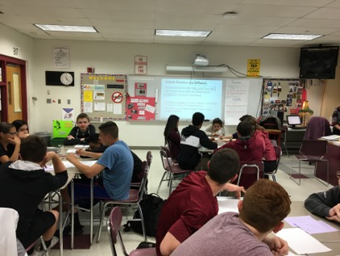
Next Steps with Student Questions
In teams, students researched their priority questions
Students prepared their debate arguments and rebuttals, using research
Students practiced public speaking and rhetorical skills

Slide 40
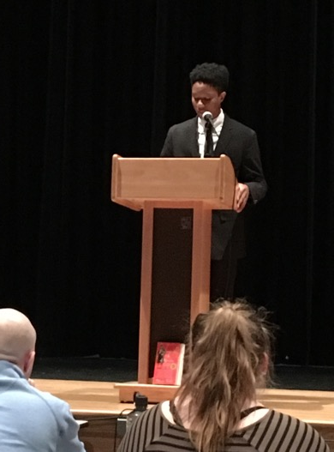
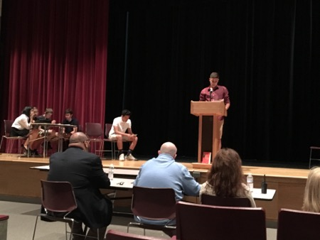
Next Steps with Student Questions
The Debate
The 3 Judges: administrators, teachers and a former student
The Audience: students, parents, teachers, school & district leaders

Slide 41
To read more about another QFT lesson Ellen did to start the Henrietta Lacks unit, read:
http://rightquestion.org/blog/biography-and-bioethics-9th-graders-ask-questions-about-the-immortal-life-of-henrietta-lacks/
This post includes insight into how to tailor certain steps of the QFT and ramp up difficulty in particular areas for students already experienced with the process

Slide 42
Classroom Example: 10th Grade
Teacher: Johnny Walker, Sylmar, CA
Topic: Imperialism in South Africa
Purpose: To generate at least 1 formative and at least 1 summative question for the day’s lesson

Slide 43
Question Focus
Video of South Africans taking down a statue of Cecil Rhodes
Notes:
A video of South Africans pulling down a statue of Cecil Rhodes

Slide 44
Student Questions
Why are they covering his face?
What is going on?
Where is it taking place?
What are they singing?
Is that King Leopold?
Why are they throwing stuff at him?
Why is his face discolored?
What are they wrapping around him?
What did they get by taking it down?
Why are they celebrating?
What is the statue of?
Why are they cheering?
Are they trying to destroy it?
Why are they throwing trash at it?
Where is this?
Who is that?
Why are they smacking it?
Why are people filming?
Why is there a boy there?
Notes:
A video of South Africans pulling down a statue of Cecil Rhodes

Slide 45
Classroom Example: 10th Grade
Teacher: Johnny Walker, Sylmar, CA
Topic: Imperialism in India
Purpose: To generate formative and summative questions for the day’s lesson and for the end of unit exam

Slide 46
Question Focus

Slide 47
Student Questions
Are those people?
Why are people laying down?
Why are they so skinny?
Do they eat?
Are there more people like that?
What does she have wrapped around her neck?
Why are the still alive? (O) → Are they still alive? (C)
How long has it been like that?
Are they related?
Who took the picture?
Where are they?
How did they end up in this situation?

Slide 48
Next Steps with Student Questions
Students answered their questions on the board after learning more about the picture

Slide 49
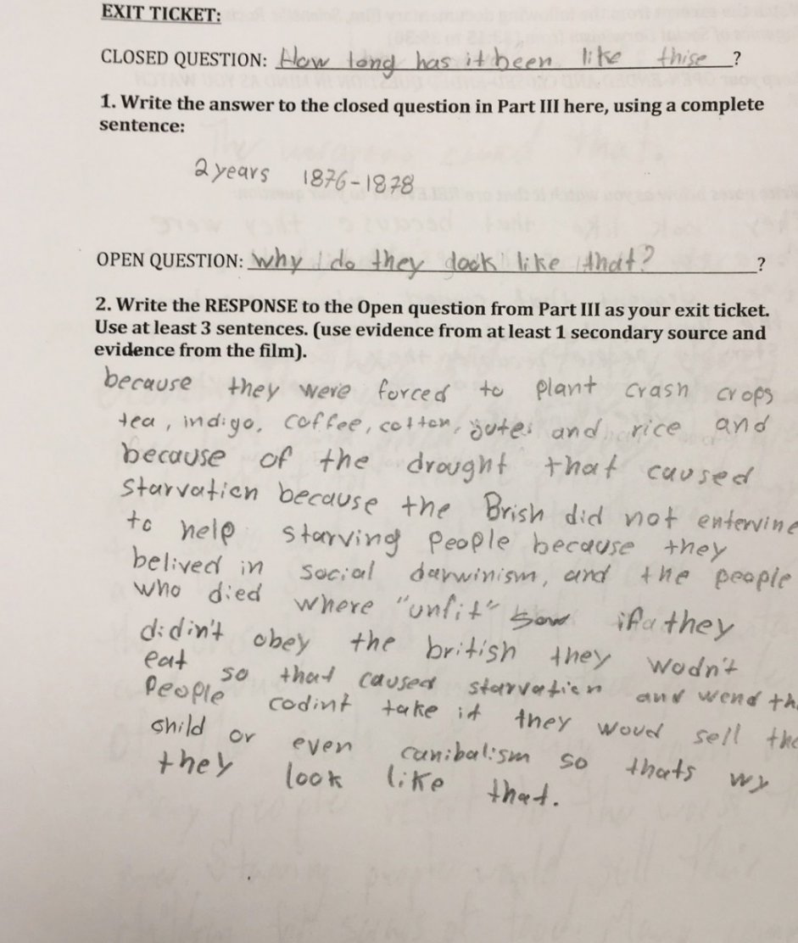
Next Steps with Student Questions
Students answered one open-ended and one close-ended question as an exit ticket.

Slide 50
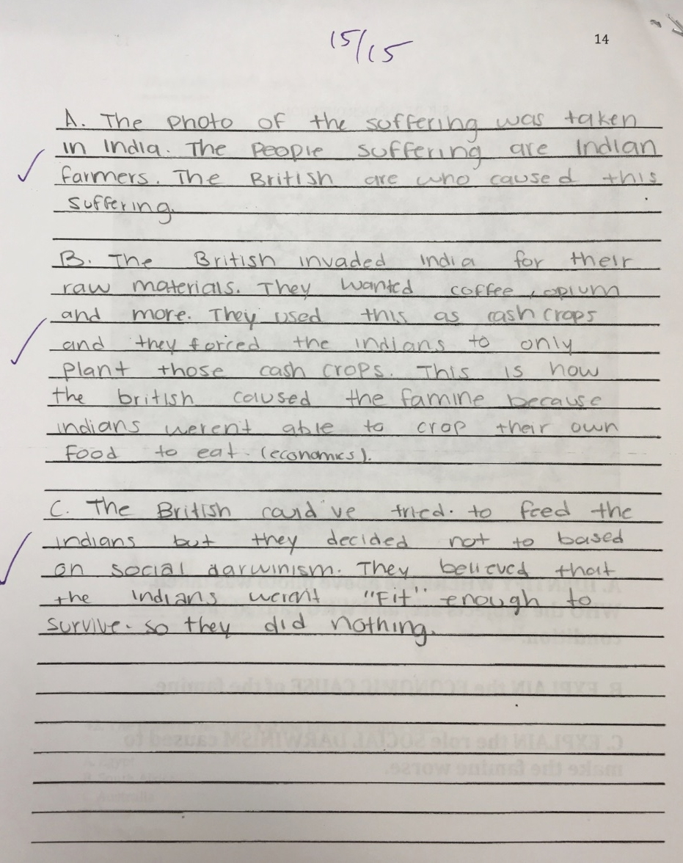
Next Steps with Student Questions
Teacher used QFocus prompt on unit summative assessment

Slide 51
Classroom Example: 10th Grade
Topic: WW1- Effects of the Treaty of Versailles. (3 days)
Purpose: Explain the cartoon using primary and secondary source evidence.

Slide 52
Question Focus

Slide 53
Next Steps
Students generated questions and answered them as we analyzed secondary and primary sources.
2 questions were used to generate claims that were supported with primary source evidence in a DBQ
Why is there a treaty on the ground?
Why is the child crying?

Slide 54
Classroom Example: High School Social Studies
Teacher: Kelly Grotrian, East Brunswick, NJ
Topic: The end of World War II
Purpose: Leads into a discussion about whether the United States was justified in dropping the atomic bomb. Students’ questions were also used for a homework assignment on Google classroom.
Notes:
11th Grade U.S. History II

Slide 55
Question Focus
http://www.loc.gov/pictures/item/98506956/

Slide 56
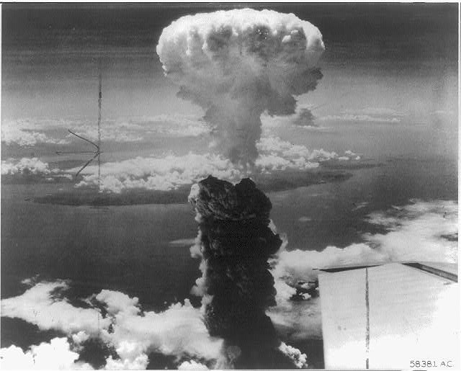
Student Questions
What is this?
Who did this?
How did this affect people?
What were the environmental & economic implications of dropping the bomb?
How many people were hurt?
Is that a plane wing in the bottom right?
Did the people in that plane drop the bomb?
Did the people dropping the bomb know what they were doing?
Did they make the bomb?
Who was responsible for dropping the bomb?
What led to this event?
What happened as a result of dropping the bomb?
Where was the bomb dropped?
Had people been given warning?
How long did it take to notice effects of the bomb?
When did this happen (at what point in the war)?
How many lives were lost as a result?

Slide 57
Classroom Example: 12th Grade Government
Teacher: Daniel Fouts, Des Plaines, IL
Topic: 12th Grade AP Government unit on the American presidency at moments of crisis
Purpose: To engage students at the start of the unit and to help students select a topic for an independent project

Slide 58
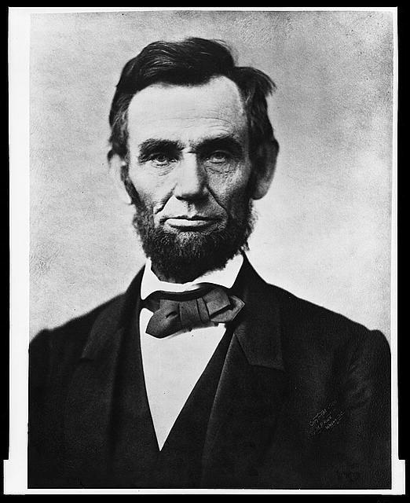
Question Focus
“Nearly all men can handle adversity; but if you really want to test a man’s character, give him power.”
https://www.loc.gov/pictures/item/96522529/

Slide 59
Student Questions
How does power challenge one’s morality?
Should everyone have some type of power?
Does power make people corrupt?
What if the person who is qualified for power doesn’t attain it?
How is a man’s power tested?
What is considered power?
What defines good character?
How can we ensure that the good men get the power?
What kind of man can handle adversity?
What can power tell us about a man’s character?
How can power be obtained by adversity?
Why are some people affected by power differently?
If adversity supposedly makes you stronger, does that mean that power makes you weaker?

Slide 60
Next Steps with Student Questions
Each student selected l question from the class list to work on throughout the unit
Students answered their question using research and knowledge from the unit in a two-page reflection paper
Students shared their reflections in a class discussion on the final day of the unit

Slide 61
Classroom Example: 12th Grade Civics
Teacher: Ms. Akiko Doi, Hyogo, Japan
Topic: The impact of elections on all citizens
Purpose: To encourage students to think about the value of voting
Notes:
in 2015, the government lowered the voting age to 18 from 20.
The Voting rate under 20 was 41.5 %
The voting rate for the election of the House of Representatives was 53.68 % second lowest after the WW2

Slide 62
Question Focus
Voting benefits me.
Notes:
選挙に行くことは自分が得をするためだ。
The reason for going to vote is my own benefit.
I go to vote because it is beneficial to myself.

Slide 63
Each Groups’ Prioritized Questions [Translated]
<Group 1 >
<Group 5 >
Doesn’t voting reflect minority’s opinion?
Why is the voting rate (voter turnout) low?
Can we get benefit from voting?
How can my opinion be reflected by voting?
<Group 6 >
Why do many Japanese people not vote?
Why do students have opportunities to think about election at school?
Are manifests actually implemented?
<Group 2 >
How different is our generation’s voting behavior?
How beneficial is election?
Isn’t it meaningless if a candidate I voted is not selected?
<Group 7 >
Does election equally benefit to all generations?
What kinds of benefit do we have by going to vote?
<Group 3 >
Do we waste money for election?
How does my one vote change the result?
Does going to vote pay if the candidate whom I vote does not get elected?
<Group 8 >
Should the voter turnout be higher if voting is beneficial to ourselves?
Can we participate in politics by voting?
Do political parties really implement their policies they stated before election?
<Group 4 >
Who can benefit from election?
What is the meaning of election itself?
What is the purpose of going to vote?
Notes:
Prioritized instruction: Choose three most interesting questions and think about the reasons.
Not all groups chose three questions.
Qs that show different perspectives- bold
4 or 5 qs to cover different things-

Slide 64
Next Steps
Over the next couple of classes, students:
Participated in a mock election based on their own preferences
Looked at the elections from the perspectives of different generations from the 20s to the 70s
Voted again from the perspective of the specific generations
Listened to a lecture about government and its impact on different generations
Students answered their prioritized questions.
Notes:
Class #1 is the QFT class- do not have the reflection from the class.
Class #2 : The first mock election
Students filled out worksheet with which they considered fictional parties’ policies.
They voted, counted the votes, shared the result and had reflection.
Class #3 : Think about the election from different generations
Divided the class into each generation’s group (-20s, 30-40s, 50-60s and above 70s).
Investigated each generation’s lifestyle and needs, and thought about their opinions about policies and priorities in election.
Class #4 : The second mock election
Shared each group’s discussion in the class.
They voted in the same election from different generations, and had reflection.
Class #5 : Overall reflection
Shared the result of the second mock election
Lecture of “Sovereign and the stream of time”
Answered the questions to three interesting questions formulated in the QFT individually.
In group, students created their best answers to the questions.

Slide 65
Students’ Reflection after the unit
We started talking about politics even during recess.
During the QFT, I asked questions without having answers, but now I am surprised that I can answer the questions in my own words after the classes.
I realized that media influence a lot to my political opinions.
I think it is important to think about how to reflect my opinion to politics while thinking about others.
It is important to vote for my own interests in election…
My classmates have more opinions than I expected.
Notes:
This is the reflection after the whole unit.
I do not see any good one related to the QFT though.

Slide 66
Classroom Example: High School
Teacher: Connie Williams, Petaluma, CA
Topic: Debate Team
Purpose: To anticipate the information necessary to research before a debate

Slide 67
Question Focus
Resolved that the United States screen immigrants for extremist ideological views.

Slide 68
Student Questions
What are extremist views?
How are we screening now?
What kinds of extremist views are there?
What about homegrown extremist views?
How might we screen immigrants differently?
What would happen if we didn’t let anyone in anymore?
Don’t we already have a good system?
Why are we re-building something that isn’t broken?
How do we know if it’s broken or not?

Slide 69
Next Steps with Student Questions:
Students created questions for the evaluation of the sources they were using:
Who wrote this?
For what purpose was this written?
How do they want me to feel?
How do they want me to act?
What are the sources of their numbers, charts, or other evidence?
Can we trace them back to their creator?… and then question the purpose and authority of those numbers also.

Slide 70
Classroom Example: 11th Grade
Teacher: Isabel Morales, Los Angeles, CA
Topic: Social Justice
Purpose: Engage students in thinking about systemic injustice ahead of several fiction and nonfiction texts in the semester

Slide 71
Question Focus
“The disciplinary policies of our society perpetuate injustice.”

Slide 72
Student Questions
Why are student of color targeted the most?
How do disciplinary policies target specific racial groups?
Do teachers nationwide take notice of these stats?
How can teachers develop better & effective disciplinary policies?
Why do people see the stats & data as a coincidence?
What does a kid learn about the system once in jail?
What do people believe expulsion will teach the students?
Does going to juvie have a long-term effect on younger students about education?
When will it get better?
What are some ways to improve behavior?
What type of training will teachers go through that’ll bring justice to classrooms?
Shouldn’t school police officers be trained like teachers?
What is considered a criminal offense in school?
Isn’t it the teacher’s job to keep the students “in line”?
How should disruption in class be handled?
How come there aren’t any policies keeping students out of prison?

Slide 73
Next Steps with Student Questions
Students decided to research statistics and poll students and teachers.
Students met with the school administration to ask questions and address their concerns.
School principal founded a student advisory council, which many students joined, to give students a voice in new policies.

