Slide 1
The Power of Question Formulation for Lifelong Learning
Sarah Westbrook
Director of Professional Learning
The Right Question Institute
Sarah.westbrook@rightquestion.org, @Sarah RQI

Slide 2
Who is in the room?

Slide 3
To Access Today’s Materials:
https://bit.ly/3vQwtPJ
Notes:
This leads to Monticello CSD’s event page on rightquestion.org

Slide 4
Access RQI’s Free QFT Resources
https://rightquestion.org/education/resources
Classroom Examples
Instructional Videos
Planning Tools & Templates

Slide 5
Use and Share These Resources
The Right Question Institute offers materials through a Creative Commons License. You are welcome to use, adapt, and share our materials for noncommercial use, as long as you include the following reference:
“Source: The Question Formulation Technique (QFT) was created by the Right Question Institute (rightquestion.org).”

Slide 6
Today’s Agenda
Welcome
Why Spend Time on Teaching the Skill of Question Formulation?
Collaborative Learning with the Question Formulation Technique (QFT)
Explore Real Classroom Examples & Applications
Why is Question Formulation Important Now?
Q&A

Slide 7
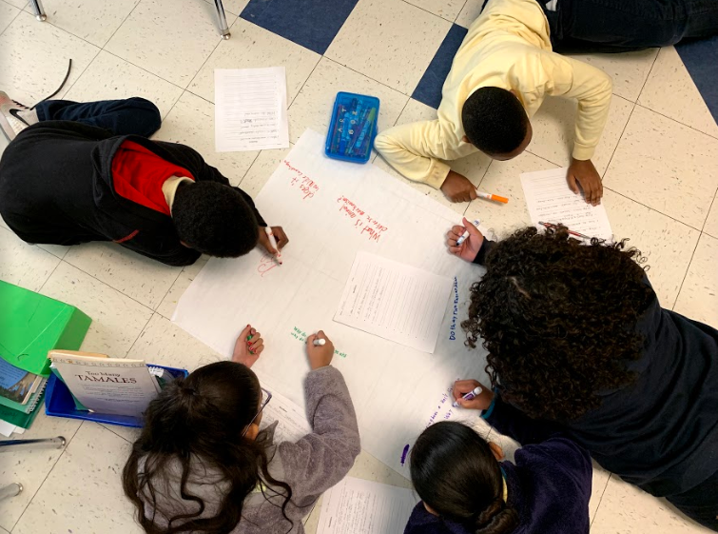
Why spend time teaching the skill of question formulation?

Slide 8
Origin of the Right Question Institute: Parents in Lawrence, Massachusetts, 1990
“We don’t go to the school because we don’t even know what to ask.”
Notes:
As you saw in the introductory video…

Slide 9
"There is no learning without having to pose a question."
- Richard Feynman
Nobel Laureate, Physics, 1965

Slide 10
“We must teach students how to think in questions, how to manage ignorance.”
– Stuart Firestein
Former chair, Department of Biology,
Columbia University

Slide 11
College Presidents on What College Students Should Learn
“The primary skills should be analytical skills of interpretation and inquiry. In other words, know how to frame a question.”
- Leon Botstein, President of Bard College
“…the best we can do for students is have them ask the right questions.”
- Nancy Cantor, Former Chancellor of University of Illinois
The New York Times, August 4, 2002

Slide 12
Yet, Only 27% of Graduates Believe College Taught Them How to Ask Their Own Questions
Alison Head, Project Information Literacy at University of Washington, 2016

Slide 13
But, the problem begins long before college…

Slide 14
Question Asking Declines with Age
Tizard, B., Hughes, M., Carmichael, H., & Pinkerton, G. (1983).
Pearson, J.C. & West, R. (2009)
Notes:
Tizard, B., Hughes, M., Carmichael, H., & Pinkerton, G. (1983). Children’s questions and adults’ answers. Journal of Child Psychology and Psychiatry, 24, 269-281.
Girls (mean age 3 years 11 months) from working class and middle class families asked 24 and 29 questions per hour at home, respectively. At school, these same girls asked on average 1.4 and 3.7 questions per hour (working and middle class, respectively)

Slide 15
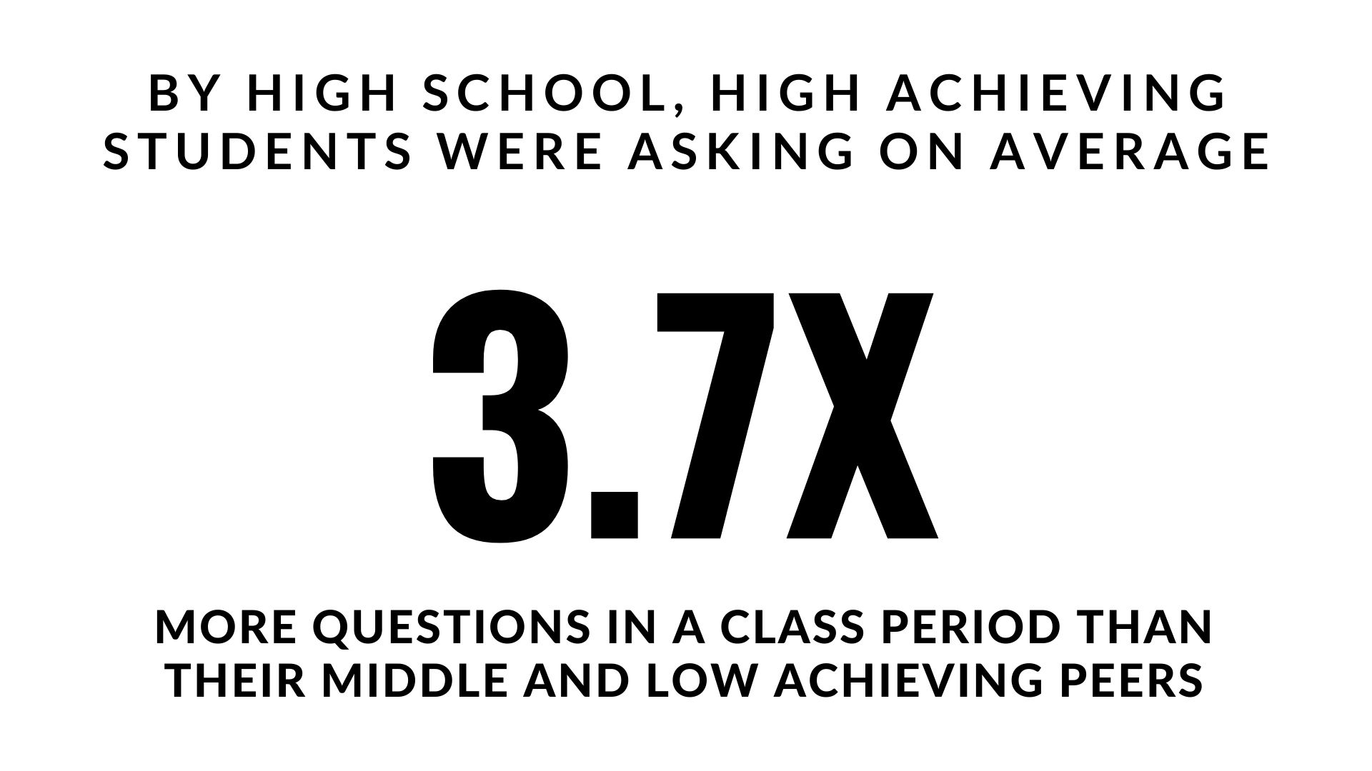
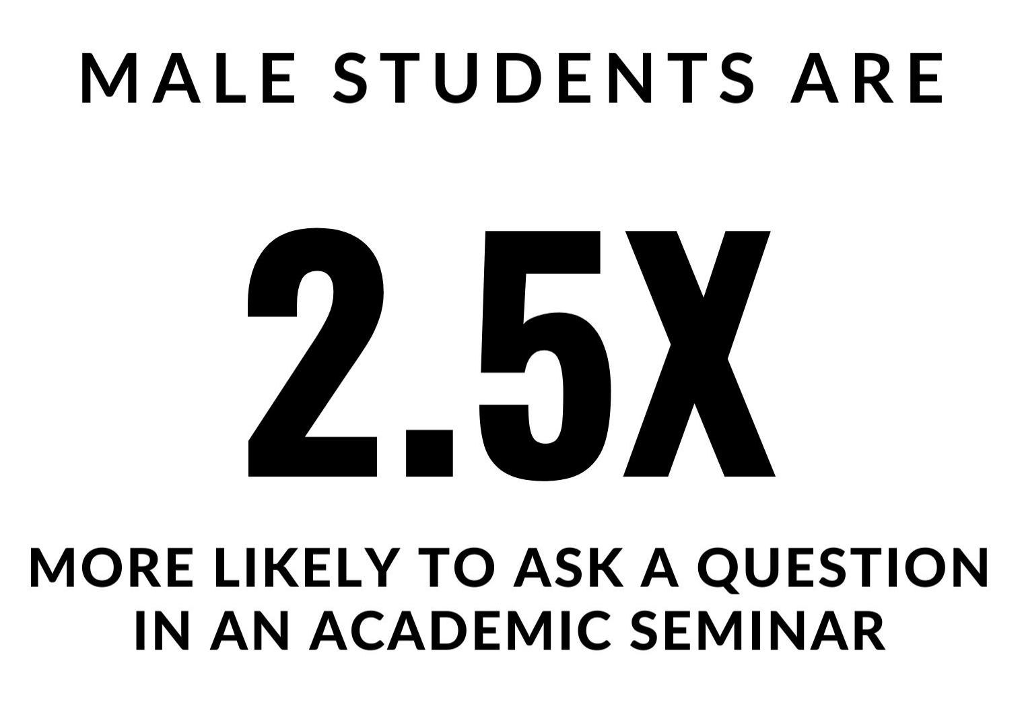
Which students ask questions?
Tizard, B., Hughes, M., Carmichael, H., & Pinkerton, G. (1983)
Carter, A., Croft, A., Lukas, D., Sandstrom, G. (2017).
Notes:
First: Tizard, B., Hughes, M., Carmichael, H., & Pinkerton, G. (1983). Children’s questions and adults’ answers. Journal of Child Psychology and Psychiatry, 24, 269-281.
Girls (mean age 3 years 11 months) from working class and middle class families asked 24 and 29 questions per hour at home, respectively. At school, these same girls asked on average 1.4 and 3.7 questions per hour (working and middle class, respectively)
Second:
Good, T. L., Slavings, R. L., Harel, K., Emerson, H. (1987). Student Passivity: A Study of Question Asking in K-12 Classrooms. Sociology of Education, 60, 187 & 189.
Classroom observations made across 22 k-12 classrooms which tracked students’ question asking behavior showed that in upper grades, low-achieving students ask fewer questions in a 50 minute class period than other students. : On average, high achieving students asked 3.7X the number of questions middle and low achieving students asked in the high school grades.
Quote from study: The data in Table 2 indicate that low achievers in upper grades ask fewer questions than younger low achievers. Tables 2 and 3 also show that low-achieving students continue to be active participants through the third grade; however, by the sixth grade, they have become relatively passive. The data thus support the view that low-achieving elementary students learn to avoid asking questions in the classroom. In higher grades, it is clear that low-achieving students ask fewer questions in class than other students.

Slide 16
We can work together on creating more opportunities for all students to ask their own questions

Slide 17
We Are Not Alone
More than 1 million classrooms worldwide

Slide 18
What happens when students do learn to ask their own questions?

Slide 19
Research Confirms the Importance of Questioning
Self-questioning (metacognitive strategy):
Student formulation of their own questions is one of the most effective metacognitive strategies
Engaging in pre-lesson self-questioning improved students rate of learning by nearly 50% (Hattie, p.193)
John Hattie
Visible Learning: A Synthesis of Over 800
meta-Analyses Relating to Achievement, 2008
Notes:
UC Davis Research Linking Curiosity to Memory (UC Davis) 2014
The Fullerton Longitudinal Study (FLS), a 30-plus year study of the development of giftedness across various points in time conducted by Adele and Allen Gottfried of California State University ”This finding has strong implications for the development of STEM considering that curiosity is a fundamental predictor of the aspiration to become a scientist.”
S. von Stumm, B. Hell, T. Chamorro-Premuzic. The Hungry Mind: Intellectual Curiosity Is the Third Pillar of Academic Performance. Perspectives on Psychological Science, 2011 meta-analysis shows They found that curiosity did, indeed, influence academic performance. In fact, it had quite a large effect, about the same as conscientiousness. When put together, conscientiousness and curiosity had as big an effect on performance as intelligence.

Slide 20
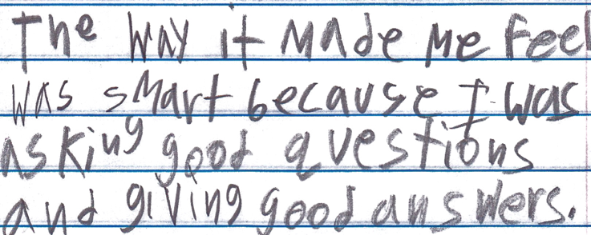
Student Reflection
“The way it made me feel was smart because I was asking good questions and giving good answers.”
-Boston 9th grade summer school student

Slide 21
Today’s Agenda
Welcome & Community Building
Why Spend Time on Teaching the Skill of Question Formulation?
Collaborative Learning with the Question Formulation Technique (QFT)
Explore Real Classroom Examples & Applications
Why is Question Formulation Important Now?
Q&A

Slide 22
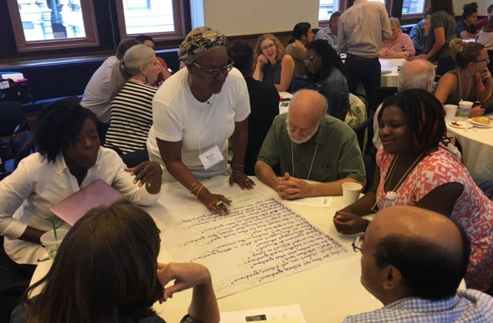
Collaborative Learning with the Question Formulation Technique (QFT)

Slide 23
There are 2 icons you will see:
Please think or work on the task assigned
Use the chat box to share some of your work

Slide 24
The Question Formulation Technique (QFT)
Individuals learn to:
Produce their own questions
Improve their questions
Strategize on how to use their questions
Reflect on what they have learned and how they learned it

Slide 25
Rules for Producing Questions
1. Ask as many questions as you can
2. Do not stop to answer, judge, or discuss
3. Write down every question exactly as stated
4. Change any statements into questions
Notes:
If you are working alone, rule #3 becomes: “write down every question as it first comes to mind.” Don’t judge yourself!

Slide 26
Produce Questions
Ask Questions
Follow the Rules
Ask as many questions as you can.
Do not stop to answer, judge, or discuss.
Write down every question exactly as it was stated.
Change any statements into questions.
Number the Questions

Slide 27
Question Focus
Some students are not asking questions.
→Now, ask questions. Number the questions. Follow the rules:
Ask as many questions as you can.
Don’t stop to answer, judge, or discuss.
Record each question exactly as it was stated (or first came to mind).
Change any statements into questions.

Slide 28
Categorize Questions: Closed/Open
Definitions:
Closed-ended questions can be answered with a “yes” or “no” or with a one-word answer.
Open-ended questions require
more explanation.
Directions: Identify your questions as closed-ended or open-ended by marking them with a “C” or an “O.”

Slide 29
Discuss
Closed-ended Questions
Advantages
Disadvantages

Slide 30
Discuss
Open-ended Questions
Advantages
Disadvantages
Notes:
The point here is that the closed-ended questions are equally useful as open-ended!

Slide 31
Improve Questions
Take one closed-ended question and change it into an open-ended question.
Take one open-ended question and change it into a closed-ended question.
Add these as new questions to your list
Closed
Open
Open
Closed

Slide 32
Prioritize Questions
Review your list of questions
Choose three questions that you feel are most important.
While prioritizing, think about your Question Focus, Some students are not asking questions.
Then, think about why you chose those questions.
After prioritizing, use the chat box to share ONE of your priority questions.

Slide 33
Action Plan
In order to answer your priority questions:
What do you need to know? Information
What do you need to do? Tasks
Write down a couple ideas you have.
After prioritizing, use the chat box to share ONE possible action step.

Slide 34
Reflect
What did you learn?
How did you learn it?
How could you use it in your work?

Slide 35
A Look Inside the Process

Slide 36
The QFT, on one slide…
Ask as many questions as you can
Do not stop to discuss, judge or answer
Record exactly as stated
Change statements into questions
Question Focus
Produce Your Questions
Follow the rules
Number your questions
Improve Your Questions
Categorize questions as Closed or Open-ended
Change questions from one type to another
Strategize
Prioritize your questions
Action plan or discuss next steps
Share
Reflect
Closed-Ended:
Answered with “yes,” “no” or one word
Open-Ended: Require longer explanation
Source: The Right Question Institute rightquestion.org
Notes:
I

Slide 37
Three thinking abilities
with one process

Slide 38
Thinking in many different directions
Divergent
Thinking

Slide 39
Narrowing Down, Focusing
Convergent
Thinking

Slide 40
Thinking about Thinking
Metacognition

Slide 41
Today’s Agenda
Welcome & Community Building
Why Spend Time on Teaching the Skill of Question Formulation?
Collaborative Learning with the Question Formulation Technique (QFT)
Explore Real Classroom Examples & Applications
Why is Question Formulation Important Now?
Q&A

Slide 42
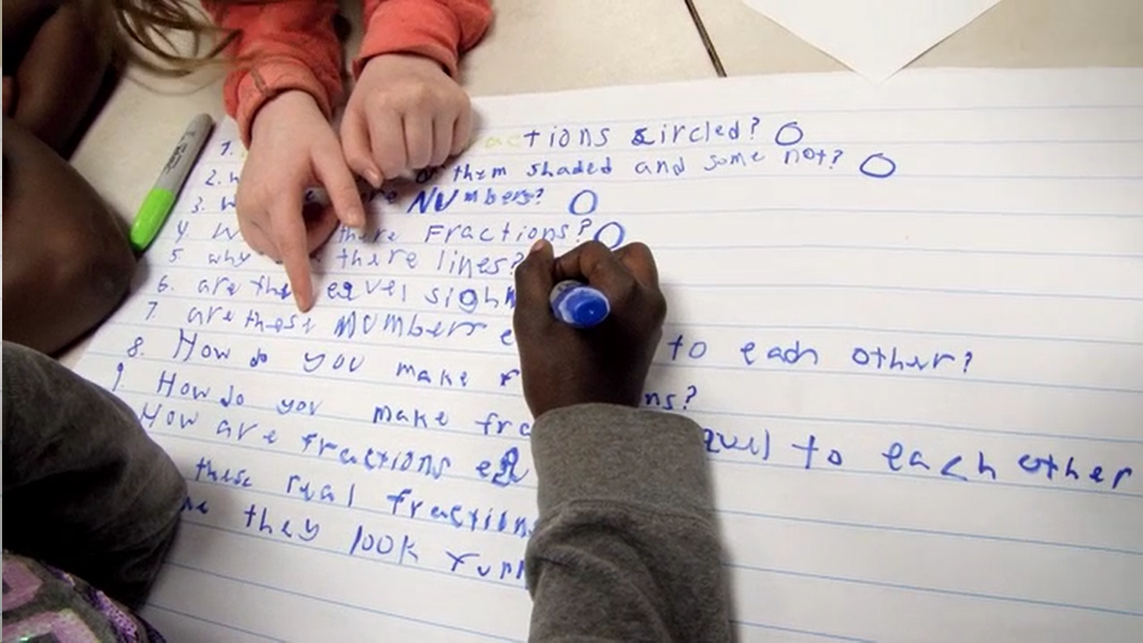
Exploring Classroom Examples

Slide 43
Classroom Example: Kindergarten
Teacher: Jennifer Shaffer, Walkersville, MD
Topic: Non-fiction literacy
Purpose: To engage students prior to reading a nonfiction text about alligators

Slide 44
Question Focus
Photograph by Nuwan Samaranayake, 2013

Slide 45
Student Questions
Is the alligator camouflaged?
Why do the babies have stripes?
Are those baby crocodiles?
Is it a mom or dad crocodile?
What is the green stuff?
Why are they in the water so low?
Where are they going?
Why are the baby alligator’s eyes white and the mom’s black?
Why are baby alligators on top of the momma alligator?
Why does momma or daddy have bumps on them?

Slide 46
Classroom Example: 4th Grade
Teacher: Deirdre Brotherson, Hooksett, NH
Topic: Math unit on variables
Purpose: To engage students at the start of a unit on variables and assess their current skill level

Slide 47
Question Focus
24 = ☺ + ☺ + ☺

Slide 48
Student Questions
Why is the 24 first?
What do the smiley faces mean?
Why are there 3 smiley faces?
How am I suppose to figure this out?
Is the answer 12?
Can I put any number for a smiley face?
Do three faces mean something?
Do the numbers have to be the same because the smiley faces are the same?
What numbers will work here?
Does it mean 24 is a really happy number?
Can we replace each smiley face with an 8?
Do any other numbers work?
Can we do this for any number?
Does it always have to be smiley faces?
Do we always have to use three things?

Slide 49
Next Steps
Posters of students’ questions were displayed on walls around the room
As students learned more about variables, they went up to the wall to cross off questions they had answered
At the end of the unit, students discussed what they had learned and what questions they now had

Slide 50
Classroom Example: 7th Grade
Teacher: Nicole Bolduc, Ellington, CT
Topic: “The Universe and Its Stars” Unit
Purpose: To engage students in setting the learning agenda for the unit

Slide 51
Question Focus
Students watched videos of dramatic tide change in Cape Cod, Alaska, and Canada
https://www.youtube.com/watch?v=mAYXZzKUAX4
https://www.youtube.com/watch?v=53EEDisloME

Slide 52
Selected Student Questions
Why does tide change?
How is tide created?
How does earth’s rotation cause the tide to change?
Does the sun have any part in the rise and retreat of tides?
Do tides occur because of the gravitational pull of the moon?
Do the phases of the moon come into play with the tides?
How do other planets affect it?
Are the tides opposite in Florida and Mexico? (b/c they share the Gulf of Mexico)
How come the tide changes greatly in some places but not others?
How far can high tide go?
How do tides affect people?
Can tide change be a problem in the future?
Does global warming affect tides?
Where does the water go to?
Does temperature have anything to do with tides?
Does tilt have anything to do with tides?
How do fish & wildlife survive when the tide is always changing?
If the moon disappeared, would there be no tides?
What would happen if the tide didn’t change?
Why are tides important to the earth?

Slide 53
Prioritization
Prioritization Instructions: “Questions a scientist who is studying the environment and our world would ask.”
Students from 5 different classes voted electronically on 10 priority questions
From the list of 10, they created (with teacher support) one new priority question: “How and why does the water rise and recede in Alaska, Canada, and Cape Cod?”
This became the guiding question for the unit

Slide 54
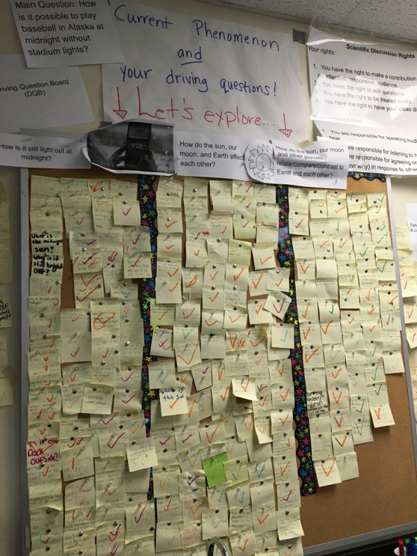
Next Steps with Students’ Questions
The Driving Questions Board and the “Parking Lot”
Students drew initial models, gave feedback, and made predictions.
Students experienced a series of scientific investigations.
At the end of the unit, the Driving Question board was “published” in poster format.
Notes:
To read more about Nicole Bolduc’s work: 5 Tips for Blending the Question Formulation Technique (QFT) with NGSS

Slide 55
Student Reflections
“Not only did I learn about the video we were analyzing, but I learned that asking questions makes me want to think more and it makes me curious. Once I started asking questions and reading other peoples responses, I was very interested and curious about the questions that were posted.”
“I learned that science is all about asking questions. To discover new inventions and things about our world, we have to ask more and more questions.”

Slide 56
Classroom Example: High School
Teacher: Daniel Fouts, Des Plaines, IL
Topic: 12th Grade Government unit on the American presidency at moments of crisis
Purpose: To engage students at the start of the unit and to help students select a topic for an independent project

Slide 57
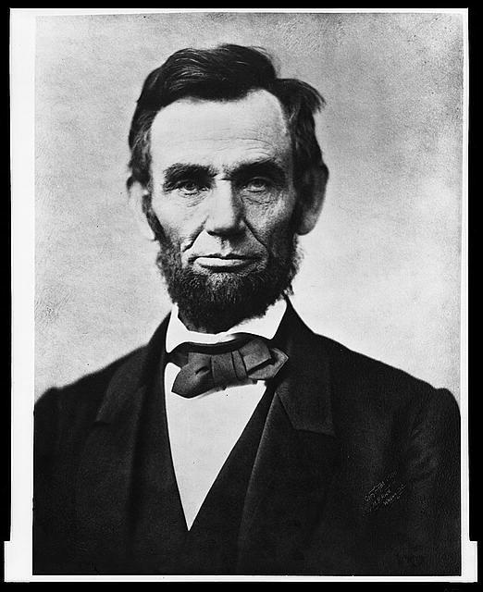
Question Focus
“Nearly all men can handle adversity; but if you really want to test a man’s character, give him power.”
https://www.loc.gov/pictures/item/96522529/

Slide 58
Student Questions
How does power challenge one’s morality?
Should everyone have some type of power?
Does power make people corrupt?
What if the person who is is qualified for power doesn’t attain it?
How is a man’s power tested?
What is considered power?
What defines good character?
How can we ensure that the good men get the power?
What kind of man can handle adversity?
What can power tell us about a man’s character?
How can power be obtained by adversity?
Why are some people affected by power differently?
If adversity supposedly makes you stronger, does that mean that power makes you weaker?

Slide 59
Next Steps
Each student selected l question from the class list to work on throughout the unit
Students answered their question using research and knowledge from the unit in a two-page reflection paper
Students shared their reflections in a class discussion on the final day of the unit

Slide 60
Today’s Agenda
Welcome & Community Building
Why Spend Time on Teaching the Skill of Question Formulation?
Collaborative Learning with the Question Formulation Technique (QFT)
Explore Real Classroom Examples & Applications
Why is Question Formulation Important Now?
Q&A

Slide 61
Why is the skill of question formulation so important now?

Slide 62
In the Age of Google
“How should you respond when you get powerful new tools for finding answers?
Think of harder questions.”
– Clive Thompson
Journalist and Technology Blogger

Slide 63
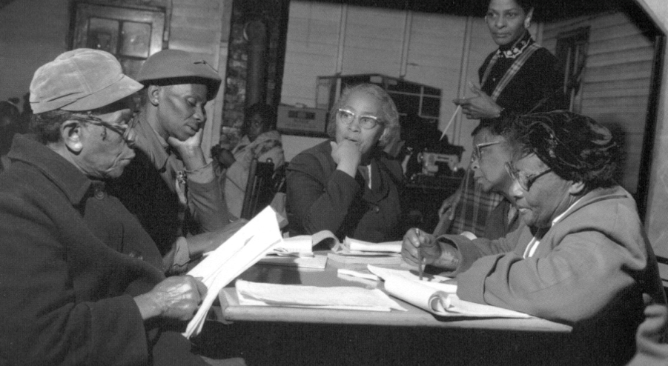
Questions and Democracy
“We need to be taught to study rather than to believe, to inquire rather than to affirm.”
– Septima Clark
Chapter 6 on Septima Clark in Freedom Road: Adult Education of African Americans (Peterson, 1996)

Slide 64
Reflection
What connections do you see with Monticello Central School District’s focus on: Diversity, Equity, and Inclusion, Social-Emotional Learning, Parent/Community Engagement, and Inquiry-based Learning?

Slide 65
Thank you!
What are your questions?

Slide 66
Using & Sharing RQI’s Resources
The Right Question Institute offers materials through a Creative Commons License. You are welcome to use, adapt, and share our materials for noncommercial use, as long as you include the following reference:
“Source: The Question Formulation Technique (QFT) was created by the Right Question Institute (rightquestion.org).”
Access the full library of resources: http://rightquestion.org/education/resources

