Slide 1
Teaching Students to Formulate Their Own Questions: Practice and Theory
Dan Rothstein
Co-Director of Democracy Building Program
Sarah Westbrook
Director of Professional Learning
The Right Question Institute, Cambridge, MA
PoLS-T Network
July 12, 2022

Slide 2
Acknowledgments
We are deeply grateful to:
The National Science Foundation for our GERMINATION EXPANSION grant (#2203717:Building Question Formulation Capacity through the Research Question Network (rQnet)) that allows us to explore the rubric for impactful research questions and disseminate the effectiveness of the Question Formulation Technique in higher education
Tomoko Ouchi, Manager of the Question Formulation Theory Program at RQI, for all her hard work in helping us prepare for this session

Slide 3
Using & Sharing RQI’s Resources
The Right Question Institute offers materials through a Creative Commons License. You are welcome to use, adapt, and share our materials for noncommercial use, as long as you include the following reference:
“Source: The Right Question Institute (RQI). The Question Formulation Technique (QFT) was created by RQI. Visit rightquestion.org for more information and free resources.”

Slide 4
Overview
Introduction and overview
Collaborative learning with the Question Formulation Technique (QFT)
Looking behind the curtain
- Break-
Your observations about student learning
Question Focus design
Question Formulation Theory and final reflection

Slide 5
Introduction and Overview
What is question formulation?
Questions and Learning

Slide 6
Question Formulation (QF)
“Generating questions divergently and then working to improve them through convergent and metacognitive thinking”

Slide 7
We shall not cease from exploration
And the end of all our exploring
Will be to arrive where we started
And know the place
For the first time
-T.S. Eliot
Notes:
1906-09 Harvard college
1909- college
1910- MA

Slide 8
“Modern science is a technique… it is a practice that allows us to learn reliable things about the world. [Science] is a technique that was waiting for people to discover it.”
– Steven Weinberg
Nobel Laureate in Physics
To Explain the World, 2015

Slide 10
“There is no learning without having to pose a question.”
- Richard Feynman
Nobel Laureate, Physics, 1965
Feynman, Richard (1999), The pleasure of finding things out, New York: Basic Books. P.112.
Notes:
"There is no learning without having to pose a question." Richard Feynman Nobel Laureate, Physics, 1965
From a talk Feynman gave to an audience of scientists at the Galileo Symposium in Italy, in 1964.
With frequent acknowledgement and references to the great work and intense anguish of Galileo, Feynman speaks on the effect of science on religion, on society, and on philosophy, and warns that it is our capacity to doubt that will determine the future of civilization.

Slide 11
College presidents on what college students should learn
“The primary skills should be analytical skills of interpretation and inquiry. In other words, know how to frame a question.”
- Leon Botstein, President of Bard College
“…the best we can do for students is have them ask the right questions.”
- Nancy Cantor, Former Chancellor of University of Illinois
The New York Times, August 4, 2002
Notes:
“…I would suggest…that the process of questioning and learning how to question around patterns, how the world is put together and how people relate to each other, is I believe, the essential skill of education. I believe it is generalizable, and I believe that colleges have a special opportunity to teach that skill of questioning to acquire patterns and the use of patterns in questioning. I believe that colleges, despite the fact that it can be done elsewhere, have some special advantages. “
TALK GIVEN BY PRESIDENT HENRY B. EYRING
Tuesday July 6, 1971 at Ricks College (Ricks College is now BYU-Idaho)

Slide 12
“If you are a researcher you are trying to figure out what the question is as well as what the answer is.”
“You want to find the question that is sufficiently easy that you might be able to answer it, and sufficiently hard that the answer is interesting.”
– Edward Witten
Physicist, Institute of Advanced Study

Slide 13
“We must teach students how to think in questions, how to manage ignorance.”
– Stuart Firestein
Professor, Department of Biology, Columbia University

Slide 14
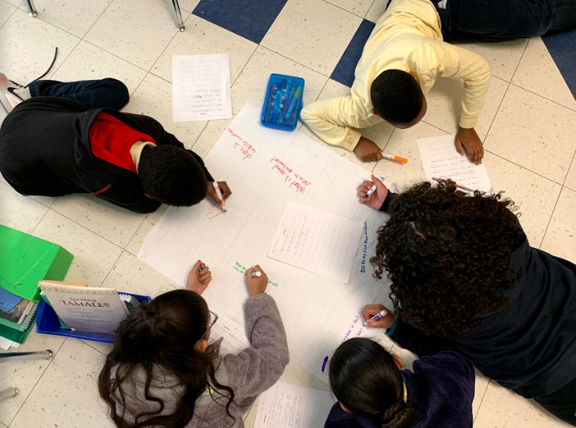
Why spend time teaching the skill of question formulation?

Slide 15
Only 27% of Graduates Believe College Taught Them How to Ask Their Own Questions
Alison Head, Project Information Literacy at University of Washington, 2016

Slide 16
But, the problem begins long before college…

Slide 17
Question Asking Declines with Age
Tizard, B., Hughes, M., Carmichael, H., & Pinkerton, G. (1983)
Pearson, J.C. & West, R. (2009)
Notes:
Tizard, B., Hughes, M., Carmichael, H., & Pinkerton, G. (1983). Children’s questions and adults’ answers. Journal of Child Psychology and Psychiatry, 24, 269-281.
Girls (mean age 3 years 11 months) from working class and middle class families asked 24 and 29 questions per hour at home, respectively. At school, these same girls asked on average 1.4 and 3.7 questions per hour (working and middle class, respectively)

Slide 18
What happens when students do learn to ask their own questions?

Slide 19
Research on the Importance of Questioning
Self-questioning (metacognitive strategy):
Student formulation of their own questions is one of the most effective metacognitive strategies
Engaging in pre-lesson self-questioning improved students rate of learning by nearly 50%
- John Hattie
Hattie, J., 2008. Visible Learning: A Synthesis of Over 800 meta-Analyses Relating to Achievement
Notes:
Additional Research:
UC Davis Research Linking Curiosity to Memory (UC Davis) 2014
The Fullerton Longitudinal Study (FLS), a 30-plus year study of the development of giftedness across various points in time conducted by Adele and Allen Gottfried of California State University ”This finding has strong implications for the development of STEM considering that curiosity is a fundamental predictor of the aspiration to become a scientist.”
S. von Stumm, B. Hell, T. Chamorro-Premuzic. The Hungry Mind: Intellectual Curiosity Is the Third Pillar of Academic Performance. Perspectives on Psychological Science, 2011 meta-analysis shows They found that curiosity did, indeed, influence academic performance. In fact, it had quite a large effect, about the same as conscientiousness. When put together, conscientiousness and curiosity had as big an effect on performance as intelligence.

Slide 20
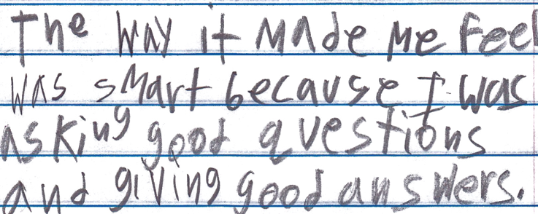
Student Reflection
“The way it made me feel was smart because I was asking good questions and giving good answers.”
-Boston 9th grade summer school student

Slide 21
Overview
Introduction and overview
Collaborative learning with the Question Formulation Technique (QFT)
Looking behind the curtain
- Break-
Your observation about student learning
Question Focus design
Question Formulation Theory and final reflection

Slide 22
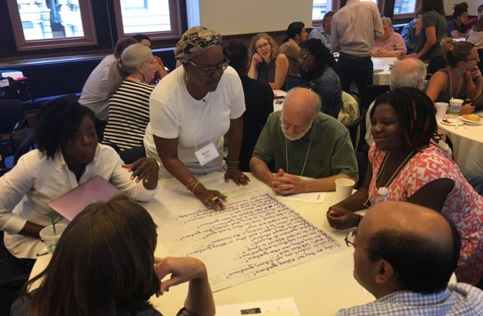
Collaborative Learning with the Question Formulation Technique

Slide 23
Rules for Producing Questions
1. Ask as many questions as you can
2. Do not stop to answer, judge, or discuss
3. Write down every question exactly as stated
4. Change any statements into questions

Slide 24
The Question Formulation Technique (QFT)
Individuals learn to:
Produce their own questions
Improve their questions
Strategize on how to use their questions
Reflect on what they have learned and how they learned it

Slide 25
Produce Questions
Ask Questions
Follow the Rules
Ask as many questions as you can.
Do not stop to answer, judge, or discuss.
Write down every question exactly as it was stated.
Change any statements into questions.
Number the Questions

Slide 26
Question Focus
Students struggle to understand key concepts.
→ Now, ask questions. Number the questions. Follow the rules:
Ask as many questions as you can.
Don’t stop to answer, judge, or discuss.
Write down every question exactly as it was stated.
Change any statements into questions.

Slide 27
Categorize Questions: Closed/ Open
Definitions:
Closed-ended questions can be answered with a “yes” or “no” or with a one-word answer.
Open-ended questions require more explanation.
Directions:
Identify your questions as closed-ended or open-ended by marking them with a “C” or an “O.”

Slide 28
Discuss
Closed-ended Questions
Advantages
Disadvantages

Slide 29
Discuss
Open-ended Questions
Advantages
Disadvantages
Notes:
The point here is that the closed ended questions are equally useful as open-ended!!!

Slide 30
Change Questions
Take one closed-ended question and change it into an open-ended question.
Take one open-ended question and change it into a closed-ended question.
Add these as new questions to your list
Closed
Open
Open
Closed

Slide 31
Prioritize Questions
Review your list of questions
Choose the three questions you consider most important.
While prioritizing, think about QFocus, “Students struggle to understand key concepts.”
Prepare to share
Why you chose those three questions?
Where are your priority questions in the sequence of your entire list of questions?

Slide 32
Strategize and Action Plan
In order to answer your priority questions:
What do you need to know? Information
What do you need to do? Tasks
Information | Tasks

Slide 33
Share
Priority questions
The numbers where your prioritized questions appear on your list and the number of questions you generated (ex. 2,5 and 7 out of 8)
A few ideas from your action plan

Slide 34
Reflect
What did you learn?
How did you learn it?
Notes:
How do you see now the role of students learning to ask questions in their higher education?

Slide 35
Overview
Introduction and overview
Collaborative learning with the Question Formulation Technique (QFT)
Looking behind the curtain
- Break-
Your observation about student learning
Question Focus design
Question Formulation Theory and final reflection

Slide 36
3. Looking behind the curtain
Unpacking the Question Formulation Technique
Classroom Examples

Slide 37
Unpacking the Question Formulation Technique

Slide 38
The QFT, on one slide…
Ask as many questions as you can
Do not stop to discuss, judge or answer
Record exactly as stated
Change statements into questions
Question Focus
Produce Your Questions
Follow the rules
Number your questions
Improve Your Questions
Categorize questions as Closed or Open-ended
Change questions from one type to another
Strategize
Prioritize your questions
Action plan or discuss next steps
Share
Reflect
Closed-Ended:
Answered with “yes,” “no” or one word
Open-Ended: Require longer explanation
Source: The Right Question Institute rightquestion.org
Notes:
It is not just a question brainstorming process, but a rigorous protocol that moves through question generation to refinement, strategy, and action. The LARGER POINT of the PROCESS—is about changing the way that school is played.

Slide 39
Three thinking abilities, one strategy.

Slide 40
Thinking in many different directions
Divergent
Thinking

Slide 41
Narrowing down, focusing
Convergent
Thinking

Slide 42
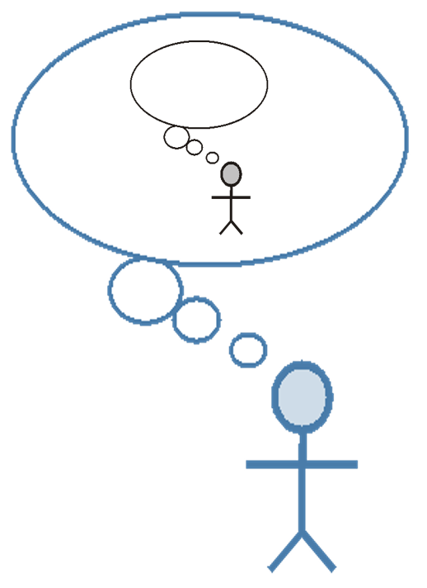
Thinking about thinking
Metacognition

Slide 43
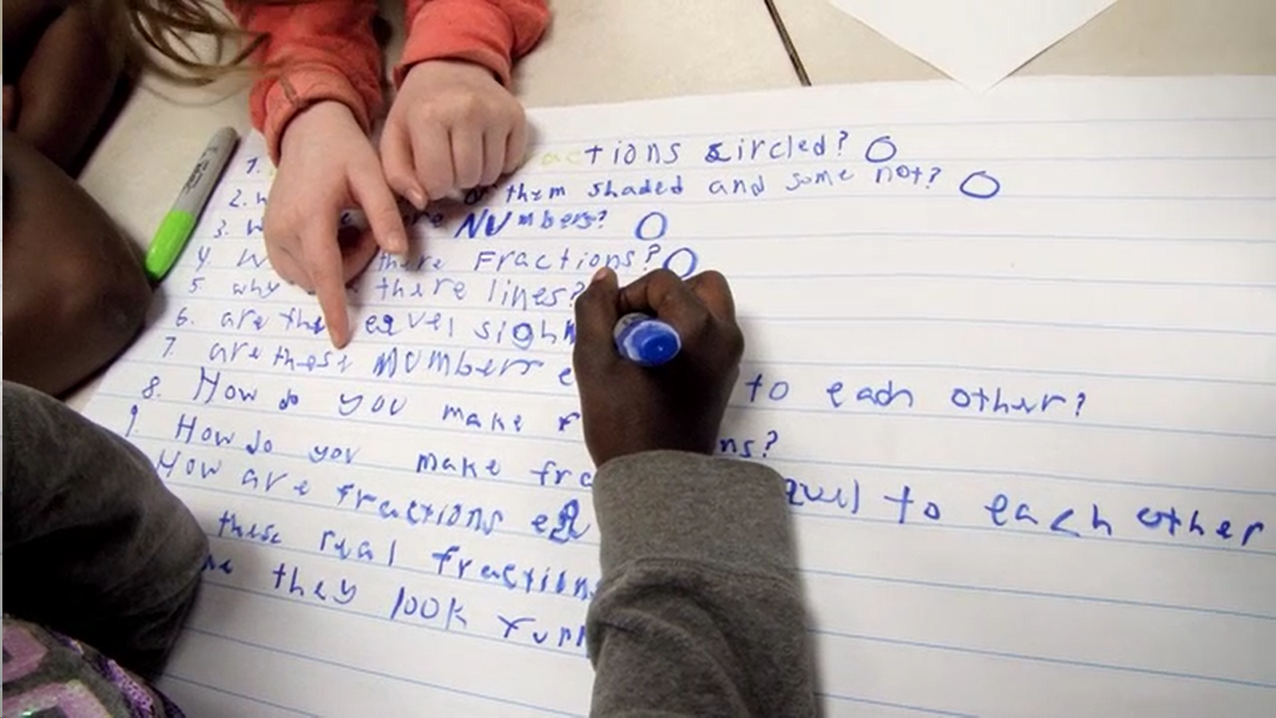
Exploring Classroom Examples

Slide 44
The QFT in Action
https://youtu.be/9wrIIDNECUQ

Slide 45
Classroom Example: 7th Grade
Teacher: Nicole Bolduc, Ellington, CT
Topic: “The Universe and Its Stars” Unit
Purpose: To engage students in setting the learning agenda for the unit

Slide 46
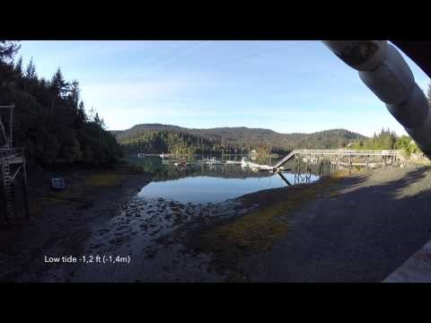
Question Focus
Students watched videos of dramatic tide change in Cape Cod, Alaska, and Canada
https://www.youtube.com/watch?v=mAYXZzKUAX4
https://www.youtube.com/watch?v=53EEDisloME

Slide 47
Selected Student Questions
Why does tide change?
How is tide created?
How does earth’s rotation cause the tide to change?
Does the sun have any part in the rise and retreat of tides?
Do tides occur because of the gravitational pull of the moon?
Do the phases of the moon come into play with the tides?
How do other planets affect it?
Are the tides opposite in Florida and Mexico? (b/c they share the Gulf of Mexico)
How come the tide changes greatly in some places but not others?
How far can high tide go?
How do tides affect people?
Can tide change be a problem in the future?
Does global warming affect tides?
Where does the water go to?
Does temperature have anything to do with tides?
Does tilt have anything to do with tides?
How do fish & wildlife survive when the tide is always changing?
If the moon disappeared, would there be no tides?
What would happen if the tide didn’t change?
Why are tides important to the earth?

Slide 48
Prioritization
Prioritization Instructions: “Questions a scientist who is studying the environment and our world would ask.”
Students from 5 different classes voted electronically on 10 priority questions
From the list of 10, they created (with teacher support) one new priority question: “How and why does the water rise and recede in Alaska, Canada, and Cape Cod?”
This became the guiding question for the unit

Slide 49
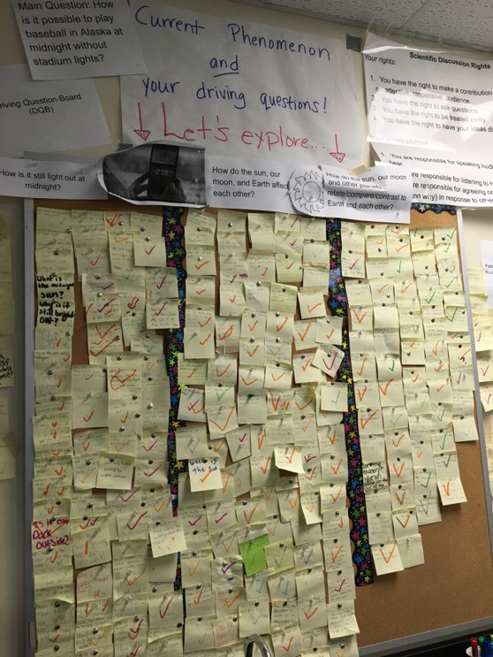
Next Steps with Students’ Questions
The Driving Questions Board and the “Parking Lot”
Students drew initial models, gave feedback, and made predictions.
Students experienced a series of scientific investigations.
At the end of the unit, the Driving Question board was “published” in poster format.
Notes:
To read more about Nicole Bolduc’s work: 5 Tips for Blending the Question Formulation Technique (QFT) with NGSS

Slide 50
Student Reflections
“Not only did I learn about the video we were analyzing, but I learned that asking questions makes me want to think more and it makes me curious. Once I started asking questions and reading other people’s responses, I was very interested and curious about the questions that were posted.”
“I learned that science is all about asking questions. To discover new inventions and things about our world, we have to ask more and more questions.”

Slide 51
Classroom Example: High School Physics
Teacher: Rachel Riemer, Cambridge, MA
Topic: Relationship between angle of incline and acceleration
Purpose: For students to develop their own question to investigate in a lab

Slide 52
Question Focus
Motion on an incline
Notes:
Students had previewed the lab station prior to this.

Slide 53
Student Questions
How steep is the incline?
How would the angle of the incline affect the motion of the cart?
How does the weight of the cart affect it going up the ramp?
How do the size of the wheels affect the cart?
How does the incline affect the acceleration of gravity?
How much friction does the cart have?
How much momentum does the cart have?
How long is the ramp?
How tall is the ramp?
Does the shape of the cart matter?
Do the magnets work?
What is the maximum speed of the cart?
What forces are affecting the cart?
How much force is required to push the cart off the ramp?
Is the ramp linear?
What is the width of the cart?
How does the mass of the cart affect the motion of the cart?
What is the initial velocity of the cart?
What is the final velocity of the cart?

Slide 54
Next Steps with Student Questions
Students categorized their questions into topics using color-coding.
Within those categories, students’ identified a “lead question” and the questions they’d have to answer first to get at the lead question.
Students then prioritized with the instructions, “If you were to design a lab, which question would you design a lab around, and why?”
Students turned the lead question they chose into a “purpose statement”. This became their hypothesis to test in the lab.

Slide 55
Priority Question
How does the mass of the cart affect the acceleration of the cart?

Slide 56
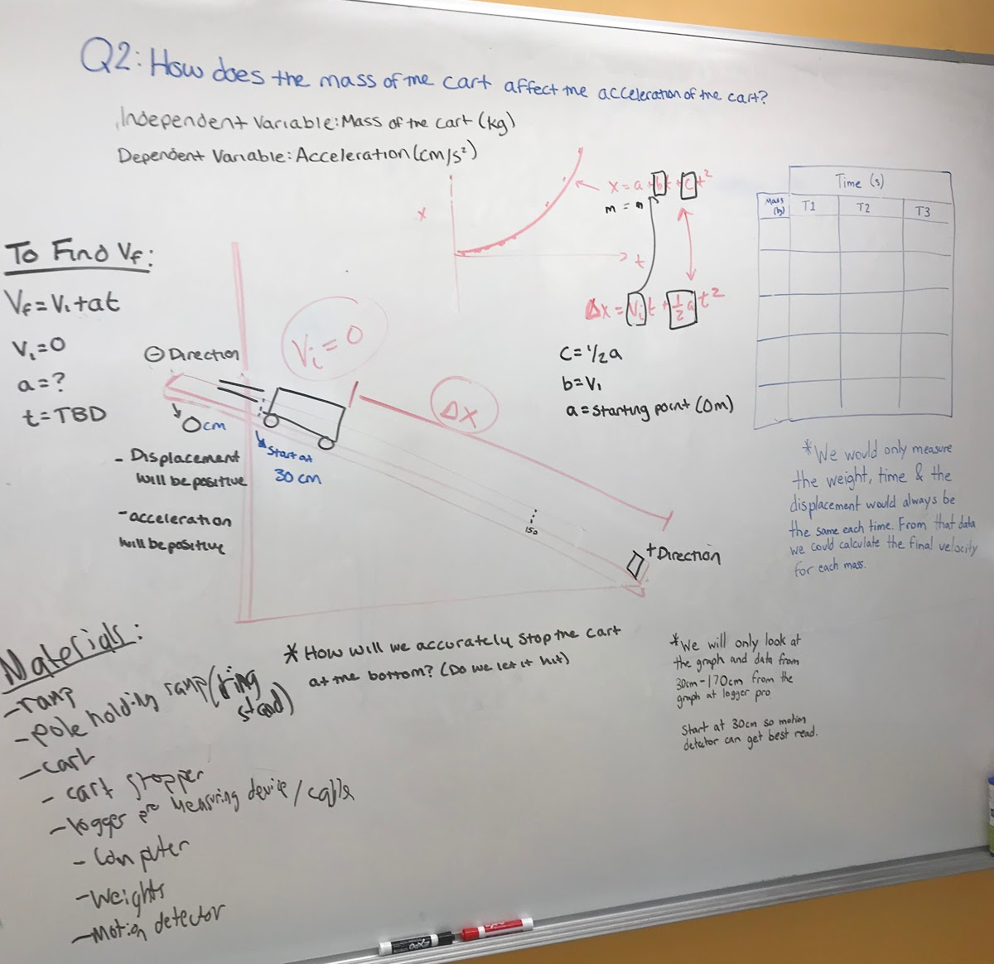
Next Steps with Student Questions
Groups chose similar questions, either: How does the mass of the cart affect the motion? Or, how does the angle of incline affect the motion?
Groups identified dependent variable(s), independent variable(s), and the set up for their experiment, all groups using the same materials.
Students experimented and collected data.
Students presented their initial questions, design process, and Lab results.

Slide 57
Classroom Example: AP Physics
Teacher: Rachel Riemer, Cambridge, MA
Topic: Bias in science
Purpose: To open up discussion around an important issue

Slide 58
Question Focus
Bias in Science

Slide 59
Student Questions
What are some occurences?
What topics in science have most bias?
How is bias defined?
Are there different types of biases in science?
How does bias affect experiments and results?
How does bias influence data collection?
Is it possible to be completely bias free?
How to reduce bias?
Why is there bias?
Is bias intrinsic?
Is bias necessarily bad?
How important is the fact that there is bias? (O)🡪 Is it important that there is bias? (C)
When in history did bias in results of experiments affect the public?
How do you quantify bias?
What increases/decreases bias?
What is the trend of bias in science? More? Less?
Are certain groups of people more easily biased? (C)🡪 What are the certain groups of people? (O)
How can we eliminate bias in high school experiments w/o high tech?
What’s in place now to reduce bias?

Slide 60
Next Steps with Students’ Questions
Students identified patterns that emerged from their questions
They categorized their questions into those patterns
Students priority questions were used as a class discussion activity

Slide 61
Students’ Categorization
Impact
How does bias affect experiments and results?
How does bias affect influence data collection?
History/definition
How is bias defined?
Why is there bias?
Is bias intrinsic?
Is bias necessarily bad?
When in history did bias in results of experiments affect the public?
How do you quantify bias?
Help/reduce
Is it possible to be completely bias free?
How do you reduce bias?
What increases/decreases bias?
How can we eliminate bias in high school experiments w/o high tech?
What’s in place now to reduce bias?
Examples
What are some occurences?
What topics in science have most bias?
Are there different types of bias in science?
Patterns/trends
What is the trend of bias in science? More? Less?
Are certain groups of people more easily biased? (C) 🡪 What are the certain groups of people? (O)

Slide 62
Question Focus
Professor: Dan Perlman, Ph.D. Associate Provost of Innovation in Education, Professor of Biology, Brandeis University
Topic: Evolutionary Ecology
Purpose: Introducing and concluding a course on ecology
Organisms
Andrewartha, H. G.

Slide 63
Examples of development of student ability to formulate better questions
QFocus: Distribution and Abundance of Organisms
How do you measure species abundance? (start)
→How do you measure species abundance if it has a naturally varying population size? (end)
What are the typical patterns of abundance? Distribution? (start)
→When measuring distribution, how do we define a species when it gradually changes over space? (end)
Notes:
At the start of the semester
Students “identified ALL of the sub-disciplines in ecology" that would be covered in the course.
At the end of the semester
Students “saw how much more sophisticated their questions had become”
Dan Perlman at Brandeis talking about how his students were presented with a QFocus about what had been Dan P's dissertation and he said "in 20 minutes they got to all the questions i had to address in my dissertation and more that i hadn't thought about." That's acceleration.

Slide 64
Student reflections
“The QFT really teaches a way of thinking so students can be thinking critically every time they read, trying to connect the concepts and deciding whether to take facts and information at face value or to dig a little deeper.”
“…Developing our own questions …encourages us to avoid making assumptions about seemingly basic or evident concepts... I really like how the QFT exercises …have helped to make the learning environment more interactive…”
-Brandeis University student
-Brandeis University student

Slide 65
Overview
Introduction and overview
Collaborative learning with the Question Formulation Technique (QFT)
Looking behind the curtain
- Break-
Your observation about student learning
Question Focus Design
Question Formulation Theory and final reflection

Slide 66
What do you observe when your students are fully engaged?

Slide 67
What do you observe when your students demonstrate comprehension?

Slide 68
What do you observe when your students discover something new?

Slide 69
Overview
Introduction and overview
Collaborative learning with the Question Formulation Technique (QFT)
Looking behind the curtain
- Break-
Your observation about student learning
Question Focus Design
Question Formulation Theory and final reflection

Slide 70
The Basics of QFT Lesson Planning

Slide 71
Finding the Scale that Works for You
Start here!
Large scale, weeks- long civic action project or PBL unit
5 minute
“Do Now”
One-day class activity
A multi-day research process
15 minute brainstorm before guest speaker arrives
Student- designed lab investigation
Students generate unit-long essential questions that are answered over course of unit

Slide 72
Various Teaching Purposes
Engagement
Research
Formative assessment
Summative assessment
Peer review
Skill development
Problem-solving
Is the QFT the right tool for your objective?
How will you make use of the questions students ask?

Slide 73
Next Steps?
Pop Quiz or Reading Check
Debate Prep
Paper topic
Lab work & Experiments
Exit ticket or ”Do Now”
Hang on walls,
Check Off as Answered
Research
Projects
Test Prep
Presentations
Homework
Class discussion prompts
And sometimes…
Nothing!
Student Choice Projects
Socratic Seminar Prompts
Interview an Expert
Make Your Own Final Test
Journal Prompt
Guest speakers
Close Reading Protocol
Year-long or Unit-long Essential Questions
Tailoring Instruction
Service Action Projects

Slide 74
Question Focus (QFocus): A stimulus or prompt for student questions
A phrase or quotation
An image or video
A primary source
A podcast or speech
A hands-on experience or experiment
An equation or data set
Some combination of the above
The QFocus is not a question!

Slide 75
Designing a Question Focus
An effective QFocus is:
Directly tied to lesson’s main idea or objective
Simple…but not too simple
Interesting or provocative to students…but not biased or leading

Slide 76
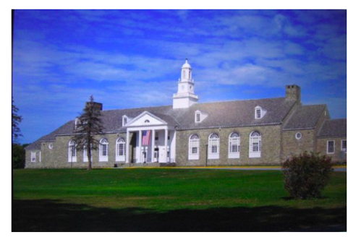
Initial Question Focus:
Student Questions: 1. Why does it look so old?
2. Why does the school have a Fallout Zone?
3. Why is there a flag hanging upside down?
4. How old is the building?
5. Why are the classrooms numbered?
6. How many acres does it take up?
7. Why are there so many windows?
8. Why is there 4 big pillars at the front?
9. What is the big tower at the top?
10. Why are we being fit into one building?
11. When was the school made?
12. How much money did it cost to build it?
13. Why does it look like so many parts put together?
14. What is that white thing on top?
15. Why does it have 2 chimneys?
16. What is the point of lockers?
17. Who was the first principal?
18. Who is the boss of the superintendents?
Context: 6th Grade. The teacher designed this QFocus to elicit questions students might have related to their first few days of middle school. (the image is the exterior of their middle school building)

Slide 77
Initial Question Focus: “People, Animals, and Friends”
Do people exist?
Where do people live?
Why do animals live in the zoo?
Why do people go to the pool?
Why are friends fun?
Why do animals bite?
Why do people go to school?
Do people, animals, and friends play together?
Do animals make friends?
Why do I need friends?
Why do people want to be friends with animals?
Why are people making friends with animals?
Why do people, animal, and friends live in different countries?
Where did my dog and friend go?
Can my friend pet our new dog?
Why do I have eyes?
How do people smell?
Can animals speak?
Can people fly?
Where is my bunny? What happened?

Slide 78
Revising the Question Focus
“People, Animals, and Friends”
Your idea here!

Slide 79
Initial Question Focus

Slide 80
Revised Question Focus
“How you behave online is how you are in real life. That’s you. There’s no separation. You are a person who says those kind of things.”
– Mitch Gerads

Slide 81
Putting it into Practice: QFocus Testing
Try drafting a Question Focus. It’s ok if it is still a bit rough.
Give your QFocus to a partner with no context.
Partner generates questions about your Qfocus for 30 seconds (not the context; the QFocus itself). Follow the 4 rules!
Debrief with your partner(s) and revise as needed.

Slide 82
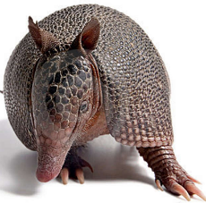
The one quality all excellent QFT designers share?
Thick Skin.

Slide 83
Overview
Introduction and overview
Collaborative learning with the Question Formulation Technique (QFT)
Looking behind the curtain
- Break-
Your observation about student learning
Question Focus design
Question Formulation Theory and final reflection

Slide 84
A 1912 Study
“An unusual lesson because twenty-five of the thirty-four questions were asked by the pupils.…The result was that the lesson developed an impetus born of real interest. I mention it because this lesson was unique in the series of one hundred.”
Romiett Stevens, 1912
The Question as a Measure of Efficiency in Instruction: A critical study of classroom practice.
Columbia University Contributions to Education, No. 48

Slide 85
A Question Formulation Theory for Learning

Slide 86
Honoring the Original Source: Parents in Lawrence, Massachusetts, 1990
“We don’t go to the school because we don’t even know what to ask.”

Slide 87
RQI’s Question Formulation Theory for Learning
Question Formulation
defined as “Generating questions divergently and then working to improve them through convergent and metacognitive thinking”
Question formulation is a foundational skill that enhances learning in any situation.
Formulating one’s own questions facilitates:
Engagement
Comprehension
Discovery
Activate prior knowledge,
make connections and meaning,
assess information,
gain new knowledge
Confirm or challenge knowledge,
create, hypothesize, problem-naming, research, explore, innovate, generate new ideas and new questions
Focused, interested,
curious, joyful, autonomous,
personalized learning agenda
*Discovery can be discovery for themselves all the way to discovery for an entire field
Question formulation is also a transformational skill that leads to profound changes in learners at all levels.
As people learn to formulate their own questions, they become more:
Motivated learners
Nimble thinkers
Purposeful, committed, self-directed, persistent
Flexible, analytic, responsive, agile, independent

Slide 88
The Question Formulation Theory for Learning:
Overview
What is Question Formulation (QF)?
Generating questions divergently and then working to improve them through convergent and metacognitive thinking
Beyond
asking questions
The process of QF facilitates
Engagement
Comprehension
Discovery
QF results in more
Motivated learners
Nimble thinkers

Slide 89
Question Formulation (QF)
“Generating questions divergently and then working to improve them through convergent and metacognitive thinking”

Slide 90
We shall not cease from exploration
And the end of all our exploring
Will be to arrive where we started
And know the place
For the first time
-T.S. Eliot
Notes:
1906-09 Harvard college
1909- college
1910- MA

Slide 91
Closing remarks

Slide 92
Asking Questions and Democracy
Image Courtesy of Highlander Research and Education Center

Slide 93
Asking Questions and Democracy
“We need to be taught to study rather than to believe, to inquire rather than to affirm.”
Septima Clark
Clark, Septima (Chapter 6) in Peterson, Elizabeth A., 1996, Freedom road: Adult education of African Americans, Malabar, FL: Krieger Publishing Co.

Slide 94
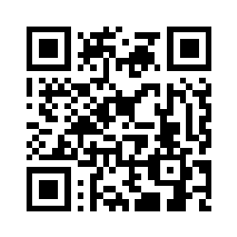
Final Reflection
What is one important thing you learned today?
What would you tell your colleagues about the Question Formulation Technique?
Please respond to the above and session evaluation in the google form
https://tinyurl.com/RQI07122022

Slide 95
Using & Sharing RQI’s Resources
The Right Question Institute offers materials through a Creative Commons License. You are welcome to use, adapt, and share our materials for noncommercial use, as long as you include the following reference:
“Source: The Right Question Institute (RQI). The Question Formulation Technique (QFT) was created by RQI. Visit rightquestion.org for more information and free resources.”

