Slide 1
An Experience in the Question Formulation Technique (QFT)
Sarah Westbrook Director of Professional Learning The Right Question Institute
Cambridge, MA

Slide 2
Who is in the room?

Slide 3
Access RQI’s Free QFT Resources
https://rightquestion.org/education/resources
Classroom Examples
Instructional Videos
Planning Tools & Templates

Slide 4
Use and Share These Resources
The Right Question Institute offers materials through a Creative Commons License. You are welcome to use, adapt, and share our materials for noncommercial use, as long as you include the following reference:
“Source: The Right Question Institute (RQI). The Question Formulation Technique (QFT) was created by RQI. Visit rightquestion.org for more information and free resources.”

Slide 5
Today’s Agenda
Why Spend Time on Teaching the Skill of Question Formulation?
Collaborative Learning with the Question Formulation Technique (QFT)
Explore Real Examples & Applications
Why is Question Formulation Important Now?
Q&A

Slide 6
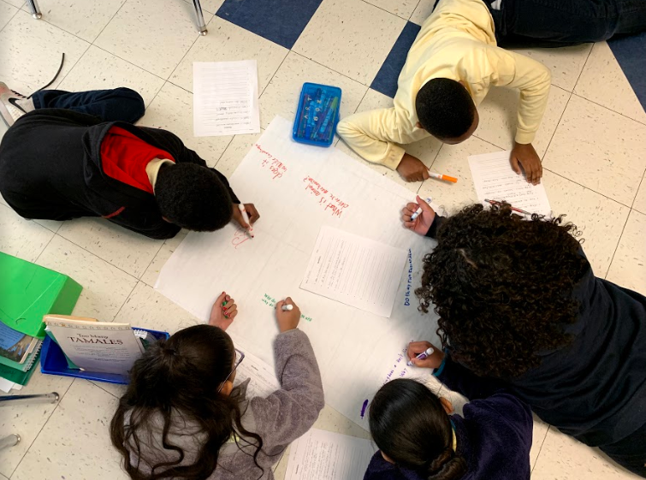
Why spend time teaching the skill of question formulation?

Slide 7
Honoring the Original Source: Parents in Lawrence, Massachusetts, 1990
“We don’t go to the school because we don’t even know what to ask.”

Slide 8
“We must teach students how to think in questions, how to manage ignorance.”
– Stuart Firestein
Former chair, Department of Biology,
Columbia University

Slide 9
College Presidents on What College Students Should Learn
“The primary skills should be analytical skills of interpretation and inquiry. In other words, know how to frame a question.”
- Leon Botstein, President of Bard College
“…the best we can do for students is have them ask the right questions.”
- Nancy Cantor, Former Chancellor of University of Illinois
The New York Times, August 4, 2002

Slide 10
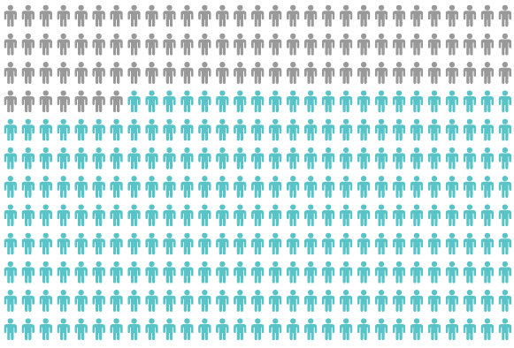
Yet, Only 27% of Graduates Believe College Taught Them How to Ask Their Own Questions
Alison Head, Project Information Literacy at University of Washington, 2016

Slide 11
But, the problem begins long before college…

Slide 12
Question Asking Declines with Age
Tizard, B., Hughes, M., Carmichael, H., & Pinkerton, G. (1983).
Pearson, J.C. & West, R. (2009)
Notes:
Tizard, B., Hughes, M., Carmichael, H., & Pinkerton, G. (1983). Children’s questions and adults’ answers. Journal of Child Psychology and Psychiatry, 24, 269-281.
Girls (mean age 3 years 11 months) from working class and middle class families asked 24 and 29 questions per hour at home, respectively. At school, these same girls asked on average 1.4 and 3.7 questions per hour (working and middle class, respectively)

Slide 13
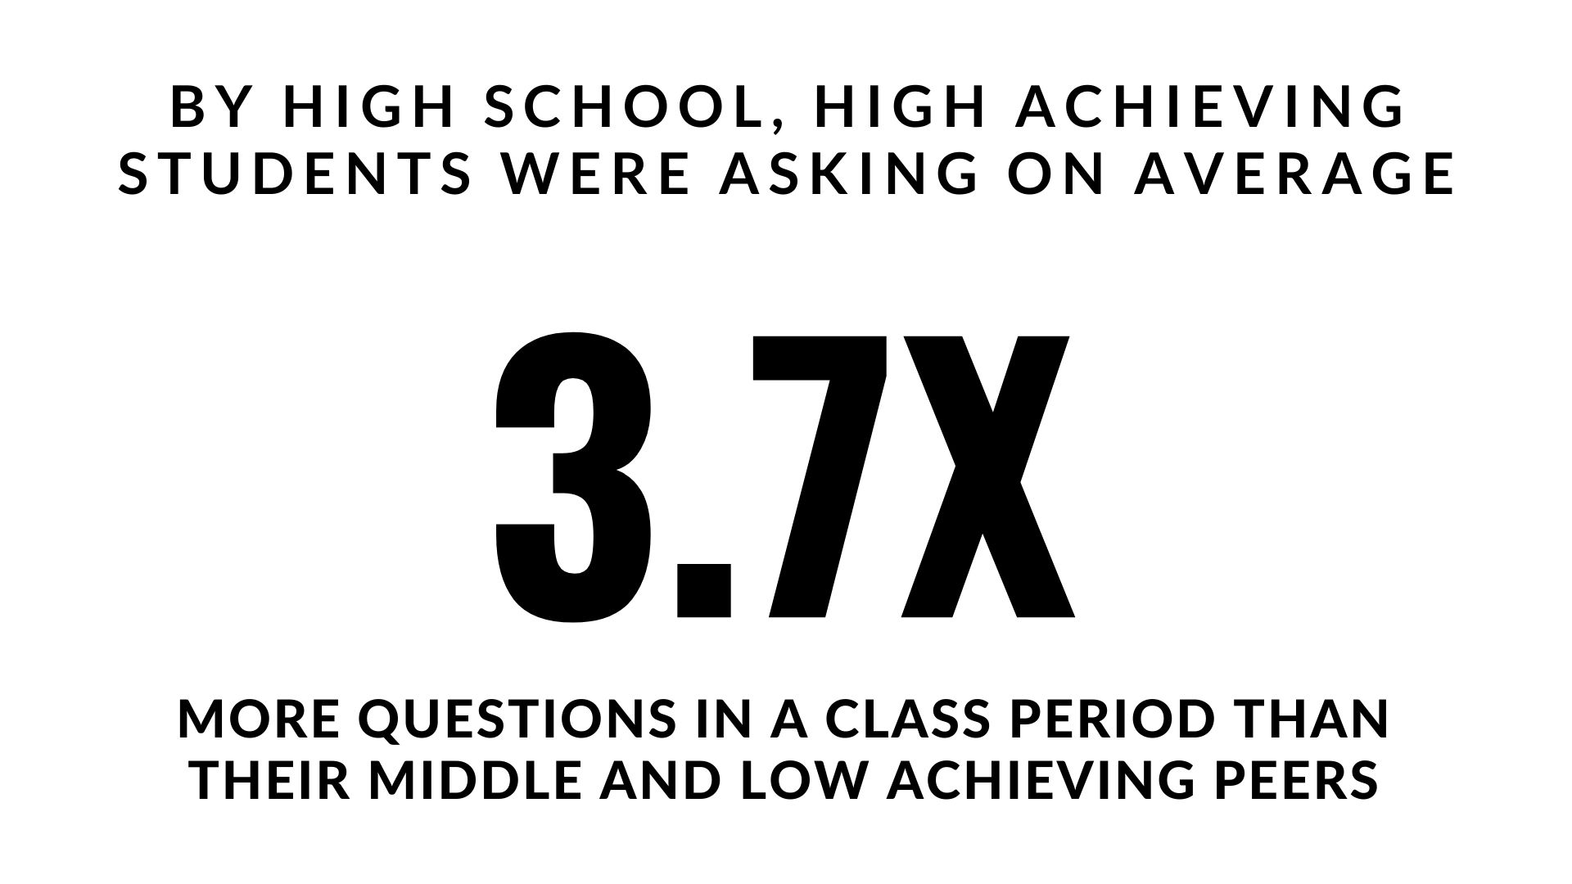
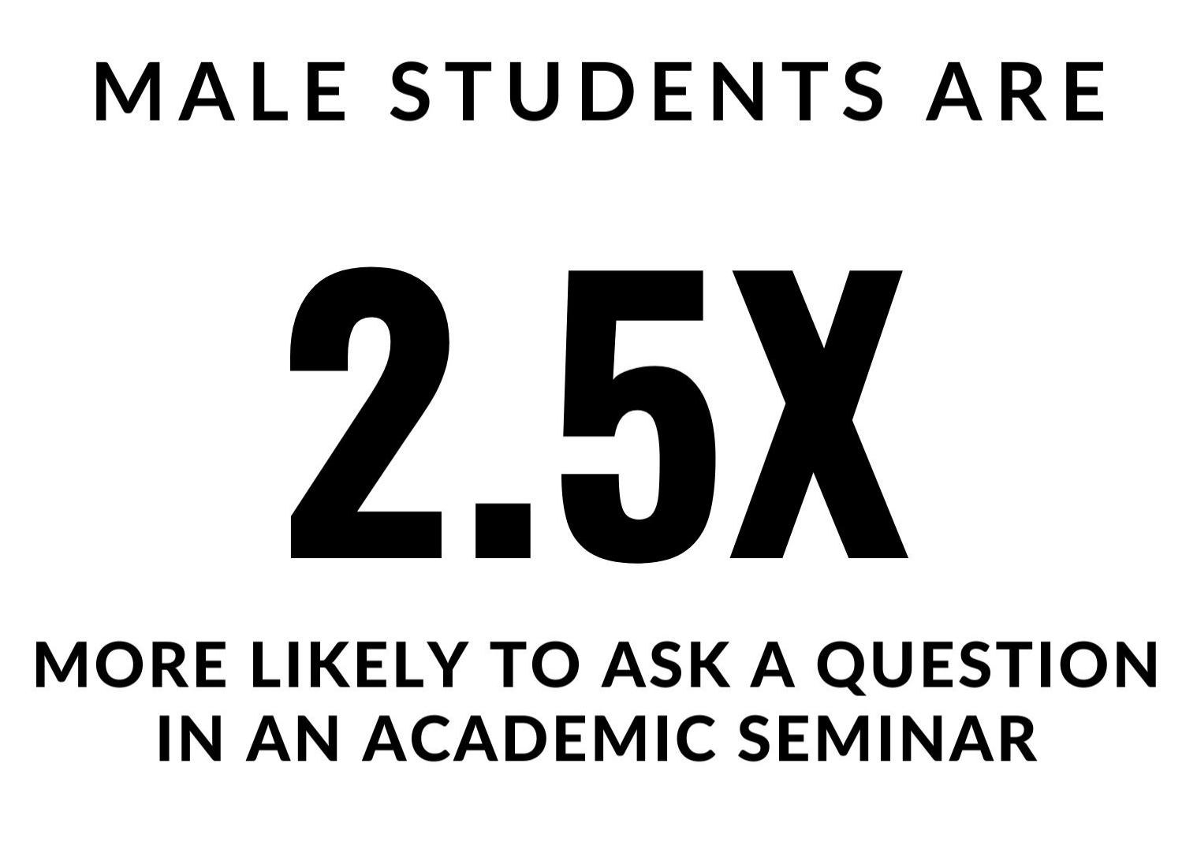
Which students ask questions?
Tizard, B., Hughes, M., Carmichael, H., & Pinkerton, G. (1983)
Carter, A., Croft, A., Lukas, D., Sandstrom, G. (2017).
Notes:
First: Tizard, B., Hughes, M., Carmichael, H., & Pinkerton, G. (1983). Children’s questions and adults’ answers. Journal of Child Psychology and Psychiatry, 24, 269-281.
Girls (mean age 3 years 11 months) from working class and middle class families asked 24 and 29 questions per hour at home, respectively. At school, these same girls asked on average 1.4 and 3.7 questions per hour (working and middle class, respectively)
Second:
Good, T. L., Slavings, R. L., Harel, K., Emerson, H. (1987). Student Passivity: A Study of Question Asking in K-12 Classrooms. Sociology of Education, 60, 187 & 189.
Classroom observations made across 22 k-12 classrooms which tracked students’ question asking behavior showed that in upper grades, low-achieving students ask fewer questions in a 50 minute class period than other students. (our interpretation): On average, high achieving students asked 3.7X the number of questions middle and low achieving students asked in the high school grades.
Quote from study: The data in Table 2 indicate that low achievers in upper grades ask fewer questions than younger low achievers. Tables 2 and 3 also show that low-achieving students continue to be active participants through the third grade; however, by the sixth grade, they have become relatively passive. The data thus support the view that low-achieving elementary students learn to avoid asking questions in the classroom. In higher grades, it is clear that low-achieving students ask fewer questions in class than other students.

Slide 14
We can work together on creating more opportunities for all students to ask their own questions

Slide 15
We Are Not Alone
More than 1 million classrooms worldwide

Slide 16
What happens when students do learn to ask their own questions?

Slide 17
Research Confirms the Importance of Questioning
Self-questioning (metacognitive strategy):
Student formulation of their own questions is one of the most effective metacognitive strategies
Engaging in pre-lesson self-questioning improved students rate of learning by nearly 50% (Hattie, p.193)
John Hattie
Visible Learning: A Synthesis of Over 800
meta-Analyses Relating to Achievement, 2008
Notes:
UC Davis Research Linking Curiosity to Memory (UC Davis) 2014
The Fullerton Longitudinal Study (FLS), a 30-plus year study of the development of giftedness across various points in time conducted by Adele and Allen Gottfried of California State University ”This finding has strong implications for the development of STEM considering that curiosity is a fundamental predictor of the aspiration to become a scientist.”
S. von Stumm, B. Hell, T. Chamorro-Premuzic. The Hungry Mind: Intellectual Curiosity Is the Third Pillar of Academic Performance. Perspectives on Psychological Science, 2011 meta-analysis shows They found that curiosity did, indeed, influence academic performance. In fact, it had quite a large effect, about the same as conscientiousness. When put together, conscientiousness and curiosity had as big an effect on performance as intelligence.

Slide 18
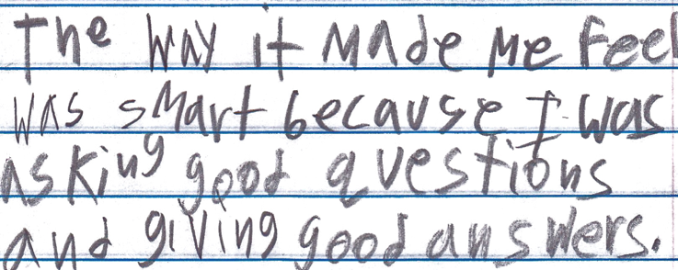
Student Reflection
“The way it made me feel was smart because I was asking good questions and giving good answers.”
-Boston 9th grade summer school student

Slide 19
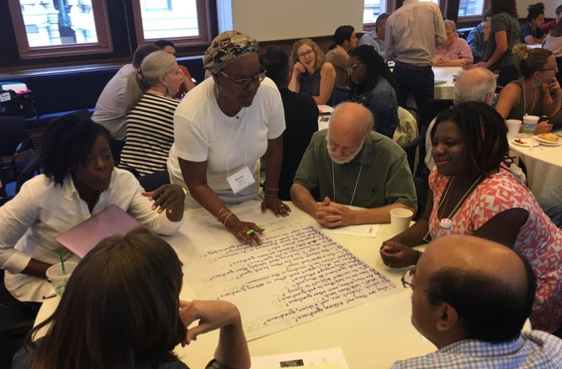
Collaborative Learning with the Question Formulation Technique (QFT)

Slide 20
The Question Formulation Technique (QFT)
Individuals learn to:
Produce their own questions
Improve their questions
Strategize on how to use their questions
Reflect on what they have learned and how they learned it

Slide 21
Rules for Producing Questions
1. Ask as many questions as you can
2. Do not stop to answer, judge, or discuss
3. Write down every question exactly as stated
4. Change any statements into questions

Slide 22
Produce Questions
Ask Questions
Follow the Rules
Ask as many questions as you can.
Do not stop to answer, judge, or discuss.
Write down every question exactly as it was stated.
Change any statements into questions.
Number the Questions

Slide 23
Question Focus
“Curiosity is deviant.”
→Ask questions. Number the questions. Follow the rules:
Ask as many questions as you can.
Don’t stop to answer, judge, or discuss.
Record each question exactly as it was stated.
Change any statements into questions.

Slide 24
Categorize Questions: Closed/Open
Definitions:
Closed-ended questions can be answered with a “yes” or “no” or with a one-word answer.
Open-ended questions require
more explanation.
Directions: Identify your questions as closed-ended or open-ended by marking them with a “C” or an “O.”

Slide 25
Discuss
Closed-ended Questions
Advantages
Disadvantages

Slide 26
Discuss
Open-ended Questions
Advantages
Disadvantages
Notes:
The point here is that the closed ended questions are equally useful as open-ended!!!

Slide 27
Improve Questions
Take one closed-ended question and change it into an open-ended question.
Take one open-ended question and change it into a closed-ended question.
Add these as new questions at the bottom of your list.
Closed
Open
Open
Closed

Slide 28
Prioritize Questions
Review your list of questions
Choose three questions that you are most curious to discuss further.
While prioritizing, think about your Question Focus, Curiosity is deviant.
Then, think about why you chose those questions.

Slide 29
Action Plan
Moving from priority questions into action steps.
In order to answer your priority questions:
What do you need to know? Information
What do you need to do? Tasks
Write down a couple ideas you have.

Slide 30
Share
Your priority questions and rationale for choosing them
One idea you had from your action plan
The numbers of your three priority questions in your original sequence (For ex: “2, 4, 7 out of 8 total”)

Slide 31
Reflect
What did you learn?
How did you learn it?
How could you use it in your work?

Slide 32
A Look Inside the Process

Slide 33
The QFT, on one slide…
Ask as many questions as you can
Do not stop to discuss, judge or answer
Record exactly as stated
Change statements into questions
Question Focus
Produce Your Questions
Follow the rules
Number your questions
Improve Your Questions
Categorize questions as Closed or Open-ended
Change questions from one type to another
Strategize
Prioritize your questions
Action plan or discuss next steps
Share
Reflect
Closed-Ended:
Answered with “yes,” “no” or one word
Open-Ended: Require longer explanation
Source: The Right Question Institute rightquestion.org
Notes:
It is not just a question brainstorming process, but a rigorous protocol that moves through question generation to refinement, strategy, and action. The LARGER POINT of the PROCESS—is about changing the way that school is played.

Slide 34
Three thinking abilities
with one process

Slide 35
Thinking in many different directions
Divergent
Thinking

Slide 36
Narrowing Down, Focusing
Convergent
Thinking

Slide 37
Thinking about Thinking
Metacognition

Slide 38
Exploring Classroom Examples

Slide 39
Classroom Example: 11th Grade
Teacher: Isabel Morales, Los Angeles, CA
Topic: Social Justice
Purpose: Engage students in thinking about systemic injustice ahead of several fiction and nonfiction texts in the semester

Slide 40
Question Focus
“The disciplinary policies of our society perpetuate injustice.”

Slide 41
Students’ Questions
Why are student of color targeted the most?
How do disciplinary policies target specific racial groups?
Do teachers nationwide take notice of these stats?
How can teachers develop better & effective disciplinary policies?
Why do people see the stats & data as a coincidence?
What does a kid learn about the system once in jail?
What do people believe expulsion will teach the students?
Does going to juvie have a long-term effect on younger students about education?
When will it get better?
What are some ways to improve behavior?
What type of training will teachers go through that’ll bring justice to classrooms?
Shouldn’t school police officers be trained like teachers?
What is considered a criminal offense in school?
Isn’t it the teacher’s job to keep the students “in line”?
How should disruption in class be handled?
How come there aren’t any policies keeping students out of prison?

Slide 42
Next Steps with Student Questions
Students decided to research statistics and poll students and teachers.
Students met with the school administration to ask questions and address their concerns.
School principal founded a student advisory council, which many students joined, to give students a voice in new policies.

Slide 43
Classroom Example: Community College
Teacher: Sun Ezzell, Walnut, CA
Topic: “The Case Against Grades,” Educational Leadership article by Alfie Kohn
Purpose: Have students write a response to the article using their questions as a guide and consider for themselves whether they should switch from a letter grade to pass/fail for the course

Slide 44
Question Focus
The case against grades.

Slide 45
Students’ Questions
Why are students intimidated against grades?
Is the grading process needed?
How does the grading system affect students?
Why do we have a grading system?
Does the grading system need improvement?
Why is it challenging to get good grades?
Why do students think school is challenging?
Why do students focus more on grading than learning?
Does the grading system help students in life?

Slide 46
Next Steps with Student Questions
Moving into the writing assignment, students found it was beneficial to think in questions as a way to debrief and to distill some of their own thinking and what they had learned from the article.
As a class, the priority questions led to a discussion about feedback. Professor Ezzell was able to better understand students’ thought processes on the topic.
Some students did switch from letter grades to pass/no pass

Slide 47
Why is the skill of question formulation so important now?

Slide 48
In the Age of Google
“How should you respond when you get powerful new tools for finding answers?
Think of harder questions.”
– Clive Thompson
Journalist and Technology Blogger

Slide 49
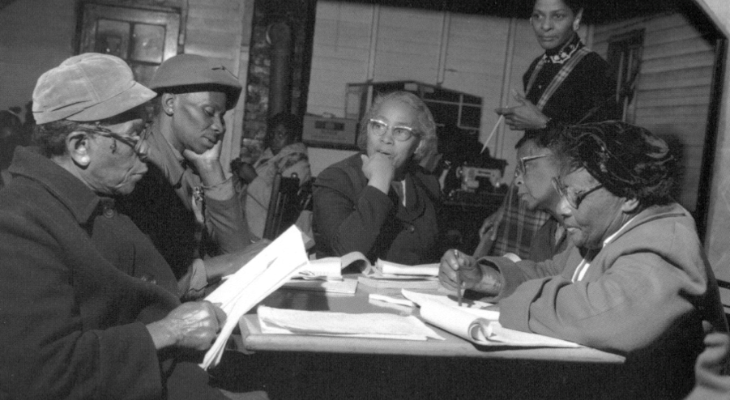
Questions and Democracy
“We need to be taught to study rather than to believe, to inquire rather than to affirm.”
– Septima Clark
Chapter 6 on Septima Clark in Freedom Road: Adult Education of African Americans (Peterson, 1996)

Slide 50
What are your questions for us?

Slide 51
Thank you! Enjoy!

Slide 52
Using & Sharing RQI’s Resources
The Right Question Institute offers materials through a Creative Commons License. You are welcome to use, adapt, and share our materials for noncommercial use, as long as you include the following reference:
“Source: The Right Question Institute (RQI). The Question Formulation Technique (QFT) was created by RQI. Visit rightquestion.org for more information and free resources.”
Access the full library of resources: http://rightquestion.org/education/resources

