Slide 1
Day 2: Designing for Student Questioning in the Classroom
Sarah Westbrook
Director of Professional Learning
Sarah.westbrook@rightquestion.org@SarahRQI
Imaan Yousuf
Education Program Associate
Imaan.Yousuf@rightquestion.org
@rightquestion

Slide 2
Access Today’s Materials:
https://bit.ly/RQICHARGE

Slide 3
Access RQI’s Free Additional Resources
https://rightquestion.org/education/resources
Classroom Examples
Instructional Videos
Planning Tools & Templates

Slide 4
Use and Share These Resources
The Right Question Institute offers materials through a Creative Commons License. You are welcome to use, adapt, and share our materials for noncommercial use, as long as you include the following reference:
“Source: The Right Question Institute (RQI). The Question Formulation Technique (QFT) was created by RQI. Visit rightquestion.org for more information and free resources.”

Slide 5
Opening Reflection
Please share:
A question you’re coming into today with
- Or -
Something new that occurred to you since last time; how are you thinking differently now about questioning?

Slide 6
Looking Ahead
Date | Agenda | Homework
September 29, 2022 | The Power of Question Formulation for Lifelong Learning | Complete the Qfocus design tool—ok if a bit rough! (due 11/10)
November 10, 2022 | Designing for Student Questioning in the Classroom | Finish planning QFT lesson Practice facilitating the QFT (due 1/19)
January 19, 2023 | Pictures of Practice | Facilitate the QFT with students in your setting at least once (due Spring 2023)
Spring 2023 (TBD) | Using Student Questions to Drive and Sustain Learning

Slide 7
Today’s Agenda
Welcome Back
The Art & the Science of the QFT: A Deep Dive into Design, Tailoring, and Troubleshooting
Testing and Honing Your QFocus
Prioritization, Categorization, and Reflection
Discuss Facilitation Principles
Preparing to Move into Action

Slide 8
The QFT on One Slide
Ask as many questions as you can
Do not stop to discuss, judge or answer
Record exactly as stated
Change statements into questions
Question Focus
Produce Your Questions
Follow the rules
Number your questions
Improve Your Questions
Categorize questions as Closed or Open-ended
Change questions from one type to another
Strategize
Prioritize your questions
Action plan or discuss next steps
Share
Reflect
Closed-Ended:
Answered with “yes,” “no” or one word
Open-Ended: Require longer explanation
Source: The Right Question Institute rightquestion.org
Notes:
I

Slide 9
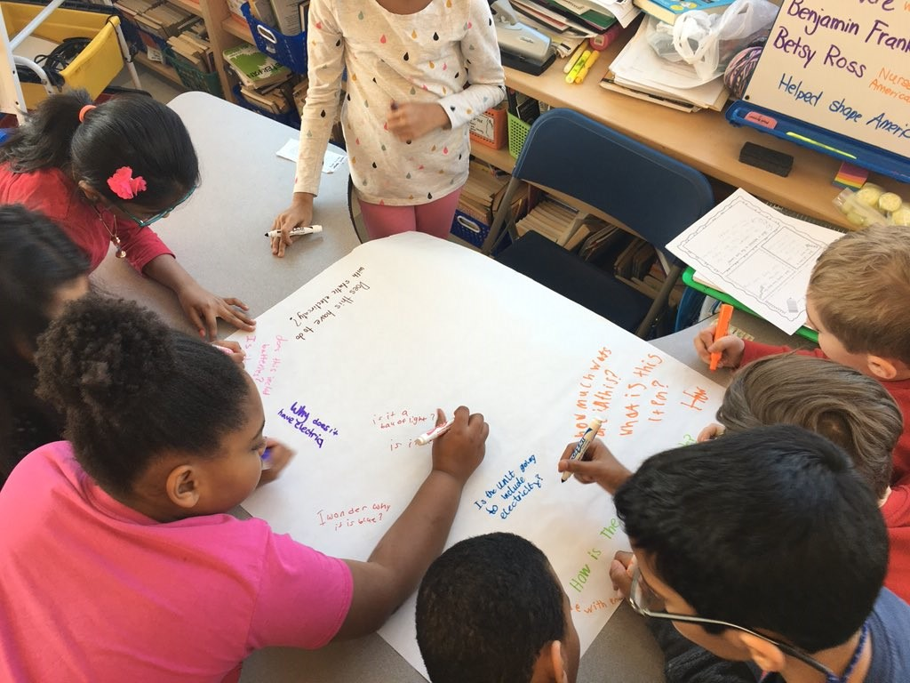
An Art and a Science: Best Practices in QFT Planning, Design, and Facilitation

Slide 10
QFT: An Art and a Science
The Science:
The QFT is a rigorous protocol, with specific steps and sequence, that produces consistent results
The QFT
Present a Question Focus
Produce questions following the 4 rules
Improve questions
Prioritize questions
Discuss next steps
Reflect

Slide 11
QFT: An Art and a Science
The Art:
You should tailor the QFT process to the specific content and people you are working with.
Tailor the QFT through:
Planning how to use student questions
Question Focus design
Prioritization instructions
Reflection questions
Facilitation

Slide 12
Five Areas Related to the Art of the QFT
Starting at the End
QFocus Design
Prioritization Instructions
Reflection Questions
Facilitation

Slide 13
Finding the Scale that Works for You
Start here!
Large scale, weeks- long civic action project or PBL unit
5 minute
“Do Now”
One-day class discussion
A multi-day research process
15 minute brainstorm before guest speaker arrives
Student- designed lab investigation
Students generate unit-long essential questions that are answered over course of unit

Slide 14
Various Teaching Purposes
Engagement
Research
Formative assessment
Summative assessment
Peer review
Skill development
Problem-solving
Is the QFT the right tool for your objective?
How will you make use of the questions students ask?

Slide 15
Next Steps?
Pop Quiz or Reading Check
Debate Prep
Paper topic
Lab work & Experiments
Exit ticket or ”Do Now”
Hang on walls,
Check Off as Answered
Research
Projects
Test Prep
Homework
Class discussion prompts
And sometimes…
Nothing!
Presentations
Student Choice Projects
Socratic Seminar Prompts
Interview an Expert
Make Your Own Final Test
Journal Prompt
Guest speakers
Close Reading Protocol
Year-long or Unit-long Essential Questions
Tailoring Instruction
Service Action Projects

Slide 16
Five Areas Related to the Art of the QFT
Starting at the End
QFocus Design
Prioritization Instructions
Reflection Questions
Facilitation

Slide 17
Question Focus (QFocus): A stimulus or prompt for student questions
A phrase or quotation
An image or video
A primary source
A podcast or speech
A hands-on experience or experiment
An equation or data set
The QFocus is not a question!

Slide 18
Designing a Question Focus
An effective QFocus is:
Directly tied to lesson’s main idea or objective
Simple…but not too simple
Interesting or provocative to students…but not biased or leading
Not a question

Slide 19
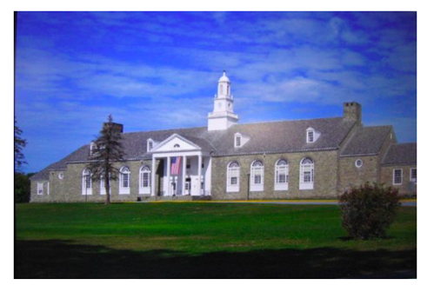
Initial Question Focus:
Student Questions: 1. Why does it look so old?
2. Why does the school have a Fallout Zone?
3. Why is there a flag hanging upside
down?
4. How old is the building?
5. Why are the classrooms numbered?
6. How many acres does it take up?
7. Why are there so many windows?
8. Why is there 4 big pillars at the
front?
9. What is the big tower at the top?
10. Why are we being fit into one
building?
11. When was the school made?
12. How much money did it cost to build it?
13. Why does it look like so many parts put together?
14. What is that white thing on top?
15. Why does it have 2 chimneys?
16. What is the point of lockers?
17. Who was the first principal?
18. Who is the boss of the superintendents?
Context: 6th Grade. The teacher designed this QFocus to elicit questions students might have related to their first few days of middle school. (the image is the exterior of their middle school building)

Slide 20
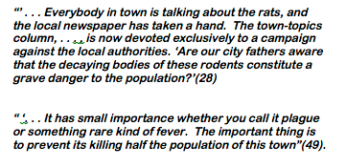
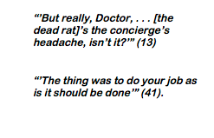
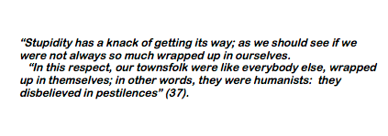
Initial Question Focus (11th Grade):

Slide 21
Revised Question Focus:
The city fathers were aware that the decaying bodies of these rodents were making people sick. (page 28)

Slide 22
Initial Question Focus (1st Grade): “People, Animals, and Friends”
Do people exist?
Where do people live?
Why do animals live in the zoo?
Why do people go to the pool?
Why are friends fun?
Why do animals bite?
Why do people go to school?
Do people, animals, and friends play together?
Do animals make friends?
Why do I need friends?
Why do people want to be friends with animals?
Why are people making friends with animals?
Why do people, animal, and friends live in different countries?
Where did my dog and friend go?
Can my friend pet our new dog?
Why do I have eyes?
How do people smell?
Can animals speak?
Can people fly?
Where is my bunny? What happened?

Slide 23
Initial Question Focus (1st Grade): “People, Animals, and Friends”
How might the teacher revise?

Slide 24
Initial Question Focus

Slide 25
Revised Question Focus
“How you behave online is how your are in real life. That’s you. There’s no separation. You are a person who says those kind of things.”
– Mitch Gerads

Slide 26
Putting it into Practice: QFocus Testing
Share your draft Question Focus with as little context as possible. It’s ok if it is still a bit rough.
Partner(s) to generate questions about your QFocus (not the context; the QFocus itself). Follow the 4 rules!
The person who created the QFocus is silent during question generation.
Debrief with your partner(s) and revise as needed.
Are those the questions you’re hoping students might ask? If not, why not?

Slide 27
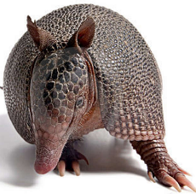
The one quality all excellent QFT designers share?
Thick Skin.

Slide 28
Five Areas Related to the Art of the QFT
Starting at the End
QFocus Design
Prioritization Instructions
Reflection Questions
Facilitation

Slide 29
The QFT on One Slide
Ask as many questions as you can
Do not stop to discuss, judge or answer
Record exactly as stated
Change statements into questions
Question Focus
Produce Your Questions
Follow the rules
Number your questions
Improve Your Questions
Categorize questions as Closed or Open-ended
Change questions from one type to another
Strategize
Prioritize your questions
Action plan or discuss next steps
Share
Reflect
Closed-Ended:
Answered with “yes,” “no” or one word
Open-Ended: Require longer explanation
Source: The Right Question Institute rightquestion.org
Notes:
I

Slide 30
Prioritization Instructions
Teaching & Learning Goals
QFocus
Prioritization Instructions

Slide 31
Tailoring the Prioritization Instructions
Choose three questions…
General Instructions:
that you consider most important
that you are most curious about
Specific Purposes:
that you need to research further
to help you solve the problem
that you need to answer first
that a scientist studying the earth might ask
that will help you understand the text
that require analyzing data
that are not “Googleable” and may be difficult to answer
that you think will best open up dialogue
that you consider “outside the box”
that would best help us learn about (topic or QFocus)
that best align with today’s objective
that we could answer using math

Slide 32
You Can Use Prioritization to Troubleshoot
QFocus:
“History, despite its wrenching pain, cannot be unlived, but if faced with courage, need not be lived again.”
– Maya Angelou
Solution: “Prioritize 3 questions you feel best lend themselves to a yearlong exploration of history.”

Slide 33
Question Focus: “People, Animals, and Friends”
Do people exist?
Where do people live?
Why do animals live in the zoo?
Why do people go to the pool?
Why are friends fun?
Why do animals bite?
Why do people go to school?
Do people, animals, and friends play together?
Do animals make friends?
Why do I need friends?
Why do people want to be friends with animals?
Why are people making friends with animals?
Why do people, animal, and friends live in different countries?
Where did my dog and friend go?
Can my friend pet our new dog?
Why do I have eyes?
How do people smell?
Can animals speak?
Can people fly?
Where is my bunny? What happened?

Slide 34
Five Areas Related to the Art of the QFT
Starting at the End
QFocus Design
Prioritization Instructions
Reflection Questions
Facilitation

Slide 35
The QFT on One Slide
Ask as many questions as you can
Do not stop to discuss, judge or answer
Record exactly as stated
Change statements into questions
Question Focus
Produce Your Questions
Follow the rules
Number your questions
Improve Your Questions
Categorize questions as Closed or Open-ended
Change questions from one type to another
Strategize
Prioritize your questions
Action plan or discuss next steps
Share
Reflect
Closed-Ended:
Answered with “yes,” “no” or one word
Open-Ended: Require longer explanation
Source: The Right Question Institute rightquestion.org
Notes:
I

Slide 36
Tailoring Reflection Questions
QFT Process
Content Specific
What did you learn about asking questions?
How did you learn it?
What did you notice about the order/sequence of questions?
How can you use what you learned about asking questions?
How do you feel about asking questions?
How has your thinking changed since last time we did the QFT?
What did you learn about the (content)?
What do you understand differently now about [topic]?
How did your questions help you think about…
key concept
specific assignment
overarching topic
theme in the unit
your teaching practice
a challenge in our school

Slide 37
Don’t skip the reflection!
“Reflection is the piece that keeps me coming back the next day.
The most profound reflections are almost always from the students who perhaps seemed disengaged in class. Quiet students often do a great deal of their thinking in the written reflection.”
-Ling-Se Chesnakas, Boston Public Schools

Slide 38
Five Areas Related to the Art of the QFT
Starting at the End
QFocus Design
Prioritization Instructions
Reflection Questions
Facilitation

Slide 39
Principles for Facilitating the QFT

Slide 40
Reflect
Reflect on the words “facilitation” or “facilitator”
What comes to mind when you hear these words?
What connotations or connections do you have with this word?

Slide 41
Pick a Video to Watch
The QFT in a 12th Grade Humanities class in Boston, Massachusetts
https://bit.ly/3CmFjp2
The QFT in a Virtual Los Angeles High School Classroom
https://bit.ly/3s996NH
Note: What is the teacher doing? What are the students doing?

Slide 42
The 4 Facilitation Principles
Monitor student adherence to the process
Do not give examples
Do not get pulled into group discussion
Acknowledge all contributions equally
Discuss:
What might be difficult about each principle?
Why might each be valuable for student learning?

Slide 43
Other Facilitation Considerations
Grouping
Timing
Scaffolds
Virtual learning tools

Slide 44
The Science of the QFT: a protocol
The Art of the QFT: You

Slide 45
Today’s Agenda
Welcome Back
The Art & the Science of the QFT: A Deep Dive into Design, Tailoring, and Troubleshooting
Testing and Honing Your QFocus
Prioritization, Categorization, and Reflection
Discuss Facilitation Principles
Preparing to Move into Action

Slide 46
Looking Ahead
Date | Agenda | Homework
September 29, 2022 | The Power of Question Formulation for Lifelong Learning | Complete the Qfocus design tool—ok if a bit rough! (due 11/10)
November 10, 2022 | Designing for Student Questioning in the Classroom | Finish planning QFT lesson Practice facilitating the QFT (due 1/19)
January 19, 2023 | Pictures of Practice | Facilitate the QFT with students in your setting at least once (due April/May)
April/May 2023 (TBD) | Using Student Questions to Drive and Sustain Learning

Slide 47
Access Today’s Materials:
https://bit.ly/RQICHARGE

Slide 48
Use and Share These Resources
The Right Question Institute offers materials through a Creative Commons License. You are welcome to use, adapt, and share our materials for noncommercial use, as long as you include the following reference:
“Source: The Right Question Institute (RQI). The Question Formulation Technique (QFT) was created by RQI. Visit rightquestion.org for more information and free resources.”

