Slide 1
Day 1: The Power of Question Formulation for Lifelong Learning
Sarah Westbrook
Director of Professional Learning
Sarah.westbrook@rightquestion.org
@SarahRQI
Imaan Yousuf
Education Program Associate
Imaan.Yousuf@rightquestion.org
@rightquestion

Slide 2
Who is in the zoom?
Please share:
Your name
Grade/Subject
Notes:
Add poll

Slide 3
Access Today’s Materials:
https://bit.ly/RQIHERO

Slide 4
Access RQI’s Free Additional Resources
https://rightquestion.org/education/resources
Classroom Examples
Instructional Videos
Planning Tools & Templates

Slide 5
Use and Share These Resources
The Right Question Institute offers materials through a Creative Commons License. You are welcome to use, adapt, and share our materials for noncommercial use, as long as you include the following reference:
“Source: The Right Question Institute (RQI). The Question Formulation Technique (QFT) was created by RQI. Visit rightquestion.org for more information and free resources.”

Slide 6
Looking Ahead
Date | Agenda | Homework
November 9, 2022 | The Power of Question Formulation for Lifelong Learning | Complete the Qfocus design tool—ok if a bit rough! (due 1/26)
January 26, 2023 | Designing for Student Questioning in the Classroom | Finish planning QFT lesson Practice facilitating the QFT Facilitate the QFT with students in your setting at least once
TBD Spring 2023

Slide 7
Today’s Agenda
Welcome & Community Building
Why Spend Time on Teaching the Skill of Question Formulation?
Collaborative Learning with the Question Formulation Technique (QFT)
Explore Real Classroom Examples & Applications
Begin Planning Your Own QFT Lesson
Why is Question Formulation Important Now?
Closing Thoughts and Preparing for next time

Slide 8
Why spend time teaching the skill of question formulation?

Slide 9
Honoring the Original Source: Parents in Lawrence, Massachusetts, 1990
“We don’t go to the school because we don’t even know what to ask.”

Slide 10
"There is no learning without having to pose a question."
- Richard Feynman
Nobel Laureate, Physics, 1965

Slide 11
“We must teach students how to think in questions, how to manage ignorance.”
– Stuart Firestein
Former chair, Department of Biology,
Columbia University

Slide 12
College Presidents on What College Students Should Learn
“The primary skills should be analytical skills of interpretation and inquiry. In other words, know how to frame a question.”
- Leon Botstein, President of Bard College
“…the best we can do for students is have them ask the right questions.”
- Nancy Cantor, Former Chancellor of University of Illinois
The New York Times, August 4, 2002

Slide 13
Yet, Only 27% of Graduates Believe College Taught Them How to Ask Their Own Questions
Alison Head, Project Information Literacy at University of Washington, 2016

Slide 14
But, the problem begins long before college…

Slide 15
Question Asking Declines with Age
Tizard, B., Hughes, M., Carmichael, H., & Pinkerton, G. (1983).
Pearson, J.C. & West, R. (2009)
Notes:
Tizard, B., Hughes, M., Carmichael, H., & Pinkerton, G. (1983). Children’s questions and adults’ answers. Journal of Child Psychology and Psychiatry, 24, 269-281.
Girls (mean age 3 years 11 months) from working class and middle class families asked 24 and 29 questions per hour at home, respectively. At school, these same girls asked on average 1.4 and 3.7 questions per hour (working and middle class, respectively)

Slide 16
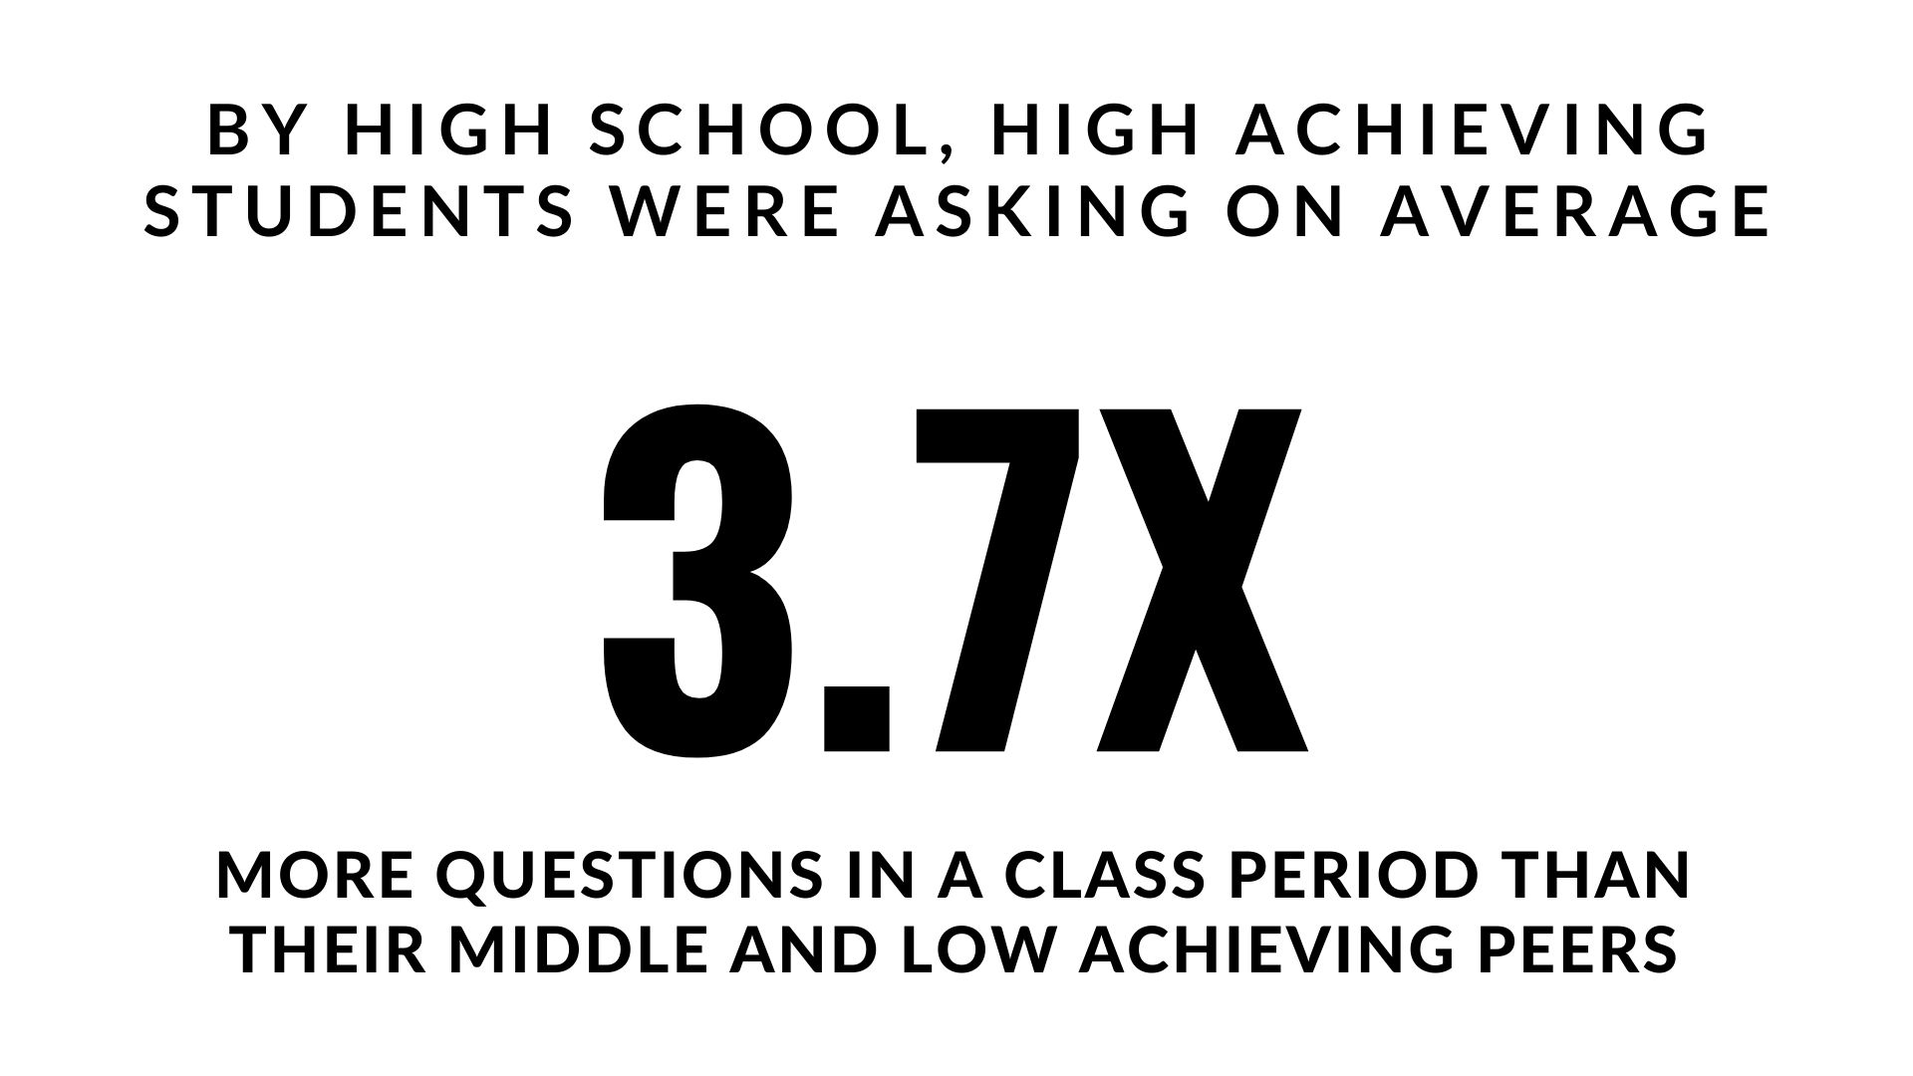
Which students ask questions?
Tizard, B., Hughes, M., Carmichael, H., & Pinkerton, G. (1983)
Carter, A., Croft, A., Lukas, D., Sandstrom, G. (2017).
Notes:
First: Tizard, B., Hughes, M., Carmichael, H., & Pinkerton, G. (1983). Children’s questions and adults’ answers. Journal of Child Psychology and Psychiatry, 24, 269-281.
Girls (mean age 3 years 11 months) from working class and middle class families asked 24 and 29 questions per hour at home, respectively. At school, these same girls asked on average 1.4 and 3.7 questions per hour (working and middle class, respectively)
Second:
Good, T. L., Slavings, R. L., Harel, K., Emerson, H. (1987). Student Passivity: A Study of Question Asking in K-12 Classrooms. Sociology of Education, 60, 187 & 189.
Classroom observations made across 22 k-12 classrooms which tracked students’ question asking behavior showed that in upper grades, low-achieving students ask fewer questions in a 50 minute class period than other students. : On average, high achieving students asked 3.7X the number of questions middle and low achieving students asked in the high school grades.
Quote from study: The data in Table 2 indicate that low achievers in upper grades ask fewer questions than younger low achievers. Tables 2 and 3 also show that low-achieving students continue to be active participants through the third grade; however, by the sixth grade, they have become relatively passive. The data thus support the view that low-achieving elementary students learn to avoid asking questions in the classroom. In higher grades, it is clear that low-achieving students ask fewer questions in class than other students.

Slide 17
We can work together on creating more opportunities for all students to ask their own questions

Slide 18
We Are Not Alone
More than 1 million classrooms worldwide

Slide 19
What happens when students do learn to ask their own questions?

Slide 20
Research Confirms the Importance of Questioning
Self-questioning (metacognitive strategy):
Student formulation of their own questions is one of the most effective metacognitive strategies
Engaging in pre-lesson self-questioning improved students rate of learning by nearly 50% (Hattie, p.193)
John Hattie
Visible Learning: A Synthesis of Over 800
meta-Analyses Relating to Achievement, 2008
Notes:
UC Davis Research Linking Curiosity to Memory (UC Davis) 2014
The Fullerton Longitudinal Study (FLS), a 30-plus year study of the development of giftedness across various points in time conducted by Adele and Allen Gottfried of California State University ”This finding has strong implications for the development of STEM considering that curiosity is a fundamental predictor of the aspiration to become a scientist.”
S. von Stumm, B. Hell, T. Chamorro-Premuzic. The Hungry Mind: Intellectual Curiosity Is the Third Pillar of Academic Performance. Perspectives on Psychological Science, 2011 meta-analysis shows They found that curiosity did, indeed, influence academic performance. In fact, it had quite a large effect, about the same as conscientiousness. When put together, conscientiousness and curiosity had as big an effect on performance as intelligence.

Slide 21
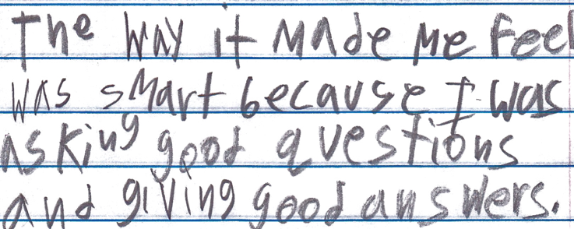
Student Reflection
“The way it made me feel was smart because I was asking good questions and giving good answers.”
-Boston 9th grade summer school student

Slide 22
Today’s Agenda
Welcome & Community Building
Why Spend Time on Teaching the Skill of Question Formulation?
Collaborative Learning with the Question Formulation Technique (QFT)
Explore Real Classroom Examples & Applications
Begin Planning Your Own QFT Lesson
Why is Question Formulation Important Now?
Closing Thoughts and Preparing for Day 2

Slide 23
Collaborative Learning with the Question Formulation Technique (QFT)

Slide 24
The Question Formulation Technique (QFT)
Individuals learn to:
Produce their own questions
Improve their questions
Strategize on how to use their questions
Reflect on what they have learned and how they learned it

Slide 25
Rules for Producing Questions
1. Ask as many questions as you can
2. Do not stop to answer, judge, or discuss
3. Write down every question exactly as stated
4. Change any statements into questions

Slide 26
Produce Questions
Ask Questions
Follow the Rules
Ask as many questions as you can.
Do not stop to answer, judge, or discuss.
Write down every question exactly as it was stated.
Change any statements into questions.
Number the Questions

Slide 27
Question Focus
Some students are not asking questions.
→Now, ask questions. Number the questions. Follow the rules:
Ask as many questions as you can.
Don’t stop to answer, judge, or discuss.
Record each question exactly as it was stated (or first came to mind).
Change any statements into questions.

Slide 28
Categorize Questions: Closed/Open
Definitions:
Closed-ended questions can be answered with a “yes” or “no” or with a one-word answer.
Open-ended questions require
more explanation.
Directions: Identify your questions as closed-ended or open-ended by marking them with a “C” or an “O.”

Slide 29
Discuss
Closed-ended Questions
Advantages
Disadvantages

Slide 30
Discuss
Open-ended Questions
Advantages
Disadvantages
Notes:
The point here is that the closed-ended questions are equally useful as open-ended!

Slide 31
Improve Questions
Take one closed-ended question and change it into an open-ended question.
Take one open-ended question and change it into a closed-ended question.
Add these as new questions to your list
Closed
Open
Open
Closed

Slide 32
Prioritize Questions
Review your list of questions
Choose three questions that you feel are most important.
While prioritizing, think about your Question Focus, Some students are not asking questions.
Then, think about why you chose those questions.

Slide 33
Action Plan
Moving from priority questions into action steps.
In order to answer your priority questions:
What do you need to know? Information
What do you need to do? Tasks
Write down a couple ideas you have.

Slide 34
Share
Using the Chat Box, please share:
One idea you had from your action plan
- and -
The numbers of your three priority questions in your original sequence (For ex: “2, 4, 7 out of 8 total”)

Slide 35
Reflect
What did you learn?
How did you learn it?

Slide 36
A Look Inside the Process

Slide 37
The QFT, on one slide…
Ask as many questions as you can
Do not stop to discuss, judge or answer
Record exactly as stated
Change statements into questions
Question Focus
Produce Your Questions
Follow the rules
Number your questions
Improve Your Questions
Categorize questions as Closed or Open-ended
Change questions from one type to another
Strategize
Prioritize your questions
Action plan or discuss next steps
Share
Reflect
Closed-Ended:
Answered with “yes,” “no” or one word
Open-Ended: Require longer explanation
Source: The Right Question Institute rightquestion.org
Notes:
I

Slide 38
Three thinking abilities
with one process

Slide 39
Thinking in many different directions
Divergent
Thinking

Slide 40
Narrowing Down, Focusing
Convergent
Thinking

Slide 41
Thinking about Thinking
Metacognition

Slide 42
Today’s Agenda
Welcome & Community Building
Why Spend Time on Teaching the Skill of Question Formulation?
Collaborative Learning with the Question Formulation Technique (QFT)
Explore Real Classroom Examples & Applications
Begin Planning Your Own QFT Lesson
Why is Question Formulation Important Now?
Closing Thoughts and Preparing for Day 2

Slide 43
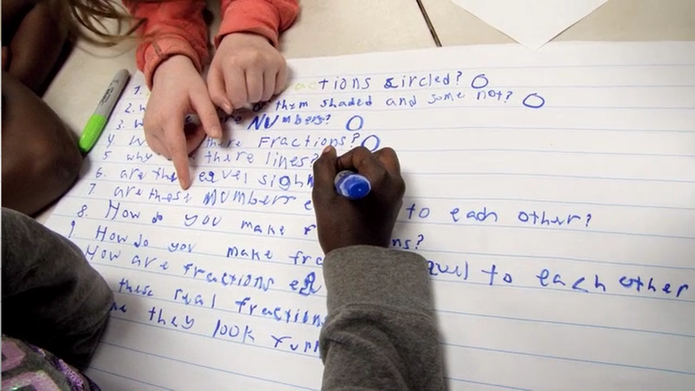
Exploring Classroom Examples

Slide 44
Classroom Example: Kindergarten
Teacher: Jennifer Shaffer, Walkersville, MD
Topic: Non-fiction literacy
Purpose: To engage students prior to reading a nonfiction text about alligators

Slide 45
Question Focus
Photograph by Nuwan Samaranayake, 2013

Slide 46
Student Questions
Is the alligator camouflaged?
Why do the babies have stripes?
Are those baby crocodiles?
Is it a mom or dad crocodile?
What is the green stuff?
Why are they in the water so low?
Where are they going?
Why are the baby alligator’s eyes white and the mom’s black?
Why are baby alligators on top of the momma alligator?
Why does momma or daddy have bumps on them?

Slide 47
Classroom Example: 4th Grade
Teacher: Deirdre Brotherson, Hooksett, NH
Topic: Math unit on variables
Purpose: To engage students at the start of a unit on variables and assess their current skill level

Slide 48
Question Focus
24 = ☺ + ☺ + ☺

Slide 49
Student Questions
Why is the 24 first?
What do the smiley faces mean?
Why are there 3 smiley faces?
How am I suppose to figure this out?
Is the answer 12?
Can I put any number for a smiley face?
Do three faces mean something?
Do the numbers have to be the same because the smiley faces are the same?
What numbers will work here?
Does it mean 24 is a really happy number?
Can we replace each smiley face with an 8?
Do any other numbers work?
Can we do this for any number?
Does it always have to be smiley faces?
Do we always have to use three things?

Slide 50
Next Steps
Posters of students’ questions were displayed on walls around the room
As students learned more about variables, they went up to the wall to cross off questions they had answered
At the end of the unit, students discussed what they had learned and what questions they now had

Slide 51
Virtual Classroom Example: 7th Grade
Teacher: Melissa Lawson, Folsom, CA
Topic: Japanese American Internment during World War II
Purpose: To help students engage with primary sources to begin a research process.

Slide 52
Question Focus
Lange, Dorothea. (1942) Oakland, CA, Mar. 1942.
A large sign reading "I am an American" placed in the window of a store on December 8, the day after Pearl Harbor. The store was closed following orders to persons of Japanese descent to evacuate from certain West Coast areas.
[Photograph] Retrieved from the Library of Congress, https://www.loc.gov/pictures/resource/cph.3a24566/.

Slide 53
Selected Questions
Why is the car there?
Who was the owner of the car?
Is that a BMW or something?
Where is this?
Who took the photograph?
Why is there a sign that says, I am an American?
Who is “I”?
What does "Wanto Co.," mean?
Who wrote the "I Am an American" sign?
Was the 'I am American' because the owner was of Japanese heritage and defending him/herself from prosecution? (after Pearl Harbor)
When the picture was taken, was the store open or closed?
Why was this picture taken?
What year is this from?
Who decided to close the store?
What happened to the store after this?
What happened to the Japanese Americans?
Did they ever get full fledged justice?

Slide 54
Asking and Answering via Padlet
Notes:
Access all of RQI’s Virtual Learning Resources:
https://rightquestion.org/remote-learning-resources/
Access the QFT Padlet Template Here:
https://padlet.com/sarahwestbrook1/QFT2

Slide 55
Student Reflections
“I learned that we cannot draw conclusions just by looking at a picture once. You can look at it and ask questions to learn more. I am wondering if we can use this technique on other things.”
“Not only did I learn about the picture we were analyzing, but I learned that asking questions makes me want to think more and it makes me curious. Once I started asking questions and reading other peoples responses, I was very interested and curious about the questions that were posted.”
“I learned that I should have been using this for my History Day paper.”

Slide 56
Today’s Agenda
Welcome & Community Building
Why Spend Time on Teaching the Skill of Question Formulation?
Collaborative Learning with the Question Formulation Technique (QFT)
Explore Real Classroom Examples & Applications
Begin Planning Your Own QFT Lesson
Why is Question Formulation Important Now?
Closing Thoughts and Preparing for Day 2

Slide 57
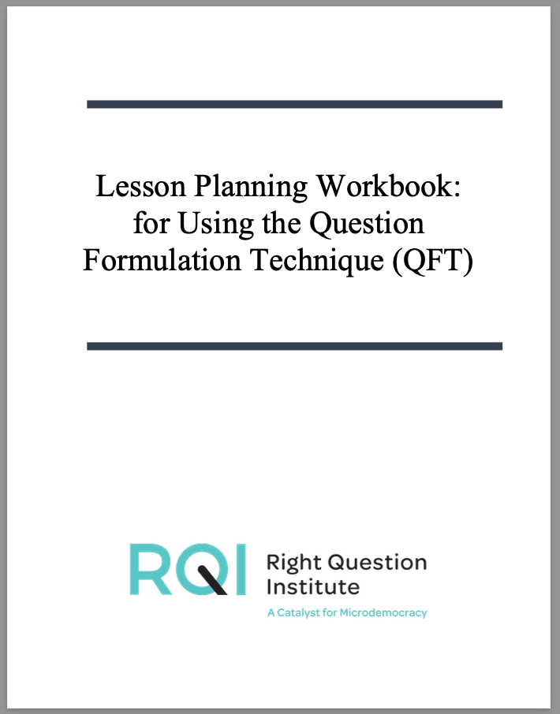
Introduction to QFT Lesson Planning

Slide 58
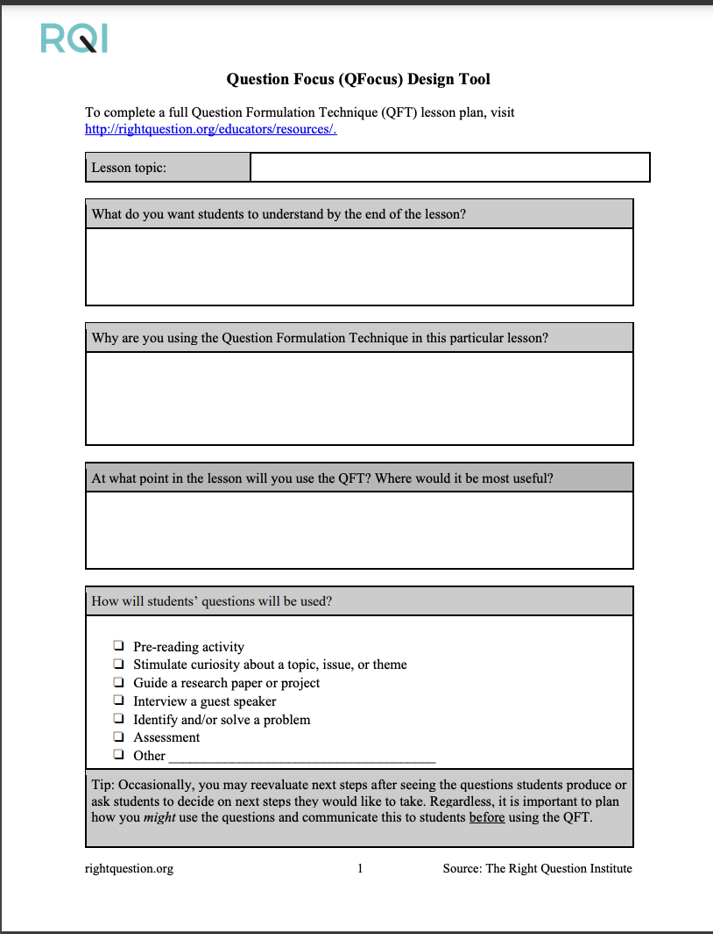
1. Identify your objectives

Slide 59
Finding the Scale that Works for You
Start here!
Large scale, weeks- long civic action project or PBL unit
5 minute
“Do Now”
50-minute class activity
A multi-day research process
15 minute brainstorm before guest speaker arrives
Student- designed lab investigation
Students generate unit-long essential questions that are answered over course of unit

Slide 60
Various Teaching Purposes
Engagement
Research
Formative assessment
Summative assessment
Peer review
Skill development
Problem-solving
Is the QFT the right tool for your objective?
How will you make use of the questions students ask?

Slide 61
Next Steps?
Pop Quiz or Reading Check
Debate Prep
Paper topic
Lab work & Experiments
Exit ticket or ”Do Now”
Hang on walls,
Check Off as Answered
Research
Projects
Test Prep
And sometimes…
Nothing!
Presentations
Homework
Class discussion prompts
Student Choice Projects
Socratic Seminar Prompts
Interview an Expert
Make Your Own Final Test
Journal Prompt
Guest speakers
Close Reading Protocol
Year-long or Unit-long Essential Questions
Tailoring Instruction
Service Action Projects

Slide 62
2. Design a Question Focus (QFocus)

Slide 63
Question Focus (QFocus): A stimulus or prompt for student questions
A phrase or quotation
An image or video
A primary source
A podcast or speech
A hands-on experience or experiment
An equation or data set
The QFocus is not a question!

Slide 64
Designing a Question Focus
An effective QFocus is:
Directly tied to lesson’s main idea or objective
Simple…but not too simple
Interesting or provocative to students…but not biased or leading
Not a question!

Slide 65
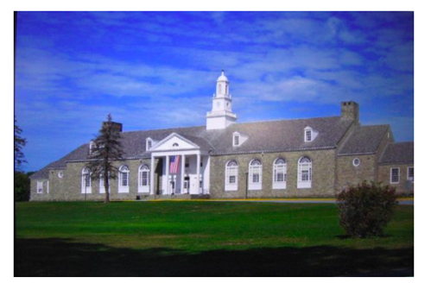
Initial Question Focus:
Student Questions: 1. Why does it look so old?
2. Why does the school have a Fallout Zone?
3. Why is there a flag hanging upside
down?
4. How old is the building?
5. Why are the classrooms numbered?
6. How many acres does it take up?
7. Why are there so many windows?
8. Why is there 4 big pillars at the
front?
9. What is the big tower at the top?
10. Why are we being fit into one
building?
11. When was the school made?
12. How much money did it cost to build it?
13. Why does it look like so many parts put together?
14. What is that white thing on top?
15. Why does it have 2 chimneys?
16. What is the point of lockers?
17. Who was the first principal?
18. Who is the boss of the superintendents?
Context: 6th Grade. The teacher designed this QFocus to elicit questions students might have related to their first few days of middle school. (the image is the exterior of their middle school building)

Slide 66
Initial Question Focus: “People, Animals, and Friends”
Do people exist?
Where do people live?
Why do animals live in the zoo?
Why do people go to the pool?
Why are friends fun?
Why do animals bite?
Why do people go to school?
Do people, animals, and friends play together?
Do animals make friends?
Why do I need friends?
Why do people want to be friends with animals?
Why are people making friends with animals?
Why do people, animal, and friends live in different countries?
Where did my dog and friend go?
Can my friend pet our new dog?
Why do I have eyes?
How do people smell?
Can animals speak?
Can people fly?
Where is my bunny? What happened?

Slide 67
Looking Ahead
Date | Agenda | Homework
November 9, 2022 | The Power of Question Formulation for Lifelong Learning | Complete the Qfocus design tool—ok if a bit rough! (due 1/26)
January 26, 2023 | Designing for Student Questioning in the Classroom | Finish planning QFT lesson Practice facilitating the QFT Facilitate the QFT with students in your setting at least once
TBD Spring 2023

Slide 68
Today’s Agenda
Welcome & Community Building
Why Spend Time on Teaching the Skill of Question Formulation?
Collaborative Learning with the Question Formulation Technique (QFT)
Explore Real Classroom Examples & Applications
Begin Planning Your Own QFT Lesson
Why is Question Formulation Important Now?
Preparing for Day 2

Slide 69
Why is the skill of question formulation so important now?

Slide 70
In the Age of Google
“How should you respond when you get powerful new tools for finding answers?
Think of harder questions.”
– Clive Thompson
Journalist and Technology Blogger

Slide 71
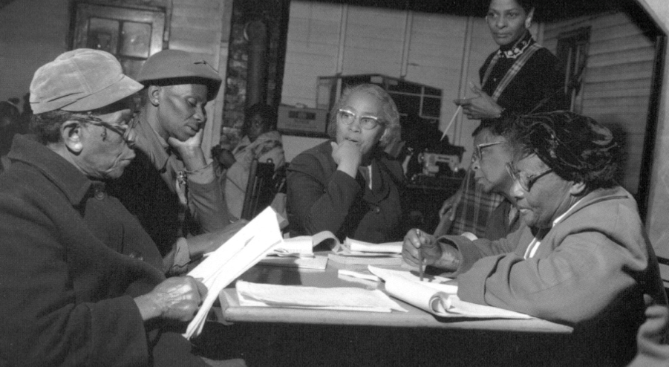
Questions and Democracy
“We need to be taught to study rather than to believe, to inquire rather than to affirm.”
– Septima Clark
Chapter 6 on Septima Clark in Freedom Road: Adult Education of African Americans (Peterson, 1996)

Slide 72
What are your questions?

Slide 73
Access Today’s Materials:
https://bit.ly/RQIHERO

Slide 74
Access RQI’s Free QFT Resources
https://rightquestion.org/education/resources
Classroom Examples
Instructional Videos
Planning Tools & Templates

Slide 75
Using & Sharing RQI’s Resources
The Right Question Institute offers materials through a Creative Commons License. You are welcome to use, adapt, and share our materials for noncommercial use, as long as you include the following reference:
“Source: The Right Question Institute (RQI). The Question Formulation Technique (QFT) was created by RQI. Visit rightquestion.org for more information and free resources.”
Access the full library of resources: http://rightquestion.org/education/resources

