Slide 1
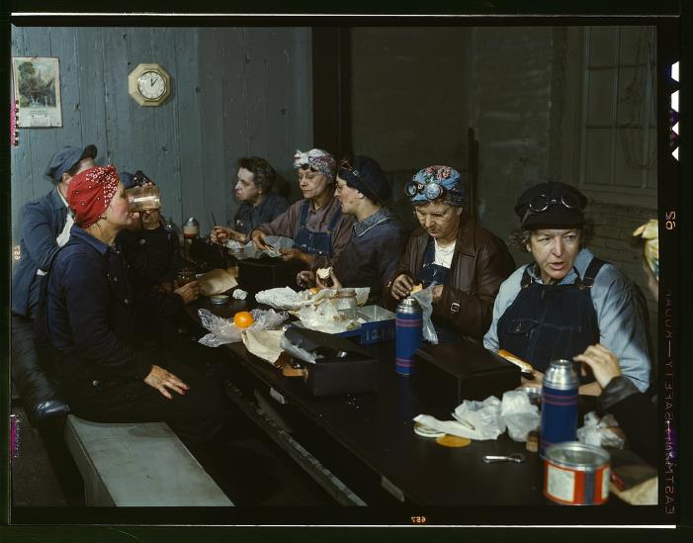
Lunch and Learn Incorporating Primary Sources into an Inquiry-Based Literacy Program for Early Learners
Katy Connolly
Education Program Coordinator
Sarah Westbrook
Director of Professional Learning
Maame Conduah
Education Program Associate
The Right Question Institute
Cambridge, MA
https://www.loc.gov/resource/fsac.1a34808/

Slide 2
Access RQI’s Free QFT Resources
https://rightquestion.org/education/resources
Classroom Examples
Instructional Videos
Planning Tools & Templates

Slide 3
Use and Share These Resources
The Right Question Institute offers materials through a Creative Commons License. You are welcome to use, adapt, and share our materials for noncommercial use, as long as you include the following reference:
“Source: The Right Question Institute (RQI). The Question Formulation Technique (QFT) was created by RQI. Visit rightquestion.org for more information and free resources.”

Slide 4
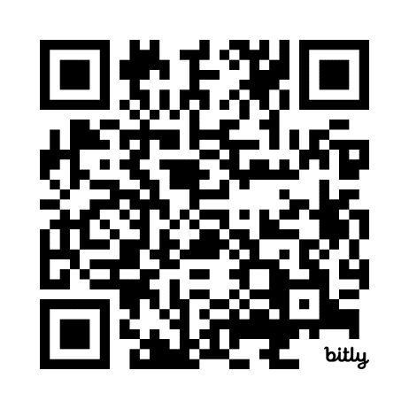
Link to Event Page for this session
https://bit.ly/rqi-lunch-and-learn

Slide 5
Today’s Agenda
Introduction: Using primary sources with the QFT in the elementary classroom
Primary Source-QFT Experience
Demonstration: Finding primary sources at the Library of Congress
Time to explore loc.gov and sharing ideas
Tour of RQI Resources for further learning

Slide 6
Discuss
Do you use primary sources with your students? Why or why not?
Have you ever used the QFT with primary sources? How might it be different from other uses?

Slide 7
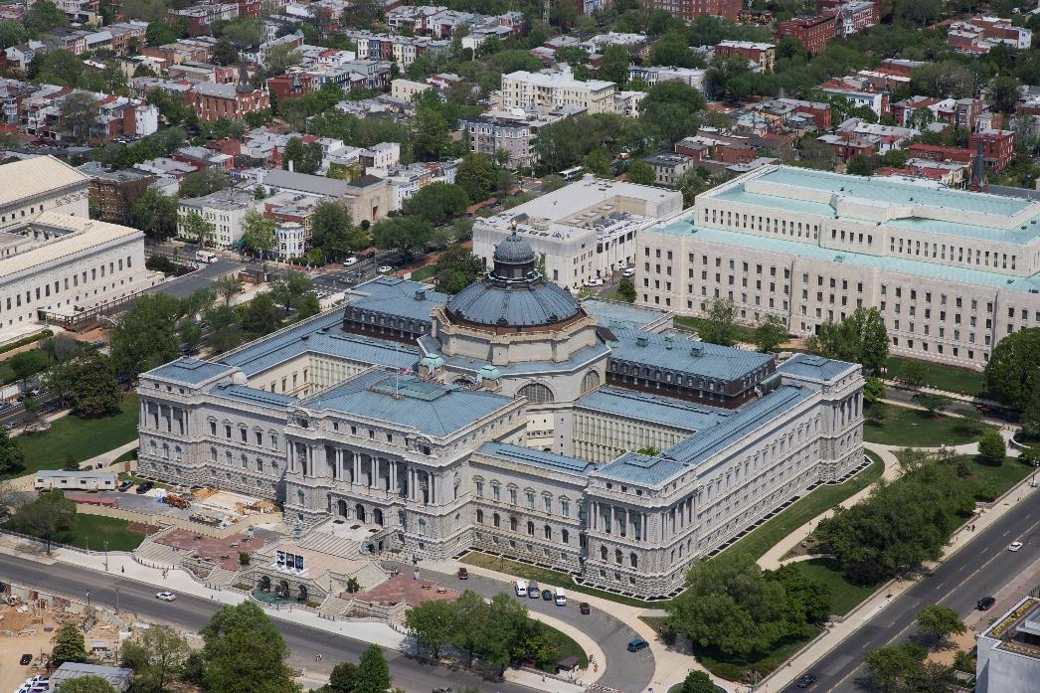
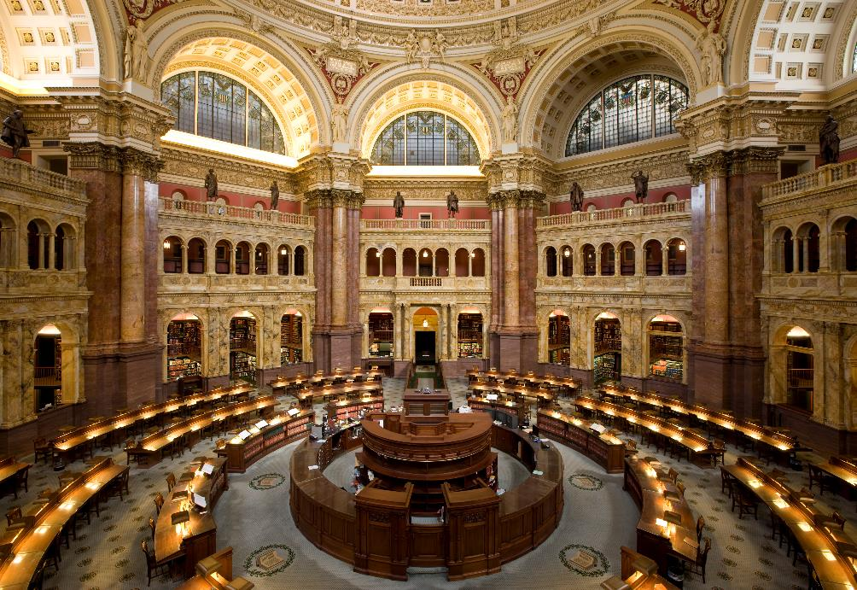
The Library of Congress: loc.gov
https://www.loc.gov/item/2007684215/
https://www.loc.gov/item/2011646837/

Slide 8
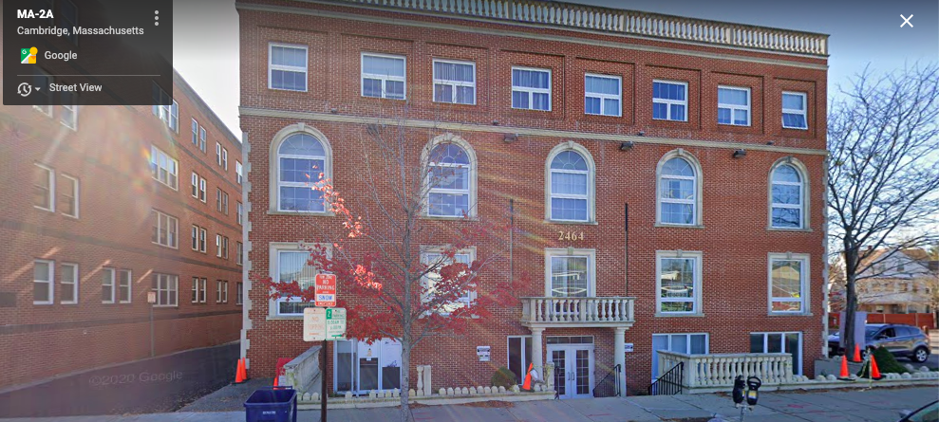
Right Question Institute: rightquestion.org

Slide 9
30+ Years 1 deceptively simple skill: asking your own questions

Slide 10
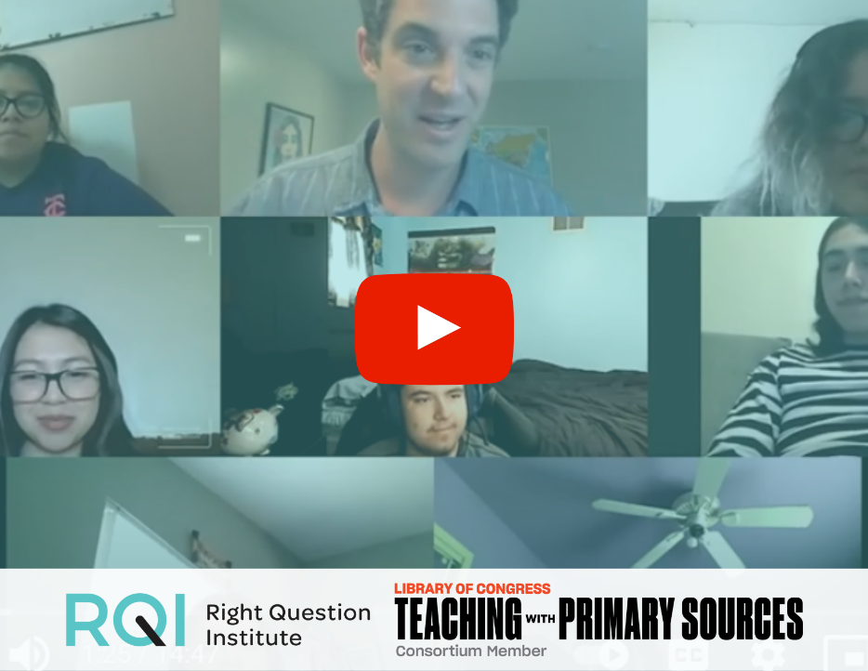
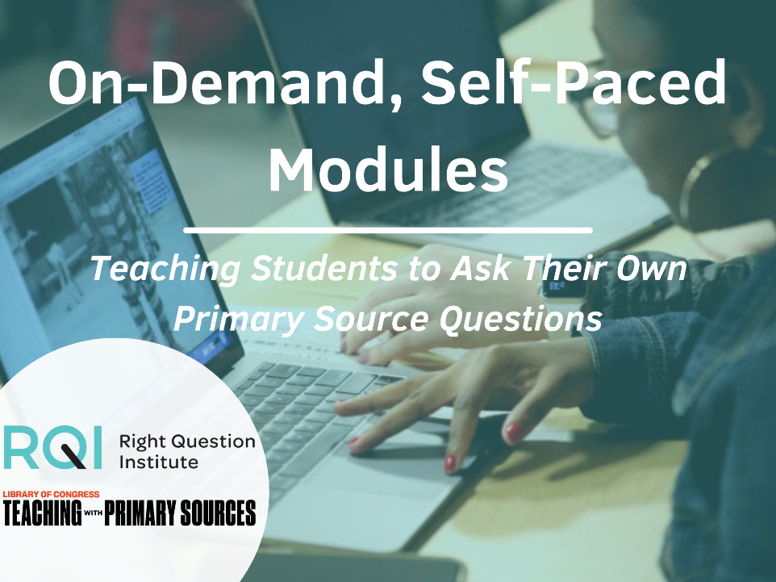
4 Years, 2 Institutions, 2,000 teachers
8 runs of a 3-week online course
4 Self-Paced “learn on your own time” Modules
Resource Hub with more than 25 original lesson plans, videos, and other tools and guides
Explore our free Resource Hub for Using the QFT with Primary Sources at rightquestion.org/primary-sources

Slide 11
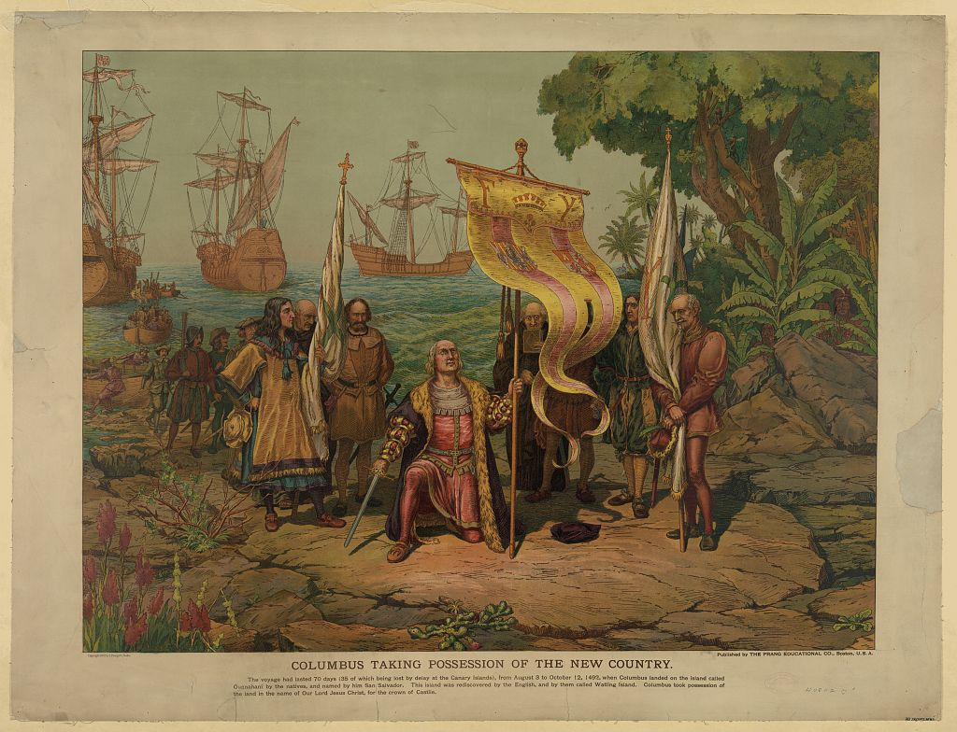
A Question to Consider: Is This a Primary Source?
Title: Columbus taking possession of the new country
Creator(s): L. Prang & Co.,
Date Created/Published: Boston, U.S.A. : Published by the Prang Educational Co., 1893.
Medium: 1 print : chromolithograph ; 63.3 x 83 cm (sheet)

Slide 12
Here’s what the Library of Congress would say
It depends…
If you’re studying lithographs from the 1800s, then yes.
If you’re studying Columbus’ arrival to the Americas in the 1490s, then no.
What topic and time period are you studying?

Slide 13
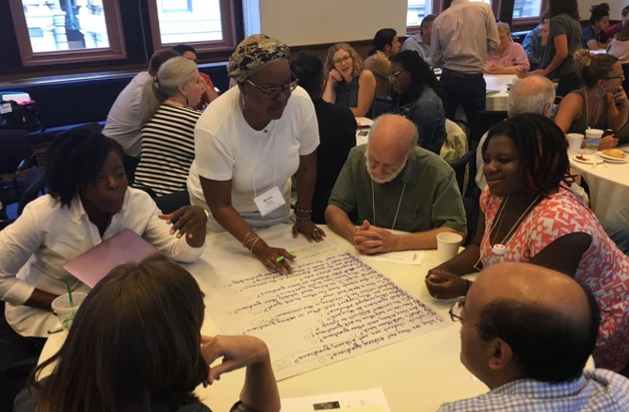
Primary Source-QFT Experience

Slide 14
Rules for Producing Questions
1. Ask as many questions as you can
2. Do not stop to answer, judge, or discuss
3. Write down every question exactly as stated
4. Change any statements into questions

Slide 15
Produce Questions
Ask Questions
Follow the Rules
Ask as many questions as you can.
Do not stop to answer, judge, or discuss.
Write down every question exactly as it was stated.
Change any statements into questions.
Number the Questions

Slide 16
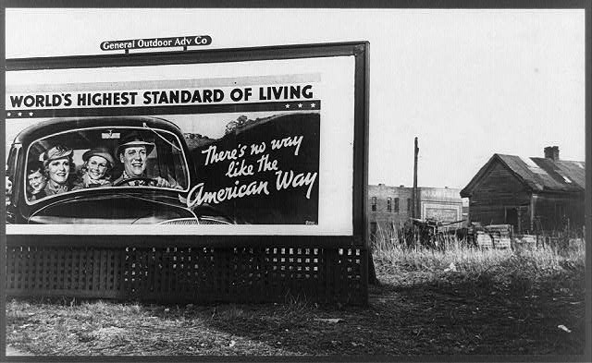
Question Focus
First, just make some observations. What do you see?
Sign, Birmingham, Alabama, 1937

Slide 17
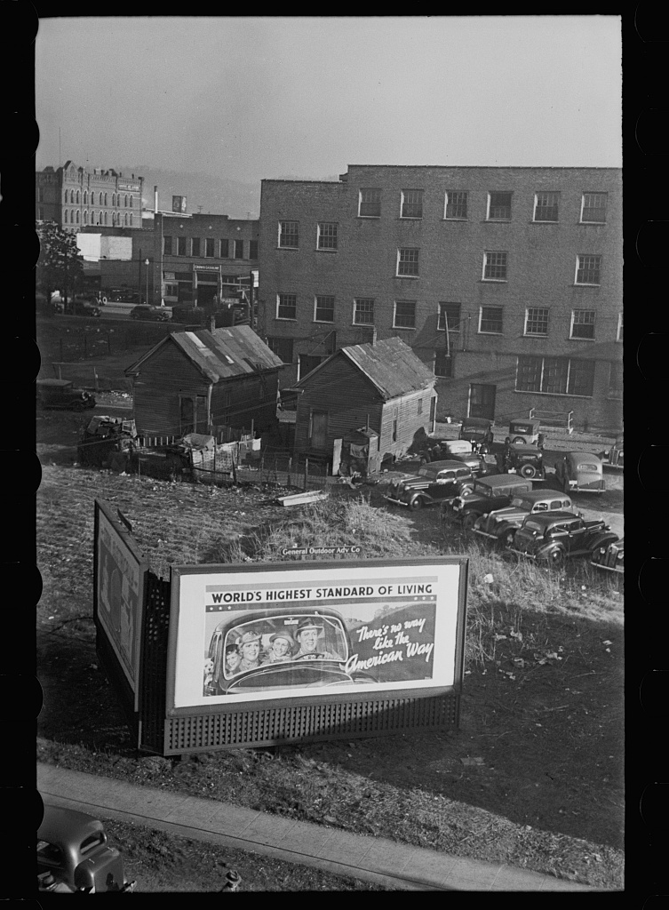
Question Focus
Another view of the same billboard
Birmingham, Alabama, 1937

Slide 18
Categorize Questions: Closed/Open
Definitions:
Closed-ended questions can be answered with a “yes” or “no” or with a one-word answer.
Open-ended questions require
more explanation.
Directions: Identify your questions as closed-ended or open-ended by marking them with a “C” or an “O.”

Slide 19
Discuss
Closed-ended Questions
Advantages
Disadvantages

Slide 20
Discuss
Open-ended Questions
Advantages
Disadvantages

Slide 21
Improve Questions
Take one closed-ended question and change it into an open-ended question.
Take one open-ended question and change it into a closed-ended question.
Add these as new questions at the bottom of your list.
Closed
Open
Open
Closed

Slide 22
Prioritize Questions
Review your list of questions
Choose three questions that you are most curious to research or discuss further.
Draw a next to those questions.
Then, think about why you chose those questions.

Slide 23
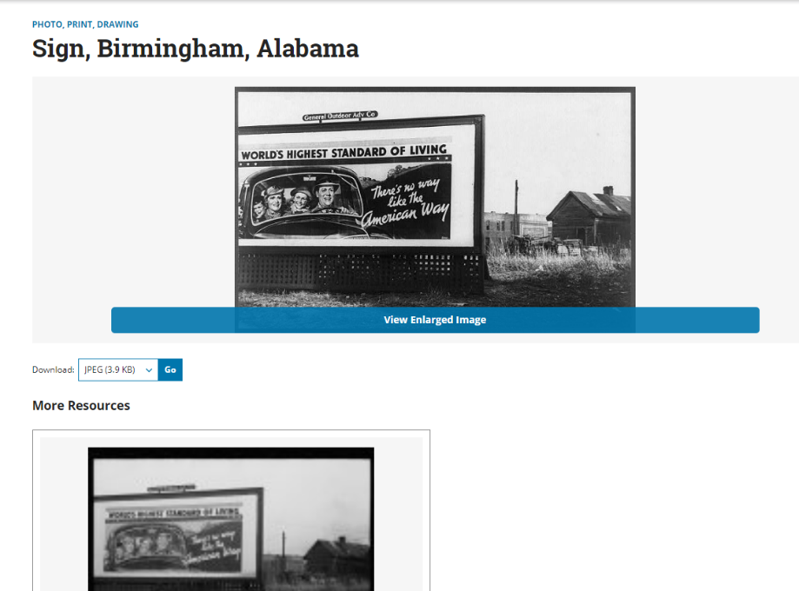
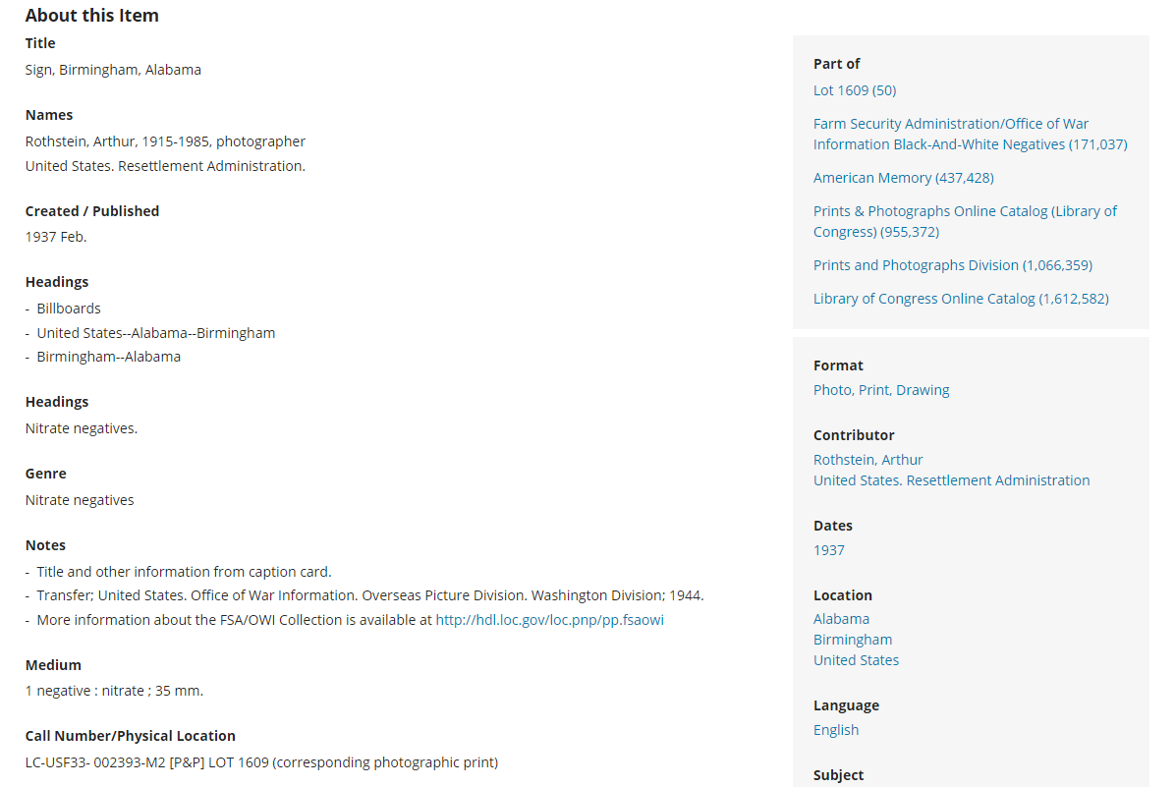
Pause: Let’s build some more context.
This is the original record from the Library of Congress.
What are you thinking or wondering about now?

Slide 24
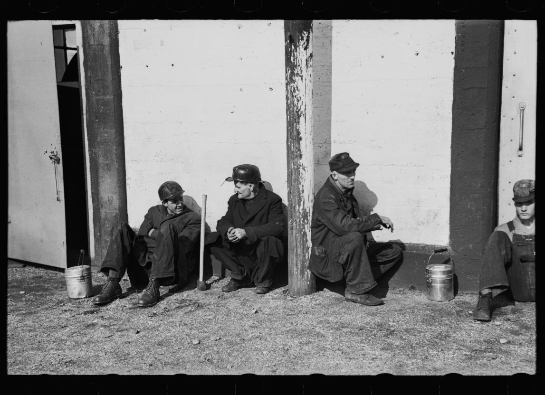
More context building: related sources
Another shot by the same photographer, location, and time period.
Coal miners, Birmingham, Alabama
https://www.loc.gov/item/2017722140/

Slide 25
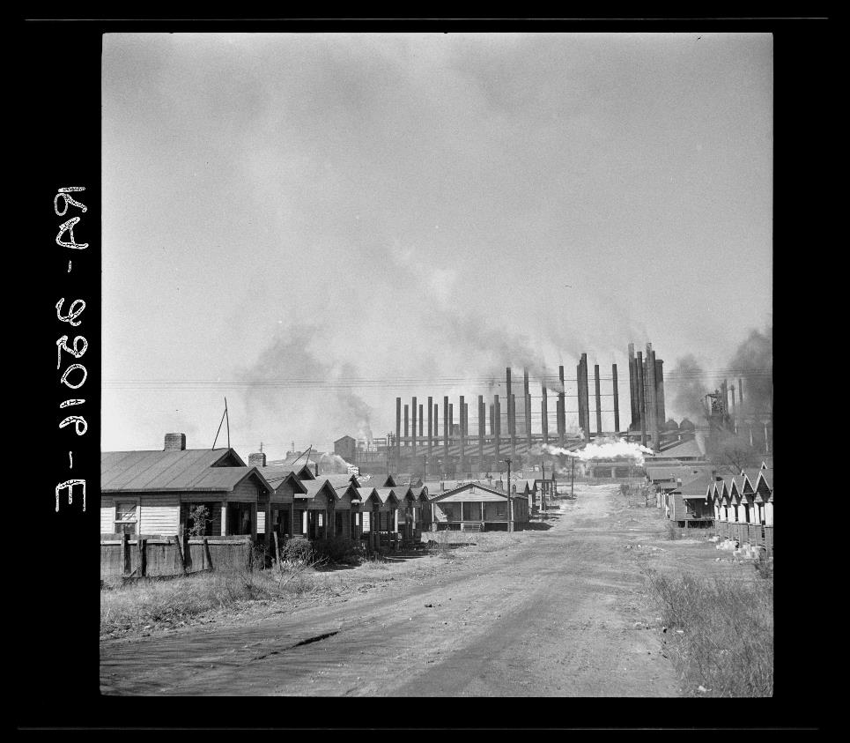
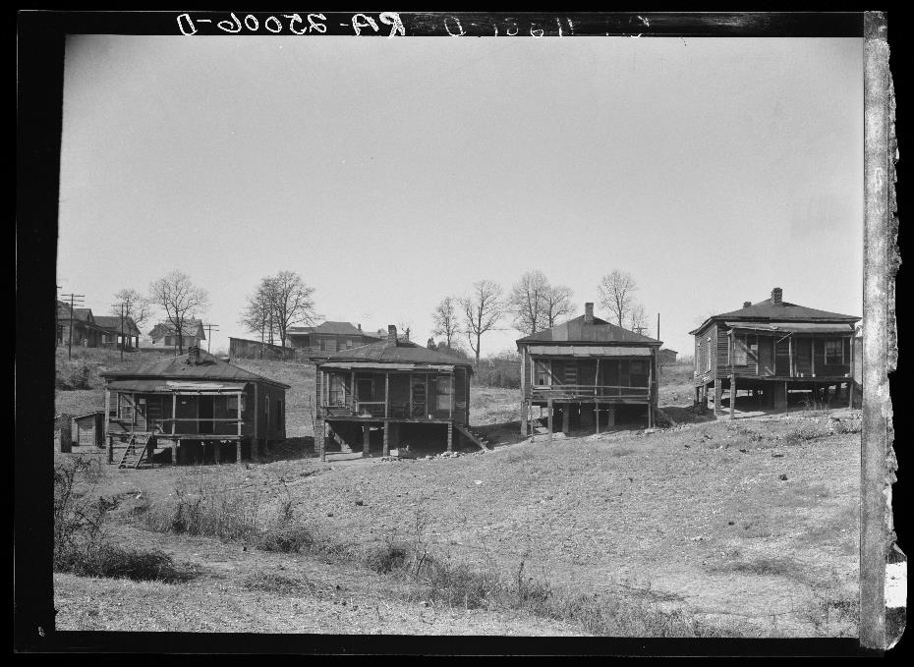
Related Sources
https://www.loc.gov/item/2017775567/
https://www.loc.gov/item/2017775577/
Company houses near steel mills. Ensley, Alabama
Miners’ houses. Birmingham, Alabama

Slide 26
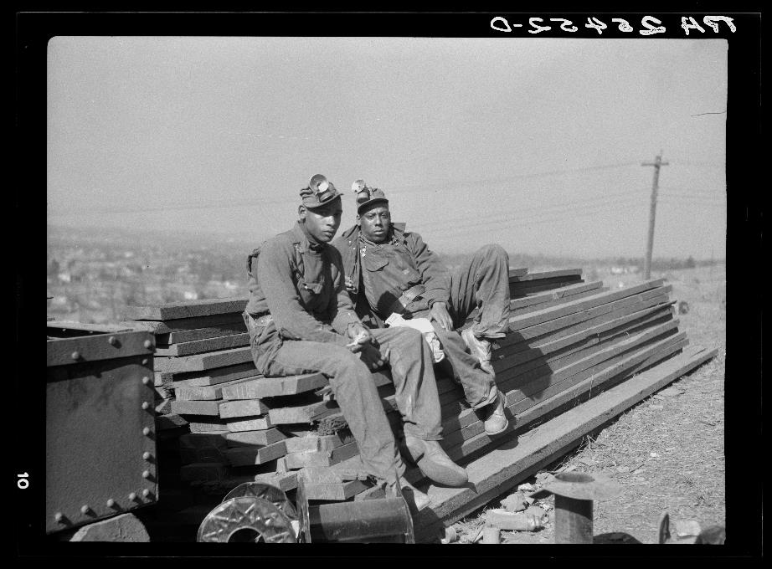
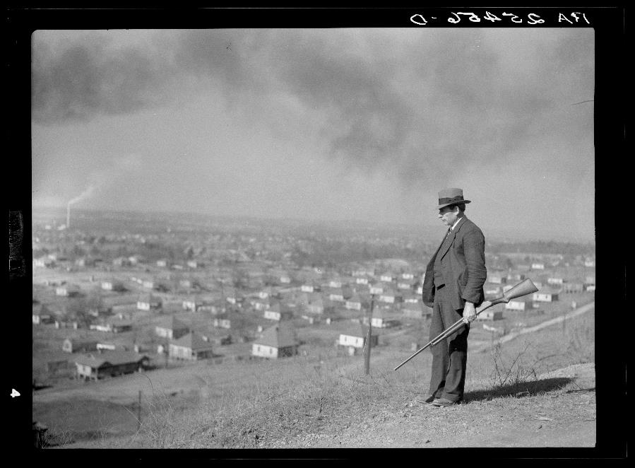
Related Sources
https://www.loc.gov/item/2017775577/
https://www.loc.gov/item/2017775916/
Guard at company town. Jefferson County, Alabama
Iron ore miners. Jefferson County, Alabama.

Slide 27
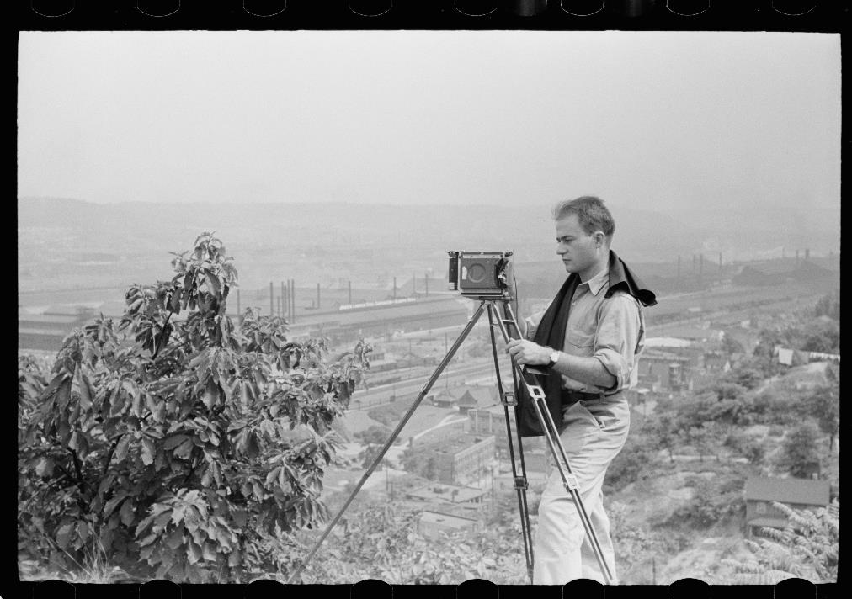
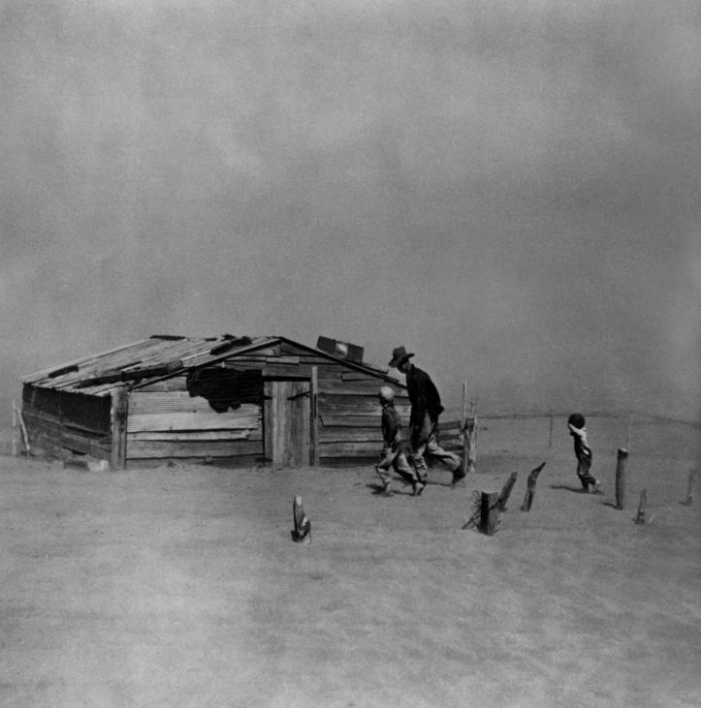
Related Sources
Arthur Rothstein and his most famous photograph, which was titled “Dust Storm, Cimarron County, Oklahoma.”
https://www.loc.gov/resource/fsa.8a09935/
https://collections.eastman.org/objects/127782/dust-

Slide 28
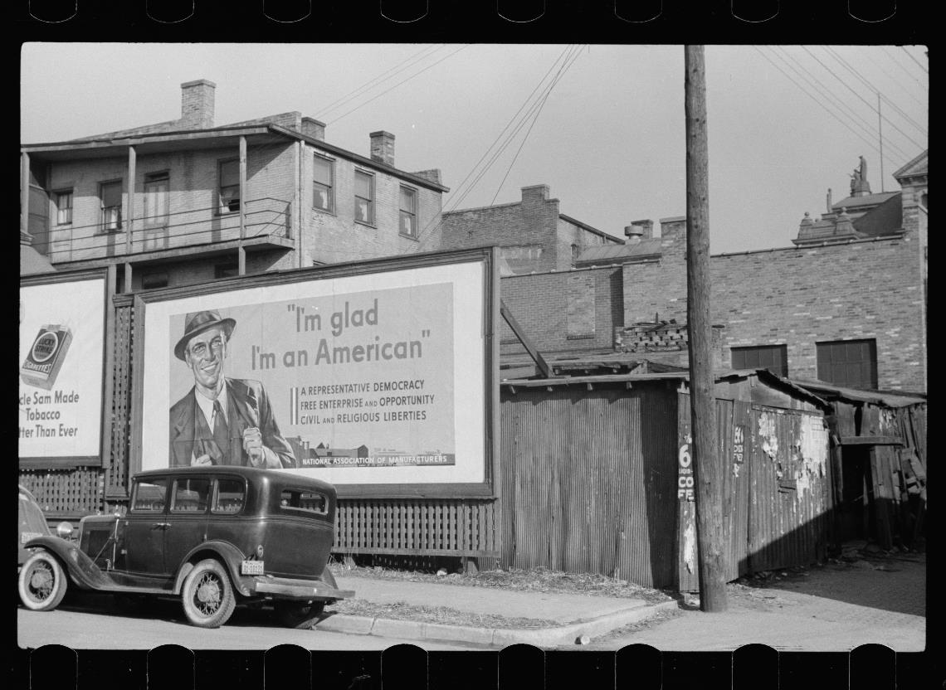
Related Sources
One of many similar billboards across the country at the time, this one is called “Dubuque, Iowa. National Association of Managers Signboard.”

Slide 29
Add and Improve Questions
Now, review your list of questions.
Add new questions to your list:
A question inspired by someone else’s
An adaptation or wording change of an existing question to create a new question.
Something that was sparked by seeing additional primary sources or building some context.

Slide 30
Further Investigation
Reflect on the questions you prioritized already.
What would you prioritize now?
What area/topic would you be most personally curious about for further investigation?

Slide 31
Further Investigation
Instructions:
1) Choose from one of the following topics and head to the appropriate table:
More about the photographer of the first photo, Arthur Rothstein
More about the work of the Farm Security Administration
More about billboards and signs cropping up around the country at the time
Something else – feel free to choose your own topic, and take it upon yourself to do some research
2) See what you can answer, address, or infer about your questions using the additional sources provided (or your own research) as evidence
3) Jot down some notes to share later

Slide 32
Discuss
What did you learn and what are you thinking about now from exploring the additional sources?
What would you want to do next? Are there any questions you think you can’t or won’t be able to answer?

Slide 33
Reflection
As a learner: What did you learn? How did your thinking change from the beginning to the end of the process?
As a teacher: What did you notice about how the process was constructed or facilitated?

Slide 34
A Look Inside the Process

Slide 35
The QFT, on one slide…
Ask as many questions as you can
Do not stop to discuss, judge or answer
Record exactly as stated
Change statements into questions
Question Focus
Produce Your Questions
Follow the rules
Number your questions
Improve Your Questions
Categorize questions as Closed or Open-ended
Change questions from one type to another
Strategize
Prioritize your questions
Action plan or discuss next steps
Share
Reflect
Closed-Ended:
Answered with “yes,” “no” or one word
Open-Ended: Require longer explanation
Source: The Right Question Institute rightquestion.org

Slide 36
What we did today
Ask as many questions as you can
Do not stop to discuss, judge or answer
Record exactly as stated
Change statements into questions
Observe the QFocus
Produce Questions
Follow the 4 rules
Layer in a second view
Produce Questions (part 2)
Improve Questions
Categorize questions as Closed or Open-ended
Change questions from one type to another
Prioritize Questions
Basic context building
Add and Improve Questions
Explore, Strategize and share
Discuss next steps
Reflect
Closed-Ended:
Answered with “yes,” “no” or one word
Open-Ended: Require longer explanation
Continue to add & Refine Questions

Slide 37
Demonstration: Exploring loc.gov

Slide 38
Two ways to find primary sources:
When you are open to different possibilities
When you have a common topic
Browse pre-curated sets
Search and filter
When you have a specific topic in mind
When you have a slightly obscure topic

Slide 39
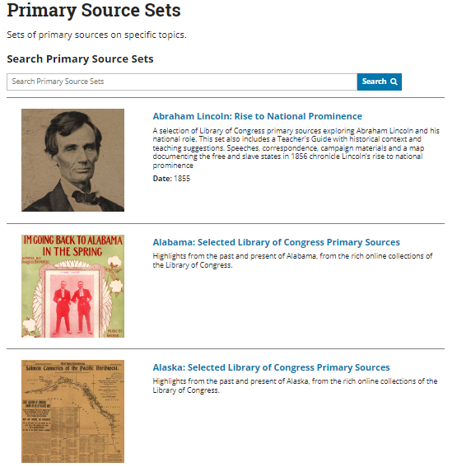
Browse pre-curated sets and collections
Primary Source Sets (find on the Teachers page)
Free to Use and Reuse
Prints & Photographs

Slide 40
Search
Many ways to search, but I like to use a site-limited google search
Keyword + site:loc.gov
No spaces here

Slide 41
One More Tip
Keep going!
Go deeper on items of interest by:
Scrolling down to “see more like this”
Clicking in to linked subject tags, etc in “About this item”
Once in the collections, change your view to see more items at once

Slide 42
Exploring the loc.gov
Instructions:
Take some time to explore loc.gov on your own
Start at one of the curated sets I showed you, or if you have a topic in mind, try a site-limited google search
Jot down some ideas

Slide 43
Share
What primary sources did you find?
What ideas do you have for using them with students?

Slide 44
Tour of RQI Resources for further learning
Watch videos to hear from teachers and students
Check out real lesson plan examples
Learn more on your own time
Explore our free Resource Hub for Using the QFT with Primary Sources at rightquestion.org/primary-sources

Slide 45
Final thoughts, questions, and evaluation
https://bit.ly/rqi-lunch-and-learn

