Slide 1
Encourage Curiosity, Spark Inquiry:
Teach Students to Ask Their Own Questions
NSTA National Conference | New Orleans | November 7, 2024
Speakers
Maureen McGrail
Katy Connolly
Notes:
Mo says hello

Slide 2
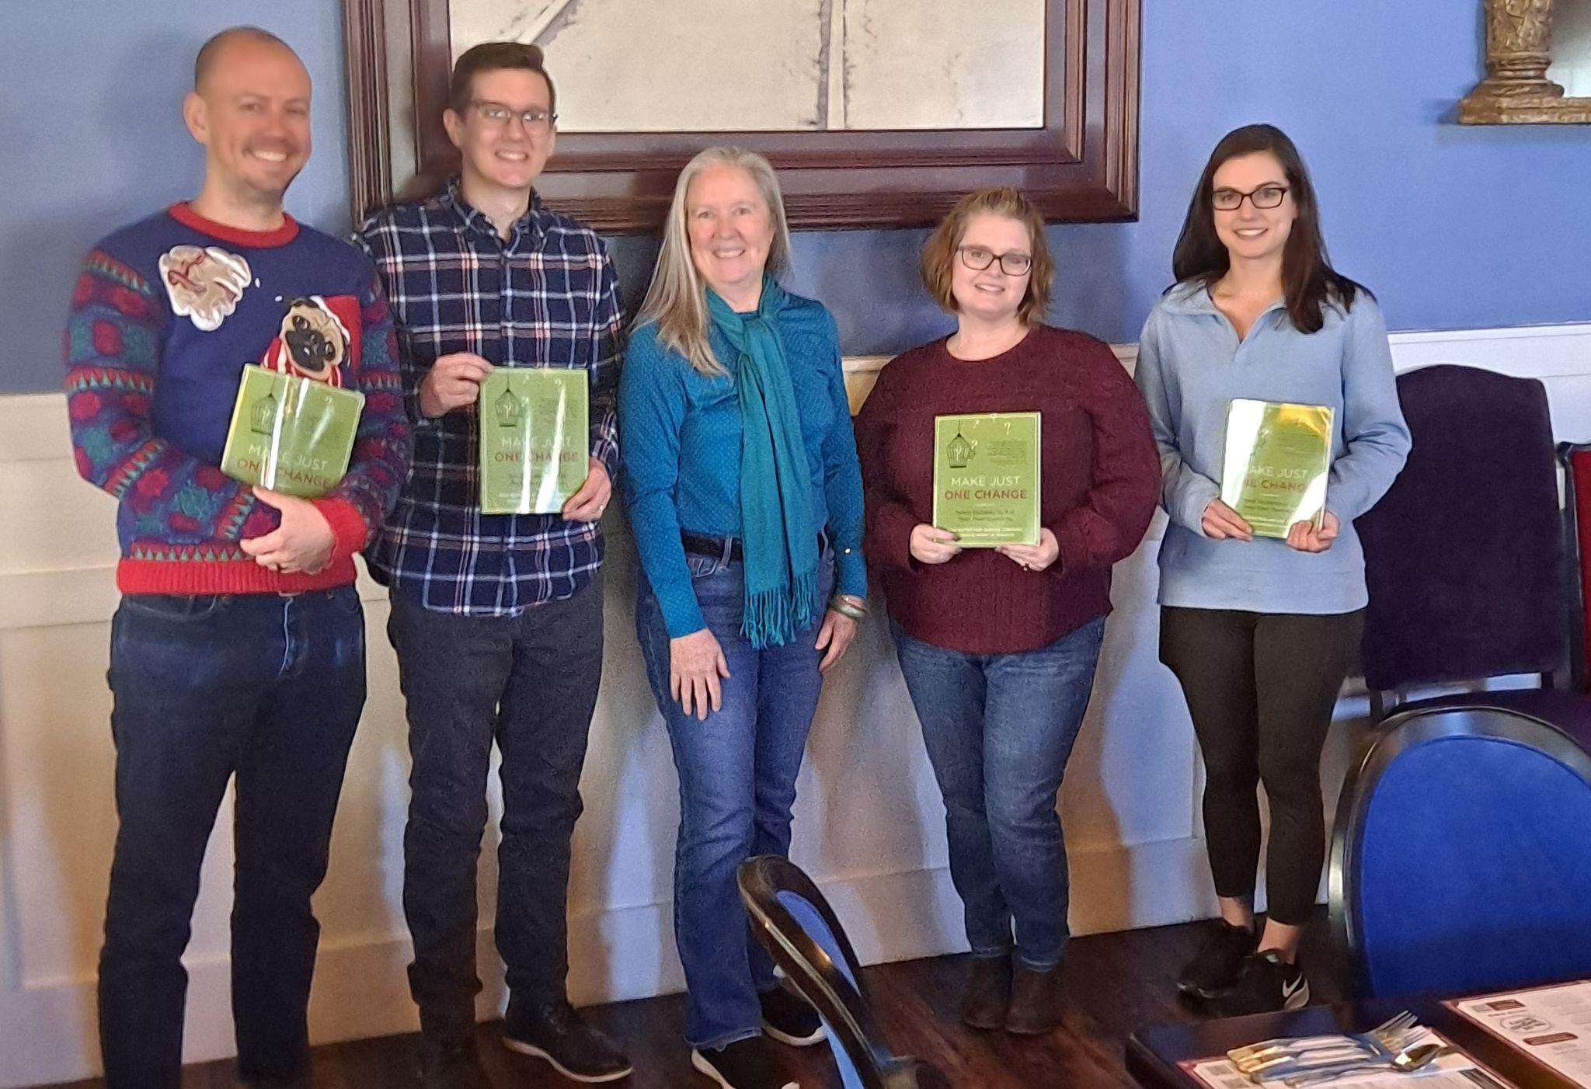
Introductions
Maureen McGrail
Science Content Director
Educator/Engineer
Katy Connolly
Right Question Institute
Education Program Coordinator
Science Support Team
Kevin Morse (Chemistry)
Jacob Bowman (Physics)
Kristi Phillippe (Biology)
Melissa Burger (Environmental Science)
Notes:
Mo introduce yourself
Katy introduce yourself
show of hands, what subject: life science vs. physical science, high school vs. middle school

Slide 3
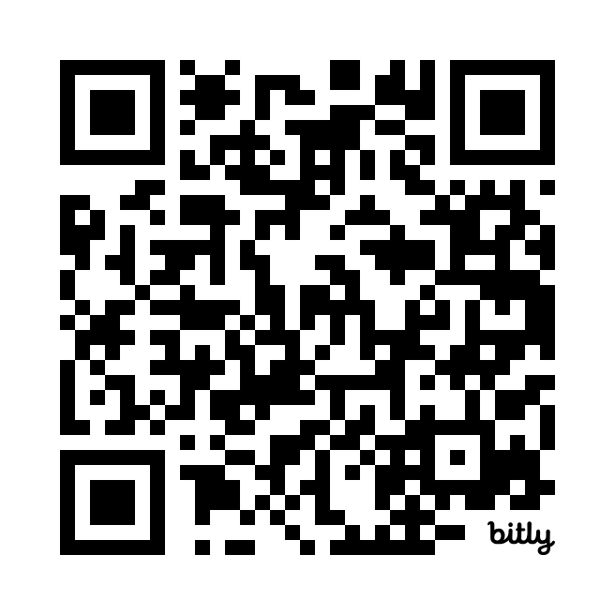
Event Links
https://bit.ly/QFTatNSTA
Notes:
Katy

Slide 4
Today’s Challenge:
“How can we work together on creating more opportunities for all students to ask their own questions?”
Notes:
Mo

Slide 5
What is QFT?
Q: Question
F: Formulation
T: Technique
QFT is a research-based instructional strategy developed by the Right Question Institute to prepare students to ask more and better questions.
Notes:
Mo

Slide 6
Where did the QFT come from?
ORIGINS
“We don’t go to the school because we don’t even know what to ask.” —Lawrence, MA
Notes:
Katy

Slide 7
Why spend time on teaching question formulation?
RESEARCH & EVIDENCE
"There is no learning without having to pose a question."
—Richard Feynman, Nobel Laureate, Physics, 1965
"We must teach students how to think in questions, how to manage ignorance."
—Stuart Firestein, Former chair, Dept. of Biology, Columbia Univ
“The primary skills should be analytical skills of interpretation and inquiry. In other words, know how to frame a question.”
— Leon Botstein, President of Bard College
Scholars, educators, and college presidents say…
Notes:
katy

Slide 8
Did you know…
Notes:
katy
kristi found this

Slide 9
Why spend time on teaching question formulation?
Only 27% believe college taught them to ask questions
RESEARCH & EVIDENCE
And yet, college students say…
Notes:
katy

Slide 10
Why spend time on teaching question formulation?
RESEARCH & EVIDENCE
Question asking may decline
Research shows…
Tizard, B., Hughes, M., Carmichael, H., & Pinkerton, G. (1983).
Pearson, J.C. & West, R. (2009)
Notes:
katy

Slide 11
Why spend time on teaching question formulation?
RESEARCH & EVIDENCE
Question asking is beneficial
Research shows…
One of the most effective metacognitive strategies
Improved rate of learning by nearly 50%
—John Hattie
Notes:
Mo
John Hattie

Slide 12
Why spend time on teaching question formulation?
RESEARCH & EVIDENCE
AP-TIP High school student:
Students say…
Notes:
Mo
from one of our Indiana high school physics students

Slide 13
Overview of the QFT
EXPERIENCE
Individuals learn to:
Produce their own questions
Improve their questions
Strategize on how to use their questions
Reflect on what they have learned and how they learned it
And yet, college students say…
Notes:
Mo

Slide 14
Producing Questions
EXPERIENCE
4 Rules
Ask as many questions as you can.
Do not stop to answer, judge, or discuss.
Write down every question exactly as stated.
Change any statements into questions.
Which rule is going to be the hardest for you to follow?
Notes:
Mo
this will be done individually on pieces of paper, or on a handout that Mo will make, can put the QR code on there
“now you are putting on your student hat”

Slide 15
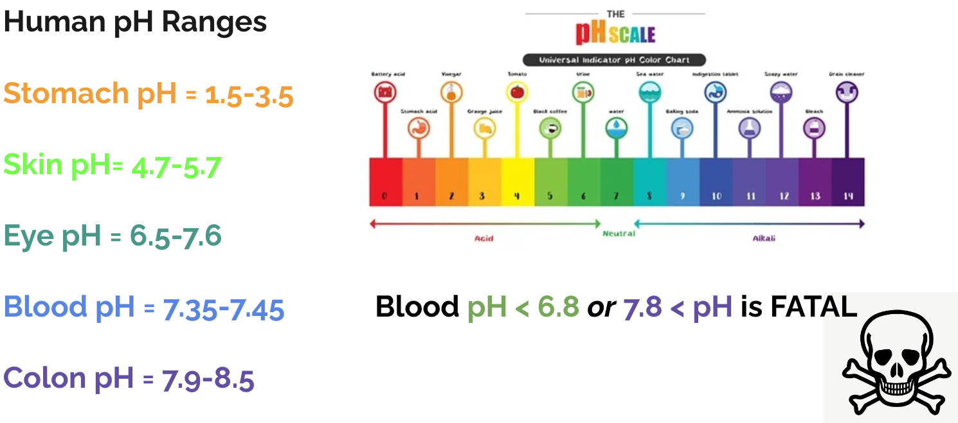
Question Focus:
Now, ask away!
Follow the 4 rules.
And yet, college students say…
Notes:
Mo

Slide 16
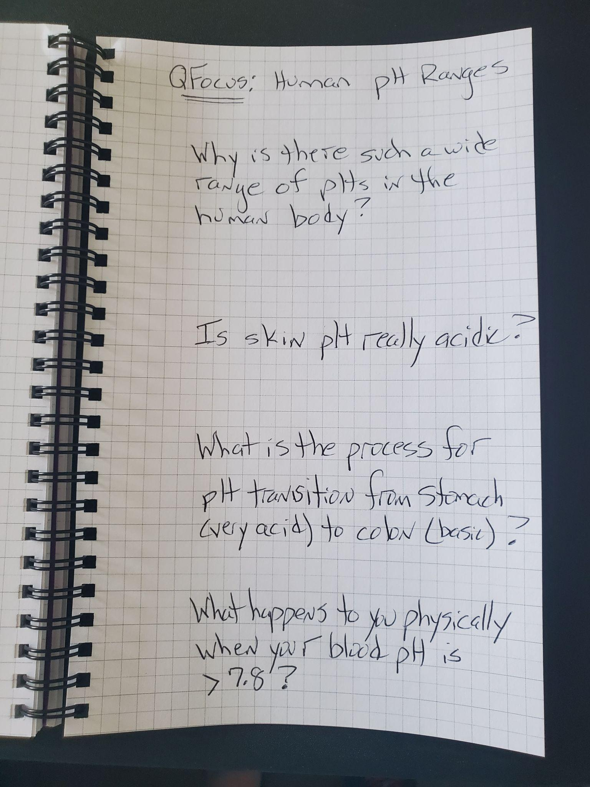
Question Focus:
EXPERIENCE
Notes:
Mo
sample, you should have a list of questions

Slide 17
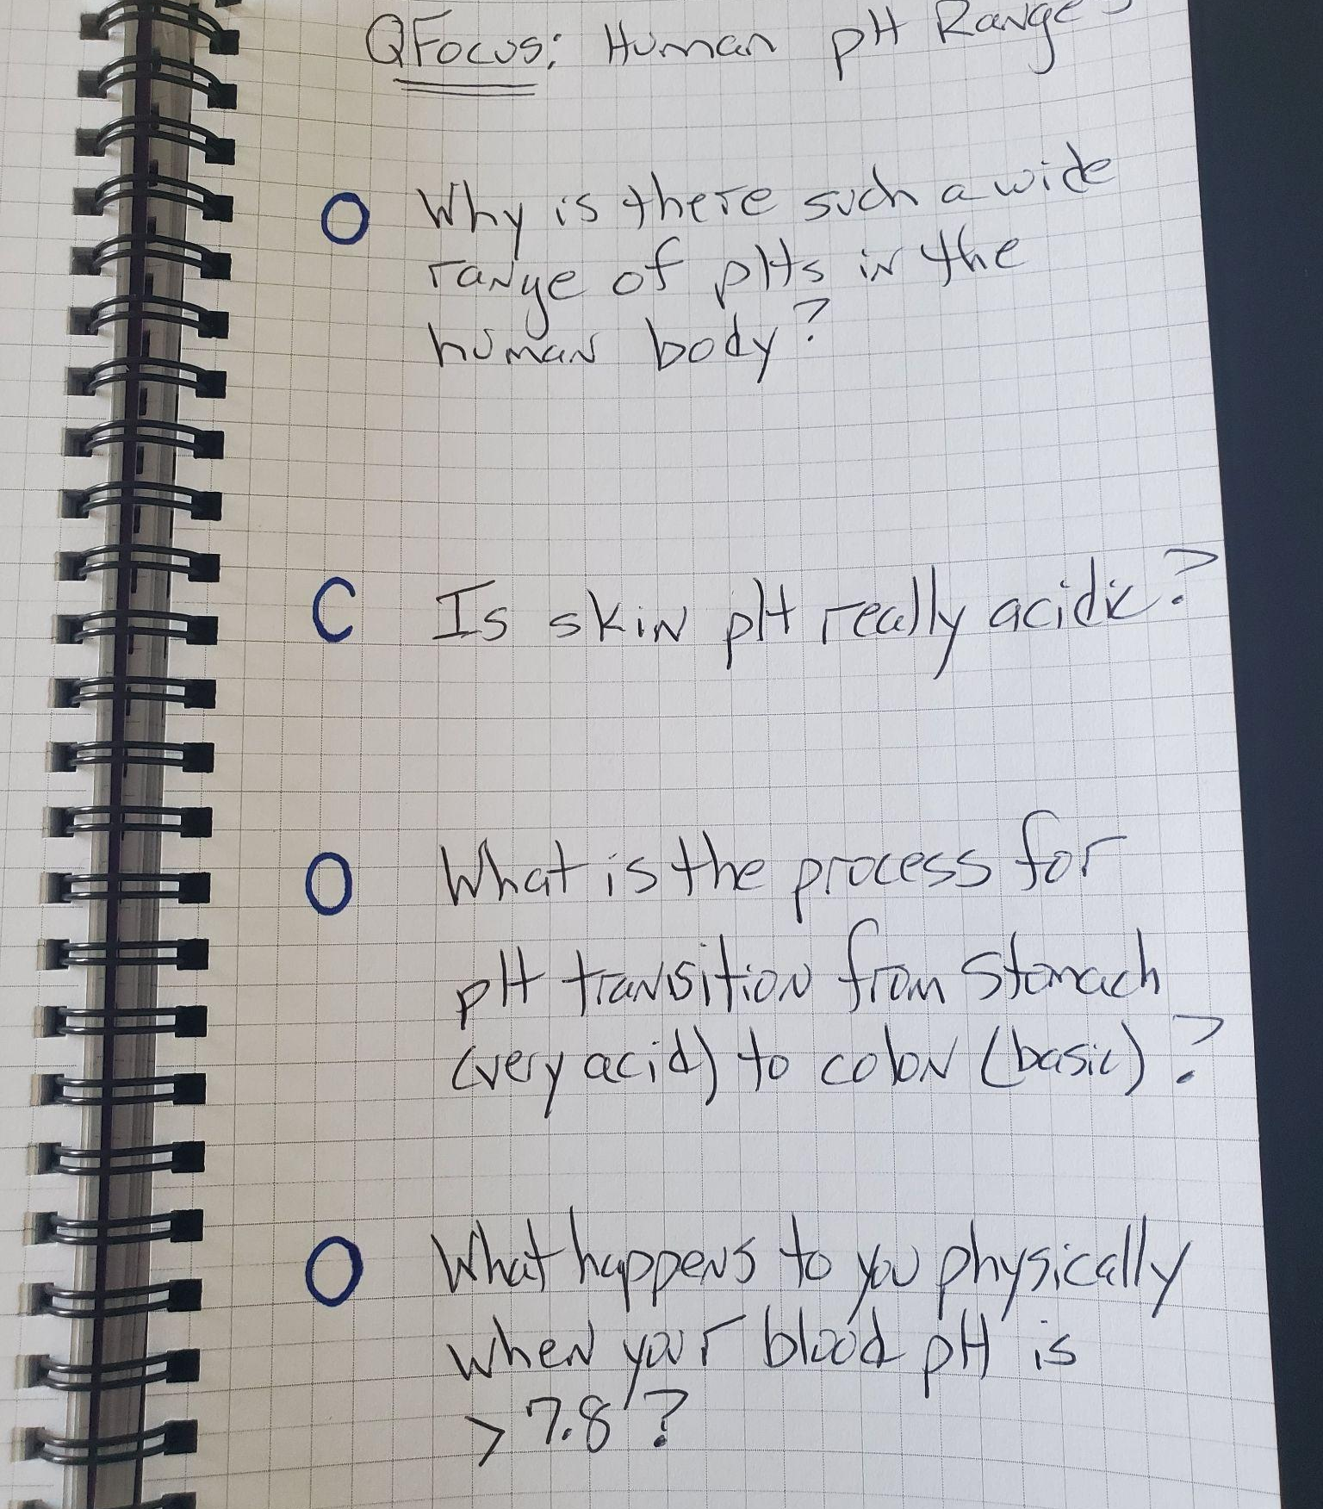
Improving Questions— Categorize by Open/Closed
EXPERIENCE
Closed = can be answered by “yes”, “no”, or one word
Open = require more explanation
Mark your questions with “O” or “C”
Notes:
Katy
there are many different ways to categorize questions

Slide 18
Improving Questions— Advantages & Disadvantages
EXPERIENCE
 | Advantages | Disadvantages
Closed
Open
What advantages and disadvantages would you name?
Notes:
Katy
have audience share out, or do peer share

Slide 19
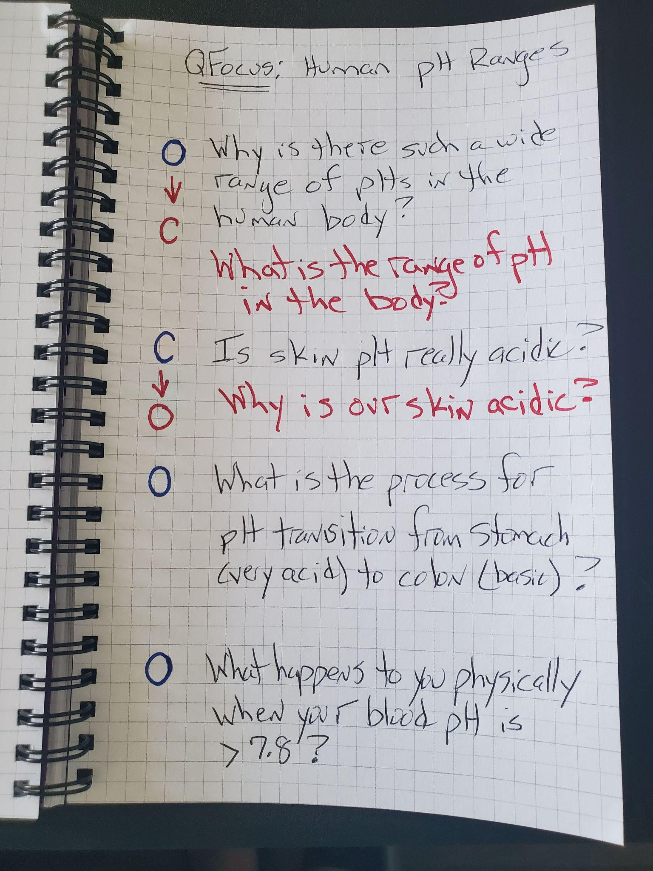
Improving Questions—Changing Questions
EXPERIENCE
Try turning one Closed question → Open
And one Open → Closed
Add these as new questions to your list
Notes:
Katy

Slide 20
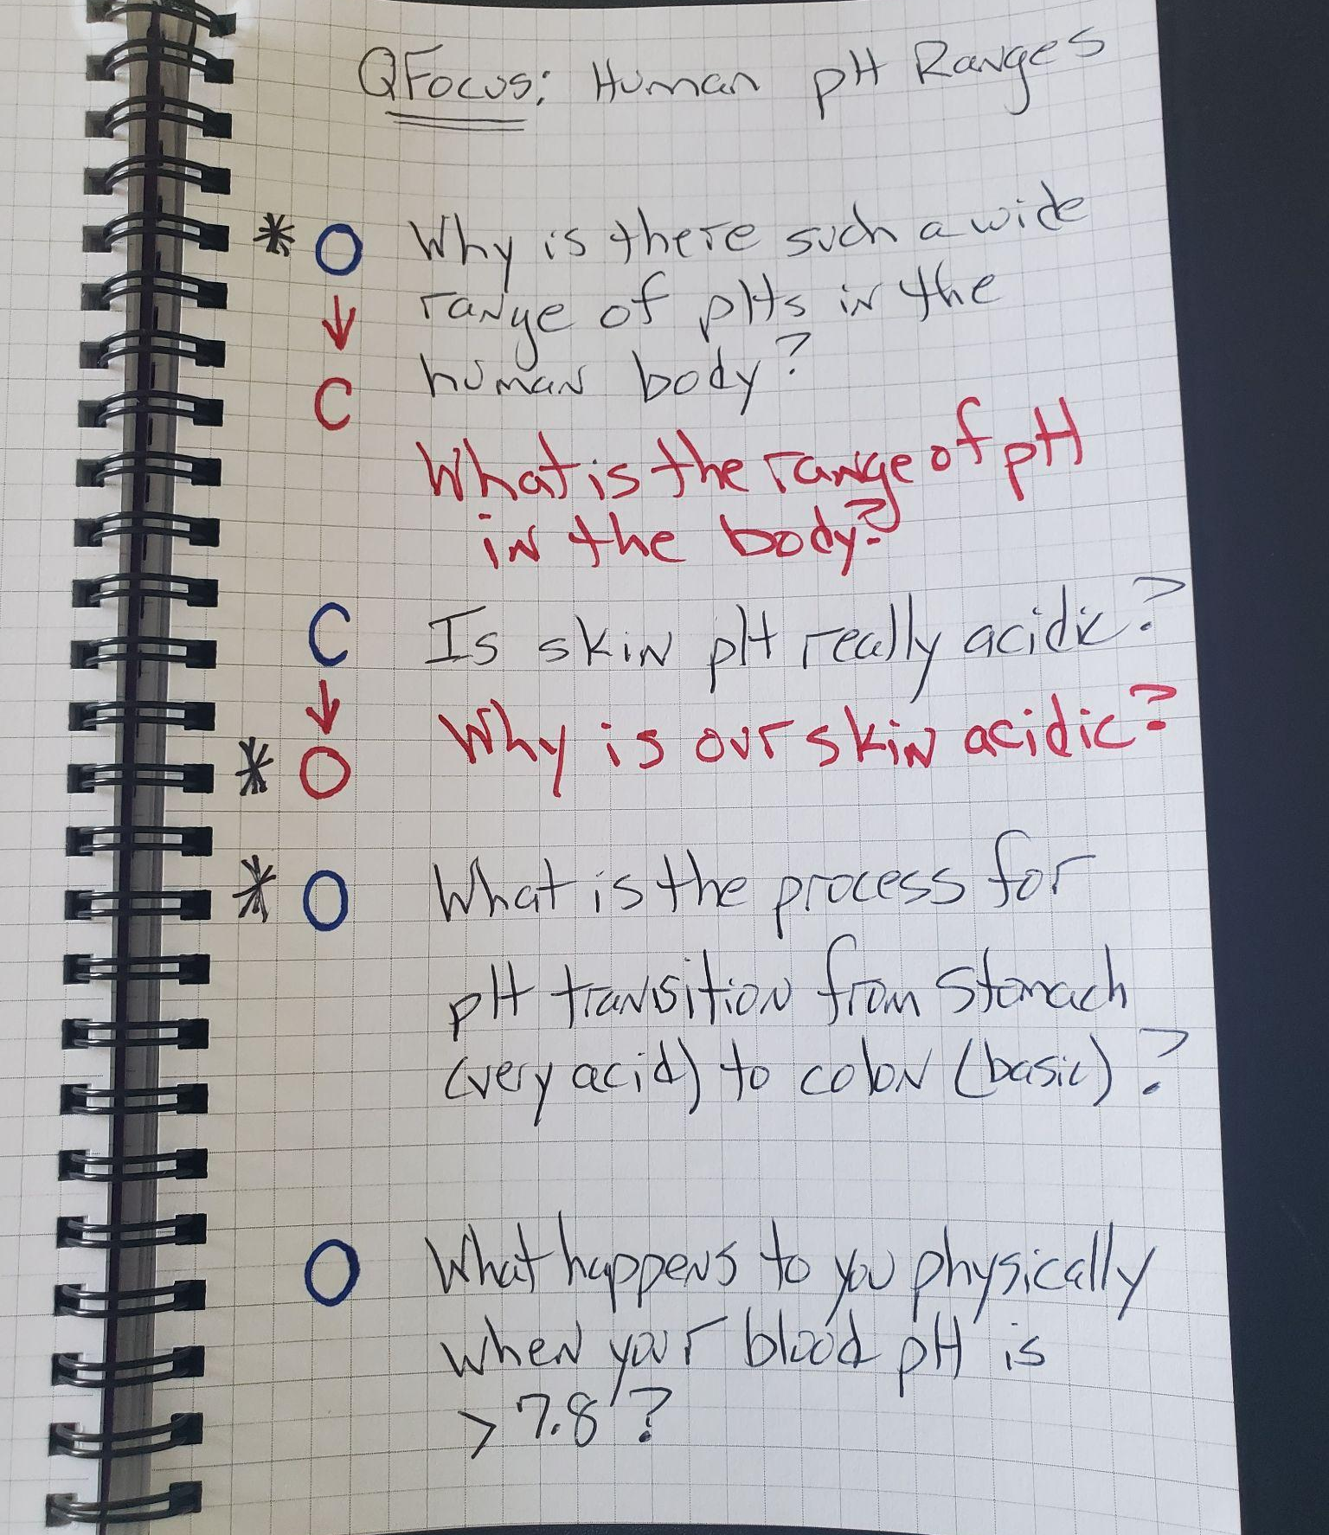
Strategizing with Questions—Prioritizing
EXPERIENCE
Turn to your neighbors
Share your lists:
Choose 3 questions you feel are the most important
Keep the QFocus in mind
Think about why
Put a star (*) next to those 3 questions
Notes:
Mo

Slide 21
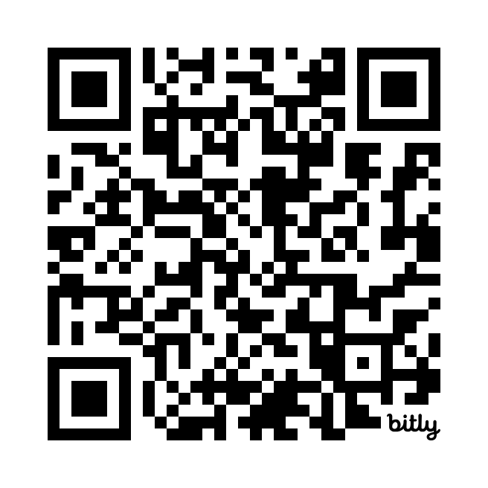
Share ONE of your top THREE Questions!
https://bit.ly/shareyourQs
Notes:
Mo

Slide 22
Let’s look at actual student questions for this QFocus…
QFT Human pH Ranges AP Chem Mooresville HS Dec 5, 2023
Notes:
Mo

Slide 23
Strategizing with Questions— Action Plan
REFLECT
Others:
Research project
Design an experiment
Explore a visual representation/graph
Qs guide unit teaching
Use Qs for test prep
Prepare for interviews
Qs shape homework
Example of one next step for action plan.
Information | Tasks
What do you need to know? | What do you need to do?
Notes:
Create a T-Chart
Mo

Slide 24
Reflect
EXPERIENCE
After this experience of
writing,
improving, and
prioritizing your own questions…
What did you learn?
How did you learn it?
Take a moment to consider these questions for yourself.
Notes:
Katy
think about it for a moment, turn and share with a neighbor, and then maybe get 1-2 people to share

Slide 25
The work you just did…
REFLECT
Question Focus
Produce Your Questions
Follow the rules
Number your questions
Improve Your Questions
Categorize questions as Closed or Open-ended
Change questions from one type to another
Strategize
Prioritize your questions
Action plan; discuss next steps
Share
Reflect
Notes:
Katy

Slide 26
Inside the Process
REFLECT
Divergent
Thinking
Convergent
Thinking
Metacognition
Notes:
Katy

Slide 27
QFT in science What does QFT look like in a Biology classroom?
Notes:
Mo

Slide 28
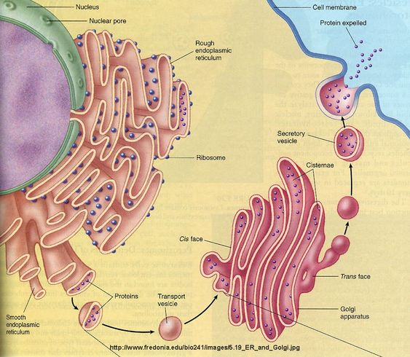
Q-Focus Examples—
Visual Representation
EXPERIENCE
QFocus: Endomembrane System
What organelles are part of the endomembrane system?
Are ribosomes part of the endomembrane system?
Why are proteins expelled from the cell?
Notes:
Mo

Slide 29
QFT in science What does QFT look like an Environmental Science classroom?
Notes:
Mo

Slide 30
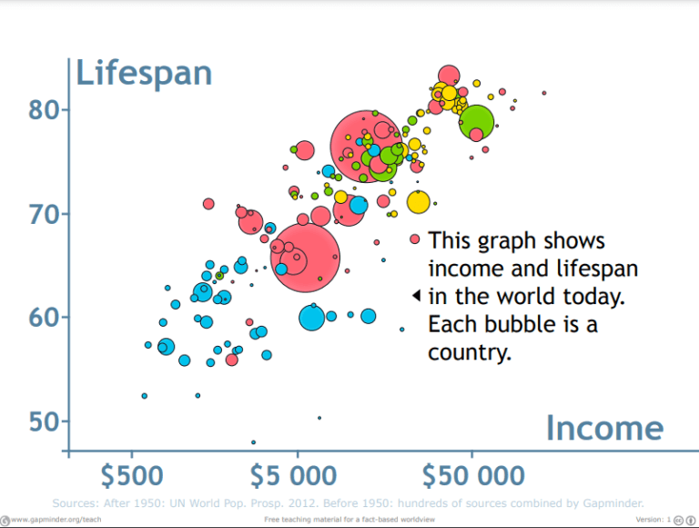
Q-Focus Examples—
Graph Interpretation
EXPERIENCE
QFocus: Gapminder Data
Notes:
Mo

Slide 31
AP-TIP Science Support Team—
Reflections on QFT Strategy
REFLECT
Environmental Science QFT Melissa Burger
Notes:
Mo

Slide 32
QFT in science What does QFT look like in a Chemistry classroom?
Notes:
Mo

Slide 33
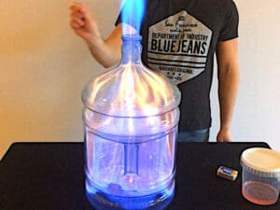
Q-Focus Examples—
Demonstration
EXPERIENCE
QFocus:The “Whoosh” Bottle
Notes:
Mo

Slide 34
QFT in science What does QFT look like in a Physics classroom?
Notes:
Mo

Slide 35
Q-Focus Examples—
Design an Experiment
EXPERIENCE
QFocus: A tennis ball and a racquet ball are dropped simultaneously and allowed to bounce on the ground until they both stop.
Notes:
Mo

Slide 36
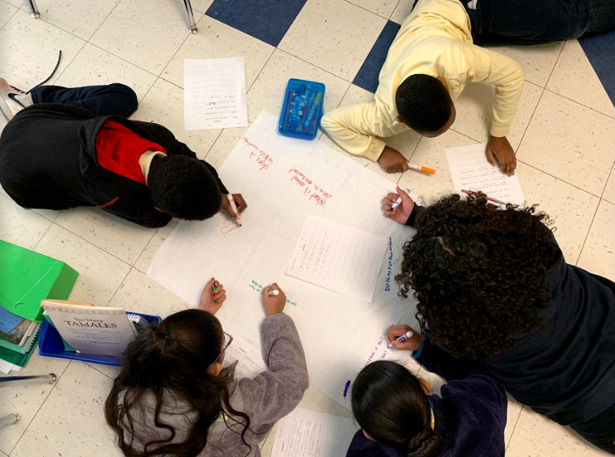
What about using QFT in your classroom?
Take a few moments to think about a QFocus you would explore with your students
Report out
Notes:
Mo
think and jot down some ideas on the handout, report out
get a diversity of volunteers across grades and subjects

Slide 37
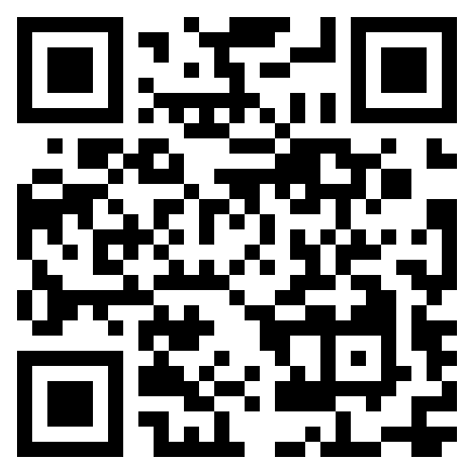
How will you apply QFT with your students?
PLAN
Tools to help:
RQI features AP-TIP Science Team
Education resources at rightquestion.org
Steps & video guide
Classroom video
Examples
Lesson planning workbook
LESSON SNAPSHOT: CLIMATE
Other ways to use QFT
Notes:
katy show the site, how to register

Slide 38
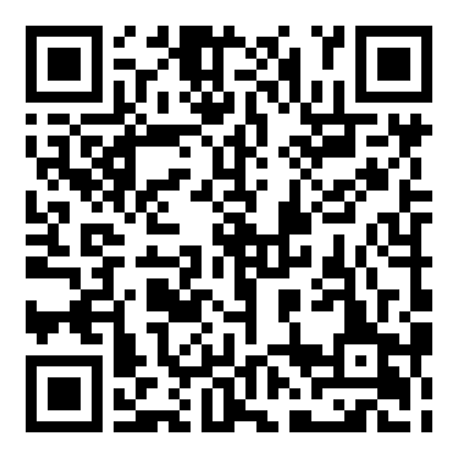
Resource for Teachers
PLAN
Make Just One Change —Dan Rothstein & Luz Santana
https://rightquestion.org/resources/make-just-one-change/
Notes:
Katy
Mo will share that she did a book study with her team

Slide 39
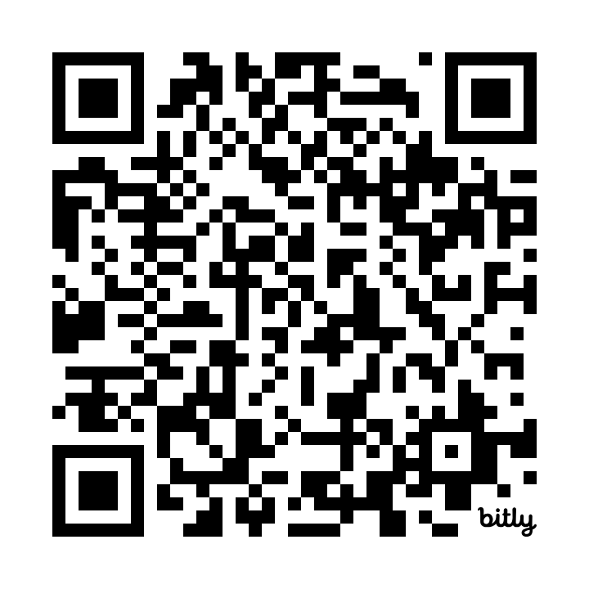
Final Thoughts
REFLECT
QFT Session Survey
https://bit.ly/QFTatNSTASurvey
Question Focuses and Feedback
mmcgrail@nd.edu
katy.connolly@rightquestion.org

Slide 40
Thanks for joining us in exploring QFT!

Slide 41
Source
“The Question Formulation Technique (QFT) was created by the Right Question Institute (rightquestion.org).”

Slide 42
Event Links
https://bit.ly/QFTatNSTA
Notes:
Katy

