Slide 1
The Power of Question Formulation for Scientific Innovation, Agency, and Identity
Maame Conduah
Education Program Associate, The Right Question Institute
Sarah Westbrook
Director of Professional Learning, The Right Question Institute
Anne Hibrar
STEAM Building Coach, Incarnate Word Academy
Notes:
BREAKOUT SESSION

Slide 2
Who is in the room?
Notes:
could do a show of hands people in the room, who teaches k-5? 6-8? 9-12? Other? Who has heard of the QFT before? Who is hearing it for the first time?

Slide 3
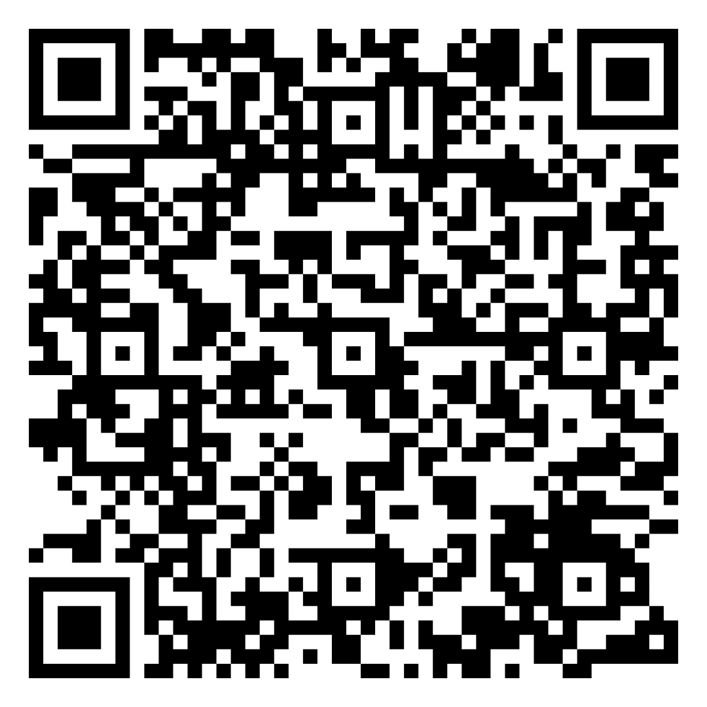
Find Today’s Slides & Free QFT Resources
Today’s materials:
https://tinyurl.com/RQISECO
RQI’s full free resource library: https://rightquestion.org/education/resources
Classroom Examples
Instructional Videos
Planning Tools & Templates

Slide 4
Use and Share These Free Resources
The Right Question Institute offers materials through a Creative Commons License. You are welcome to use, adapt, and share our materials for noncommercial use, as long as you include the following reference:
“Source: The Right Question Institute (RQI). The Question Formulation Technique (QFT) was created by RQI. Visit rightquestion.org for more information and free resources.”

Slide 5
Today’s Agenda
The Question Formulation Technique (QFT) in Real Science Classrooms
How to Plan a QFT Lesson
Collaborative Lesson Planning
Closing and Reflection

Slide 6
The Question Formulation Technique (QFT)

Slide 7
The Question Formulation Technique (QFT)
Ask as many questions as you can
Do not stop to discuss, judge or answer
Record exactly as stated
Change statements into questions
Question Focus
Produce Your Questions
Follow the rules
Number your questions
Improve Your Questions
Categorize questions as Closed or Open-ended
Change questions from one type to another
Strategize
Prioritize your questions
Action plan or discuss next steps
Share
Reflect
Closed-Ended:
Answered with “yes,” “no” or one word
Open-Ended: Require longer explanation
Source: The Right Question Institute rightquestion.org

Slide 8
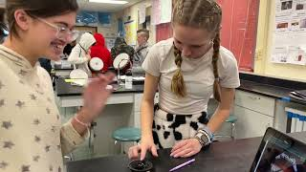
Tailoring the QFT to Achieve Science Standards

Slide 9
Discuss
With one or two people seated near you, please discuss your observations from the video:
What is the teacher doing? What are the students doing?
What did the video add to you understanding of the QFT?
How do you see applying this in your context?

Slide 10
QFT Facilitation Principles
Monitor student adherence to the process
Do not give examples
Do not get pulled into group discussion
Acknowledge all contributions equally
Discuss: What could be challenging about each principle? What might be important about each?

Slide 11
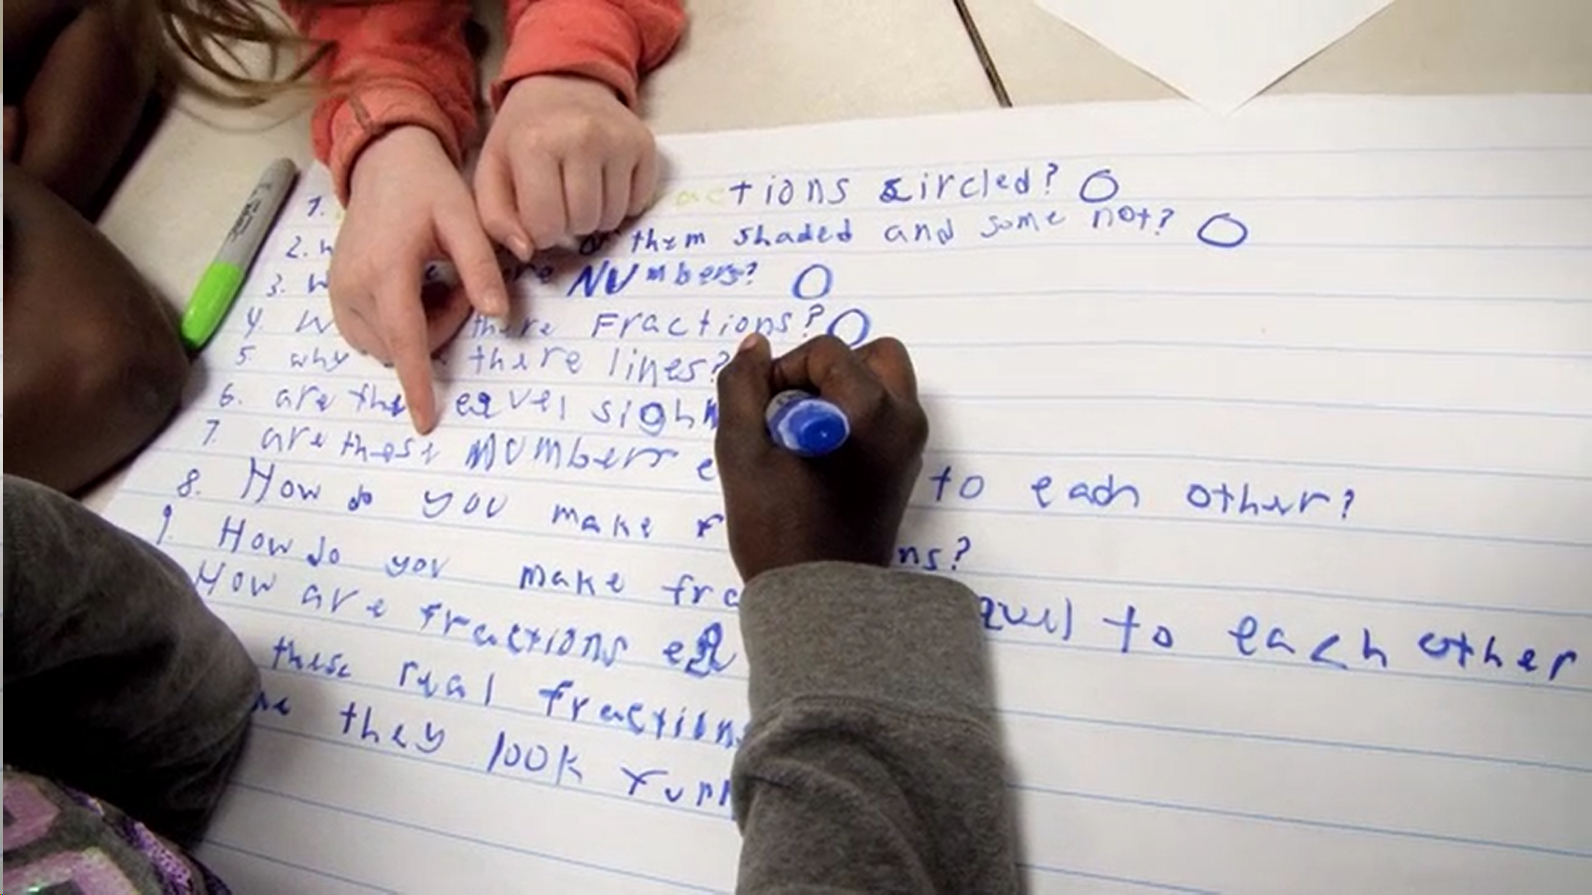
Exploring Classroom Applications & Student Work

Slide 12
Classroom Example: 2nd Grade Interdisciplinary
Teacher: Anne Hribar, Parma Heights, OH
Topic: Sustainability
Purpose: To launch the unit on stewardship and learn what students already understand about waste

Slide 13
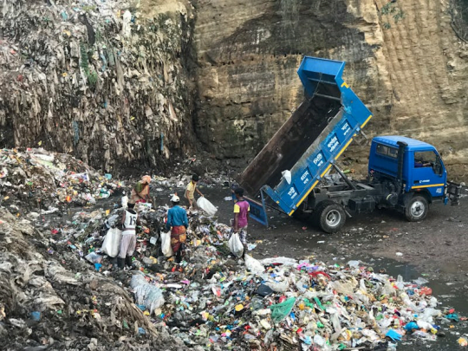
Question Focus

Slide 14
Classroom Example: Middle School
Teacher: Anne Hribar, Parma Heights, OH
Topic: Diet and nutrition
Purpose: To engage students at the start of a new unit and embed a greater understanding of data across the curriculum

Slide 15
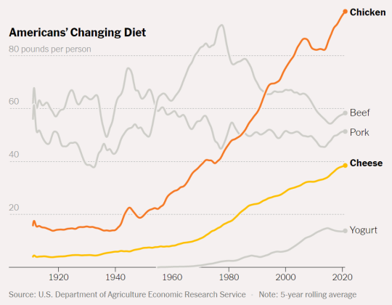
Question Focus

Slide 16
Classroom Example: High School Physics
Teacher: Rachel Riemer, Cambridge, MA
Topic: Relationship between angle of incline and acceleration
Purpose: For students to develop their own question to investigate in a lab

Slide 17
Question Focus
Motion on an incline
Notes:
Mention that students had previewed the lab station prior to this. Not intentional; she originally tried the whole station as the QFocus, but the questions had led mostly to questions about parts and pieces, etc.
Next iteration, just drawing cart on incline on board, but realized that putting cart at the top of the incline implied only motion “down” the incline, so finally landed on sketch with arrow up and down incline.

Slide 18
Selected Student Questions
Is there uniform acceleration?
Are we measuring a specific incline?
Are you going up or down?
Did Isaac Newton discover the equation for it?
Does weight matter for the motion?
Is there a starting velocity?
Is gravity involved?
How long are you traveling for on the incline?
Does the shape of the object affect motion?
How much friction is there?
Can the tracks be put on an incline?
Does the angle affect the acceleration exponentially?
Is there any other form of resistance (besides possibly friction)?
How would a non-uniform incline be represented on a velocity graph?
Can you use the same equations?
What effect would air resistance have on the motion?
How much energy is required to move up on an incline?
Is there a maximum speed you can reach when going down an incline?
Is there a minimum speed when going up?
Does weight change the coefficient of acceleration up an incline/down an incline/on an incline?

Slide 19
Next Steps with Student Questions
Students prioritized with the instructions, “If you were to design a lab, which question would you design a lab around, and why?”
Students then designed a lab to answer their question.
Student pairs identified dependent variable(s), independent variable(s), and the set up for their experiment.
Over the course of the next few days, they experimented and collected data.
Students presented the process and final results to the class.
Notes:
Most groups ended up choosing very similar questions.
All groups used the same materials for the experiment.

Slide 20
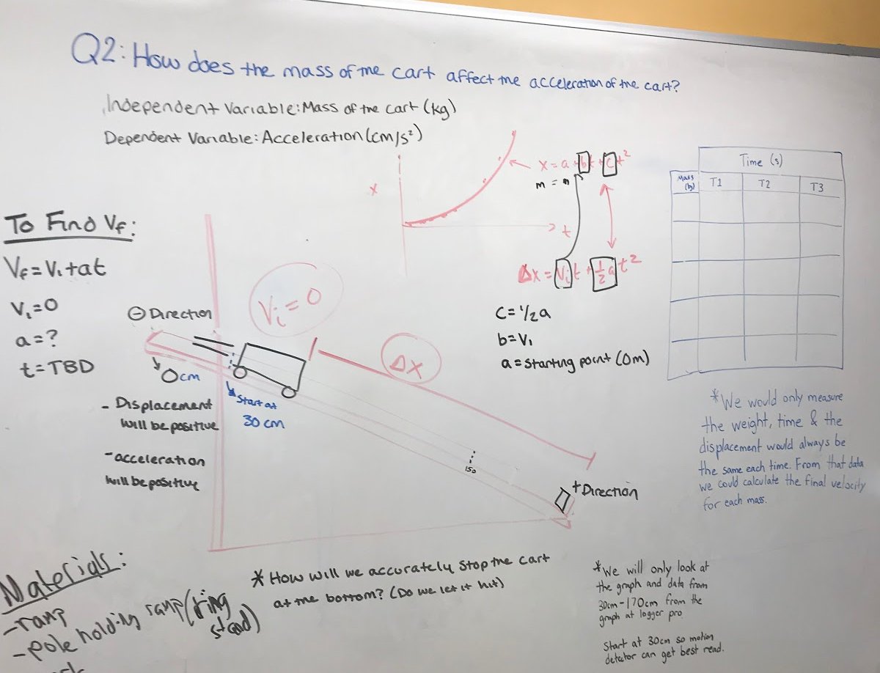
Next Steps with Student Questions
Does the angle of the incline affect the acceleration exponentially?
What would the velocity and position graphs of an object moving up and down an incline look like?

Slide 21
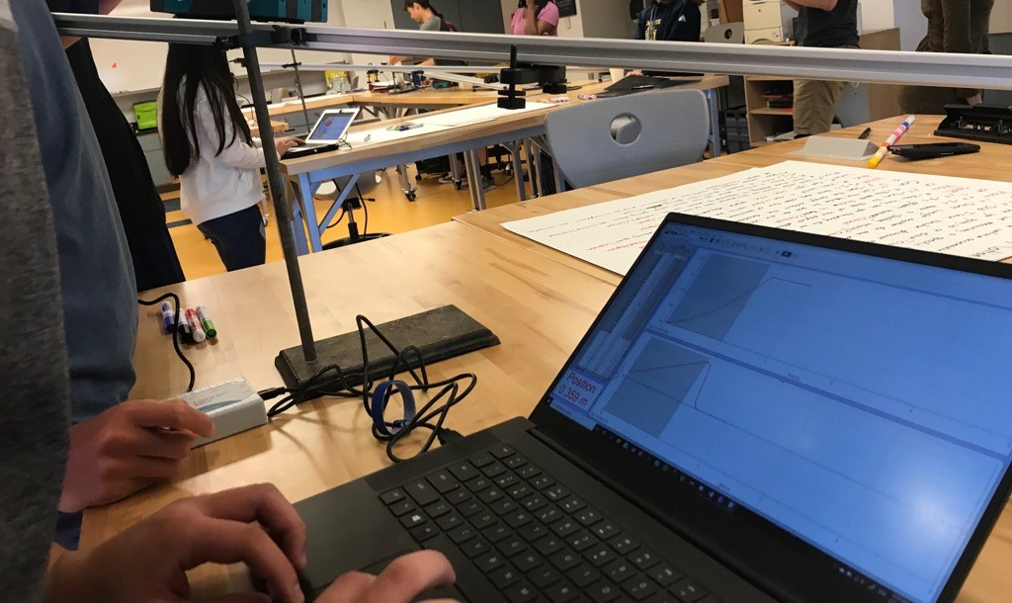
Students Improve and Add Questions
Altering The Question Based On Our Experiment:
While initially all agreeing on the question, we did not have the same understanding of what exponential meant. As a result, solving this question naturally morphed into a simpler question: What is the relationship between incline angle and acceleration?
Outcome:
We weren't able to see what that relationship might be. As a result, while generating our second set of questions, we decided to settle on the question of “do multiple lines appear to satisfy the points?” In an effort to answer this question, we thought that more data points would be helpful, so for our next course of action, we collected more points.

Slide 22
Classroom Example: High School Environmental Science
Teacher: Sara Stephenson, Ontario, Canada
Topic: Climate change
Purpose: To generate questions of interest for a mini research project
Notes:
save for workshop?

Slide 23
Question Focus
River 1, position 16, altitude 707 m, Greenland ice cap melting area],

Slide 24
Selected Student Questions
How cold is the water?
Is there any animals there? or people?
Why did the water melt in a cold area?
How might global warming affect the glacier?
How warm/cold is it?
Why didn’t the snow melt with the water?
How much has the temperature changed?
Why is there snow if the ice is melting?
Is the ice melting?
How fast does the ice melt?
Is the change in temperature the cause of the ice melting?
How long does the water go for?
Is this natural?
Where was this picture taken?
Is the water getting deeper?
Or does it drain somewhere?
What is the black stuff?
How dense is the atmosphere there?
Did it always look like this?
How long does it take to melt?
What time of year is this?
Is it ever sunny out?
How thick is the glacier?
Does it get thinner when it melts?
Is the environment dying?
What is the average temperature for each month?
Where does the water lead to?
How fast is it melting?
Is the ice melting?
What is under the ice?
How does ice melting affect humans?

Slide 25
Next Steps with Student Questions
Students did research to answer a priority question and share in a class slide deck.
Students created short 3-5 minute informative videos climate change & human health.
Notes:
Full lesson plan can be found here: https://rightquestion.org/resources/lesson-snapshot-qft-primary-sources-in-a-10th-grade-science-class/
Students did internet research to answer one of their priority questions and share it in a class slide deck.
From the information collected, the class will extract any ideas, words, or phrases that need further investigation
Students will look at the causes and effects of climate change in more detail for homework and create short 3-5 minute informative videos that highlight how climate change can negatively impact human health.

Slide 26
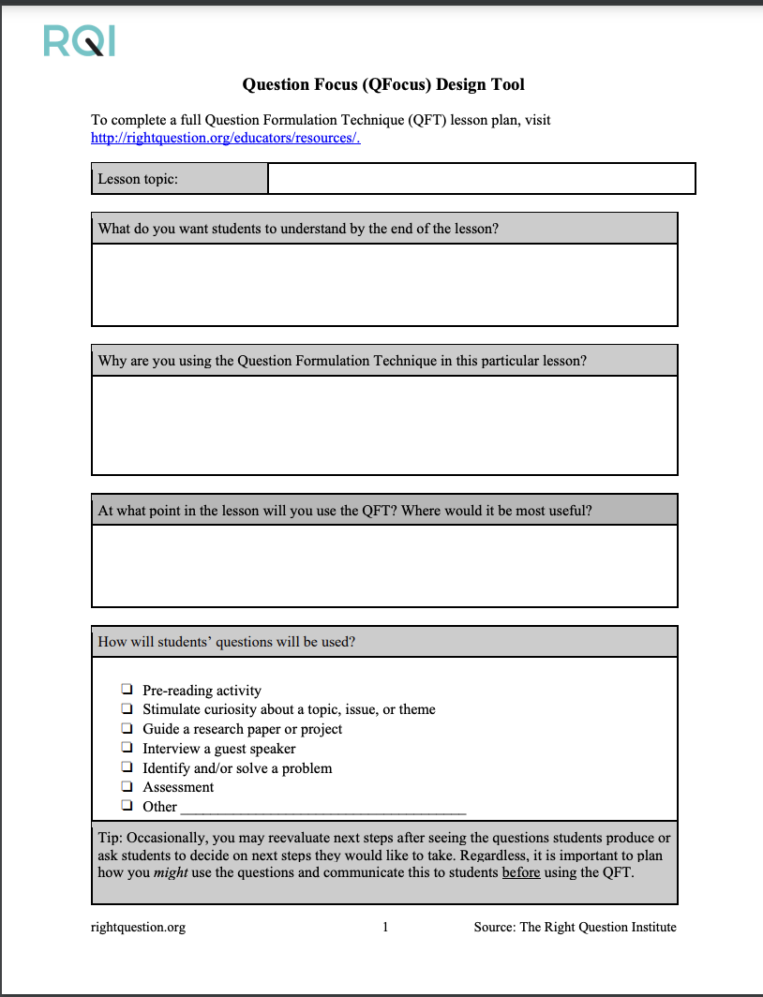
Moving into Action: Lesson Planning with the QFT

Slide 27
1. Identify your objectives

Slide 28
Various Teaching Purposes
Engagement
Research
Formative assessment
Summative assessment
Peer review
Skill development
Problem-solving
Is the QFT the right tool for your objective?
How will you make use of the questions students ask?

Slide 29
Finding the Scale that Works for You
Start here!
Large scale, weeks- long civic action project or PBL unit
5 minute
“Do Now”
50-minute class activity
A multi-day research process
15 minute brainstorm before guest speaker arrives
Student- designed lab investigation
Students generate unit-long essential questions that are answered over course of unit

Slide 30
How can you use students’ questions?
Pop Quiz or Reading Check
Lab work & Experiments
Exit ticket or ”Do Now”
Paper topic
Hang on walls,
Check Off as Answered
Research
Projects
Test Prep
And sometimes…
Nothing!
Presentations
Homework
Class discussion prompts
Student Choice Projects
Socratic Seminar Prompts
Interview an Expert
Make Your Own Final Test
Journal Prompt
Guest speakers
Close Reading Protocol
Year-long or Unit-long Essential Questions
Tailoring Instruction
Service Action Projects

Slide 31
2. Design a Question Focus (QFocus)

Slide 32
Question Focus (QFocus):
A stimulus or prompt for student questions
A phrase or quotation
An image or video
A primary source
A podcast or speech
A hands-on experience or experiment
An equation or data set
The QFocus is not a question!

Slide 33
Designing a Question Focus
An effective QFocus is:
Directly tied to lesson’s main idea or objective
Simple…but not too simple
Interesting or provocative to students…but not biased or leading
Not a question!

Slide 34
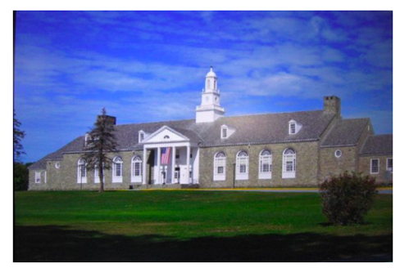
Initial Question Focus
Student Questions: 1. Why does it look so old?
2. Why does the school have a Fallout Zone?
3. Why is there a flag hanging upside
down?
4. How old is the building?
5. Why are the classrooms numbered?
6. How many acres does it take up?
7. Why are there so many windows?
8. Why is there 4 big pillars at the
front?
9. What is the big tower at the top?
10. Why are we being fit into one
building?
11. When was the school made?
12. How much money did it cost to build it?
13. Why does it look like so many parts put together?
14. What is that white thing on top?
15. Why does it have 2 chimneys?
16. What is the point of lockers?
17. Who was the first principal?
18. Who is the boss of the superintendents?
Context: 6th Grade. The teacher designed this QFocus to elicit questions students might have related to their first few days of middle school. (the image is the exterior of their middle school building)

Slide 35
Initial Question Focus: “People, Animals, and Friends”
Do people exist?
Where do people live?
Why do animals live in the zoo?
Why do people go to the pool?
Why are friends fun?
Why do animals bite?
Why do people go to school?
Do people, animals, and friends play together?
Do animals make friends?
Why do I need friends?
Why do people want to be friends with animals?
Why are people making friends with animals?
Why do people, animal, and friends live in different countries?
Where did my dog and friend go?
Can my friend pet our new dog?
Why do I have eyes?
How do people smell?
Can animals speak?
Can people fly?
Where is my bunny? What happened?
Notes:
1st Grade

Slide 36
Initial Question Focus
Notes:
Maybe middle school

Slide 37
Revised Question Focus
“How you behave online is how your are in real life. That’s you. There’s no separation. You are a person who says those kind of things.”
– Mitch Gerads

Slide 38
QFocus Testing
Think: How do you envision moving into action? What content do you/will you teach that could benefit from student questions? How could students move into action too?
Work: Complete the QFocus design tool (tinyurl.com/RQISECO). It is ok if it is bit rough!
Share: Find 1-2 people at your table to trade QFocus drafts with. Ask the first few questions that come to mind about their QFocus (not the context, lesson objectives, etc). Follow the 4 rules!
Debrief: Discuss with your partner(s) and revise as needed. Are those the questions you’re hoping students might ask? If not, why not?
Notes:
Once you have a draft QFocus, we encourage you to complete the rest of the lesson planning workbook (find it posted online on the event webpage tinyurl.com/RQISECO) to fill out the rest of the lesson details

Slide 39
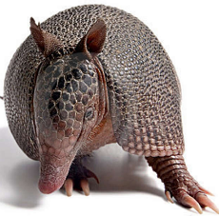
The one quality all excellent QFT designers share?
Thick Skin.

Slide 40
Closing Reflections

Slide 41
Closing Reflections
How are you planning to use the QFT?
What, in your opinion, do students need to be able to ask questions?
Please try to respond in one word and share your response on MENTIMETER.
Use the QR code or
go to Menti.com and enter code: 3699 9127

Slide 42
Resources
Access Today’s Powerpoint & Other Resources:
Powerpoint: https://tinyurl.com/RQISECO
Question Focus Design Tool
Lesson Planning Workbook
QFT on One Slide
RQI’s Free Resource Library: rightquestion.org

Slide 43
Find us on social media!
@rightquestion
facebook.com/rightquestion
@right_question
Email us: education@rightquestion.org

Slide 44
Evaluation
https://tinyurl.com/RQI-SECO-EVAL

