Slide 1
The Power of Question Formulation for Scientific Innovation, Agency, and Identity
Sarah Westbrook
Director of Professional Learning
The Right Question Institute
Cambridge, MA
Maame Conduah
Program Associate
Notes:
KEYNOTE

Slide 2
Today’s Agenda
Why spend time teaching the skill of question formulation?
Collaborative Learning with the Question Formulation Technique (QFT)
Exploring Real Classroom Applications & Student Work
Final Reflections

Slide 3
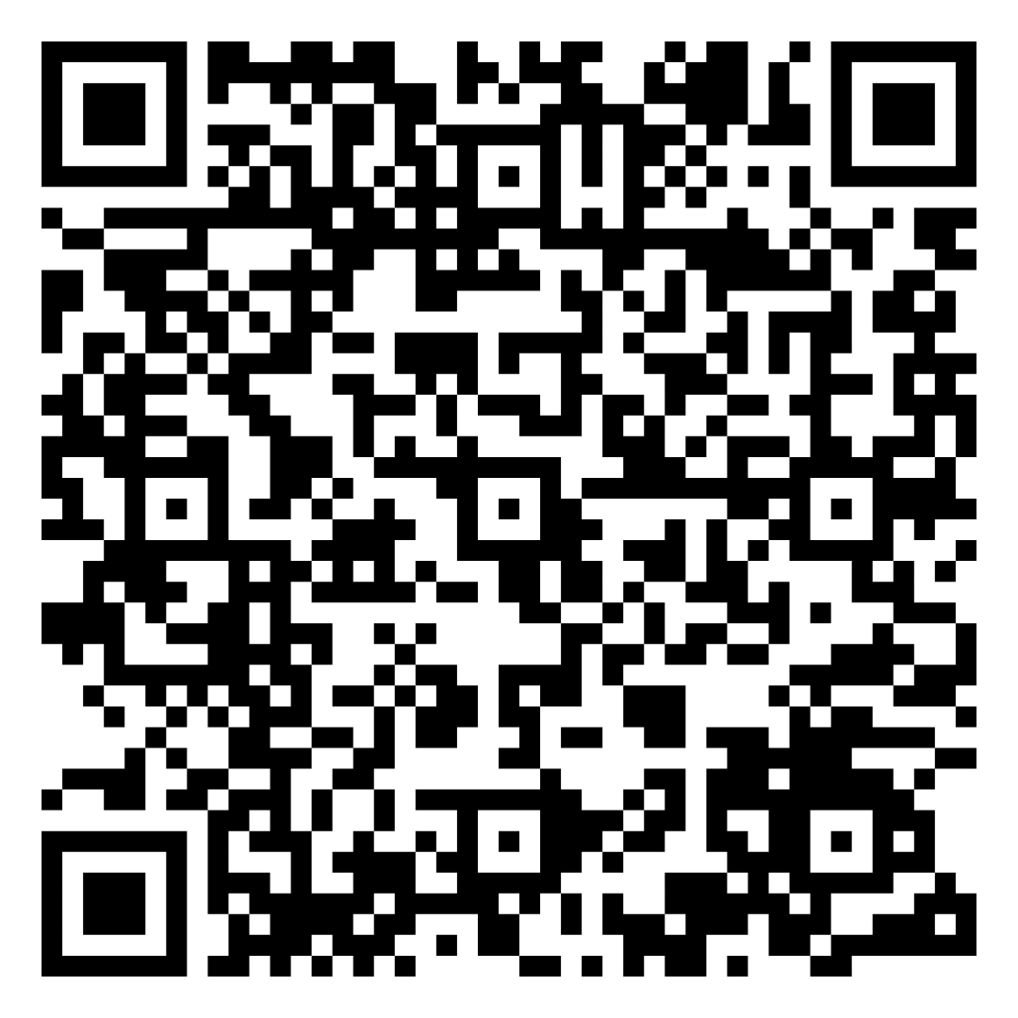
Find Today’s Slides & Free Resources
Today’s materials:
https://tinyurl.com/RQISECO
RQI’s full free resource library: https://rightquestion.org/education/resources
Classroom Examples
Instructional Videos
Planning Tools & Templates

Slide 4
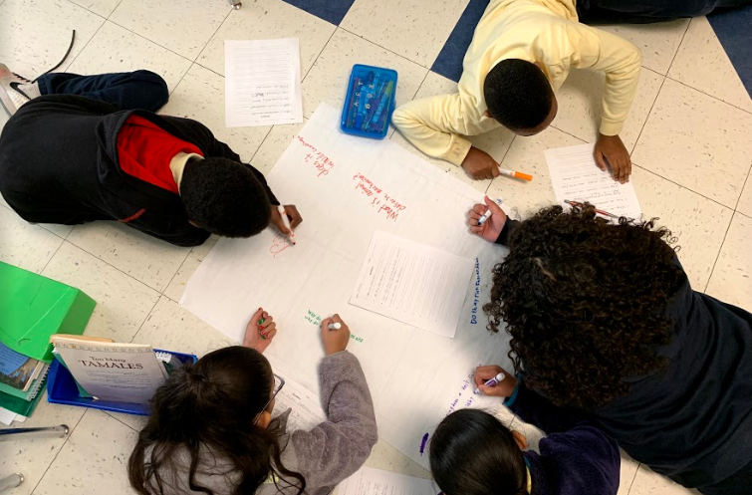
Why spend time teaching the skill of question formulation?

Slide 5
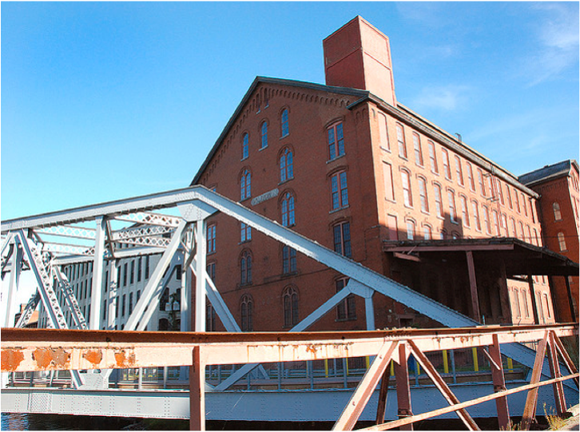
Origin of The Right Question Institute:
Parents in Lawrence, Massachusetts, 1990
“We don’t go to the school because we don’t even know what to ask.”

Slide 6
"There is no learning without having to pose a question."
- Richard Feynman
Nobel Laureate, Physics, 1965

Slide 7
“We must teach students how to think in questions, how to manage ignorance.”
– Stuart Firestein
Former chair, Department of Biology,
Columbia University

Slide 8
Curiosity and the Path to Science
“Curiosity is a fundamental predictor of the aspiration to become a scientist.”
Adele and Allen Gottfried
California State University
Fullerton Longitudinal Study (FLS), a 30-plus year study of the development of giftedness across various points in time
Notes:
The Fullerton Longitudinal Study (FLS), a 30-plus year study of the development of giftedness across various points in time conducted by Adele and Allen Gottfried of California State University ”This finding has strong implications for the development of STEM considering that curiosity is a fundamental predictor of the aspiration to become a scientist.”
https://www.theatlantic.com/education/archive/2017/07/the-underrated-gift-of-curiosity/534573/

Slide 9
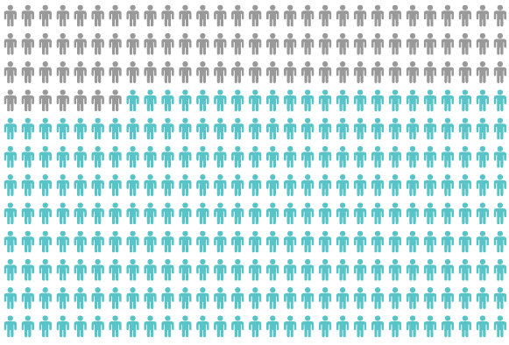
Yet, Only 27% of Graduates Believe College Taught Them How to Ask Their Own Questions
Alison Head, Project Information Literacy at University of Washington, 2016

Slide 10
Question Asking Declines with Age
Tizard, B., Hughes, M., Carmichael, H., & Pinkerton, G. (1983).
Pearson, J.C. & West, R. (2009)

Slide 11
We can work together on making sure all students are asking questions

Slide 12
We are not alone
Now in more than 1 million classrooms worldwide

Slide 13
What happens when students do learn to ask their own questions?

Slide 14
Research Confirms The Importance of Questioning
Self-questioning (metacognitive strategy):
Student formulation of their own questions is one of the most effective metacognitive strategies
Engaging in pre-lesson self-questioning improved students rate of learning by nearly 50% (Hattie, p.193)
John Hattie
Visible Learning: A Synthesis of Over 800
meta-Analyses Relating to Achievement, 2008
Notes:
UC Davis Research Linking Curiosity to Memory (UC Davis) 2014

Slide 15
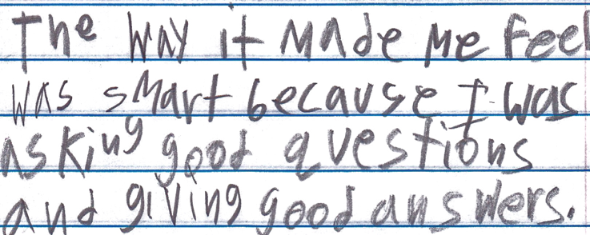
Student Reflection
“The way it made me feel was smart because I was asking good questions and giving good answers.”
Boston 9th grade summer school student

Slide 16
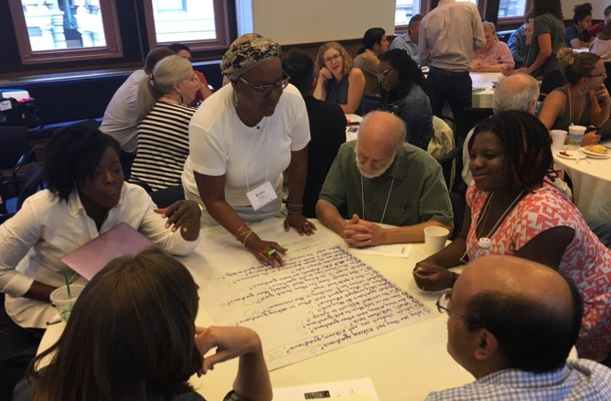
Collaborative Learning with the Question Formulation Technique (QFT)

Slide 17
The Question Formulation Technique (QFT)
Individuals learn to:
Produce their own questions
Improve their questions
Strategize on how to use their questions
Reflect on what they have learned and how they learned it

Slide 18
Rules for Producing Questions
1. Ask as many questions as you can
2. Do not stop to answer, judge, or discuss
3. Write down every question exactly as stated
4. Change any statements into questions
THINK: Which rule may be difficult for you to follow?

Slide 19
Produce Questions
Work with one or two people seated near you. One person will be the notetaker. Then:
Ask Questions
Follow the Rules
Ask as many questions as you can.
Do not stop to answer, judge, or discuss.
Write down every question exactly as it was stated.
Change any statements into questions.
Number the Questions

Slide 20
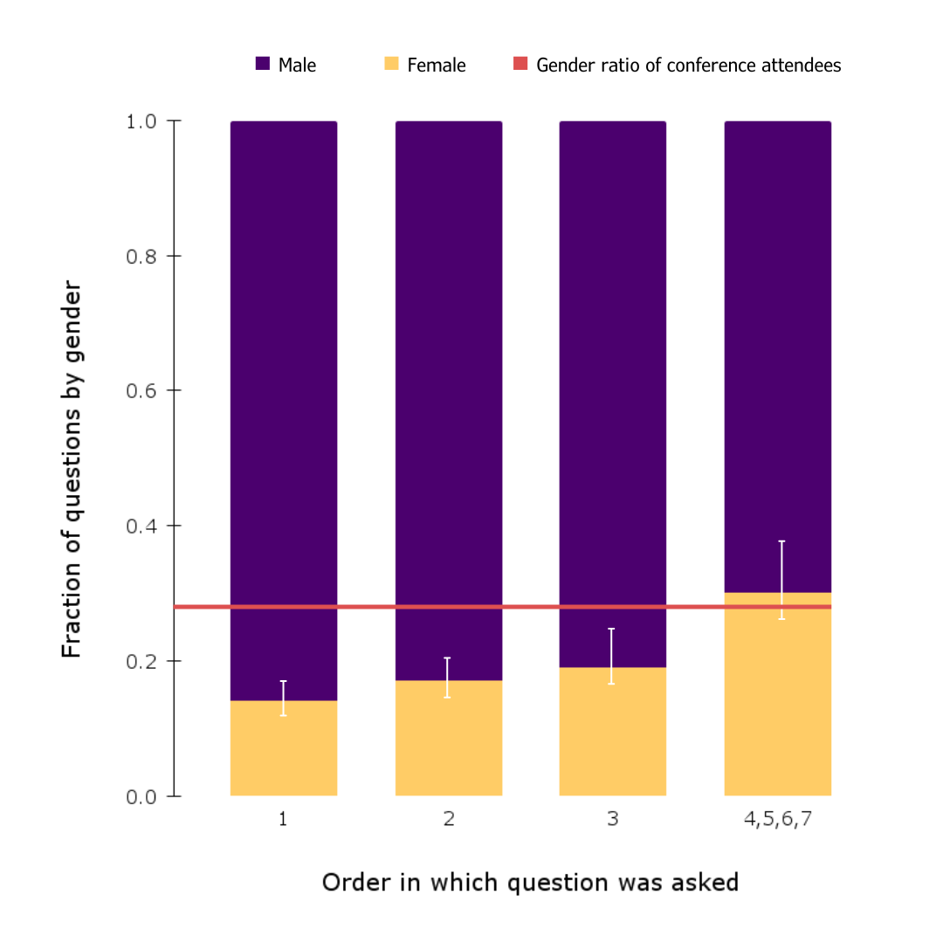
Question Focus
Figure 2. Females tend to ask more questions later. The fraction of male and female questioners are shown for the 1st, 2nd, etc. questions asked after each talk. The first question is predominantly asked by males (86%), but later questions approach the gender ratio of those attending the conference, which is shown by the green horizontal line (28% female).
Figure from Pritchard et al. 2014, who studied scientists attending a large professional conference.
Directions:
Number your questions.
Ask as many questions as you can.
Don’t stop to answer, judge, or discuss.
Record each question exactly as it was stated (or first came to mind).
Change any statements into questions.
Notes:
https://doi.org/10.1093/astrogeo/atu245
Pritchard J, Masters K, Allen J, Contenta F, Huckvale L, Wilkins S, Zocchi A. Asking gender questions. Astronomy & Geophysics. 2014. December 1;55(6):6–8.

Slide 21
Categorize Questions: Closed/Open
Definitions:
Closed-ended questions can be answered with a “yes” or “no” or with a one-word answer.
Open-ended questions require
more explanation.
Directions:
Identify your questions as closed-ended or open-ended by marking them with a “C” or an “O.”
Then, discuss the advantages AND disadvantages of BOTH closed-ended and open-ended questions.

Slide 22
Both Closed and Open Questions Are Good!
Open-Ended Questions
encourage discussion & multiple perspectives
have many possible “right” answers
can build empathy and active listening
Closed-Ended Questions
clarify and build context
can be effective follow up questions
useful for data collection and testing hypotheses
crucial for self-advocacy and holding decision makers accountable

Slide 23
Improve & Prioritize Questions
Take one closed-ended question and change it into an open-ended question. Add it as a new question to your list.
Take one open-ended question and change it into a closed-ended question. Add it as a new question to your list.
Then, review your list and star 3 questions you are most curious about. Discuss why you chose those questions.
Closed
Open
Open
Closed

Slide 24
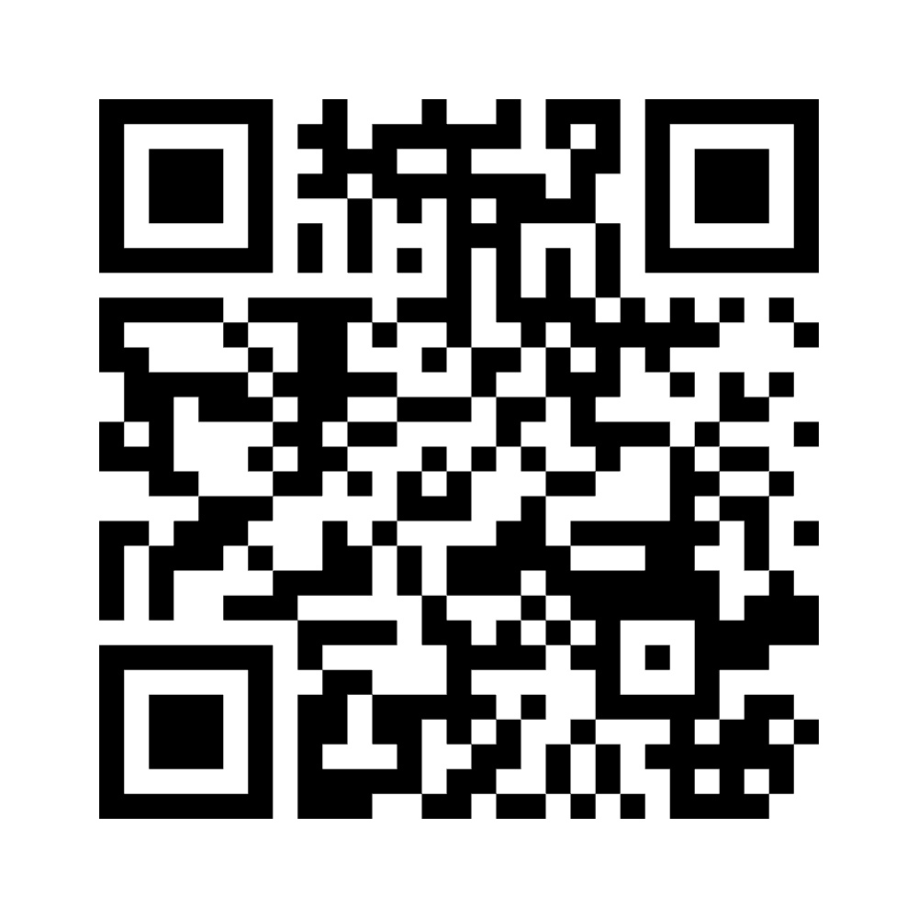
Share
Please share any ONE of your group’s priority questions using a tool called Mentimeter:
Use the QR code below
or go to Menti.com and enter the code: 7641 2894
Notes:
https://www.menti.com/al8vzgpycmjy

Slide 25
What is “Pritchard et al. 2014”?
2014 National Astronomy Meeting in the United Kingdom, the largest professional astronomy meeting in Europe with 600+ attendees
Key findings:
Women asked 10% fewer questions than expected based on the gender ratio of attendees
Males are disproportionately more likely to ask the first question
Females are increasingly likely to ask questions as more questions are asked. For the 4th-7th questions, the gender ratio of people who asked questions were roughly equal to the gender ratio of all attendees.
Limitations:
Gender was observed by researchers and limited to a gender binary
Only about 13% of attendees at these conferences ask questions - it is a limited snapshot of participation and engagement (Zhang et al. 2023)
Notes:
https://doi.org/10.1093/astrogeo/atu245
Pritchard J, Masters K, Allen J, Contenta F, Huckvale L, Wilkins S, Zocchi A. Asking gender questions. Astronomy & Geophysics. 2014. December 1;55(6):6–8.
Article Source: Gender-based disparities and biases in science: An observational study of a virtual conference
Zhang J, Torchet R, Julienne H (2023) Gender-based disparities and biases in science: An observational study of a virtual conference. PLOS ONE 18(6): e0286811. https://doi.org/10.1371/journal.pone.0286811
Another limitation of Pritchard: there were no other identity features or demographics tracked, though there were in subsequent studies.
Note that some subsequent studies used more sophisticated methods to assign gender including self-reported gender in registration lists cross-checked with recordings of Q&A sessions

Slide 26
Findings Confirmed by Subsequent Studies
Men ask disproportionately more questions than women in adult professional learning settings ( ~1.8 times as many)
Across disciplines: Astronomy, Psychology, Biology, Mathematics, Human Genetics, Philosophy, Conservation Biology, Communications
In the UK, the United States, France, and Germany
Across age groups and seniority (Hinsley et al. 2017, Zhang et al. 2023)
In evenly balanced audiences, male-majority audiences, and in female-majority audiences (Telis et al. 2019 found that even when women comprised 67% of the audience, they asked 45% of the questions)
In virtual and in person settings (Zhang et al. 2023)
When the study was performed blind or participants had pre-knowledge (Hinsley et al. 2017)
Notes:
and large and small conferences (100 ish to 4000+)
Zhang et al. 2023 also found that the disparity held in both audio and chat box questions (though the gender disparity was even greater among audio comments)
Hinsley A, Sutherland WJ, Johnston A (2017) Men ask more questions than women at a scientific conference. PLOS ONE 12(10): e0185534. https://doi.org/10.1371/journal.pone.0185534
Public Discussion Affects Question Asking at Academic Conferences Telis, Natalie et al. The American Journal of Human Genetics, Volume 105, Issue 1, 189 - 197
https://www.cell.com/ajhg/fulltext/S0002-9297(19)30229-0
Zhang J, Torchet R, Julienne H (2023) Gender-based disparities and biases in science: An observational study of a virtual conference. PLOS ONE 18(6): e0286811. https://doi.org/10.1371/journal.pone.0286811

Slide 27
Research Suggests Possible Solutions
Create time for more total questions
As the number of questions increases, the fraction asked by women increases. When 6 or more questions are asked, the fraction mirrors the attendance gender ratio. (Schmidt & Davenport 2017)
When there were fewer questions total, women asked proportionally fewer questions. (Carter et al. 2018)
Call on a woman first
When a man was the first to ask a question, women asked proportionally fewer questions. (Carter et al. 2018)
Men were more likely than women to be among the first four audience members to offer remarks (Jarvis et al. 2022)
Notes:
Carter AJ, Croft A, Lukas D, Sandstrom GM (2018) Women’s visibility in academic seminars: Women ask fewer questions than men. PLoS ONE 13(9): e0202743. https://doi.org/ 10.1371/journal.pone.0202743
https://journals.plos.org/plosone/article/file?id=10.1371/journal.pone.0202743&type=printable
Jarvis, S. N., Ebersole, C. R., Nguyen, C. Q., Zhu, M., & Kray, L. J. (2022). Stepping Up to the Mic: Gender Gaps in Participation in Live Question-and-Answer Sessions at Academic Conferences. Psychological Science, 33(11), 1882-1893.
https://doi.org/10.1177/09567976221094036
Schmidt, S., Davenport, J. Who asks questions at astronomy meetings?. Nat Astron 1, 0153 (2017). https://doi.org/10.1038/s41550-017-0153

Slide 28
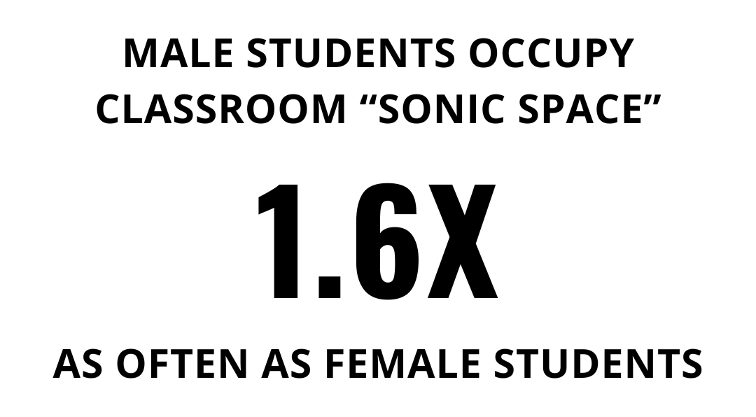
What are the implications for STEM teachers?
Carter et al. 2018: Lee & Mccabe 2021:
Notes:
Lee & MCcabe looked at humanities, social sciences, and natural sciences classes over a multi-month period at an elite college in the US, included some majority female classes. They did not observe a “statistically significant” sample of voluntary student questions.
Carter et al looked at 250 seminars in 10 countries biology, psychology, and philosophy (but primarily biology and psychology), most seminars had evenly balanced gendered audience
Lee & Mccabe noted that (surprise, surprise) the facilitation methods and classroom structures employed by the professor mattered a great deal.
Carter AJ, Croft A, Lukas D, Sandstrom GM (2018) Women’s visibility in academic seminars: Women ask fewer questions than men. PLoS ONE 13(9): e0202743. https://doi.org/ 10.1371/journal.pone.0202743
https://journals.plos.org/plosone/article/file?id=10.1371/journal.pone.0202743&type=printable
Lee, J. J., & Mccabe, J. M. (2021). Who Speaks and Who Listens: Revisiting the Chilly Climate in College Classrooms. Gender & Society, 35(1), 32-60. https://doi.org/10.1177/0891243220977141

Slide 29
What are the implications for STEM teachers?
Ruling Our eXperiences (ROX) 2024 survey of 17,502 5th-12th grade girls:
From: https://www.rulingourexperiences.com/research
Notes:
Ruling Our eXperiences (ROX) surveyed 17,502 girls 5th through 12th grade
https://www.rulingourexperiences.com/research
Based in Columbus, OH
2024 Report: https://static1.squarespace.com/static/62f55ec3c3784d0f3ec88011/t/67066baf5d540a70293d2647/1728474034072/The+Girls%27+Index%E2%84%A2+Girls+%26+STEM+Impact+Report.pdf

Slide 30
As Always, There Are More Questions
What learning experiences and skills build our students’ sense of confidence, agency, self-efficacy?
What modes or expressions of participation and engagement do we value and encourage in school? In professional STEM fields and settings?
How can “airtime” be shared equitably? How do we ensure every student has a chance to voice what they are curious about?
What kinds of questions are heard, by whom, in what settings?

Slide 31
Reflect
What did you learn?
How did you learn it?
And, what questions do you now have?
Please share a response on MENTIMETER:
Use the QR code
or go to Menti.com and enter the code:
7641 2894
Notes:
Individually

Slide 32
A Look Inside the QFT Process

Slide 33
The QFT, on one slide…
Ask as many questions as you can
Do not stop to discuss, judge or answer
Record exactly as stated
Change statements into questions
Question Focus
Produce Your Questions
Follow the rules
Number your questions
Improve Your Questions
Categorize questions as Closed or Open-ended
Change questions from one type to another
Strategize
Prioritize your questions
Action plan or discuss next steps
Share
Reflect
Closed-Ended:
Answered with “yes,” “no” or one word
Open-Ended: Require longer explanation
Source: The Right Question Institute rightquestion.org
Notes:
This is what makes it question formulation and not “question brainstorming”

Slide 34
Three thinking abilities
with one process

Slide 35
Thinking in many different directions
Divergent
Thinking

Slide 36
Narrowing Down, Focusing
Convergent
Thinking

Slide 37
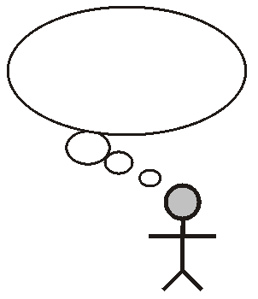
Thinking about Thinking
Metacognition

Slide 38
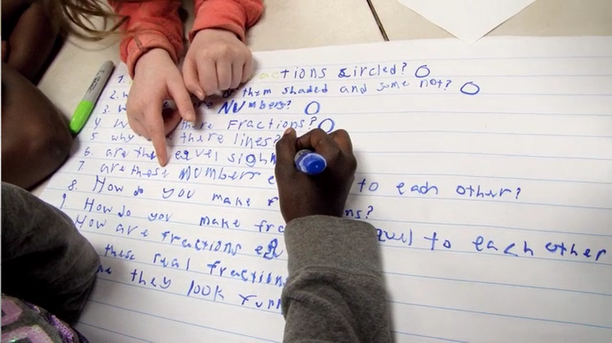
Exploring Classroom Applications & Student Work

Slide 39
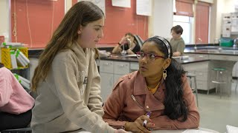
The QFT in a 7th grade Science class

Slide 40
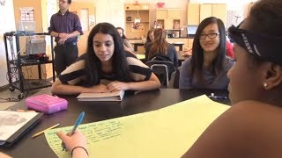
The QFT in a 9th grade Physics class

Slide 41
Classroom Example: High School Chemistry
Teacher: Sara Stephenson, Ontario, Canada
Topic: Physical and chemical properties and changes
Purpose: For students to plan and perform an investigation to test/answer one of their priority questions

Slide 42
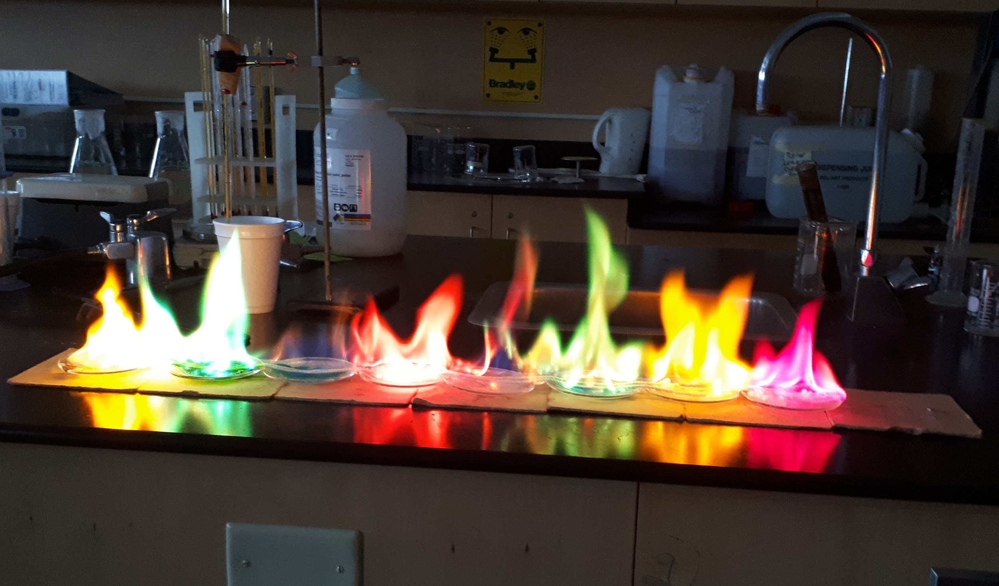
Question Focus (prompt for student questions)

Slide 43
Students’ Priority Questions
What are the substances?
What was the rope being soaked in?
Is there a chemical change occuring?
Why does it change colour?
Was the clear liquid flammable or was it the substances in the watch glass?
What can we do to determine what the substances are?
What causes the different colours?
How did the clear liquid affect the chemical change?
How much of each substance was used?
Why does it become a coloured flame and not a regular flame?
Does there need to be a specific measurement of the liquid and powder to ignite?
Does it change colour because it’s heated?
Notes:
In this case, students generated questions on their own and then each student contributed one priority question to the class list

Slide 44
Next Steps with Student Questions
In groups, students determined which of their priority questions were testable questions or re-wrote them to turn into testable questions
Definition of testable questions: they are always about changing one thing to see what the effect is on another thing. We have to be able to perform an experiment to determine if it’s true or false.

Slide 45
Students’ Revised “Testable” Questions
Does changing the amount of liquid affect the size of the flame?
How does changing the substance affect the colour of the flame?
If the rope is changed, will it affect the flame colour/size?
Does changing the room temperature affect the flame size/colour?
If we were to change one solid, would it affect the flame height?
Does changing how much liquid was used effect how long the experiment lasted?

Slide 46
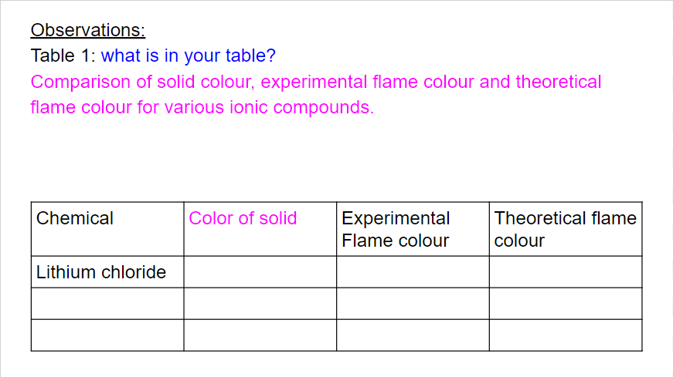
Next Steps with Student Questions
After picking one of their testable questions, student groups designed and carried out an experiment to test it:
Students completed a guided experiment design worksheet.
Students created a table to record observations.
Finally, students analyzed their results and explained if their prediction was correct or not.
Notes:
After picking one of their testable questions, student groups designed an experiment to test it
Groups were prompted to complete a worksheet to help design the experiment:
Purpose
Hypothesis
Materials needed
Students created a table to record their observations
Finally, students analyzed their results and explained if their prediction was correct or not

Slide 47
Classroom Example: AP Physics
Teacher: Rachel Riemer, Cambridge, MA
Topic: Bias in science
Purpose: To begin a class discussion

Slide 48
Question Focus
Bias in science

Slide 49
Selected Student Questions
What are some occurrences?
What topics in science have most bias?
How is bias defined?
Are there different types of biases in science?
How does bias affect experiments and results?
How does bias influence data collection?
Is it possible to be completely bias free?
How to reduce bias?
Why is there bias?
Is bias intrinsic?
Is bias necessarily bad?
How important is the fact that there is bias?
Is it important that there is bias?
When in history did bias in results of experiments affect the public?
How do you quantify bias?
What increases/decreases bias?
What is the trend of bias in science?
More? Less?
Are certain groups of people more easily biased?
What are the certain groups of people?
How can we eliminate bias in high school experiments w/o high tech?
What’s in place now to reduce bias?
Notes:
Students had class discussions based on their questions

Slide 50
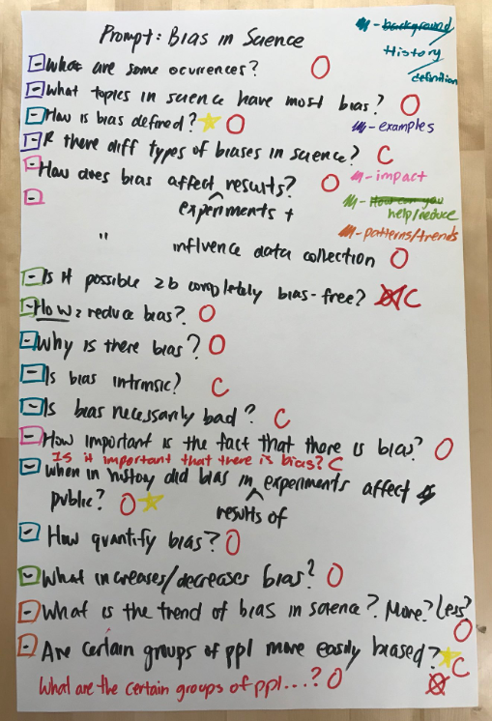
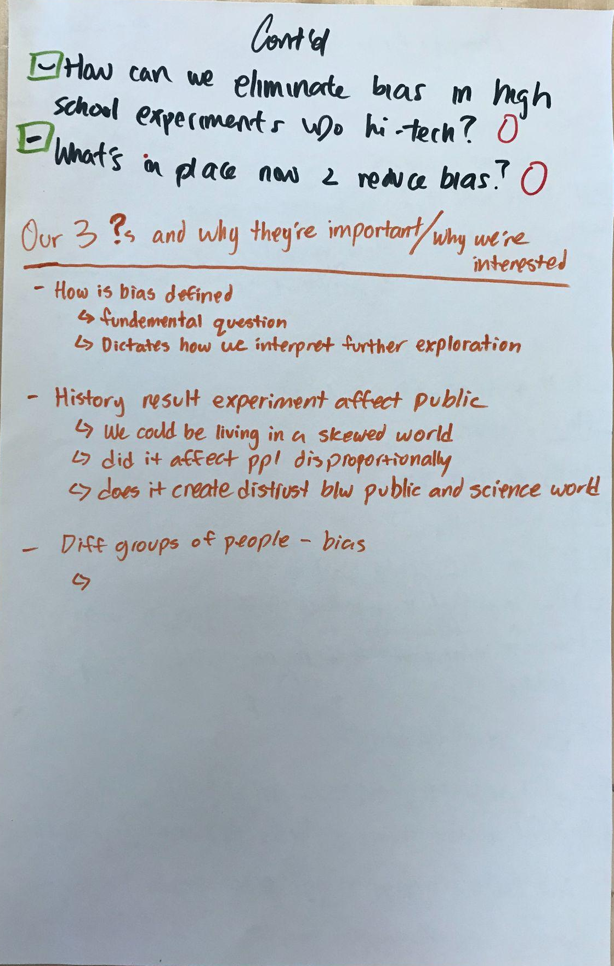
Next Steps with Student Questions
Students identified patterns that emerged from their questions
They categorized their questions into those patterns
Students’ priority questions were used as a class discussion activity
Notes:
- The teacher would use the categorization skill later in the semester for a lab

Slide 51
History/definition
How is bias defined?
Why is there bias?
Is bias intrinsic?
Is bias necessarily bad?
When in history did bias in results of experiments affect the public?
How do you quantify bias?
Impact
How does bias affect experiments and results?
How does bias affect influence data collection?
Help/reduce
Is it possible to be completely bias free?
How do you reduce bias?
What increases/decreases bias?
How can we eliminate bias in high school experiments w/o high tech?
What’s in place now to reduce bias?
Examples
What are some occurrences?
What topics in science have most bias?
Are there different types of bias in science?
Patterns/trends
What is the trend of bias in science? More? Less?
Are certain groups of people more easily biased? (C)
What are the certain groups of people? (O)
Notes:
Students identified patterns that emerged from their questions
They categorized their questions into those patterns
Students’ priority questions were used as a class discussion activity

Slide 52
Why is the skill of question formulation so important now?

Slide 53
In the Age of Google
“How should you respond when you get powerful new tools for finding answers?
Think of harder questions.”
– Clive Thompson
Journalist and Technology Blogger

Slide 54
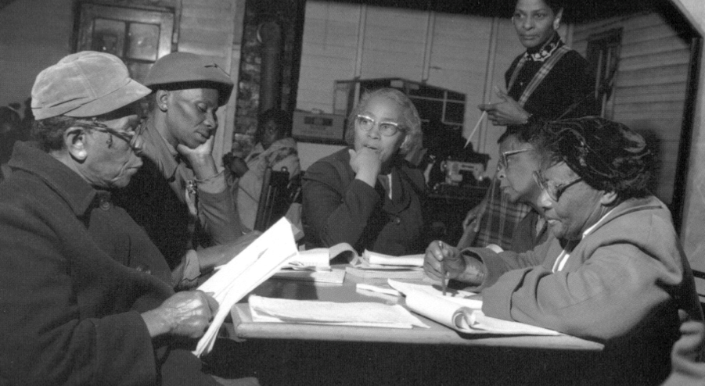
Questions and Democracy
“We need to be taught to study rather than to believe, to inquire rather than to affirm.”
– Septima Clark
Chapter 6 on Septima Clark in Freedom Road: Adult Education of African Americans (Peterson, 1996)

Slide 55
Thank You!
Access Today’s Powerpoint & Other Resources:
Powerpoint: https://tinyurl.com/RQISECO
RQI’s Free Resource Library: rightquestion.org

Slide 56
Stay in touch!
@rightquestion
facebook.com/rightquestion
@right_question
Email us: education@rightquestion.org

Slide 57
Use and Share These Free Resources
The Right Question Institute offers materials through a Creative Commons License. You are welcome to use, adapt, and share our materials for noncommercial use, as long as you include the following reference:
“Source: The Right Question Institute (RQI). The Question Formulation Technique (QFT) was created by RQI. Visit rightquestion.org for more information and free resources.”

Slide 58
Extra Classroom Examples

Slide 59
Classroom Example: 7th Grade Life Science
Teacher: Angela Miklavcic Brandon, Chicago, IL
Topic: Introduction to Animal and Plant Cells
Purpose: To find out what the students already know and generate questions to investigate during the unit.

Slide 60
Question Focus (prompt for student questions)
"The living cell is the most complex system of its size known to mankind."
Notes:
A Question Focus is the prompt or stimulus the teacher gives to students for students to ask questions about.

Slide 61
Selected Student Questions
How big is the cell? (O) → Are cells big? (C)
How long have we known cells?
What is a cell? (C) → What does it do? (O)
How many cells are in the body?
Does the cells change in a woman and man?
Are cells intelligent?
What do cells do?
Do cells help us survive?
Are there different types of cells?
How many different types of cells are there?
Do cells have different characteristics?
Can you see cells?
Where are cells located?
Are cells only in humans?
Do other things (besides animals + humans) have cells?
What conditions can cells live in?
Are cells only on earth?
Are cells in hair, in ears, feet, eyes?
What makes cells survive?
What makes a cell a cell?
What color is a cell?
Do cells have families?
Do cells die?
Do cells thrive in dying organisms? (C) → How do cells die if they do?

Slide 62
Next Steps with Student Questions
The teacher printed out their questions and every couple days throughout the unit students returned to them and crossed out ones that had been answered.
By the end most had crossed off all questions.
On the last day of class when students were finishing up projects at their own pace they could choose a question that was left and research it on their own.

Slide 63
Student Reflections
“I liked the question activity because it helped us generate questions that I don't think I ever would have really thought [of] asking.”
“I liked hearing other people’s questions because it was a good opportunity for me to make more questions in my head and then get even more curious about this cell.”

