Slide 1
Using Curiosity to Converse: How teaching students to ask questions can spur productive dialogue on difficult topics
Katy Connolly
Education Program Coordinator
The Right Question Institute

Slide 2
Who is in the room?

Slide 3
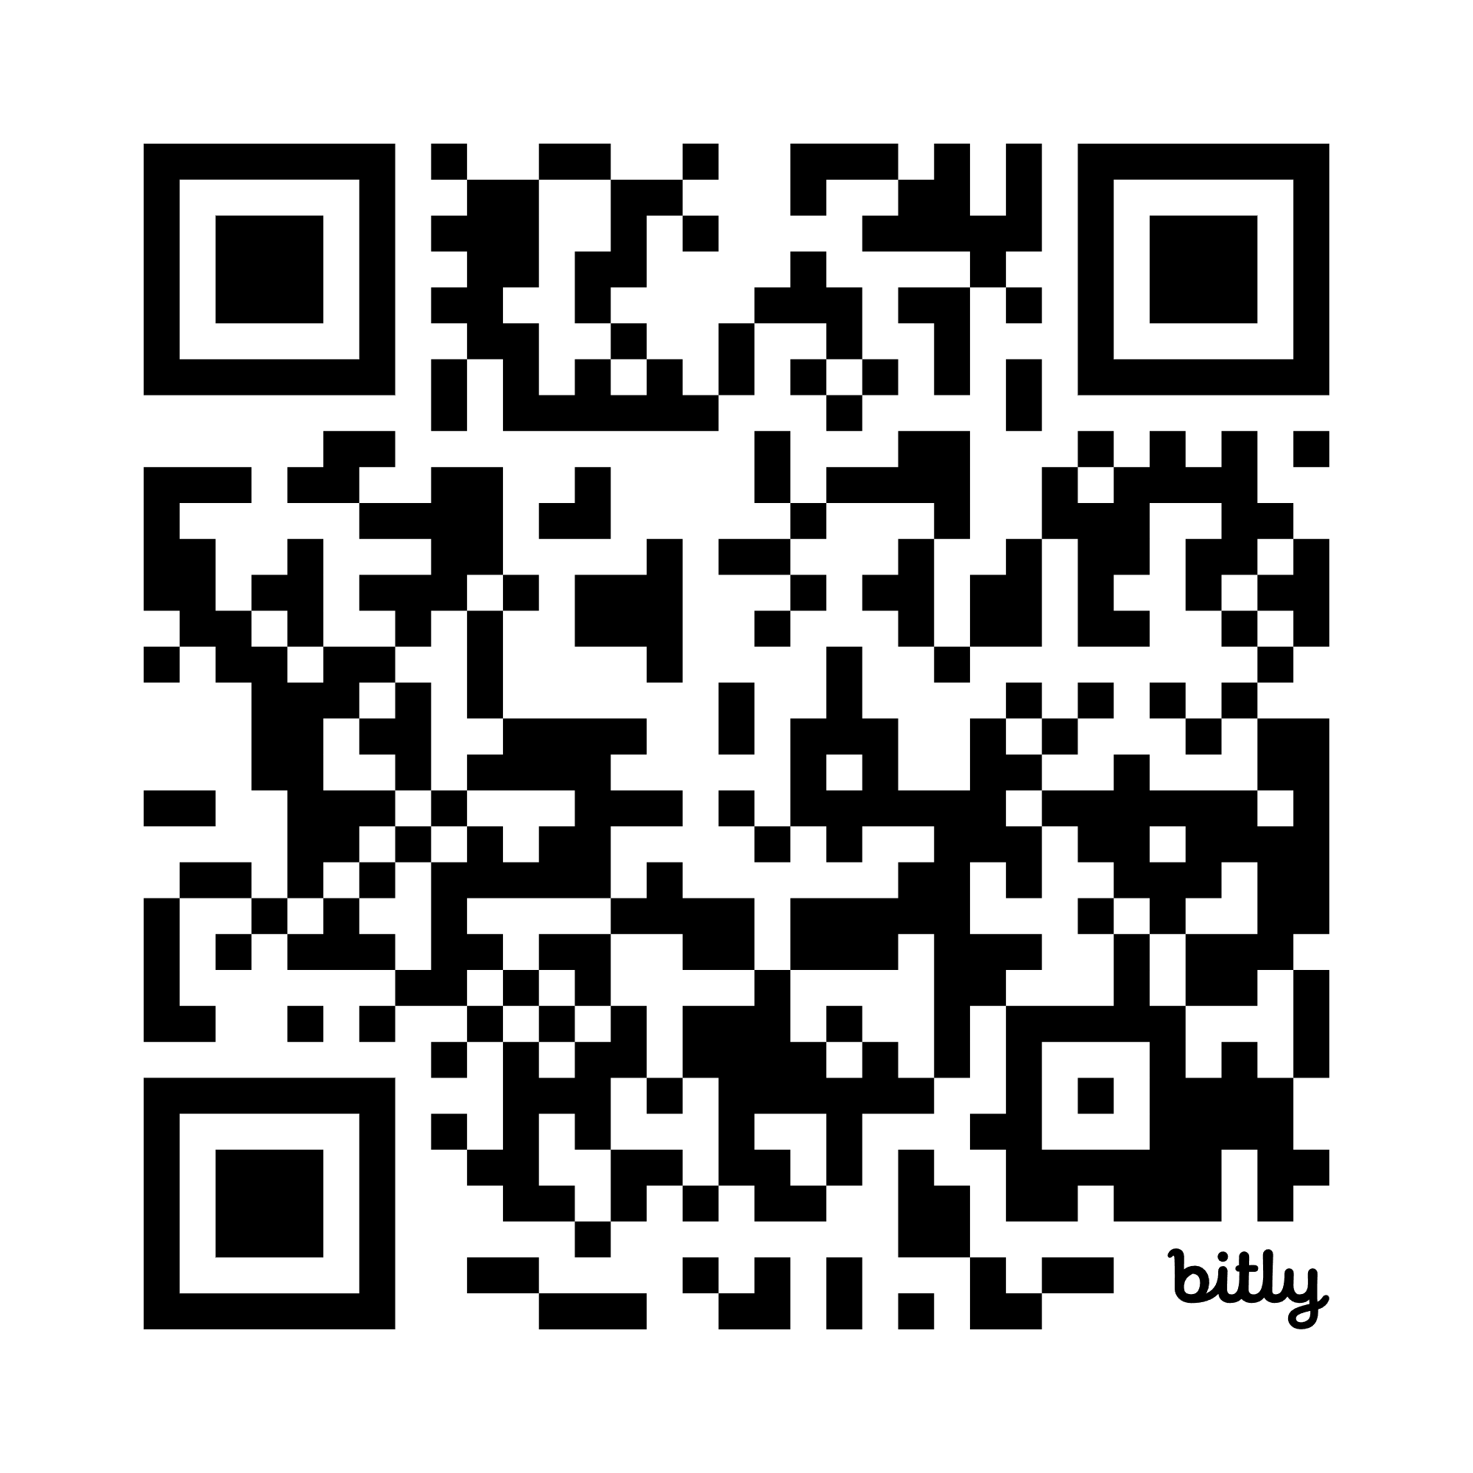
To Access Today’s Materials:
https://bit.ly/QFTatPLATO
Notes:
https://bit.ly/QFTKeynotePPT
https://rightquestion.org/events/introduction-to-the-question-formulation-technique-qft-for-stem-learning/

Slide 4
Access RQI’s Free QFT Resources
https://rightquestion.org/education/resources
Classroom Examples
Instructional Videos
Planning Tools & Templates
Notes:
https://rightquestion.org/education/resources

Slide 5
Use and Share These Resources
The Right Question Institute offers materials through a Creative Commons License. You are welcome to use, adapt, and share our materials for noncommercial use, as long as you include the following reference:
“Source: The Question Formulation Technique (QFT) was created by the Right Question Institute (rightquestion.org).”

Slide 6
Today’s Agenda
Welcome
Why Spend Time on Teaching the Skill of Question Formulation?
Collaborative Learning with the Question Formulation Technique (QFT)
Explore Applications & Examples
Final Thoughts & Reflection

Slide 7
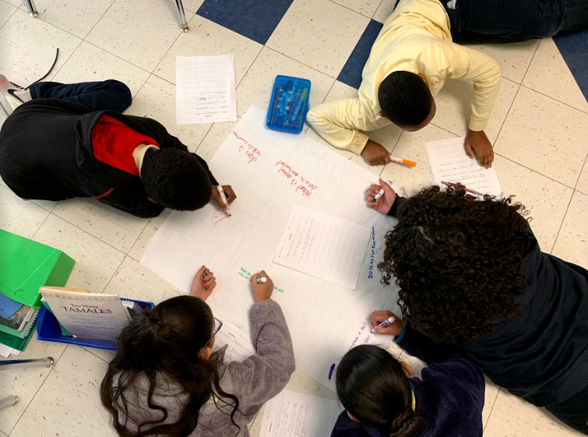
Why spend time teaching the skill of question formulation?

Slide 8
Origin of the Right Question Institute: Parents in Lawrence, Massachusetts, 1990
“We don’t go to the school because we don’t even know what to ask.”

Slide 9
"There is no learning without having to pose a question."
- Richard Feynman
Nobel Laureate, Physics, 1965

Slide 10
“We must teach students how to think in questions, how to manage ignorance.”
– Stuart Firestein
Former chair, Department of Biology,
Columbia University

Slide 11
Importance of Questions in the Workplace
“It has always bothered me how even ordinary conversations tend to be defined by what we tell rather than by what we ask. Questions are taken for granted rather than given a starring role in the human drama. Yet all my teaching and consulting experience has taught me that what builds a relationship, what solves problems, what moves things forward is asking the right questions.”
“What we choose to ask, when we ask, what our underlying attitude is as we ask—all are key to relationship building, to communication, and to task performance.”
- Edgar Schein
Professor Emeritus at the MIT Sloan School of Management
Humble Inquiry (2013)

Slide 12
College Presidents on What College Students Should Learn
“The primary skills should be analytical skills of interpretation and inquiry. In other words, know how to frame a question.”
- Leon Botstein, President of Bard College
“…the best we can do for students is have them ask the right questions.”
- Nancy Cantor, Former Chancellor of University of Illinois
The New York Times, August 4, 2002

Slide 13
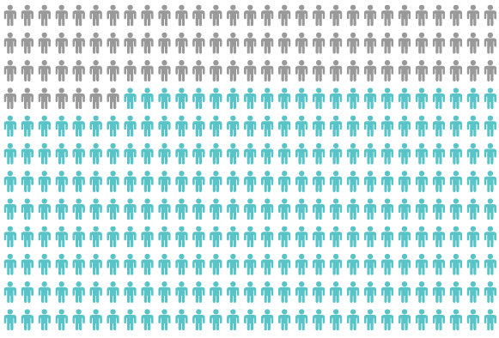
Yet, Only 27% of Graduates Believe College Taught Them How to Ask Their Own Questions
Alison Head, Project Information Literacy at University of Washington, 2016

Slide 14
But, the problem begins long before college…

Slide 15
Question Asking Declines with Age
Tizard, B., Hughes, M., Carmichael, H., & Pinkerton, G. (1983).
Pearson, J.C. & West, R. (2009)
Notes:
Note for Katy: Tomoko’s research document: https://docs.google.com/document/d/1NmDcrflNLNUNyfN-ri5u80FwuBosmmpYkPCwslDv_w4/edit?pli=1
Tizard, B., Hughes, M., Carmichael, H., & Pinkerton, G. (1983). Children’s questions and adults’ answers. Journal of Child Psychology and Psychiatry, 24, 269-281.
Girls (mean age 3 years 11 months) from working class and middle class families asked 24 and 29 questions per hour at home, respectively. At school, these same girls asked on average 1.4 and 3.7 questions per hour (working and middle class, respectively)

Slide 16
What happens when our students grow up and become…us?

Slide 17
The Uneven Communication Problem
Leigh Thompson, Creative Conspiracy: The New Rules of Breakthrough Collaboration (2013)

Slide 18
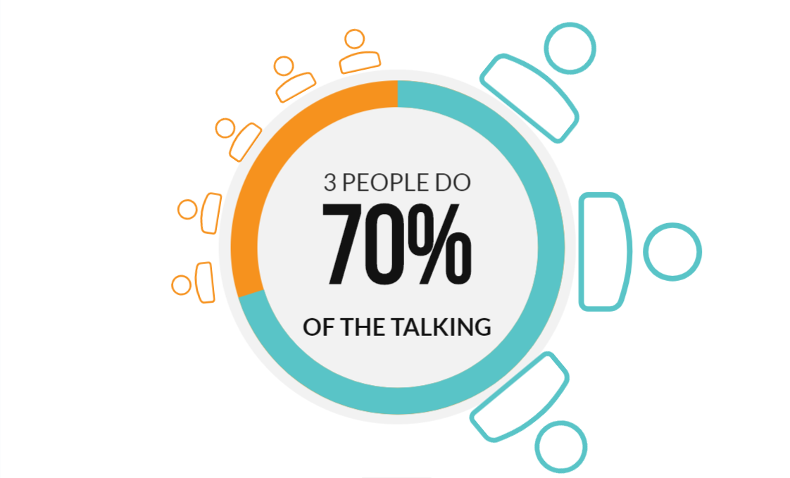
The Uneven Communication Problem
Leigh Thompson, Creative Conspiracy: The New Rules of Breakthrough Collaboration (2013)

Slide 19
We can work together on changing these dynamics

Slide 20
We Are Not Alone
More than 1 million classrooms worldwide

Slide 21
What happens when students do learn to ask their own questions?

Slide 22
Research Confirms the Importance of Questioning
Self-questioning (metacognitive strategy):
Student formulation of their own questions is one of the most effective metacognitive strategies
Engaging in pre-lesson self-questioning improved students rate of learning by nearly 50% (Hattie, p.193)
John Hattie
Visible Learning: A Synthesis of Over 800
meta-Analyses Relating to Achievement, 2008
Notes:
UC Davis Research Linking Curiosity to Memory (UC Davis) 2014
The Fullerton Longitudinal Study (FLS), a 30-plus year study of the development of giftedness across various points in time conducted by Adele and Allen Gottfried of California State University ”This finding has strong implications for the development of STEM considering that curiosity is a fundamental predictor of the aspiration to become a scientist.”
S. von Stumm, B. Hell, T. Chamorro-Premuzic. The Hungry Mind: Intellectual Curiosity Is the Third Pillar of Academic Performance. Perspectives on Psychological Science, 2011 meta-analysis shows They found that curiosity did, indeed, influence academic performance. In fact, it had quite a large effect, about the same as conscientiousness. When put together, conscientiousness and curiosity had as big an effect on performance as intelligence.

Slide 23
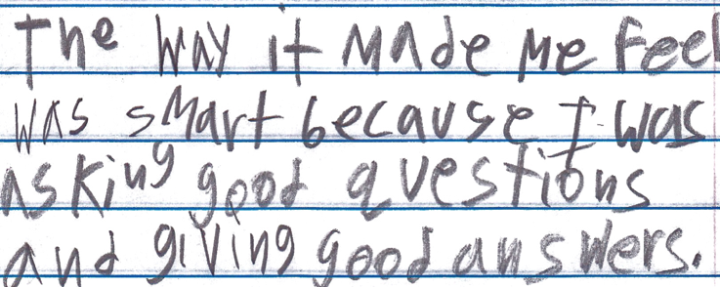
Student Reflection
“The way it made me feel was smart because I was asking good questions and giving good answers.”
-Boston 9th grade summer school student
Notes:
Note to katy: also include quote from an advanced class
quote that shows outcome? motivation, how they change as a learner

Slide 24
Student Reflection
"Knowing the answers are a roadblock while questions lead to unexpected adventures and a new way of thinking. Question asking helps us guide our own adventure and helps us find new interests. Everything starts with a question, even if you don't realize it.”
–9th grade student, Fitchburg, MA

Slide 25
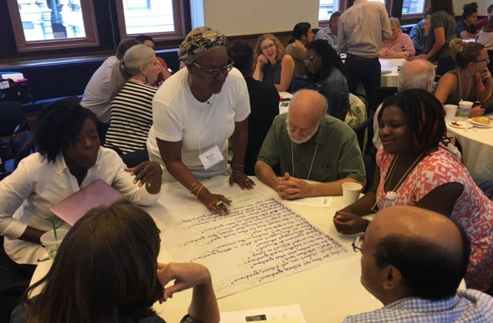
Collaborative Learning with the Question Formulation Technique (QFT)

Slide 26
The Question Formulation Technique (QFT)
Individuals learn to:
Produce their own questions
Improve their questions
Strategize on how to use their questions
Reflect on what they have learned and how they learned it

Slide 27
Rules for Producing Questions
1. Ask as many questions as you can
2. Do not stop to answer, judge, or discuss
3. Write down every question exactly as stated
4. Change any statements into questions
Notes:
one person should be the scribe
need to think carefully about this in the special ed classroom
Can e the educator/adult if needed

Slide 28
Produce Questions
Ask Questions
Follow the Rules
Ask as many questions as you can.
Do not stop to answer, judge, or discuss.
Write down every question exactly as it was stated.
Change any statements into questions.
Number the Questions

Slide 29
Question Focus
Some students are not participating in classroom conversations.
🡪Now, ask questions. Number the questions. Follow the rules:
Ask as many questions as you can.
Don’t stop to answer, judge, or discuss.
Record each question exactly as it was stated (or first came to mind).
Change any statements into questions.
Notes:
other idea: inquiry based dei

Slide 30
Categorize Questions: Closed/Open
Definitions:
Closed-ended questions can be answered with a “yes” or “no” or with a one-word answer.
Open-ended questions require
more explanation.
Directions: Identify your questions as closed-ended or open-ended by marking them with a “C” or an “O.”
Notes:
(KE) this may need some discussion and negotiation from the group

Slide 31
Discuss
Closed-ended Questions
Advantages
Disadvantages
Notes:
(KE)

Slide 32
Discuss
Open-ended Questions
Advantages
Disadvantages
Notes:
(KE) The point here is that the closed-ended questions are equally useful as open-ended!

Slide 33
Improve Questions
Take one closed-ended question and change it into an open-ended question.
Take one open-ended question and change it into a closed-ended question.
Add these as new questions to your list
Closed
Open
Open
Closed
Notes:
(KE) let’s play with our questions, questions are flexible
collaborate and negotiate at the table

Slide 34
Prioritize Questions
Review your list of questions
Choose three questions that you feel are most important to investigate further.
While prioritizing, think about your Question Focus, Some students are not participating in classroom conversations.
Then, think about why you chose those questions.
Notes:
sometimes the prioritization is about the next steps you are taking with the questions

Slide 35
Action Plan
From priority questions to action plan…
In order to answer your priority questions:
What do you need to know? Information
What do you need to do? Tasks

Slide 36
Action Plan
In order to answer your priority questions:
What do you need to know? Information
What do you need to do? Tasks
Information | Tasks

Slide 37
Share
Questions you changed from open to closed and closed to open
Your priority questions, where they fell in the overall sequence of your question list, and why you chose them
A couple ideas from your action plan

Slide 38
Reflect
What did you learn?
How did you learn it?
Notes:
it’s best to use something within 3 days of learning it in a PD

Slide 39
A Look Inside the Process

Slide 40
The QFT, on one slide…
Ask as many questions as you can
Do not stop to discuss, judge or answer
Record exactly as stated
Change statements into questions
Question Focus
Produce Your Questions
Follow the rules
Number your questions
Improve Your Questions
Categorize questions as Closed or Open-ended
Change questions from one type to another
Strategize
Prioritize your questions
Action plan or discuss next steps
Share
Reflect
Closed-Ended:
Answered with “yes,” “no” or one word
Open-Ended: Require longer explanation
Source: The Right Question Institute rightquestion.org
Notes:
https://rightquestion.org/resources/qft-card-template/

Slide 41
Three thinking abilities
with one process

Slide 42
Thinking in many different directions
Divergent
Thinking

Slide 43
Narrowing Down, Focusing
Convergent
Thinking

Slide 44
Thinking about Thinking
Metacognition

Slide 45
Benefits of a Protocol
Protocol
Diplomacy
“Protocols provide a way for people with different interests, even deeply antagonistic interests, to interact productively and respectfully.”
Science
“A plan for inquiry”
Easton, L.B. (2009). Protocols for Professional Learning.
McDonald, J. P. (1996). Redesigning school: Lessons from the 21st century.

Slide 46
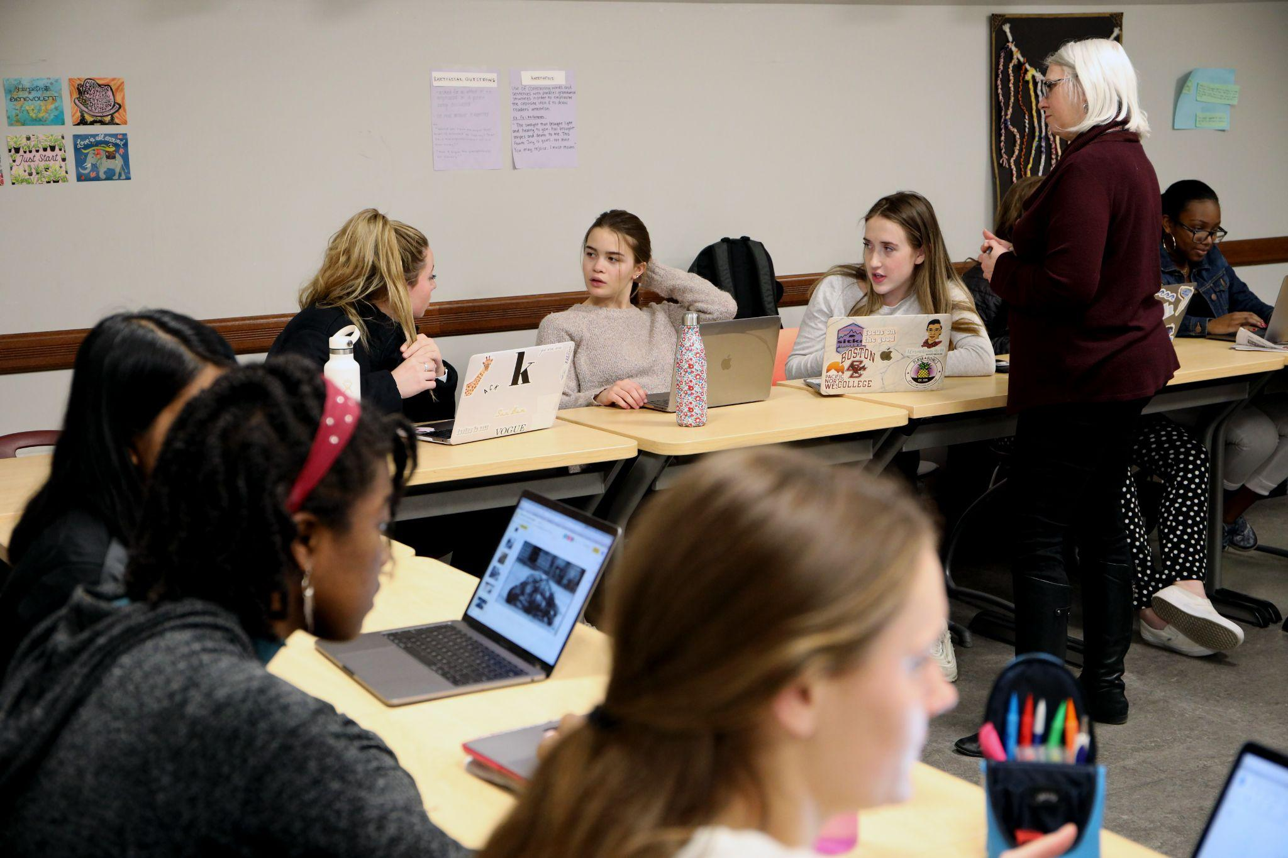
Exploring Examples

Slide 47
Classroom Example: 12th Grade
Teacher: Daniel Fouts, Des Plaines, IL
Topic: 12th Grade AP Government unit on the American presidency at moments of crisis
Purpose: To engage students at the start of the unit and to help students select a topic for an independent project

Slide 48
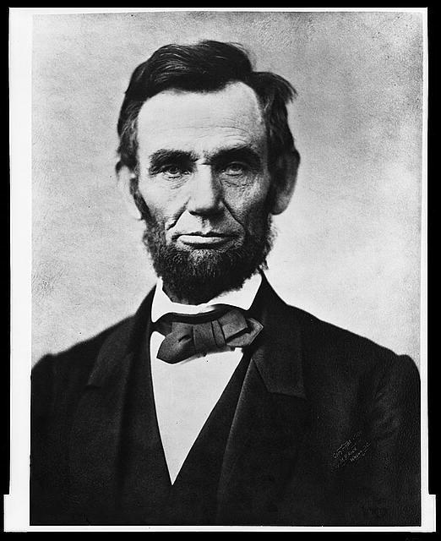
Question Focus
“Nearly all men can handle adversity; but if you really want to test a man’s character, give him power.”
https://www.loc.gov/pictures/item/96522529/

Slide 49
Student Questions
How does power challenge one’s morality?
Should everyone have some type of power?
Does power make people corrupt?
What if the person who is qualified for power doesn’t attain it?
How is a man’s power tested?
What is considered power?
What defines good character?
How can we ensure that the good men get the power?
What kind of man can handle adversity?
What can power tell us about a man’s character?
How can power be obtained by adversity?
Why are some people affected by power differently?
If adversity supposedly makes you stronger, does that mean that power makes you weaker?

Slide 50
Next Steps with Student Questions
Each student selected l question from the class list to work on throughout the unit
Students answered their question using research and knowledge from the unit in a two-page reflection paper
Students shared their reflections in a class discussion on the final day of the unit

Slide 51
Classroom Example:
High School
Teacher: Isabel Morales, Los Angeles, CA
Topic: Social Justice
Purpose: Engage students in thinking about systemic injustice at the start of a multi-disciplinary unit

Slide 52
Question Focus
The disciplinary policies of our society perpetuate injustice.
Notes:
Note - this is an image I found online.

Slide 53
Student Questions
Why are student of color targeted the most?
How do disciplinary policies target specific racial groups?
Do teachers nationwide take notice of these stats?
How can teachers develop better & effective disciplinary policies?
Why do people see the stats & data as a coincidence?
What does a kid learn about the system once in jail?
What do people believe expulsion will teach the students?
Does going to juvie have a long-term effect on younger students about education?
When will it get better?
What are some ways to improve behavior?
What type of training will teachers go through that’ll bring justice to classrooms?
Shouldn’t school police officers be trained like teachers?
What is considered a criminal offense in school?
Isn’t it the teacher’s job to keep the students “in line”?
How should disruption in class be handled?
How come there aren’t any policies keeping students out of prison?

Slide 54
Next Steps
Students decided to research statistics and poll students and teachers.
Students met with the school administration to ask questions and address their concerns.
School principal founded a student advisory council, which many students joined, to give students a voice in new policies.

Slide 55
Classroom Example: 11th Grade U.S. History
Teacher: Ellen Gammel, Fitchburg, MA
Topic: Bioethics & Nonfiction: The Immortal Life of Henrietta Lacks
Purpose: To prepare for a formal debate at the very end of the unit

Slide 56
Question Focus
Debate Resolve:
Doctors should be able to do what they want with human tissue after the patient gives consent for removal of the tissue.

Slide 57
Students’ Questions
A Team Against Debate Resolve:
A Team For Debate Resolve:
What percent of compensation should patients receive?
How have tissue ownership laws changed over the years?
Is there a law?
Do doctors owns the tissue after patients give consent?
Should patients be able to perform their own research?
Do doctors come up with the idea? (A focus)
Do doctors need consent for tissue that doesn't belong to humans?
Can patients take back consent once they find out what the doctors are doing with their tissue?
Are our bodies truly our property?
How much consent?
How much information should a patient receive in order for them to give informed consent?
Consent for removal or consent for research?
Should the patient be paid?
How should patients be paid? What for?
What counts as tissue?
Consent for removal of tissue or other body parts?
How about animals?
Are owners in charge of their pet’s tissue?
Are parents in charge of their kids’ tissue?
Can kids give informed consent?
Do gives give their parents consent?
How about teeth?
Do teeth count as bone donations?

Slide 58
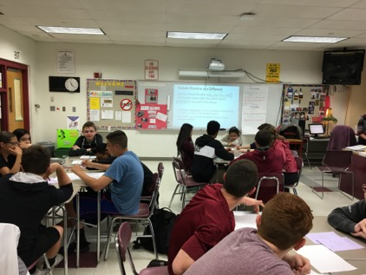
Next Steps with Student Questions
In teams, students researched their priority questions
Students prepared their debate arguments and rebuttals, using research
Students practiced public speaking and rhetorical skills

Slide 59
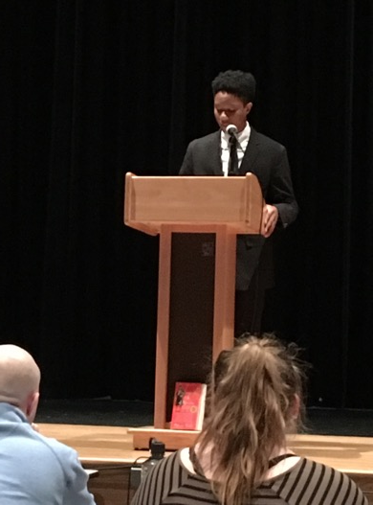
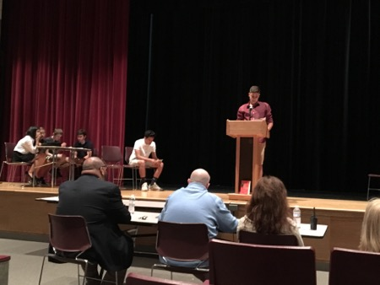
Next Steps with Student Questions
The Debate
The 3 Judges: administrators, teachers and a former student
The Audience: students, parents, teachers, school & district leaders

Slide 60
Professional Learning Example
Facilitator: Nat Vaughn, Principal
Setting: A whole-school faculty meeting at a middle school in Medfield, MA
Purpose: Re-examining homework norms; establishing consistent practices school-wide

Slide 61
Question Focus
Homework practices are inconsistent at our school.
Homework practices vary at our school.

Slide 62
Outcomes
“The conversations that took place resulting from the process were rich, meaningful, and productive. The simple process provided a non-judgmental structure to address a significant ‘issue’ in our school and led us to a position of recognizing and embracing a need for change.”

Slide 63
Reflect
How could you see applying this in your setting?
How do you see the connection to philosophy teaching?

Slide 64
Why is the skill of question formulation so important now?

Slide 65
In the Age of AI
“How should you respond when you get powerful new tools for finding answers?
Think of harder questions.”
– Clive Thompson
Journalist and Technology Blogger

Slide 66
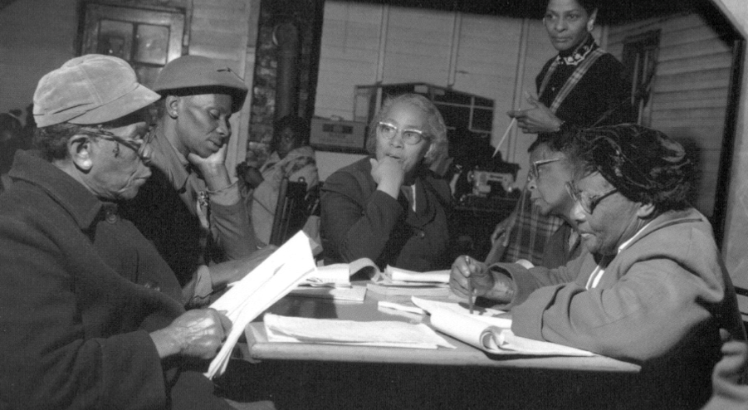
Questions and Democracy
“We need to be taught to study rather than to believe, to inquire rather than to affirm.”
– Septima Clark
Chapter 6 on Septima Clark in Freedom Road: Adult Education of African Americans (Peterson, 1996)

Slide 67
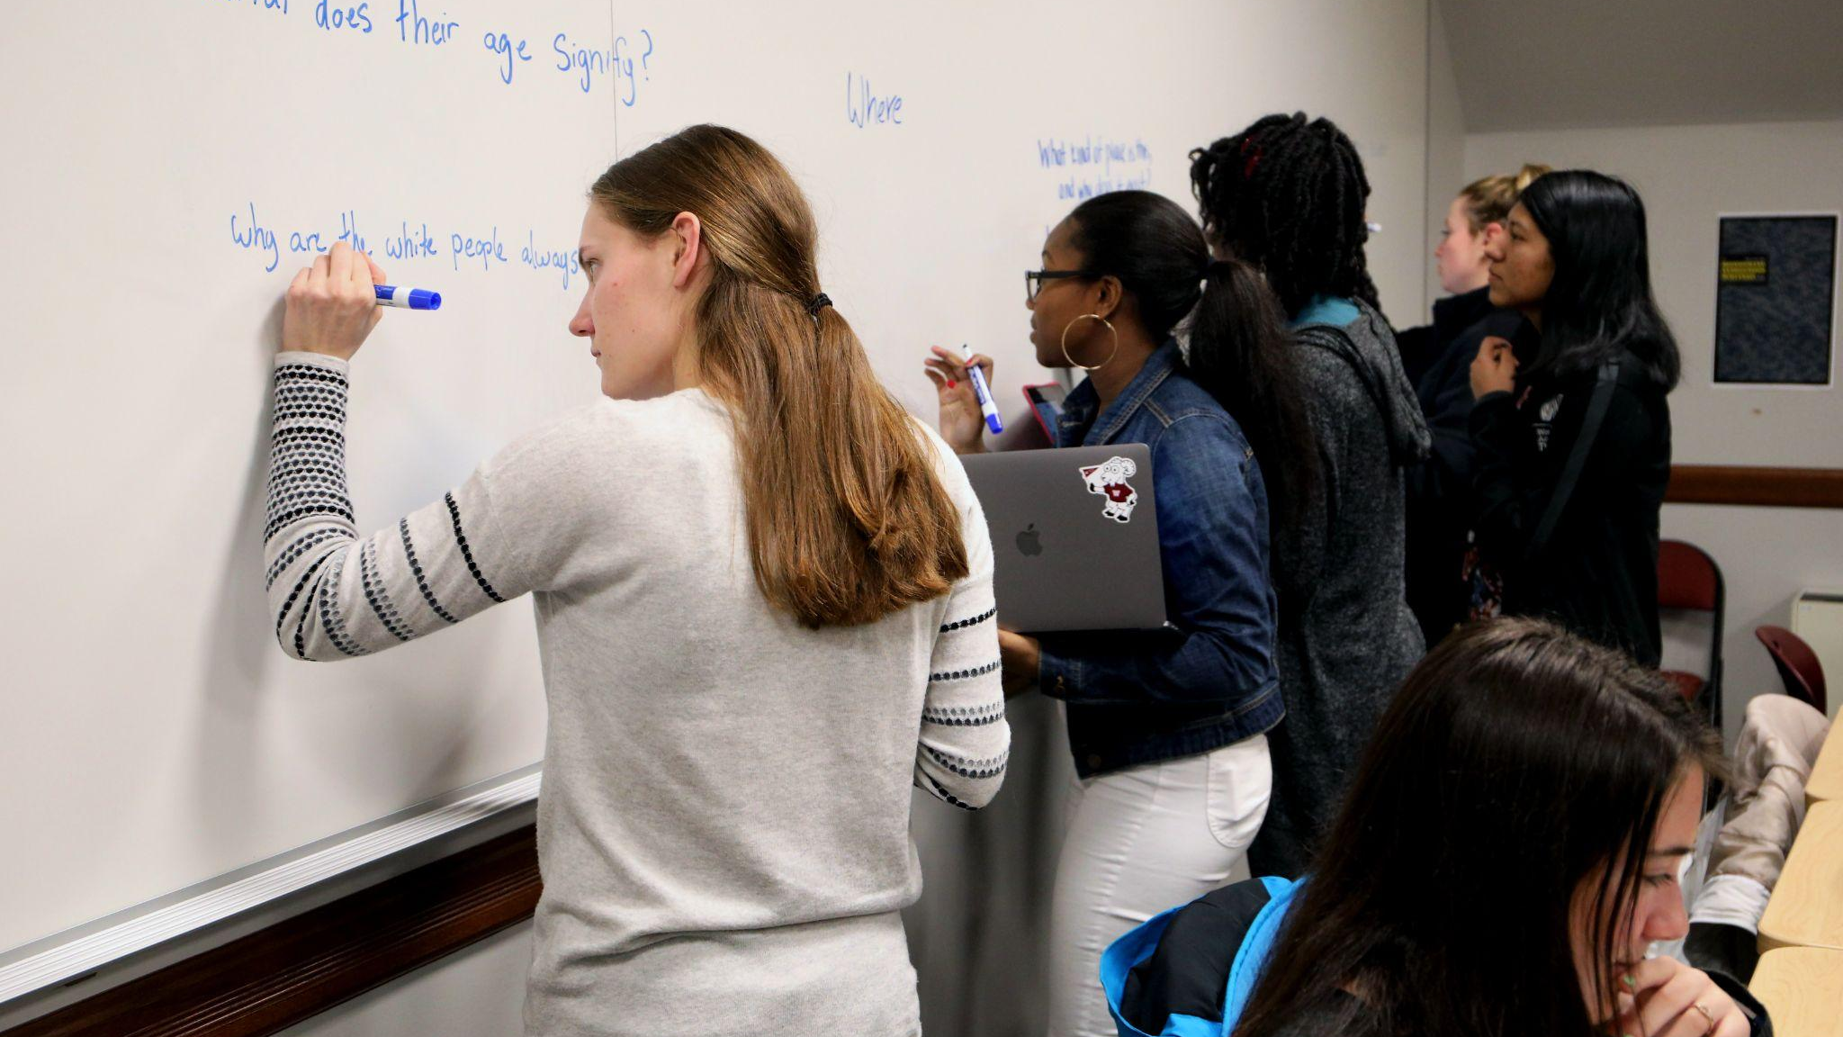
Closing Reflections

Slide 68
Q&A
What questions do you have now?

Slide 69
Resources
Access Today’s Powerpoint & Other Resources:
https://bit.ly/QFTatPLATO
Question Focus Design Tool
Lesson Planning Workbook
QFT on One Slide
Register to Access RQI’s Full Resource Library: https://rightquestion.org/register

Slide 70
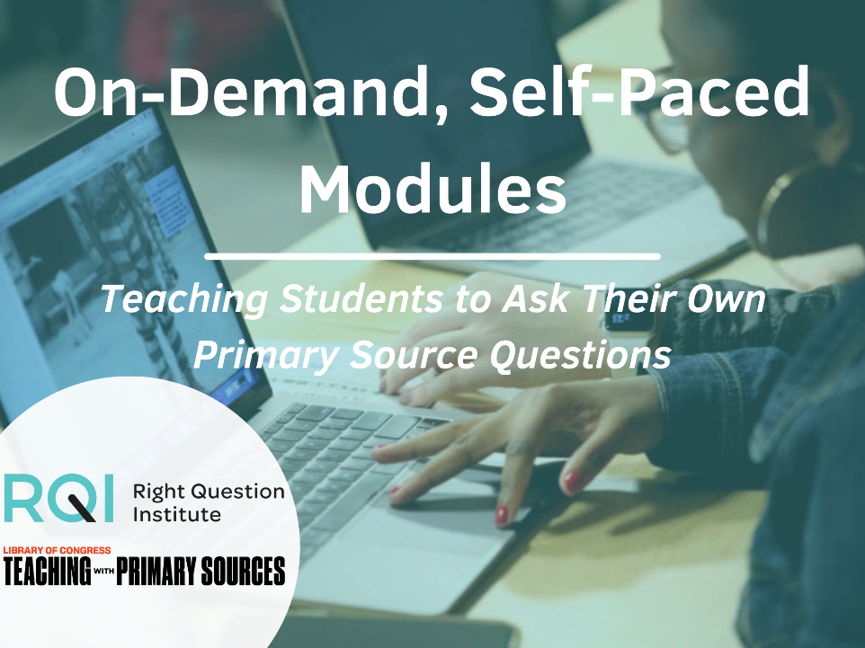
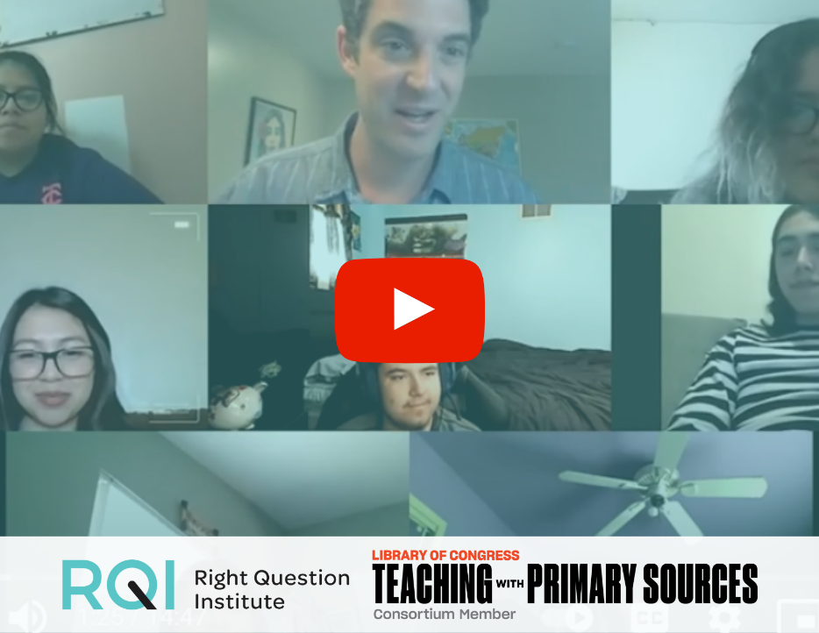
To Learn More about QFT & Primary Sources
Watch videos to hear from teachers and students
Check out real lesson plan examples
Learn more on your own time
Take our free self-paced modules and explore the Resource Hub at rightquestion.org/primary-sources

Slide 71
Upcoming online courses through Harvard Graduate School of Education
Jul 8, 2025 - Jul 28, 2025 Application Deadline: Jun 27, 2025
Oct 14, 2025 - Nov 3, 2025 Application Deadline: Oct 3, 2025
Register for the RQI Network to Get Notified: https://rightquestion.org/register
Learn More & Register Here.

Slide 72
Find us on social media!
@rightquestion
facebook.com/rightquestion
@right_question
Email us: education@rightquestion.org

